Slide 1
The RDM Service
Fran Callaghan
Research Data Management Librarian, MU

Slide 2
Rationale for Developing Dedicated RDM Service
Focus on RDM Advocacy.
Instructor Led
Classroom Based
Concepts & Benefits of RDM/DMP Explained
Uptick in Funder Requirements.
Researchers Returning with… “But Now I Need a DMP!”
Need for somebody to sign off on DMPs (e.g. HRB).

Slide 3
Setting up the RDM Service
RDM Librarian
Research Office
University IT
Tech
Transfer
Ethics
Legal
GDPR
Started in Role: Mid March 2022
Priority: Design & Deliver RDM Service
Identify & Contact Research Supporting Stakeholders
Identify & Contact RDM Colleagues Externally

Slide 4
Designing the Service for MU
Source: Will Scullin
Size of Research Community
Increasing Funder Mandates
Nature of Queries

Slide 5
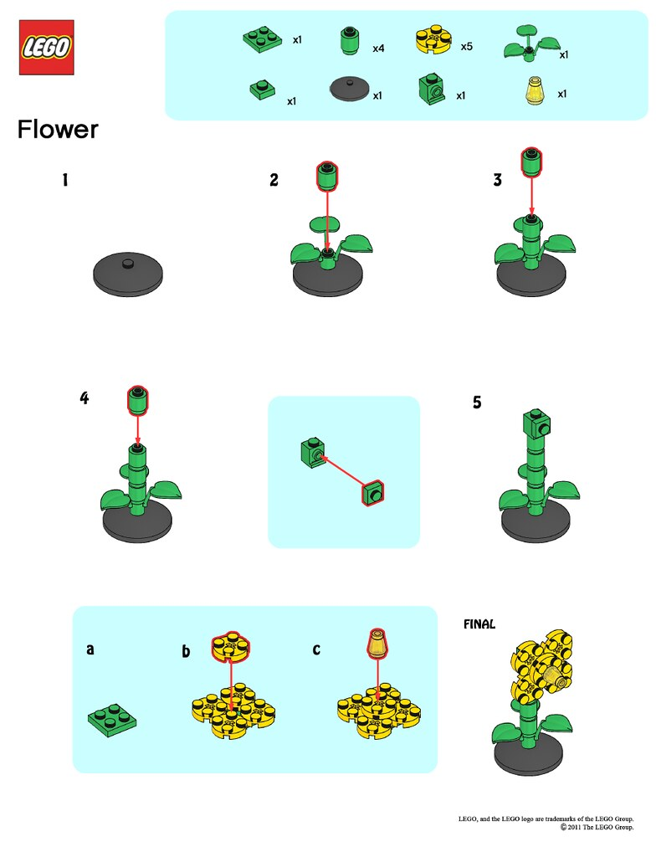
Initial Consultation: “How To”
Researcher Background
Discipline / Area of Research
Previous Experience of DMPs
What Do You Want?
“A DMP for my Funder!”
Discuss Funder Requirements
Introduce DMPOnline
Identify Potential Datasets
Release Back to the Wild

Slide 6
DMP Review Service
Use Funder Requirements (Template if available).
Evaluation Rubric if available.
Non-Domain Specific Knowledge.
Has Each Question Been Considered?
Nuance the Language.
Eliminate Woolly Answers.
“Open, Open, Open”.

Slide 7
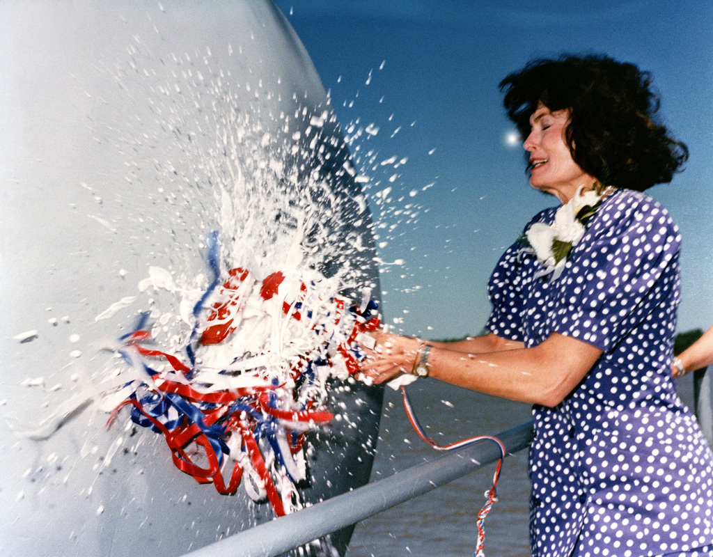
How To Launch RDM Service?
Soft Launch?
Identify Researchers One-by-One via Calls
Advertise Service via Ciarán’s Classes
Official Launch?
Promotional Material
Launch during Research/Open Access Week
Love Data Week 2023 (Too Late?)

Slide 8
Impact of Pathways Call for MU
“Applicants to the SFI-IRC Pathway programme are required to provide
a short (2 page) Data Management Plan (DMP) as part of their
full proposal application. In preparing this plan, consideration should be
given to SFI’s Guidance on Data Management Plans and the IRC‘s guide
for the preparation of Data Management Plans.”
MU – Up to 24 Applications.
Too Many for One-to-One Consults.
Two DMP Drafting Sessions Offered.
18 Attendees.
Individual Reviews Must be Offered.
Total 15 DMPs Reviewed.

Slide 9
Next Steps
Work with Ciarán to Produce Promotional Material.
Develop Process Driven “How To”.
Propose Official Launch.
Determine Success Criteria for Service.

Slide 10
Questions

