Slide 1
RDM supports and training for MU Researchers
Ciarán Quinn
Research Support Librarian, MU

Slide 2
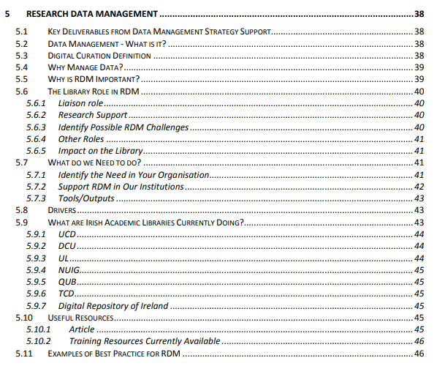
Research Support Librarian & RDM Support at MU: How it evolved !
Research Support Librarian Post (2013)
CONUL Involvement
Research Support Task & Finish Group (2014), "Briefing Documents & Recommendations" tasked to prepare a three-year strategy to develop the research support capacity of CONUL libraries. Seminar also organised "Supporting your Research Community" section 5 was RDM.
National Research Data Principles for Ireland submission: National Open Research Forum (NORF) 2018
CONUL RDM Sub-Group
CONUL Survey of current RDM Provision (2019)
Research data services and libraries international survey (Sheffield University) (2019)
Where to Submit Data Information Sheet (2019)
Collation of material for a guide to free RDM online training (2019)
MU "Good Practice in Data Retention Committee" (2016) Remit to determine what the University currently does in the area of data retention.
CPD: Completed Research Data Management Module, Summer 2017, School of Library & Information Studies, UCD.
Thanks Jenny !
Developed RDM Supports (2017 )
Background of increased Funder demands for RDM & Increased interest from researchers
MU RDM Policy Task Group : 2020/2021 (draft currently progressing through MU committees) Library Research Committee.

Slide 3
RDM Services @MU
What supports does the Research Support Librarian Offer?
Individual/Group Consultations
General advice on how to approach RDM and DMP's.
Some review of DMP's on an ad hoc basis, resources not in place until Summer 2022 to offer a full DMP review service
Research Data management Librarian has now been appointed.
DMP review, did occur but usually referred them on to DMP Online or DCC Templates, Science Europe Guides etc depending on the funder but some reviewing did take place on an ad hoc basis.
"I was wondering if you have time would you mind throwing an eye over this Data Management Plan? It has to be short, but I just want to be sure we are hitting all the right marks

Slide 4
RDM Support Services@MU
Group/Dept Seminars requested/offered.
Inputs to Research Committees
Hosting of RDM training events for Academics & Researchers
Lunchtime 30 minutes "Intro to RDM", "Tools for developing DMP's"
Summer Seminars for Academics & Researchers
Research Week(Oct) & Love Data Week (Feb) Presentations
Introduction to RDM and/or DMP’s/DMP Tools
Individual meetings & GST2 for more in depth discussions
Creating RDM Library Guide
Recordings of Seminars & posting to NUIMLibrary You Tube (Research Skills Channel)
Teaching Accredited Module as part of the MU Graduate Studies Research Skills Development Programme (RSDP) GST2 Course

Slide 5
Accredited Modules
GST2: Accredited Module including RDM, offered in 2018 as part of the "Research Skills Development Programme" (RSDP), under "Research Skills & Awareness" .
3-hour class, assessed using reflective journal.
GST4: Ethics & Integrity also has a RDM component since 2019.
Currently paused
Open to Research Students but can also be audited by Academics

Slide 6
Research Skills Development Programme (RSDP)
“The aim of the MU Research Skills Development Programme (RSDP) is to draw on the expertise of the Graduate School and Research Development Office, in conjunction with faculties, departments and professional units within the university, to support MU researchers in acquiring the skills and experience necessary to become independent academic researchers and to develop their careers in multiple settings beyond academia.
The programme is broken down into seven thematic areas. Depending on the nature of the training, sessions are open to research students, post-doctoral researchers and academic staff.
GST2 content developed by the Research Support Librarian in collaboration with the Research Development Office
Research Support Librarian delivers the module as guest lecturer

Slide 7
RSDP Thematic Areas

Slide 8
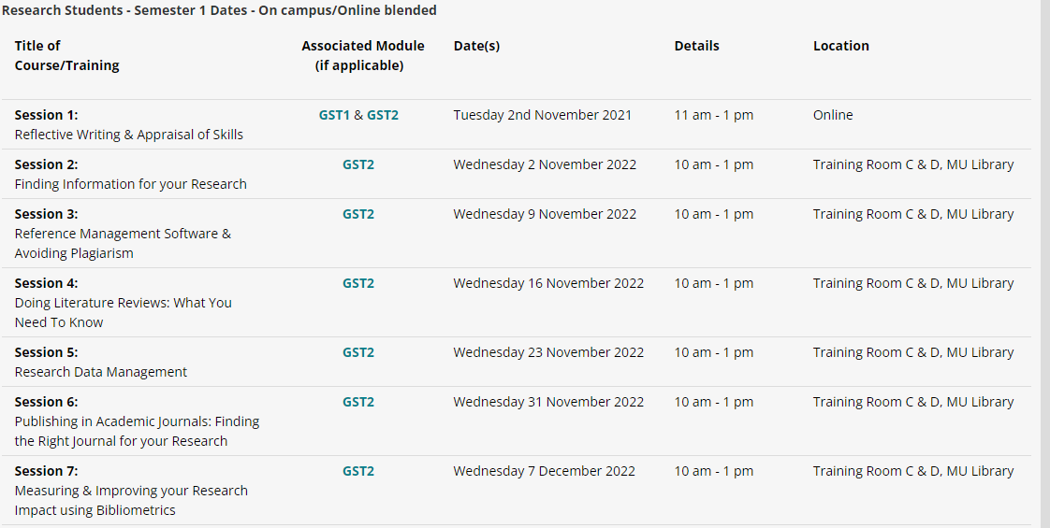
Research Skills & Awareness
GST2 Finding Information for Your Research
Current format since 2018
Sessions 2-7 taught by the Research Support Librarian
Repeated in semester 2
Accredited Module for Research Students
Audited by Academics
Session 5: Research Data Management

Slide 9
Topics covered include:
What is Data Management?
Why does it need to be managed?
Data Life Cycle
DMP development (How's & Why's)
Data formats
Meta Data
Access policies
Budgets
Tools, Templates, & Guides available
Practical: developing a DMP

Slide 10
Research Data Management Guide

Slide 11
Questions

