Slide 1


Service catalogue
Debora Testi | User Engagement coordinator
eudat.eu
@eudat_eu

Slide 2
Outline
Introduction to EUDAT CDI data infrastructure
EUDAT offering for Research Data management
EUDAT services overview

Slide 3
EUDAT CDI in a nutshell
The EUDAT Collaborative Data Infrastructure (EUDAT CDI) is one the major e-infrastructures supporting research in Europe
According to the vision, EUDAT provides a set of interoperable services that support European researchers in different steps of the research data life cycle
EUDAT’s vision:
Data is shared and preserved across borders and disciplines

Slide 4
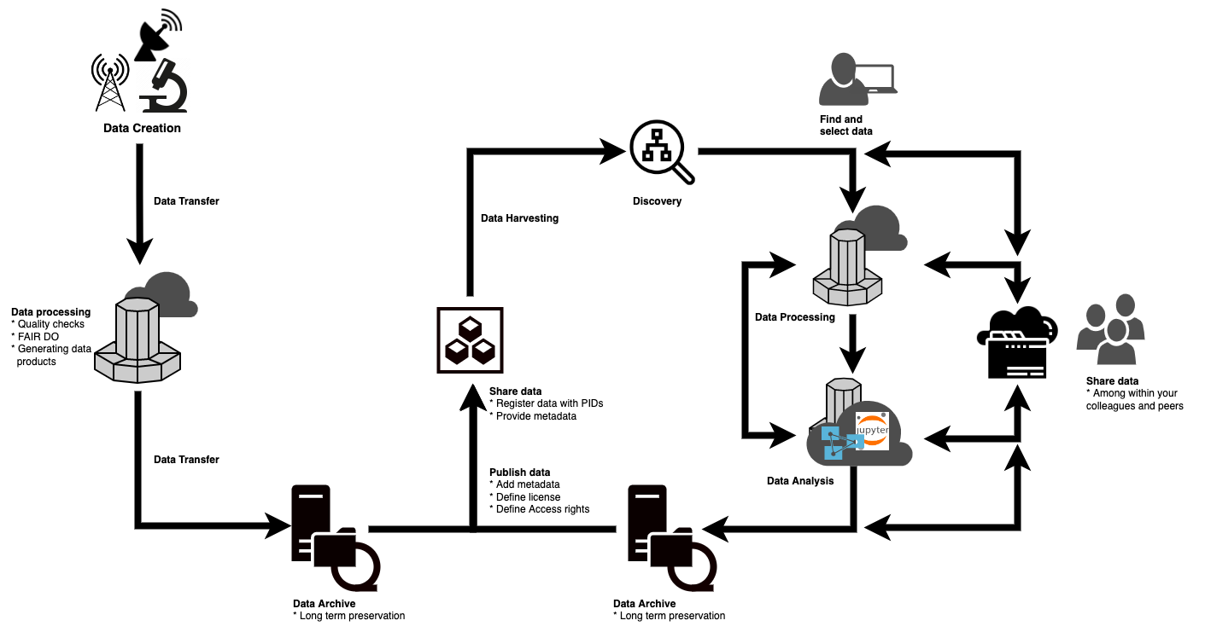
Research Data Life Cycle

Slide 5
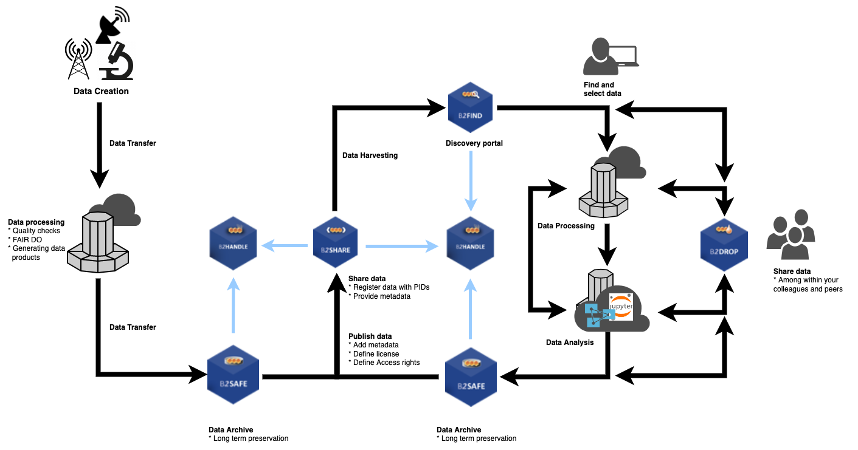
Research Data Life Cycle

Slide 6
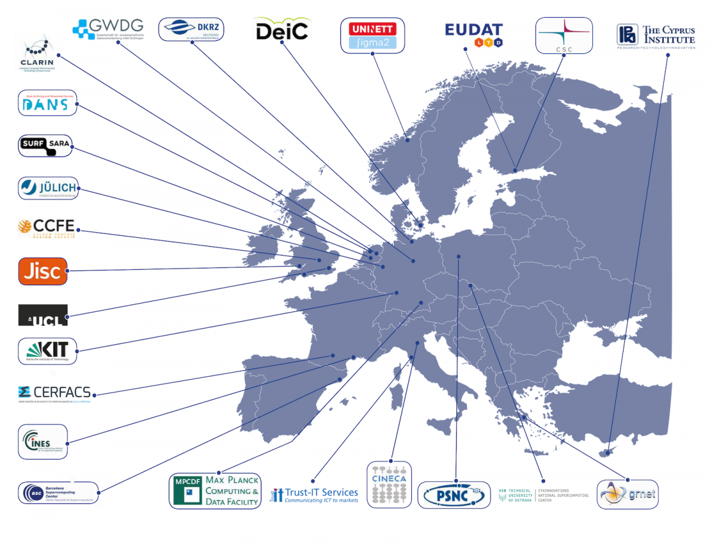
The EUDAT members
A growing network of more than 20 European research organisations, data and computing centres

Slide 7
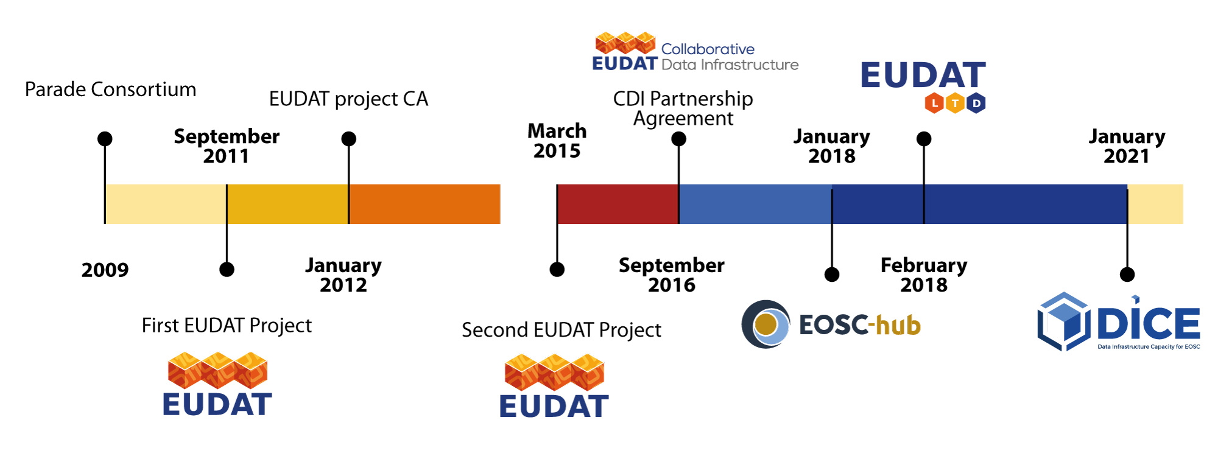
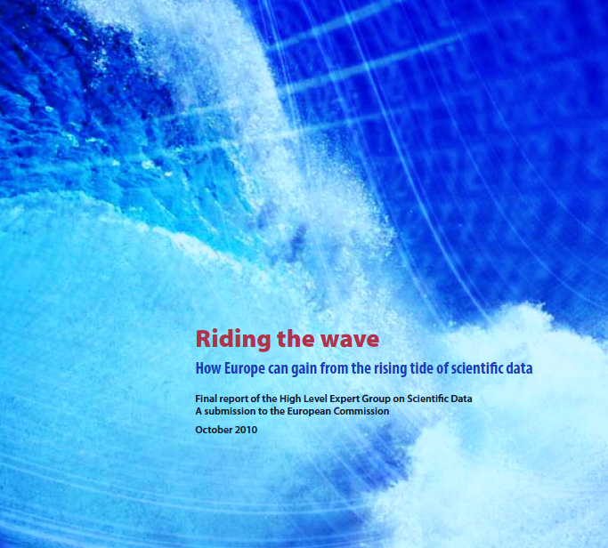
History of EUDAT

Slide 8



Who can use EUDAT service
Single researcher
Team
Community
Upload and download
Upload, add metadata, share
Periodic transfers, quality checks …
Different strategies for different usage scenarios

Slide 9

EUDAT and EOSC
The EUDAT CDI supports the vision of the European Open Science Cloud offering open and seamless services for storage, management, analysis and re-use of research data
EUDAT actively contributes to the main EOSC initiatives and projects.

Slide 10
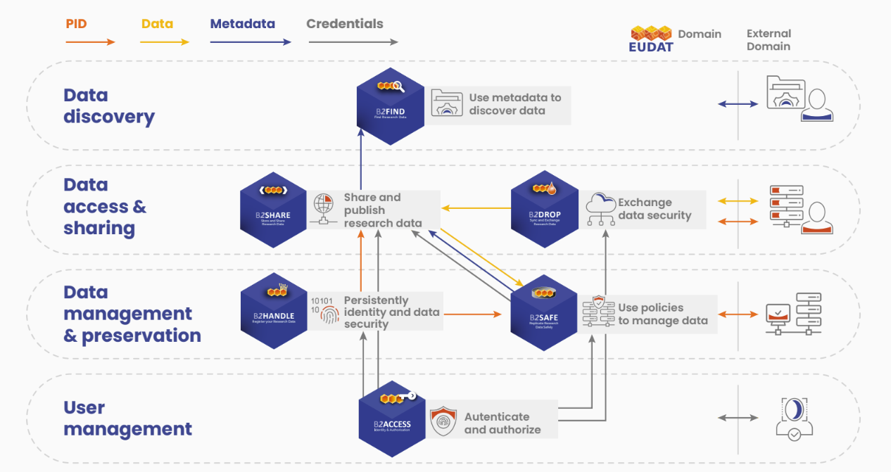
The EUDAT Service Suite

Slide 11
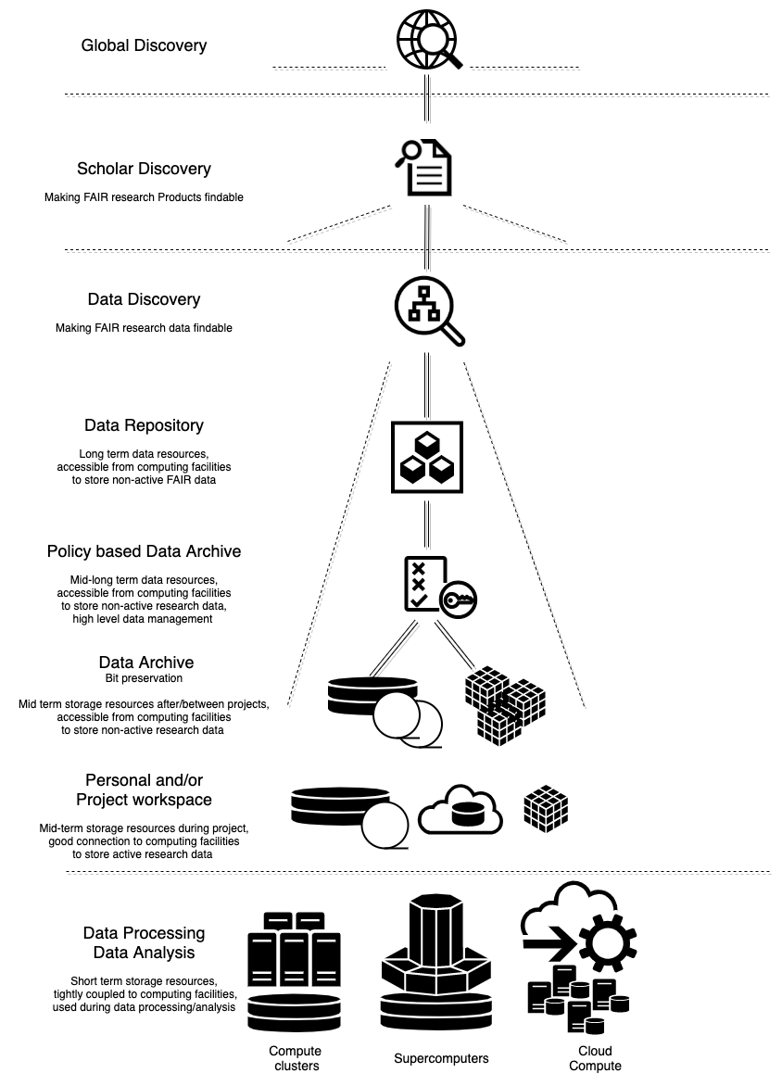
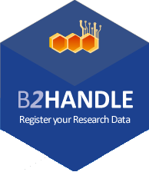
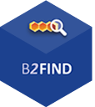
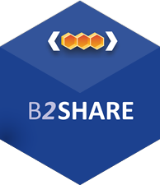

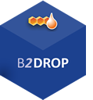
Data Discovery
Making FAIR research data findable
Data Repository
Long term data resources, accessible from computing facilities to store non-active FAIR data
Policies based Data Archive
Mid-long term data resources, accessible from computing facilities to store non-active research data, high level data management
Data Archive
Mid term storage resources after/between projects, accessible from computing facilities to store non-active research data, bitwise preservation
Personal and/or Project workspace
Mid-term storage resources during project,
Good connection to computing facilities,
To storage active resource data
Data Analysis and/or Processing
Short term storage resources,
tightly coupled to computing resources,
used during data processing and analysis

Slide 12

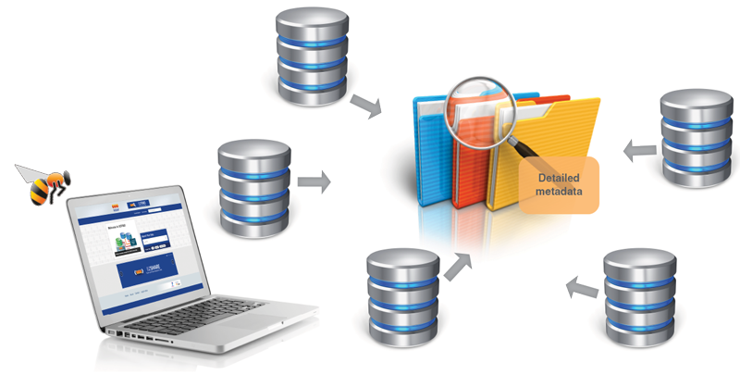
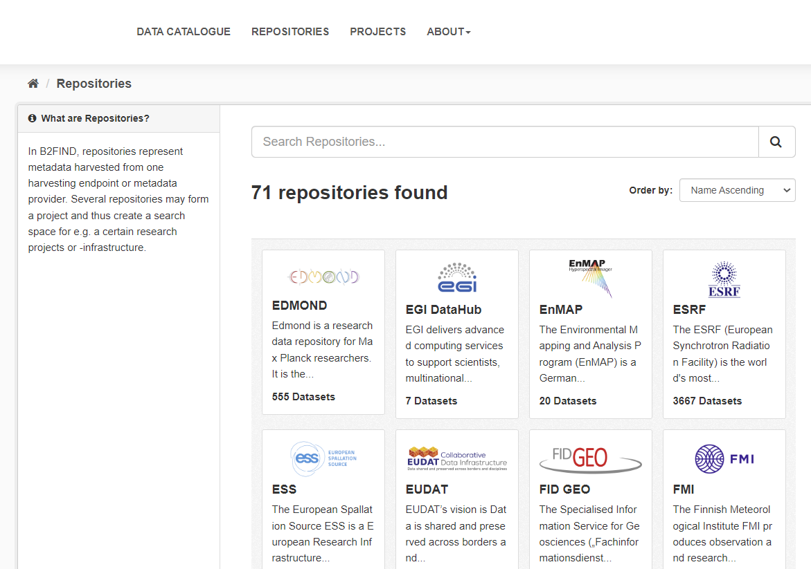
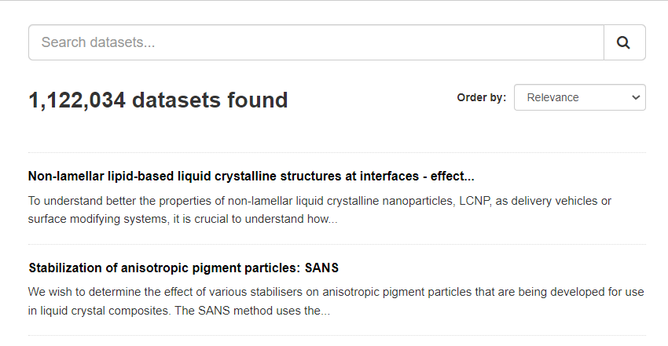
Who
  Anyone
What
  Find collections of scientific data quickly and easily, irrespective of their origin, discipline or community
  Get quick overviews of available data
  Browse through collections using standardized facets
Why
  Unique collection
  Ease of Searching
https://b2find.eudat.eu

Slide 13
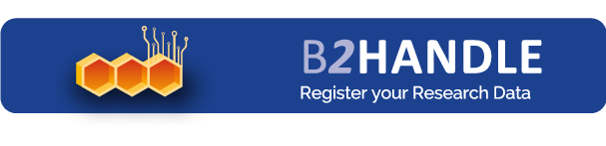
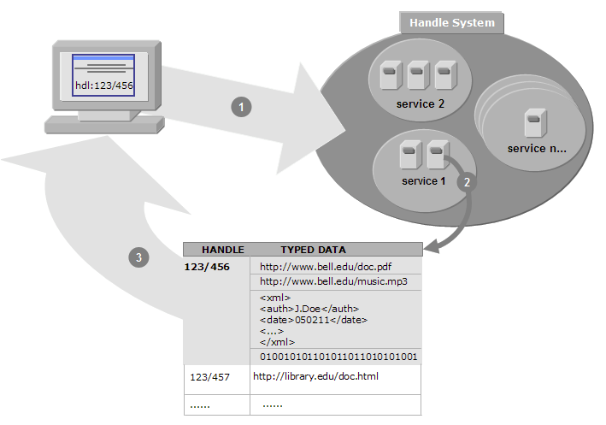
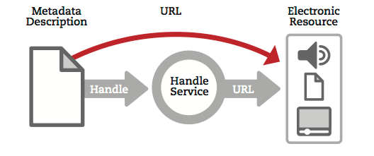
Who
  Groups or Communities who want to make their data citable
What
  Provides abstraction layer between a globally unique persistent identifier and physical location of data objects
  Follows policies to register data and make it long term refer- and citable
  Reliability through mutual PID mirroring
  Machine readable via HTTP RESTful API
Why
  Simple integration
  Technology Agnostic

Slide 14
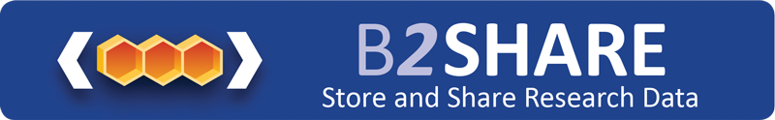
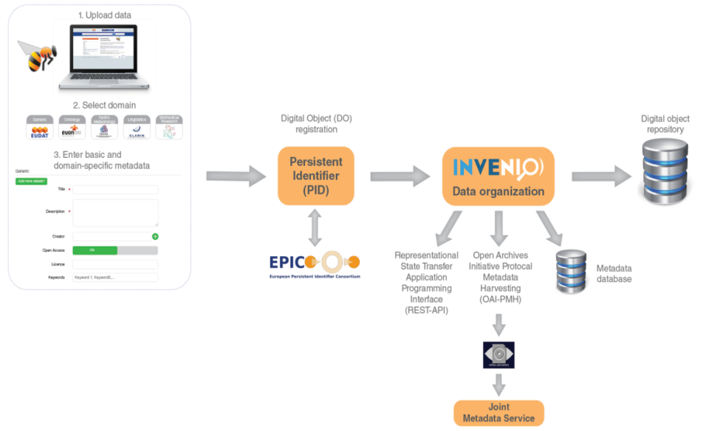
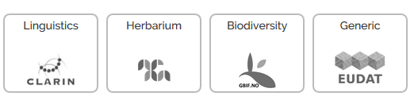
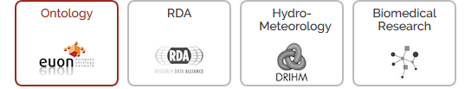
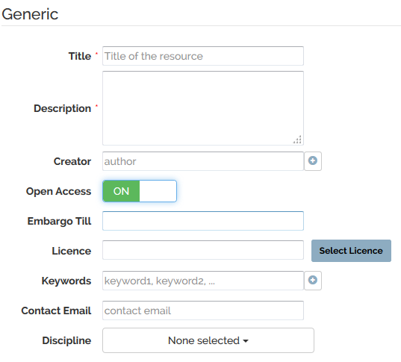
Who
  Researchers
  Small to Medium Teams
What
  Store data (incl. software) and add domain metadata
  Share registered research data worldwide
  Preserve (small-scale) research data for long-term
  Registers DOIs for datasets and Handle PIDs for data objects
  Harvested by B2FIND and OpenAIRE explorer
  Supports community domains
  Allows communities to define metadata extensions, access rules and publishing workflows
Why
  Register Data for Publications
  Make known to wider community

Slide 15
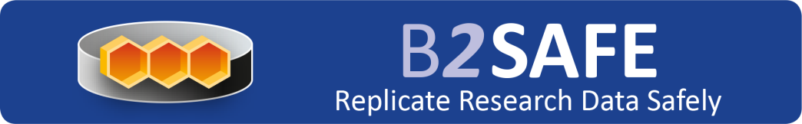
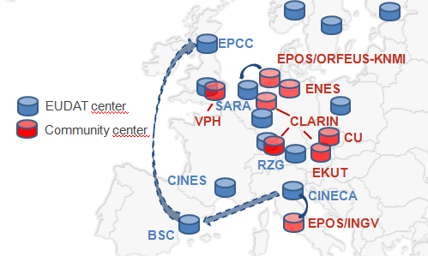
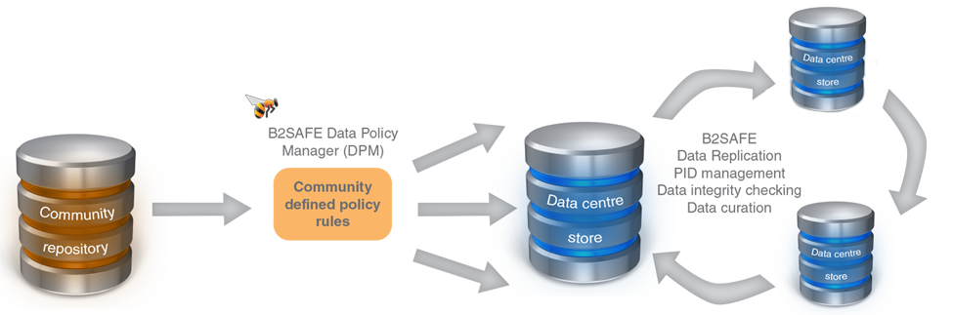
Who
  Community Data Managers
  Organisations
What
  Provide an abstraction layer which virtualizes large-scale data resources
  Support for data management policies (e.g. registration of PIDs, cross-site replication, data integrity checks)
  Support for policies customised to community and organisational needs
  Guard against data loss in long-term archiving and preservation
  Optimize access for users from different regions
  Bring data closer to powerful computers
Why
  Performance
  Replication between trusted sites
  Data Preservation

Slide 16

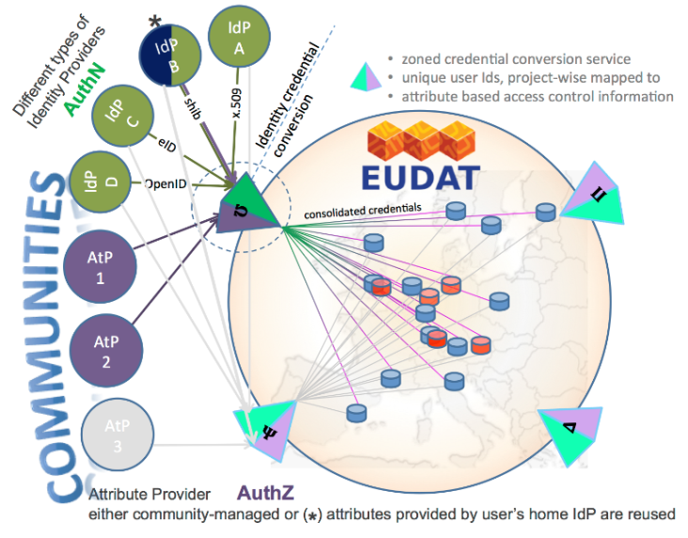
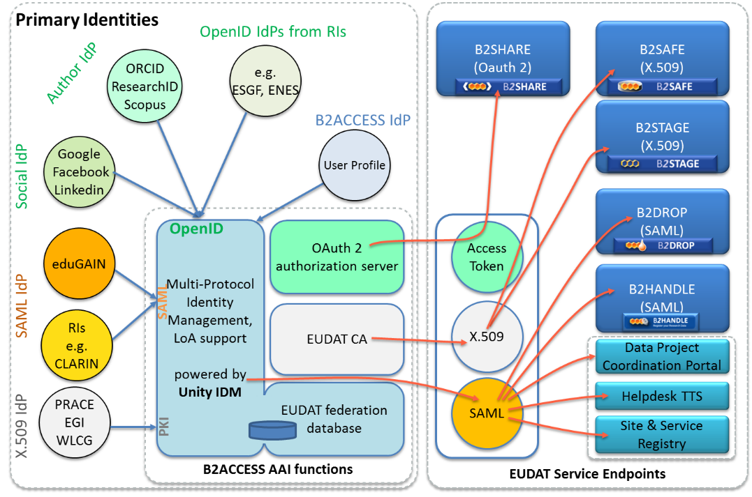
Who
  Anyone wanting to use the B2 Services
What
  Complies with community ownerships and access rights, basis of trust
  Credential conversion approach (e.g. SAML, OpenID, X.509, Username/password)
  Identity provider for citizen scientists
Why
  Use your own ID in federated environment

Slide 17
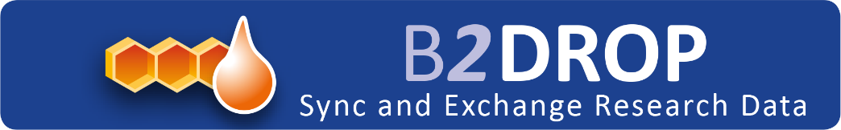
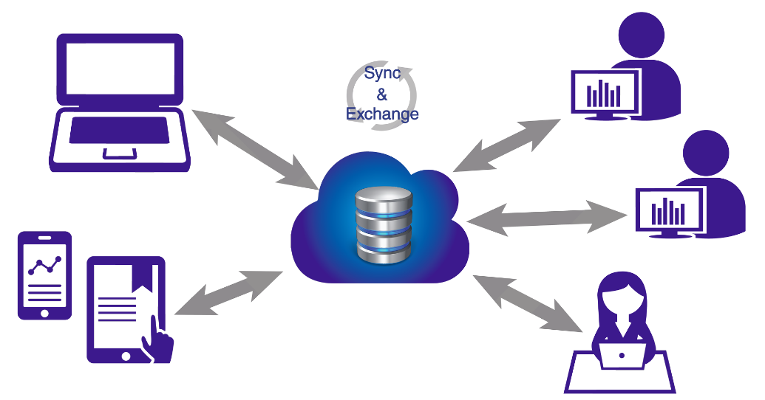
Who
  Citizens, Scientists and small teams
What
  Store and exchange data
  Synchronize multiple versions
  Ensure automatic desktop synchronization
  Access via Web GUI, desktop clients and Webdav
  Publishing of datasets to B2SHARE
Why
  Ease of Use
  Trusted European Service
  Different solutions are available at the different providers:
    Free usage at the central instance, Premium usage, dedicated instances or customised solutions

Slide 18





EUDAT support to communities
EUDAT services are designed and implemented to be generic and be used in any scientific domain
  We serve already communities from 17 different scientific domains in 23 different European countries
For end-users and single researchers
  Free generic services (i.e. B2DROP, B2SHARE, B2FIND)
For data managers of communities and projects
  Data storage, replication and transfer for computing on B2SAFE
  Sync and share data service with B2DROP
  Registration of prefixes and hosting of PIDs with B2HANDLE
  Community specific metadata and collections in B2SHARE
  Harvesting of community repositories in B2FIND
For research organisations and research infrastructures
  Contracted customised services or solutions

Slide 19

EUDAT support to communities
DICE EU funded project offer a significant amount of resources to users
    Free at the point of use until June 2023
    Ideal also for piloting the different services
Services can be used
    By themselves
    In combination with other DICE services and other providers

Slide 21
User requirements analysis
Understanding the needs of Irish communities on active data management
11 use cases have been identified and workshops were held
  use cases and data management needs were presented
Different scientific domains/data are covered:
  Material modelling, geophysics, Microscopy, signals, data sensors modelling, medical data
Requirements collected:
  Data types and volume
  Storage needs
  Expected sharing and access modalities
  Specific requirements:
    Sensitive data
    Large data
Selected use cases are now in testing phase for the sync and share service B2DROP

