Slide 1
Preservation in the context of EOSC
Sustainable repositories curating digital objects from a long term FAIR enabling perspective
EOSC-Ireland

Slide 2
Agenda
Presentation on the status of the work and the LTDP-TF vision on Preservation in the context of EOSC
Q&A
Consultation on the first set of recommendations of the task force
Discussion

Slide 3
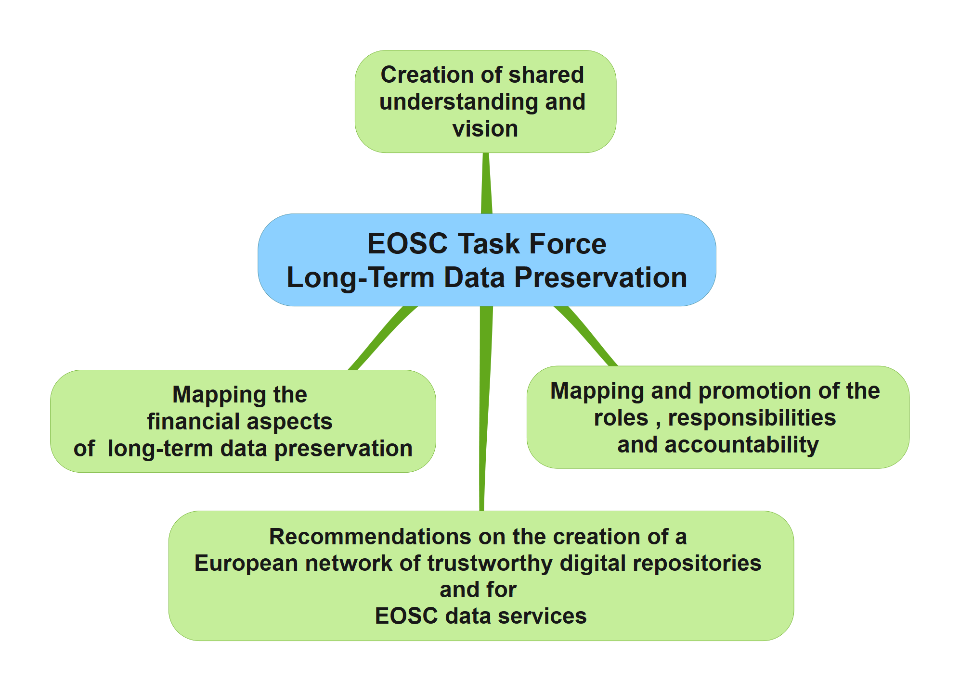
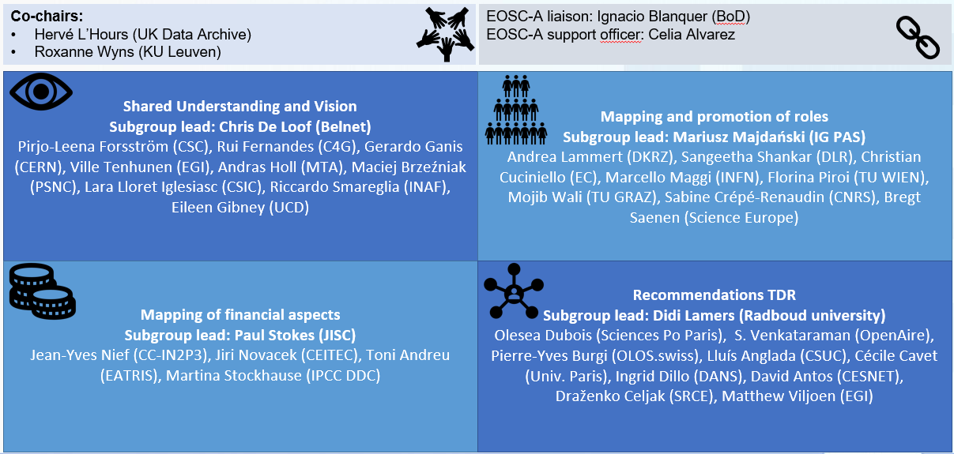
Task force structure

Slide 4
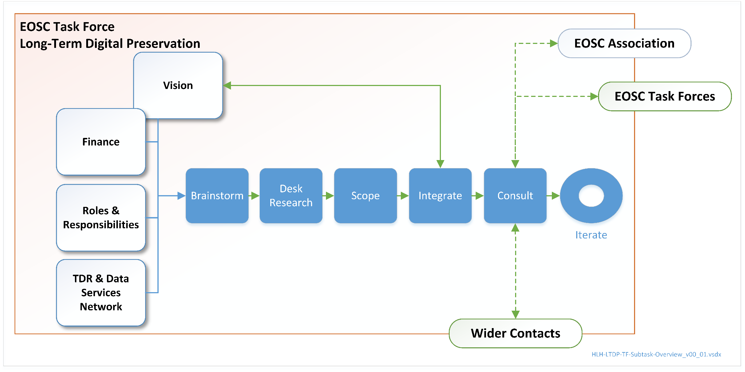
Task force approach

Slide 5
Task force timeline
November ’21 - Kick-off
September ’22 - Start of consultation period on the TF vision on EOSC preservation
Establishing the TF membership
Desk research, discussions & brainstorms
Consolidating the vision on preservation in EOSC
Drafting the Overview Discussion Paper
EOSC Symposium 2022
Drafting response to the working paper on TDRs
EOSC GA 12/’22
Paper + survey published
25/01/2023
Summer ’23 - Start of consultation period on the TF assumptions & recommendations
Preparing assumptions & recommendations
PV2023
1st version of assumptions and recommendations + survey
EOSC Symposium ‘23
Assumptions and recommendations published
Terms of reference for continuation of the TF published
Winter ’23/24 – Final deliverable of 1st TF mandate
TF outputs
Overview discussion paper https://doi.org/10.5281/zenodo.7516259 + survey
Response to the working paper “Toward a European network of FAIR-enabling Trustworthy Digital Repositories”. https://doi.org/10.5281/zenodo.7568399
Preservation in the context of EOSC. Sustainable repositories curating digital objects from a long-term FAIR enabling perspective, PV2023

Slide 6
Preservation in its wider context
Wide range of assumptions and perspectives around digital preservation
Contextualise preservation within the wider research life cycle and across the federated and consolidated network of partners that deliver scientific infrastructure (meta)data services

Slide 7
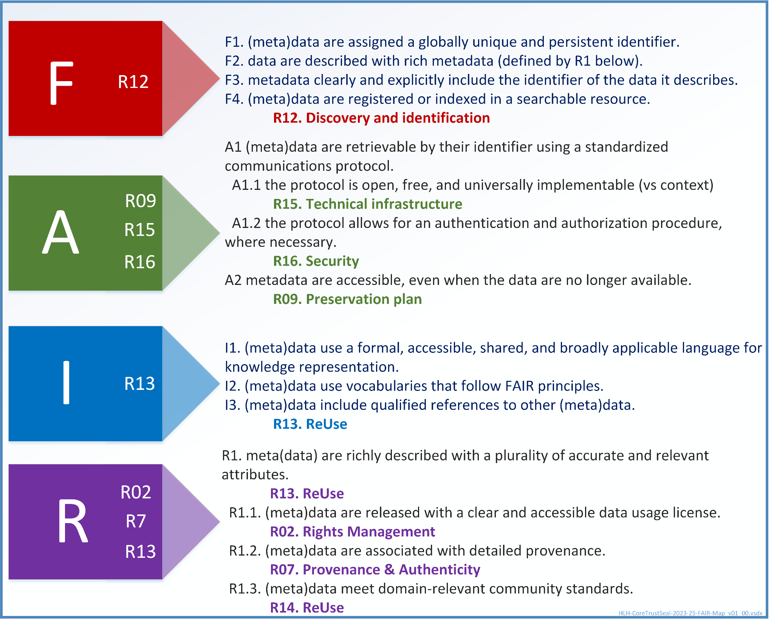
TRUST & FAIR
Trustworthy Digital Repositories cover transparency, responsibility, sustainability and technology
Digital objects with a high potential for reuse are represented by FAIR
The need for data and metadata to remain FAIR is not explicit in the FAIR principles
FAIR-enabling repositories can ensure that digital objects remain FAIR over time through preservation

Slide 8
Preservation in the context of EOSC
A successful EOSC necessitates engagement with a broad range of actors
Trustworthiness and FAIR digital objects require specialist and complex practices of different actors in one or more stages of the digital object management life cycle
Priorities for the TF
Consider the roles and financial implications related to preservation
Identify which research data management activities are unique to preservation
Clarify how preservation works alongside other research data management activities

Slide 9
An ongoing journey
Definitions and expectations of data services, including preservation, are hard to define and agree upon
Standards, associated tests of, and credit for compliance (incl. certification) are necessary and desirable, but must be seen as part of an emerging journey towards TRUST and FAIR
The TF sees transparency on the status of repositories as a priority
Organisational infrastructure
Digital object management actions
Technology
Security
Roadmap towards improvement of TRUST and FAIR
This will increase the knowledge base and the trust of funders, depositors and reusers

Slide 10
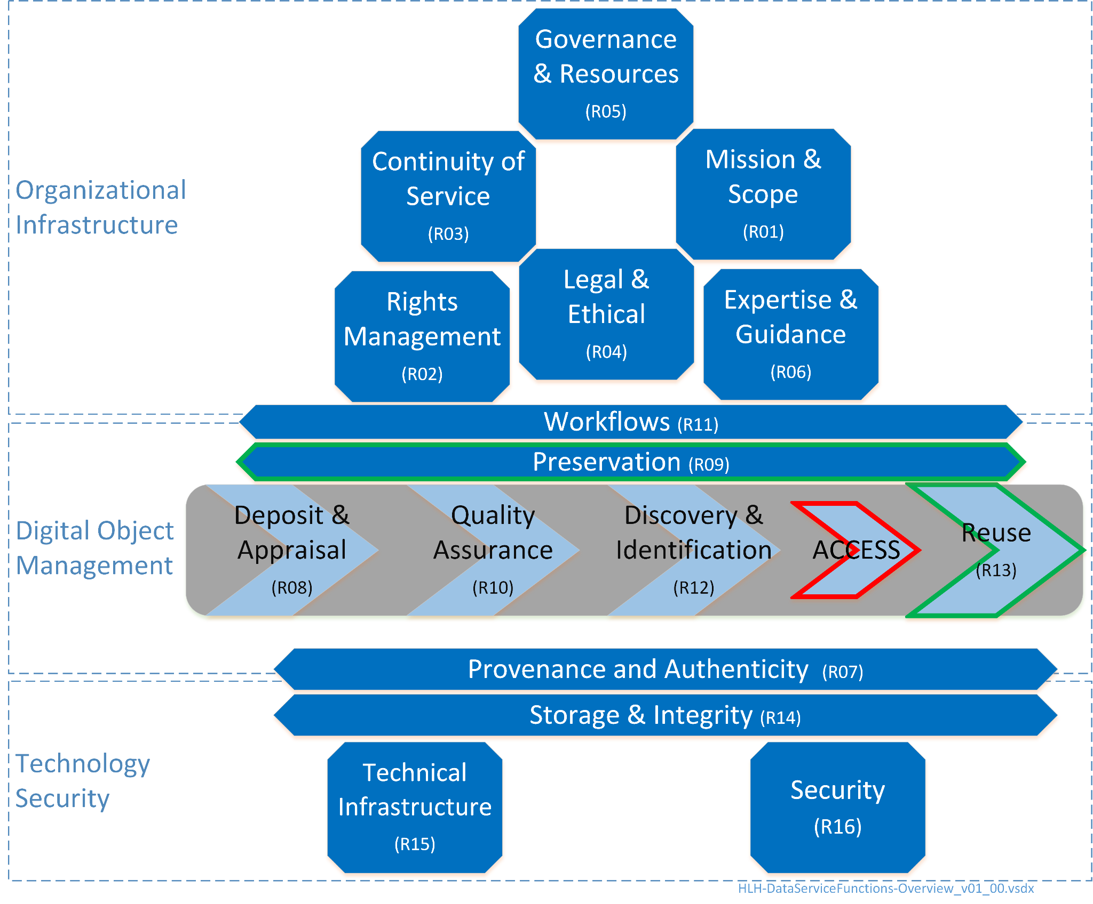
Specific requirements for preservation
CoreTrustSeal applicability to wider data services
Requirement for Preservation [R09] and ReUse [R13] unique to TDR candidate repositories
Other CTS Requirements are applicable across all organisations related to data and metadata
CoreTrustSeal as a reference point for the task force, in alignment with the perspectives on preservation outcomes, systems, and actions
Review of CoreTrustSeal Applicability to non-Preservation (Trustworthy) Data Services https://doi.org/10.5281/zenodo.7646134

Slide 11
TF perspective on preservation
EOSC Preservation: Overview Discussion Paper https://doi.org/10.5281/zenodo.7516259
“Preservation Outcomes: these concern digital objects that, having been curated for FAIRness and other desirable characteristics, are maintained to retain those characteristics for as long as necessary. These outcomes are targeted at a defined and ‘designated community’ of users.
Preservation Systems: accept the deposit of digital objects for storage and access (making them ‘repositories’ in the broad sense) and also curate them with a long term FAIR-enabling perspective on the objects and their designated community (making them candidate to become ‘trustworthy digital repositories’). The designated community’s knowledge base and technological needs are understood and monitored over time. These systems have sufficient resources, including personnel and financial resources, to be sustainable in terms of their organisational, technology and security infrastructure.
Preservation Actions: are the changes to digital objects’ (metadata and data) that are intended to keep them FAIR over time. These actions include technical steps such as emulation or transformations to modern, in-demand, file formats and metadata schemas; but also actions to ensure that the conceptual content of data and metadata, including semantic artefacts such as ontologies, continues to be understood and reusable.”

Slide 12
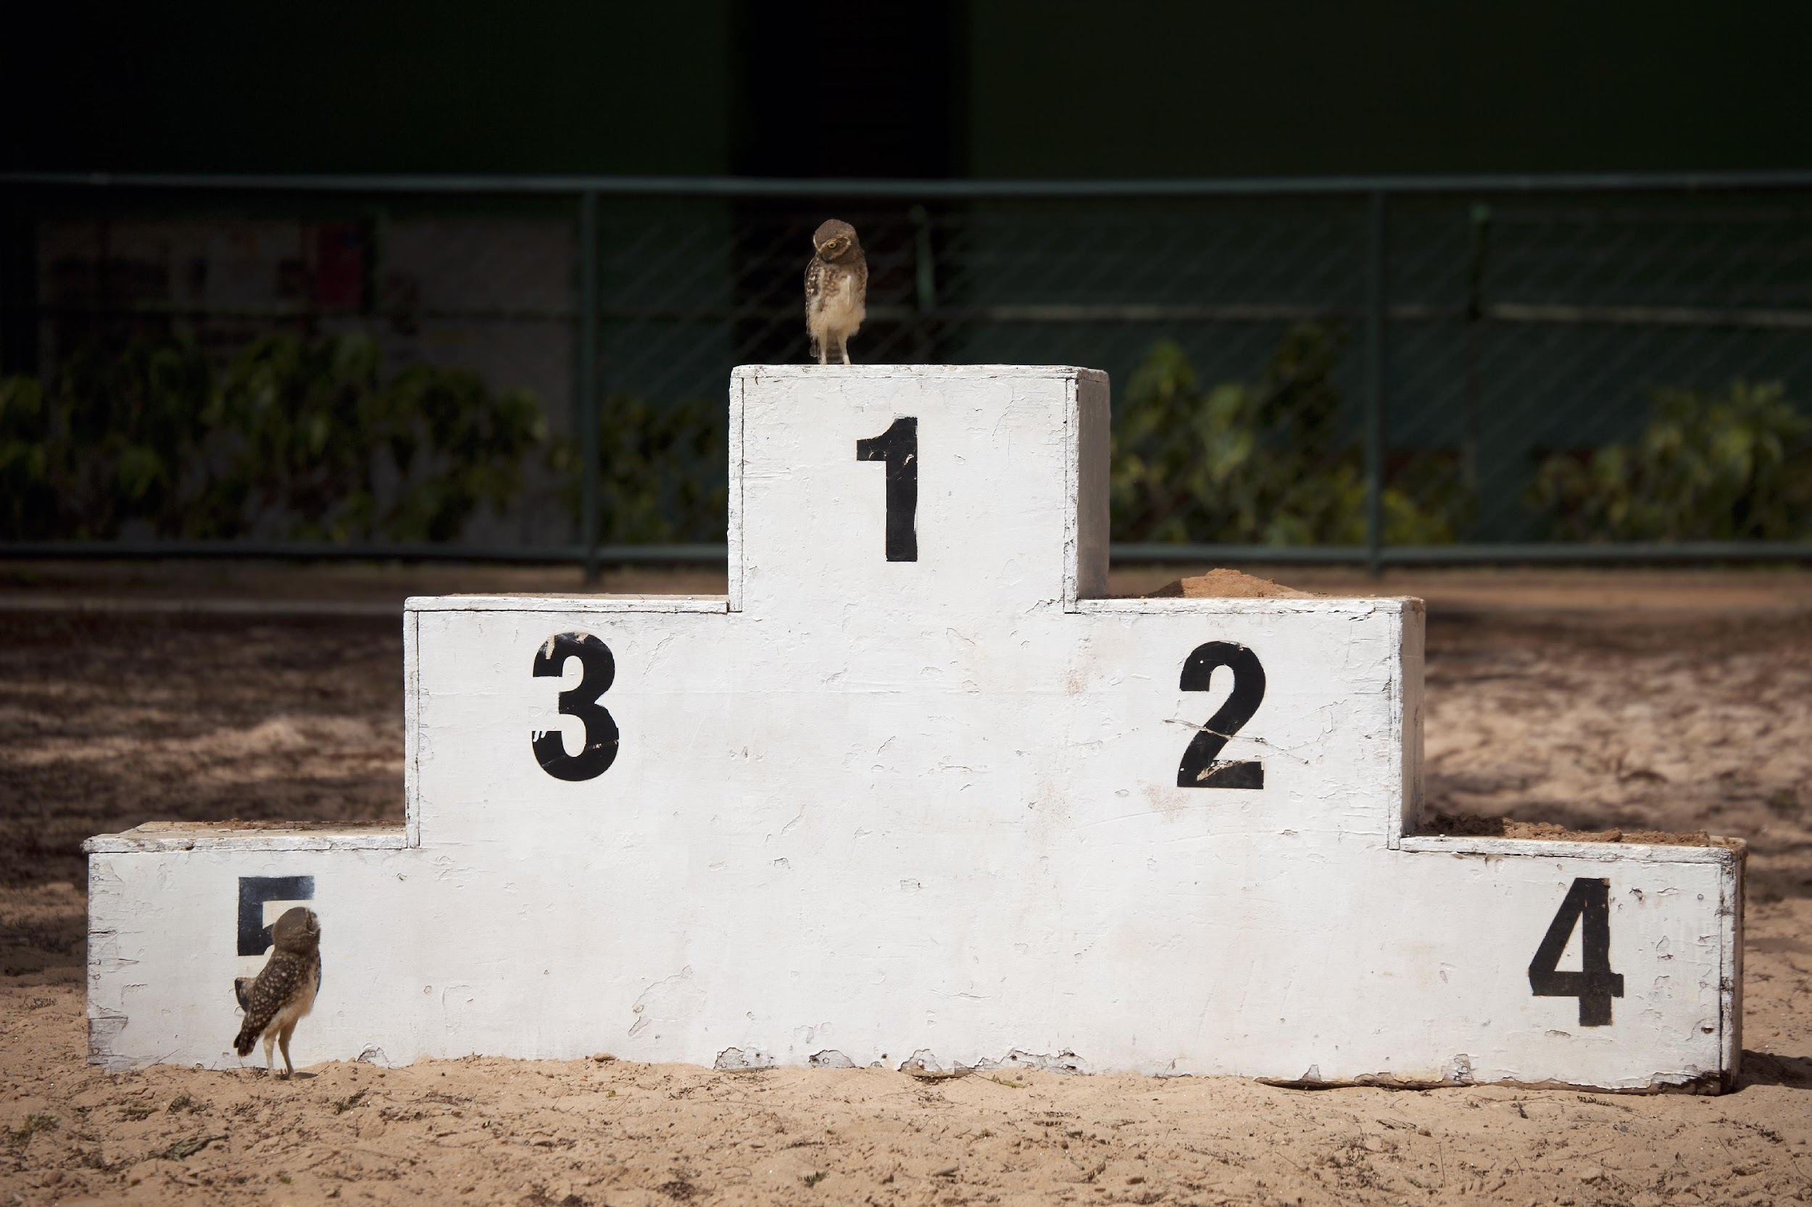
Curation and preservation levels
As proposes by CoreTrustSeal https://doi.org/10.5281/zenodo.6908019 and discussed with the TF
Level 0 Digital object is distributed unchanged from the state in which is was deposited
Level C delivers ‘Basic compliance and/or curation’
Data and metadata checked at point of deposit
Necessary steps to make sure they comply
Minimal curation for initial access and use but no long term preservation
The task force proposes to differentiate between deposit standards (D) and initial curation (C)
Level C is not providing active preservation as it provides no long term commitments or necessary actions for continued FAIRness of the deposited objects

Slide 13
Curation and preservation levels
As proposes by CoreTrustSeal https://doi.org/10.5281/zenodo.6908019 and discussed with the TF
Level B delivers ‘Logical-Technical Curation’ in addition to C
Ensures that data and metadata are updated over time to newer standards and formats (technical risks, changing needs of the designated community)
Level A delivers ‘Conceptual preservation for understanding and reuse’ in addition to B and C
Monitors changes to the definition an demands of their designated community
Takes responsibility for preservation actions to ensure that digital objects can be understood and reused
This involves updates to the content of metadata elements and other semantic artefacts
Different institutions, nations, domains and disciplines have different expectations from their trustworthy repository

Slide 14
Additional functions and costs
All repositories need the provision of deposit, storage, curation and access
Repositories delivering preservation have additional functions, activities, roles and costs
Not enough insight into the differentiate costs between initial curation and long term preservation
Active preservation may be assumed to represent additional costs over lower levels of care, but digital objects that lose their reuse value because of lack of active preservation also have a cost
Defining the value of digital objects is more challenging then defining the costs of their care (evolves over time, specific to communities, ease of reproduction …)
Value of digital objects might differ if we look at potential for reuse vs. ability to reproduce and validate

Slide 15
Towards recommendations
The task force has been explicit in defining what preservation means in the context of EOSC
Systems claiming to deliver preservation outcomes, need to be sustainable and curate digital objects from a long-term FAIR enabling perspective
Criteria for FAIR digital objects aligned with those for trustworthy digital repositories such as CoreTrustSeal provide an important reference point for evaluating objects and services
TRUST and FAIR enabling practices should be seen as an end goal in an ongoing journey
Transparency around current levels of FAIRness and trustworthiness of repositories will lead to better understanding
The TF will focus on statements and recommendations that are generally applicable
Broad policies and guidance where relevant bodies have influence
Direct practice and infrastructure where those bodies have control

Slide 16
Questions so far?

Slide 17
First Draft Assertions and Recommendations for Optimal Preservation Outcomes
We love to get your feedback!

Slide 18
Interactive feedback session
Draft assumptions & recommendations on
1. Digital Objects, Research Projects, Repository and (meta)data Services
2. Curation & Preservation Levels
3. FAIR + Time
4. Preservation Systems, Actions & Outcomes
5. Trustworthy Digital Repositories (TDR) and other (meta)data Services
6. Standards, Assessment, Certification & Knowledge
7. Outcomes, Judgement and Gatekeeping
8. Retention, Appraisal & Re-Appraisal
9. Transparency of Services, Artefacts and Levels of Care for Objects
10. Roles and Responsibilities
11. Finance & Funders
12. Network of Trustworthy Digital Repositories (TDRs)
13. Tiered Recommendations at European (13a), National (13b) and Institutional (13c) Level
Pick your 5 favourites
Response options:
Agree
Reword
Comment
Back

Slide 19
Notes:
Poll Title: Do not modify the notes in this section to avoid tampering with the Poll Everywhere activity. More info at polleverywhere.com/support Recommendations to discuss. Select 5 topics of preference https://www.polleverywhere.com/multiple_choice_polls/vhiNYP8Pfwm2680FSkQQd?state=opened&flow=Default&onscreen=persist

Slide 20
1. Digital Objects, Research Projects, Repository and (meta)data Services
DRAFT ASSUMPTIONS
Digital objects are constructs of data and metadata including research outputs such as data, software [etc]
Numerous types of digital objects exist. Some characteristics are applicable to many types of objects, others are more specialised.
In addition to disciplinary specific requirements and traditional files there are numerous complex or new and novel digital objects including distributed semantic artefacts such as ontologies.
Coverage of all objects by type is important, but beyond the scope of this task force .
Projects collect or create digital objects of relevance to research.
Digital objects must be appropriately cared for during research.
The Principles that digital objects should be Findable, Accessible, Interoperable and Reusable (FAIR) define important outcomes of digital objects’ care.
Research projects are often time limited, reducing their ability to offer operational services for the longer term required for preservation.

Slide 21
1. Digital Objects, Research Projects, Repository and (meta)data Services
Digital objects can retain their value beyond the project that curated or created them.
The value of digital objects is derived from different reuse cases including for replication, reproducibility, supporting assertions made in published papers or integration into new and novel research.
During or after a research project other digital object services may support the care of data and metadata.
A wide range of digital object services are required to support research infrastructure across the full digital object lifecycle.
Any digital object service holding data or metadata at any level of care can be very broadly defined as a repository.
Effective storage is not sufficient for preservation but it is necessary.
What is an "effective storage"?
Different types of digital object systems / repositories benefit from being transparent on their current level of storage practice as it increases trust by the user and funders alike.

Slide 22
Notes:
Poll Title: Do not modify the notes in this section to avoid tampering with the Poll Everywhere activity. More info at polleverywhere.com/support @Additional work is needed to define different types of digital object systems that offer (meta)data services, including the functions and activities they undertake and the levels of care they provide for data and metadata https://www.polleverywhere.com/multiple_choice_polls/9Xc1FLhCWd7JZYVeRrqlh?state=opened&flow=Default&onscreen=persist

Slide 23
Back
Notes:
Poll Title: Do not modify the notes in this section to avoid tampering with the Poll Everywhere activity. More info at polleverywhere.com/support @Minimum criteria for acceptable storage practice in different scenarios should be defined as a foundation for all tiers of retention, curation and preservation service https://www.polleverywhere.com/multiple_choice_polls/ZBm2WZtQLlI2Q6Tg17sQh?state=opened&flow=Default&onscreen=persist

Slide 24
2. Curation & Preservation Levels
DRAFT ASSUMPTIONS
The TF considers the different preservation levels as defined by CTS applicable for defining preservation services of a repository in the context of EOSC
Z. Level Zero. Content distributed as deposited. Unattended deposit-storage-access. No curation or long term preservation.
D. Deposit Compliance. Data content and supporting metadata deposited are checked at the point of deposit for compliance with defined criteria e.g. data formats and metadata elements. If these criteria are not met the digital objects are either returned to the depositor for change, or the repository undertakes the necessary curation steps to ensure they comply (reaching level C, below).
C. Initial Curation . Data content and supporting metadata deposited are curated to meet defined criteria e.g. for data formats and metadata elements. Curation for initial access and use, but no long term preservation.
B. Logical-Technical Preservation. In addition to D and/or C above the repository takes long-term responsibility for ensuring that the data and metadata are updated over time to newer standards and formats in response to technical risks (e.g. file format or software obsolescence), the changing needs of the designated community (e.g. newer alternate formats become necessary for reuse).
A. Conceptual preservation for understanding and reuse. In addition to B above, the repository monitors changes to the definition and demands of their designated community, including their knowledge base, and takes responsibility for the preservation actions that ensure digital objects can be understood and re-used. Often this will involve updates to the content of metadata elements and other semantic artefacts such as controlled vocabularies and ontologies. For some repositories it may include responsibility for editing the structure and content of deposited data.

Slide 25
Notes:
Poll Title: Do not modify the notes in this section to avoid tampering with the Poll Everywhere activity. More info at polleverywhere.com/support @Data services, including repositories should specify all of the levels of care they apply to objects within their collection, including through registry metadata https://www.polleverywhere.com/multiple_choice_polls/pVWtkiuRjEpMtwuxDICRQ?state=opened&flow=Default&onscreen=persist

Slide 26
Back
Notes:
Poll Title: Do not modify the notes in this section to avoid tampering with the Poll Everywhere activity. More info at polleverywhere.com/support @Digital objects should include metadata that specify their level of care and the timeframes or criteria for reappraisal of the level of care. https://www.polleverywhere.com/multiple_choice_polls/vHkIGeFnNOxNJiLjDhtih?state=opened&flow=Default&onscreen=persist

Slide 27
3. FAIR + Time
DRAFT ASSUMPTIONS
If the FAIR Principles are defined as desirable characteristics for a digital object then the object may be FAIR at the point of deposit (D), or made FAIR by initial curation (C ).
As technical infrastructure and the needs of user communities evolve, digital objects that were initially made FAIR are not guaranteed to remain FAIR over time.

Slide 28
Notes:
Poll Title: Do not modify the notes in this section to avoid tampering with the Poll Everywhere activity. More info at polleverywhere.com/support @FAIR-enabling practices to be undertaken by data services should be defined https://www.polleverywhere.com/multiple_choice_polls/yLRWjbKaVt1M08ELx4p0V?state=opened&flow=Default&onscreen=persist

Slide 29
Back
Notes:
Poll Title: Do not modify the notes in this section to avoid tampering with the Poll Everywhere activity. More info at polleverywhere.com/support @FAIR-enabling practices undertaken by data services should be made transparent to users and funders to increase trust in services https://www.polleverywhere.com/multiple_choice_polls/QshLOlfZkSrEB6myCd3wU?state=opened&flow=Default&onscreen=persist

Slide 30
4. Preservation Systems, Actions & Outcomes
DRAFT ASSUMPTIONS
Preservation systems^{WD} (organisations, partnerships, archives, repositories, libraries, galleries, museums) provide sustainable organisational infrastructure to monitor the evolution of technical infrastructure and the needs of user communities and to undertake preservation actions if necessary
Preservation actions^{WD} include any actions on a digital objects’ data, metadata or an environment provided to interact with the digital object that ensure the object retains desirable characteristics (e.g. FAIRness)
Preservation outcomes^{WD} are defined as an object maintaining desirable characteristics (e.g. FAIRness) over time

Slide 31
Back
Notes:
Poll Title: Do not modify the notes in this section to avoid tampering with the Poll Everywhere activity. More info at polleverywhere.com/support @ Unique preservation functions and activities should be defined alongside functions and activities that apply to all (meta)data services https://www.polleverywhere.com/multiple_choice_polls/4uUytKVnTtNWGYET9cPSa?state=opened&flow=Default&onscreen=persist

Slide 32
5. Trustworthy Digital Repositories (TDR) and other (meta)data Services
DRAFT ASSUMPTIONS
Repositories that undertake to offer preservation services and can meet defined criteria for their organisational infrastructure, digital object management, technical infrastructure and security provision are candidates to be a Trustworthy Digital Repository (TDR)
The CoreTrustSeal is a not-for-profit foundation, developed in response to an RDA mission and maintained through the RDA that provides 16 Requirements and an associated peer review and certification process for TDRs
The LTDP TF reasserts the conclusion of previous EOSC-relevant papers [TFiR] and groups [Previous Cert TF) that the CoreTrustSeal provides an appropriate mechanism to defining core expectations of TDR and exemplar for offering assessment and certification services
With the exception of the requirements for offering preservation services (Requirement 09) and considering reuse (Requirement 13) the CoreTrustSeal Requirements (https://doi.org/10.5281/zenodo.7051012) are broadly applicable to all (meta)data services

Slide 33
5. Trustworthy Digital Repositories (TDR) and other (meta)data Services
Transparency on the current status of repositories on organisational infrastructure, digital object management actions, technology and security, as well as the roadmap towards improvement of TRUST and FAIR, will increase the knowledge base of funders, repositories and other data services, and increase the trust of digital object depositors and reusers
The CoreTrustSeal applies to both generic and specialist repositories. It is domain aware (applicants must state any disciplinary communities that are supported) but domain agnostic
Technical repository service providers’ (storage providers, ARCHIVER etc) portfolio of service offerings should be clear and comparable to client end users

Slide 34
Notes:
Poll Title: Do not modify the notes in this section to avoid tampering with the Poll Everywhere activity. More info at polleverywhere.com/support @Other ongoing work to define repository and data service characteristics and expectations exist and should be encouraged and supported [UKDS Crosswalk spreadsheet] https://www.polleverywhere.com/multiple_choice_polls/YZt2Tyd2RKwqIKNXP5Dcj?state=opened&flow=Default&onscreen=persist

Slide 35
Notes:
Poll Title: Do not modify the notes in this section to avoid tampering with the Poll Everywhere activity. More info at polleverywhere.com/support @To maintain clarity and alignment these other efforts should map and crosswalk their own criteria to the CoreTrustSeal. Any reductions, additions or variations versus the CoreTrustSeal should be documented and explained ... https://www.polleverywhere.com/multiple_choice_polls/t6WB0XAUi4F0AAysV4ewo?state=opened&flow=Default&onscreen=persist

Slide 36
Notes:
Poll Title: Do not modify the notes in this section to avoid tampering with the Poll Everywhere activity. More info at polleverywhere.com/support @Efforts to define more specific domain/disciplinary criteria, or criteria that define expectations for specific types of digital objects should adopt the CoreTrustSeal requirements where possible, and elaborate around them where necessary https://www.polleverywhere.com/multiple_choice_polls/g1li73ayMqMfNx7XSw8B6?state=opened&flow=Default&onscreen=persist

Slide 37
Notes:
Poll Title: Do not modify the notes in this section to avoid tampering with the Poll Everywhere activity. More info at polleverywhere.com/support @Additional work is needed to define different types of digital object systems, the functions and activities they undertake and the levels of care they provide for data and metadata https://www.polleverywhere.com/multiple_choice_polls/UgFAdgcFJhxxLVkHyxWyp?state=opened&flow=Default&onscreen=persist

Slide 38
Back
Notes:
Poll Title: Do not modify the notes in this section to avoid tampering with the Poll Everywhere activity. More info at polleverywhere.com/support @Roles and responsibilities including for complex partnerships, third party relationships and outsourcing should be understood and transparent https://www.polleverywhere.com/multiple_choice_polls/4IIEV5tK50rkrfYXSmvn8?state=opened&flow=Default&onscreen=persist

Slide 39
6. Standards, Assessment, Certification & Knowledge
The development and application of standards provides mechanisms for agreeing and implementing a range of consistent practices
Indicators, metrics and tests can be designed to assess compliance with standards
Standards may be used to support, self-, peer- or third-party assessment approaches
Assessments can be used to assign credit (e.g. certification) and help service providers understand their current state and plan actions for future priorities and goals
When an assessed entity has changed, the assessment may no longer be valid and may need to be repeated
Repeated assessment may support an understanding of trends and progress over time

Slide 40
Back
Notes:
Poll Title: Do not modify the notes in this section to avoid tampering with the Poll Everywhere activity. More info at polleverywhere.com/support @ standards and guidance should be developed, coordinated and maintained to provide full lifecycle information on preservation to researchers and preservation practitioners https://www.polleverywhere.com/multiple_choice_polls/2zAEYoltnqSrEBIqqvBLj?state=opened&flow=Default&onscreen=persist

Slide 41
7. Outcomes, Judgement and Gatekeeping
Outcomes of assessments may include certification of repositories, evaluating a digital object as FAIR or compliance with a wide range of other criteria
Perceptions of negative judgement due to outcomes of assessments could negatively impact services and reduce transparency
Unnecessary gatekeeping of participation in or access to services including EOSC risks excluding potentially high quality services and high value digital objects from research infrastructures
Any cases where the outcomes of assessment result in binary inclusion/exclusion must be clearly justified and documented, e.g. to protect sensitive data through information security measures, or to protect critical services through technical interoperability criteria

Slide 42
Notes:
Poll Title: Do not modify the notes in this section to avoid tampering with the Poll Everywhere activity. More info at polleverywhere.com/support @Digital Objects and the services that enable their FAIRness, deposit, storage, curation, access and preservation should be supported in transparent efforts to use assessment as a route to improvement https://www.polleverywhere.com/multiple_choice_polls/1kBcq4opUcQ3aYmG3QcpL?state=opened&flow=Default&onscreen=persist

Slide 43
Notes:
Poll Title: Do not modify the notes in this section to avoid tampering with the Poll Everywhere activity. More info at polleverywhere.com/support @Efforts by repositories and other data services to share transparent information about their functions, activities and objects should be rewarded by targeted investment towards improvement https://www.polleverywhere.com/multiple_choice_polls/j64RDdoRdLWwfqL6t11Jb?state=opened&flow=Default&onscreen=persist

Slide 44
Notes:
Poll Title: Do not modify the notes in this section to avoid tampering with the Poll Everywhere activity. More info at polleverywhere.com/support @No data service or digital object should be unnecessarily excluded from any part of the EOSC https://www.polleverywhere.com/multiple_choice_polls/WZXzQMQaN8qfrp4Ij0ZU5?state=opened&flow=Default&onscreen=persist

Slide 45
Back
Notes:
Poll Title: Do not modify the notes in this section to avoid tampering with the Poll Everywhere activity. More info at polleverywhere.com/support @FAIRness and Trustworthiness must continue to be a supported journey for all parties https://www.polleverywhere.com/multiple_choice_polls/7OmR7SwTUjjofm7C6rjQg?state=opened&flow=Default&onscreen=persist

Slide 46
8. Retention, Appraisal & Re-Appraisal
sensitive data through information security measures, or to protect critical services through technical interoperability criteria
A long tail of data exists that has not been brought into a managed storage, curation or preservation system.
Any decision taken to evaluate a digital object with a view to delete it, retain it or assign or change a level of care is an appraisal decision.
The role and nature of data vary widely, and so there are different perspectives and insights into the kinds of preservation action that may be required.
Knowing which elements matter, and what metadata they might require is a subject specialist skill that in many cases can only be captured at the point of creation.

Slide 47
Back
Notes:
Poll Title: Do not modify the notes in this section to avoid tampering with the Poll Everywhere activity. More info at polleverywhere.com/support @Retention and reappraisal decisions and timescales, including guaranteed preservation timescales, should be transparent https://www.polleverywhere.com/multiple_choice_polls/7OmR7SwTUjjofm7C6rjQg?state=opened&flow=Default&onscreen=persist

Slide 48
9. Transparency of Services, Artefacts and Levels of Care for Objects
Transparency of metadata, supporting artefacts (policies, preservation plans, data management plans) and digital objects fosters understanding, interoperability and continuous improvement between peer services
Information shared through transparency can be designed to mitigate any risks to information security or competitive advantages
Transparency supports the establishment of feedback mechanisms to engage expert communities of practice in the evaluation and improvement of services and objects

Slide 49
Notes:
Poll Title: Do not modify the notes in this section to avoid tampering with the Poll Everywhere activity. More info at polleverywhere.com/support @Each service should be transparent about the levels of service provided https://www.polleverywhere.com/multiple_choice_polls/eghCxAcTnVrtDcjBJIRbe?state=opened&flow=Default&onscreen=persist

Slide 50
Notes:
Poll Title: Do not modify the notes in this section to avoid tampering with the Poll Everywhere activity. More info at polleverywhere.com/support @Each object should have a defined level of care associated with the service(s) taking responsibility https://www.polleverywhere.com/multiple_choice_polls/2MrhK77c7kM3tYSxumMZF?state=opened&flow=Default&onscreen=persist

Slide 51
Notes:
Poll Title: Do not modify the notes in this section to avoid tampering with the Poll Everywhere activity. More info at polleverywhere.com/support @Living and machine actionable data management plans should form the basis of continuity through the research data lifecycle https://www.polleverywhere.com/multiple_choice_polls/Veq69138gDX3VFCgVqzA3?state=opened&flow=Default&onscreen=persist

Slide 52
Notes:
Poll Title: Do not modify the notes in this section to avoid tampering with the Poll Everywhere activity. More info at polleverywhere.com/support @Registries of repositories and other data services should align service level metadata and supporting information https://www.polleverywhere.com/multiple_choice_polls/wHLwt3bQySOrPmQQNuOm7?state=opened&flow=Default&onscreen=persist

Slide 53
Back
Notes:
Poll Title: Do not modify the notes in this section to avoid tampering with the Poll Everywhere activity. More info at polleverywhere.com/support @Registries of digital objects should align metadata relating to retention periods, appraisal periods and levels of curation and preservation https://www.polleverywhere.com/multiple_choice_polls/SISkEuk9Y9QBzkIzPmuaf?state=opened&flow=Default&onscreen=persist

Slide 54
10. Roles and Responsibilities
Preservation roles, responsibilities and accountability remain unclear, this includes for data stewards as individuals and for organisations such as libraries, archives and institutional repositories
Preservation roles and skills are not limited to technical manipulation of digital objects: optimal preservation outcomes depend on a conceptual understanding of the data and metadata being cared for
Assigning clear responsibilities within groups, partnerships and across lifecycles are more effective and accountable
Roles that are assigned to individuals with clear responsibility are more effective and accountable
Lack of clarity and transparency of roles and responsibilities presents a risk to digital objects and their preservation

Slide 55
10. Roles and Responsibilities
Preservation roles must include monitoring the changing needs of communities at the point of reuse. This community watch must be aware of the knowledge base, methodologies and technologies of the user communities
Preservation roles must include monitoring the changing nature of available technologies for the deposit, storage, curation, discovery, access and reuse of data and metadata. This technology watch must continue to meet the needs identified through community watch, and be proactive as well as reactive
Roles and responsibilities include the early definition of preservation actions in a data management plan such as multi-copy/multi-location redundancy, integrity, data protection, digital object design, provenance information, appraisal criteria, desirable retention and preservation periods and future repositories
Technicians develop and maintain the hardware and software infrastructure that supports preservation systems including integrity, data protection, automation and audit
Transparency about and analysis of current roles and responsibilities associated with data services functions and activities are necessary inputs into financial calculations related to salaries and funding streams

Slide 56
Notes:
Poll Title: Do not modify the notes in this section to avoid tampering with the Poll Everywhere activity. More info at polleverywhere.com/support @Where responsibility is distributed accountability should remain clear, including accountability for (meta)data loss or destruction https://www.polleverywhere.com/multiple_choice_polls/qN6ejGul5y9zuCDlQ0VOq?state=opened&flow=Default&onscreen=persist

Slide 57
Notes:
Poll Title: Do not modify the notes in this section to avoid tampering with the Poll Everywhere activity. More info at polleverywhere.com/support @Digital object management outcomes, including preservation, should be integrated into a roles and responsibilities framework that integrates all actors and actions https://www.polleverywhere.com/multiple_choice_polls/1tKLD6cE3icys8LEhJyxL?state=opened&flow=Default&onscreen=persist

Slide 58
Notes:
Poll Title: Do not modify the notes in this section to avoid tampering with the Poll Everywhere activity. More info at polleverywhere.com/support @The roles and responsibilities framework should be aligned with clear process models that meet the needs of different stakeholder communities https://www.polleverywhere.com/multiple_choice_polls/cb8pInR3o74gOmQwvCdTu?state=opened&flow=Default&onscreen=persist

Slide 59
Notes:
Poll Title: Do not modify the notes in this section to avoid tampering with the Poll Everywhere activity. More info at polleverywhere.com/support @Defined roles should be in place to take responsibility from the point of conception to ensure that preservation actions are considered throughout the life cycles https://www.polleverywhere.com/multiple_choice_polls/PxXEVNaG7vGq17nznfVN9?state=opened&flow=Default&onscreen=persist

Slide 60
Notes:
Poll Title: Do not modify the notes in this section to avoid tampering with the Poll Everywhere activity. More info at polleverywhere.com/support @Different roles should use a living data management plan as a key artefact for periodic audit, review and revision https://www.polleverywhere.com/multiple_choice_polls/TiUyXAoKK0ne6Pli4Lh7t?state=opened&flow=Default&onscreen=persist

Slide 61
Notes:
Poll Title: Do not modify the notes in this section to avoid tampering with the Poll Everywhere activity. More info at polleverywhere.com/support @Risk analysis approaches should be used to identify when in the lifecycle it is appropriate to take preservation actions https://www.polleverywhere.com/multiple_choice_polls/UO3ec6oJlOfZTuSjHDUAH?state=opened&flow=Default&onscreen=persist

Slide 62
Notes:
Poll Title: Do not modify the notes in this section to avoid tampering with the Poll Everywhere activity. More info at polleverywhere.com/support @Policy makers must make the development and implementation of digital preservation explicit in policy applicable to all stakeholders and across the lifecycle. They are accountable for periodic review and revision of policy https://www.polleverywhere.com/multiple_choice_polls/tLDOfF8D6E6TIYLLg5qO9?state=opened&flow=Default&onscreen=persist

Slide 63
Notes:
Poll Title: Do not modify the notes in this section to avoid tampering with the Poll Everywhere activity. More info at polleverywhere.com/support @Executives must adopt preservation policy into their operational and strategic planning https://www.polleverywhere.com/multiple_choice_polls/2S4SyjXB9xAPlikpCwAhT?state=opened&flow=Default&onscreen=persist

Slide 64
Notes:
Poll Title: Do not modify the notes in this section to avoid tampering with the Poll Everywhere activity. More info at polleverywhere.com/support @Managers must integrate preservation planning into operational management including staffing, funding, service development and procurement https://www.polleverywhere.com/multiple_choice_polls/o1XriBo8KoS1i5Vb56pGe?state=opened&flow=Default&onscreen=persist

Slide 65
Notes:
Poll Title: Do not modify the notes in this section to avoid tampering with the Poll Everywhere activity. More info at polleverywhere.com/support @Practitioners must provide guidance, community and technical monitoring and, where necessary, take preservation actions to ensure optimal preservation outcomes https://www.polleverywhere.com/multiple_choice_polls/dDXc0yikzkpc0dRgSzEI8?state=opened&flow=Default&onscreen=persist

Slide 66
Notes:
Poll Title: Do not modify the notes in this section to avoid tampering with the Poll Everywhere activity. More info at polleverywhere.com/support @Data and metadata creators, collectors and reusers, including researchers, should develop the knowledge and skills at a general level and within their own disciplinary and domain area of expertise, so that their actions are preservation-aware https://www.polleverywhere.com/multiple_choice_polls/oiLGIqDbantdhyHcjR6bD?state=opened&flow=Default&onscreen=persist

Slide 67
Notes:
Poll Title: Do not modify the notes in this section to avoid tampering with the Poll Everywhere activity. More info at polleverywhere.com/support @All of the preservation-specific and supporting research data management roles across the data lifecycle require sustained training based on a rich knowledge base of preservation information https://www.polleverywhere.com/multiple_choice_polls/Y4S9IhGffGmaMGSMgz7PU?state=opened&flow=Default&onscreen=persist

Slide 68
Back
Notes:
Poll Title: Do not modify the notes in this section to avoid tampering with the Poll Everywhere activity. More info at polleverywhere.com/support @Clear responsibilities must be in place for developing standards and guidance, for communication and for training https://www.polleverywhere.com/multiple_choice_polls/EMC3igl9TZbbmJ09bmOGT?state=opened&flow=Default&onscreen=persist

Slide 69
11. Finance & Funders
“Researchers, disciplinary and cross-disciplinary research communities, Member States and EOSC are all expecting commitments from each other but lack the support to make commitments of their own”. [FAIR Forever]
Data management plans are the critical reference point across partners and lifecycle
Identify and support staffing costs for preservation specific roles and responsibilities.
Commitment to funding compliance with emerging policies is critical at the European, national and institutional level.
Any decision to retain and then undertake initial curation will imply costs. Any additional costs implied to deliver active preservation is beyond this are uniquely preservation costs. Once we’ve decided to retain, and then undertake initial curation for access, what are the true long term additional and unique costs of preservation
“Investigations into preservation roles and responsibilities and their associated costs (e.g. case studies, labour market data analysis) are necessary to establish accurate costing parameters for preservation programmes and services provided in EOSC.” [FAIR Forever]

Slide 70
Notes:
Poll Title: Do not modify the notes in this section to avoid tampering with the Poll Everywhere activity. More info at polleverywhere.com/support @Further research and analysis is necessary to support business planning based on qualitative and quantitative risks and benefits https://www.polleverywhere.com/multiple_choice_polls/ZPb7Df8WRIj4GwawS096q?state=opened&flow=Default&onscreen=persist

Slide 71
Notes:
Poll Title: Do not modify the notes in this section to avoid tampering with the Poll Everywhere activity. More info at polleverywhere.com/support @Funders should clarify to all grant holders that the FAIR Principles and the potential need for preservation are full lifecycle issues https://www.polleverywhere.com/multiple_choice_polls/QF54ifnnYjXJUptFwr0wB?state=opened&flow=Default&onscreen=persist

Slide 72
Notes:
Poll Title: Do not modify the notes in this section to avoid tampering with the Poll Everywhere activity. More info at polleverywhere.com/support @Funders should include meeting the needs for compliance with the FAIR Principles and any long term preservation needs in calculation of the funding to be awarded https://www.polleverywhere.com/multiple_choice_polls/p9aAKkM55wZJqxon7CFfh?state=opened&flow=Default&onscreen=persist

Slide 73
Notes:
Poll Title: Do not modify the notes in this section to avoid tampering with the Poll Everywhere activity. More info at polleverywhere.com/support @Audit pathways are essential for all research outputs https://www.polleverywhere.com/multiple_choice_polls/SXUizFwA52qn9cbhF4WQM?state=opened&flow=Default&onscreen=persist

Slide 74
Notes:
Poll Title: Do not modify the notes in this section to avoid tampering with the Poll Everywhere activity. More info at polleverywhere.com/support @Data management plans should define obligations and support accountability https://www.polleverywhere.com/multiple_choice_polls/o5JSaMtt7any4aBNcFm91?state=opened&flow=Default&onscreen=persist

Slide 75
Notes:
Poll Title: Do not modify the notes in this section to avoid tampering with the Poll Everywhere activity. More info at polleverywhere.com/support @Once identified, critically endangered content that retains value requires investment https://www.polleverywhere.com/multiple_choice_polls/phU1ZjomPOORPO0jtfVr4?state=opened&flow=Default&onscreen=persist

Slide 76
Back
Notes:
Poll Title: Do not modify the notes in this section to avoid tampering with the Poll Everywhere activity. More info at polleverywhere.com/support @Full lifecycle costs should be assessed, including the unique costs of preservation using methodologies that include the potential costs of inaction https://www.polleverywhere.com/multiple_choice_polls/7LXbVsWSNpDbYUDIDvgr5?state=opened&flow=Default&onscreen=persist

Slide 77
12. Network of Trustworthy Digital Repositories (TDRs)
EOSC and the global digital preservation community would both benefit from active engagement in international networks of trustworthy digital repositories, research performing organisations, and public and private sector data service providers
Current and future networks of preservation practitioners, including TDRs, can support the development, evaluation, implementation and monitoring of all the recommendations made in this paper and to
Provide a platform for networking and knowledge exchange for repositories , thereby improving their FAIR-enabling capabilities and trustworthiness
Provide a platform for stakeholder advocacy and engagement for repositories , acting as a "unified voice" of the repository community to align with and input to the EOSC ecosystem, making it easier for EOSC to monitor the repository landscape and align the EOSC ecosystem with the requirements of repositories and their data and metadata users
Coordinate and develop frameworks for best practices for research data repository policies and routines , such as a strategic framework to achieve baseline certification, to audit data management plans , and identifying preservation pathways for data
Evaluate FAIR metrics and tools and provide feedback on efforts to align certification requirements with FAIR
Identify costs of action versus inaction with respect to high value, critically endangered content
Work in progress …
Back

Slide 78
13. Tiered Recommendations at European, National and Institutional Level

Slide 79
Notes:
Poll Title: Do not modify the notes in this section to avoid tampering with the Poll Everywhere activity. More info at polleverywhere.com/support @Greater clarity is needed in the EOSC vision and for the application of preservation activity across the lifecycle and at EU, National and institutional level https://www.polleverywhere.com/multiple_choice_polls/Vzj5cpPoKVttQgPNcHyF2?state=opened&flow=Default&onscreen=persist

Slide 80
13a. Tiered Recommendations at European Level
European level influence may act directly on institutions or via the intermediary of national level policies and practices. In all cases actions should be aligned at the relevant European, National or Institutional Level.
Addressing preservation is critical to EOSC data, reputation and sustainability. EOSC cannot achieve its goals in the long-term unless they are addressed
Digital preservation risks and opportunities must be made explicit in the EOSC vision and monitored and addressed as the EOSC evolves

Slide 81
Notes:
Poll Title: Do not modify the notes in this section to avoid tampering with the Poll Everywhere activity. More info at polleverywhere.com/support @EOSC cannot rely on a single generic canon of 'digital preservation practice'. Instead, workflows should leverage large scale infrastructures while remaining faithful to discipline-specific requirements. https://www.polleverywhere.com/multiple_choice_polls/rGSNpi81sfcrRMp3V5kHq?state=opened&flow=Default&onscreen=persist

Slide 82
Notes:
Poll Title: Do not modify the notes in this section to avoid tampering with the Poll Everywhere activity. More info at polleverywhere.com/support @Roles, responsibilities, and accountabilities for preservation in EOSC should be clarified https://www.polleverywhere.com/multiple_choice_polls/sdIZiuZ3ZQrCHiHMZ7cLG?state=opened&flow=Default&onscreen=persist

Slide 83
Notes:
Poll Title: Do not modify the notes in this section to avoid tampering with the Poll Everywhere activity. More info at polleverywhere.com/support @EOSC should establish a workplan for policy development and implementation within EOSC services and partners ... https://www.polleverywhere.com/multiple_choice_polls/z7Rc5h4ToWuJR21czaaiW?state=opened&flow=Default&onscreen=persist

Slide 84
Notes:
Poll Title: Do not modify the notes in this section to avoid tampering with the Poll Everywhere activity. More info at polleverywhere.com/support @Support the alignment between the interpretations of FAIR for digital objects and the criteria for data services, including repositories to be FAIRenabling at whatever level of care they provide https://www.polleverywhere.com/multiple_choice_polls/nYNQiU495uUJA1i7T9Bt9?state=opened&flow=Default&onscreen=persist

Slide 85
Notes:
Poll Title: Do not modify the notes in this section to avoid tampering with the Poll Everywhere activity. More info at polleverywhere.com/support @Establish pathways for continuous quality improvement ... https://www.polleverywhere.com/multiple_choice_polls/REc0k8rNWiKUdLDv4z6ut?state=opened&flow=Default&onscreen=persist

Slide 86
Notes:
Poll Title: Do not modify the notes in this section to avoid tampering with the Poll Everywhere activity. More info at polleverywhere.com/support @Support the development of verified business models for data services, including preservation services https://www.polleverywhere.com/multiple_choice_polls/tYwrh1lDPmJdeQn1UkvQm?state=opened&flow=Default&onscreen=persist

Slide 87
Notes:
Poll Title: Do not modify the notes in this section to avoid tampering with the Poll Everywhere activity. More info at polleverywhere.com/support @Support the development of digital rights management standards and mechanisms that support the transition of digital objects and data services' licences and responsibilities transition to explicit, machine-actionable, scalable interoperability ... https://www.polleverywhere.com/multiple_choice_polls/lZRePhU9pPNi9K9u9xoQE?state=opened&flow=Default&onscreen=persist

Slide 88
13b. Tiered Recommendations at National Level

Slide 89
Notes:
Poll Title: Do not modify the notes in this section to avoid tampering with the Poll Everywhere activity. More info at polleverywhere.com/support @Actions taken at European level should be adopted, adapted for national needs and support provided for implementation https://www.polleverywhere.com/multiple_choice_polls/XOowmjlDNjjAj1L3R9o1Y?state=opened&flow=Default&onscreen=persist

Slide 90
Notes:
Poll Title: Do not modify the notes in this section to avoid tampering with the Poll Everywhere activity. More info at polleverywhere.com/support @When action cannot be taken at European level they should be developed and implemented at national level https://www.polleverywhere.com/multiple_choice_polls/LqjcJVVfuKcGfaBC7rNps?state=opened&flow=Default&onscreen=persist

Slide 91
13c. Tiered Recommendations at Institutional Level
Support researchers in digital object design, creation, storage, curation and preservation whether through locally provided repositories and data services or via third parties
Take appropriate responsibility for relevant phases of the research data lifecycle including assurances that digital objects are made FAIR and that services are FAIR enabling and trustworthy
Support ongoing review and audit of practice across the lifecycle

Slide 92
Back
Notes:
Poll Title: Do not modify the notes in this section to avoid tampering with the Poll Everywhere activity. More info at polleverywhere.com/support @Funders should commission repositories to conduct audits, and repositories should undertake these audits https://www.polleverywhere.com/multiple_choice_polls/r0iKEPqjJcfvVuhrW1cFl?state=opened&flow=Default&onscreen=persist

Slide 93
Discussion
Questions
Feedback
Suggestions
Discussion
Recommendations to add

Slide 94
Thank you!

