Slide 1
WP3: Solution and service design and implementation
fred.clarke@ucd.ie 04TH May 2023

Slide 2
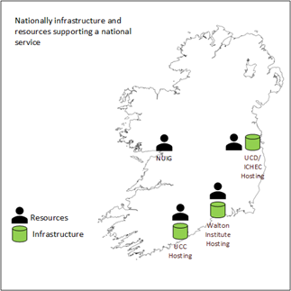
WP3 - The Team
Project Management
UCD
Technical team
UCC
ICHEC
SETU Walton Institute
Advisory
HEAnet
EUDAT
Jülich Supercomputing Centre
Surf

Slide 3
Site A
Users’ home institution
Policies & Compliance – RDM DMP, GDPR DPIA
Device, software - file encryption, metadata
Site B
Home institution access
Identity & Authentication – password, SSO, MFA
Software
EUDAT – B2ACCESS, B2DROP, B2SHARE
Software – Nextcloud, Database + caching
WP3
Site C
Servers & Storage
Hardware /IaaS
Filesystem /object store
Linux
Base infrastructure
Firewall
Datacentre
Networking – Campus + HEAnet network

Slide 4
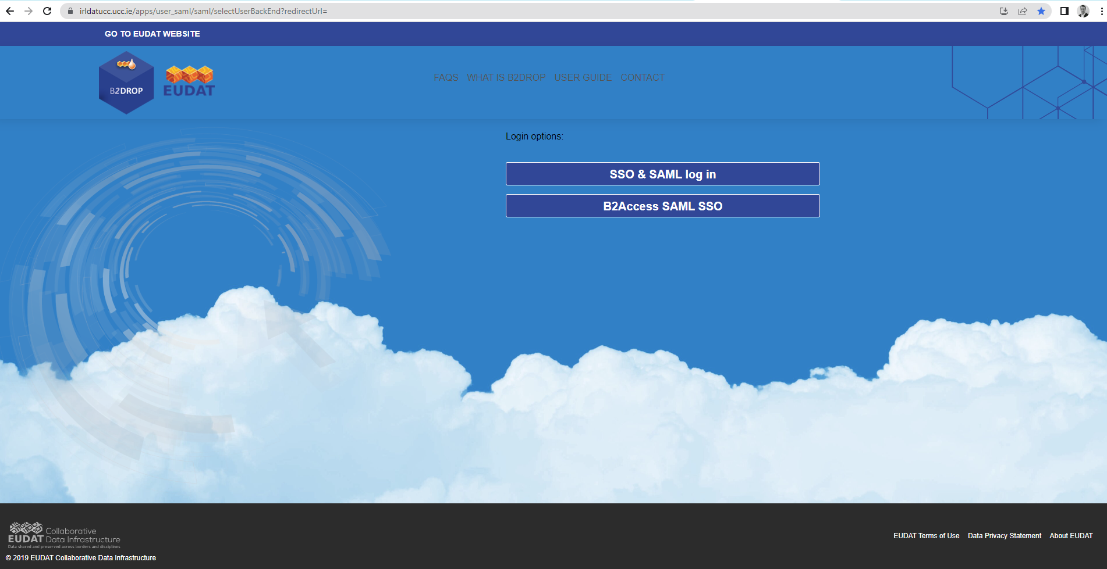
WP3 - The EUDAT Services – UCC B2ACCESS

Slide 5
WP3 - The EUDAT Services

Slide 6
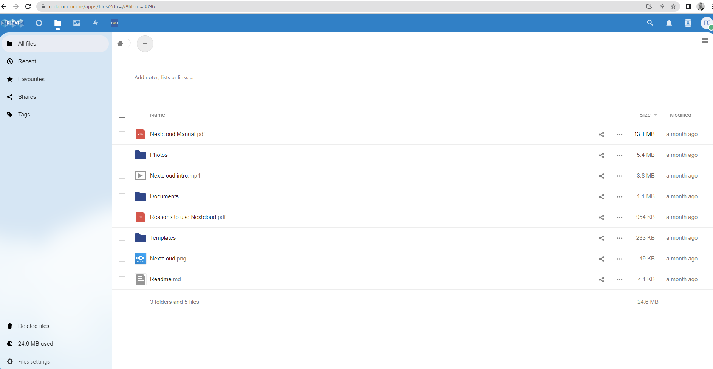
WP3 - The EUDAT Services – UCC B2DROP

Slide 7
WP3 - THANK YOU

