Slide 1
IRLDAT Use Case
Flaithrí Neff, PhD

Slide 2
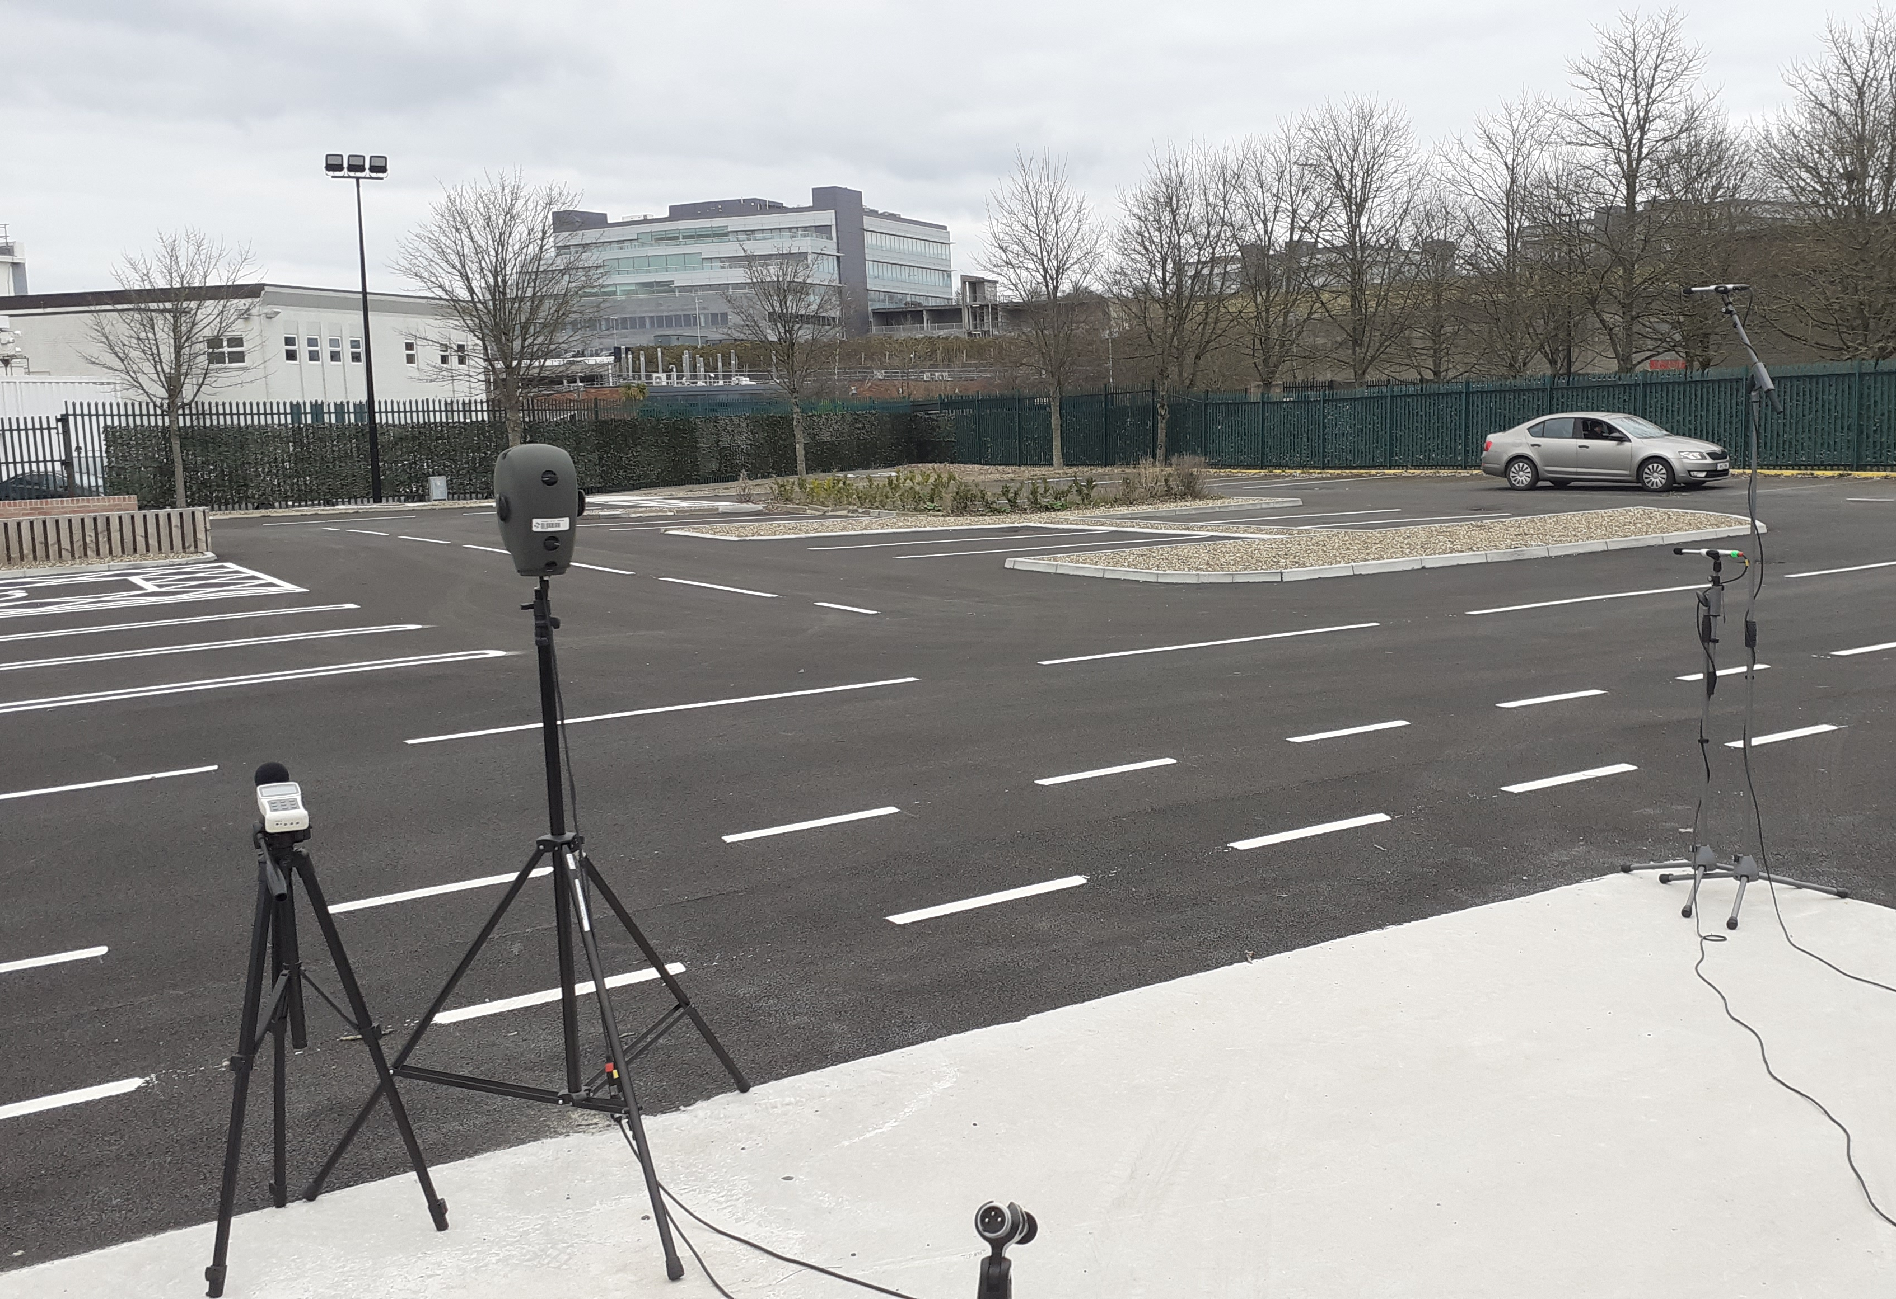
Use-case
AISHT: Acoustic Intelligence in Smart Hyperconnected Transport
- Rural Intelligent Transport Systems (ITS)
- ITS: connecting infrastructure sensing and vehicle sensing to extend situational awareness in transport
- Rural context: developing roadside sensing that is independent of line-of-sight for winding country road-sections
Sensor data
- Acoustic signals from passing vehicles and other road users
Relevant metadata
- Vehicle/tyre specifications
- Sensor specifications
- Weather and other environmental data
- Track-surface specifications

Slide 3
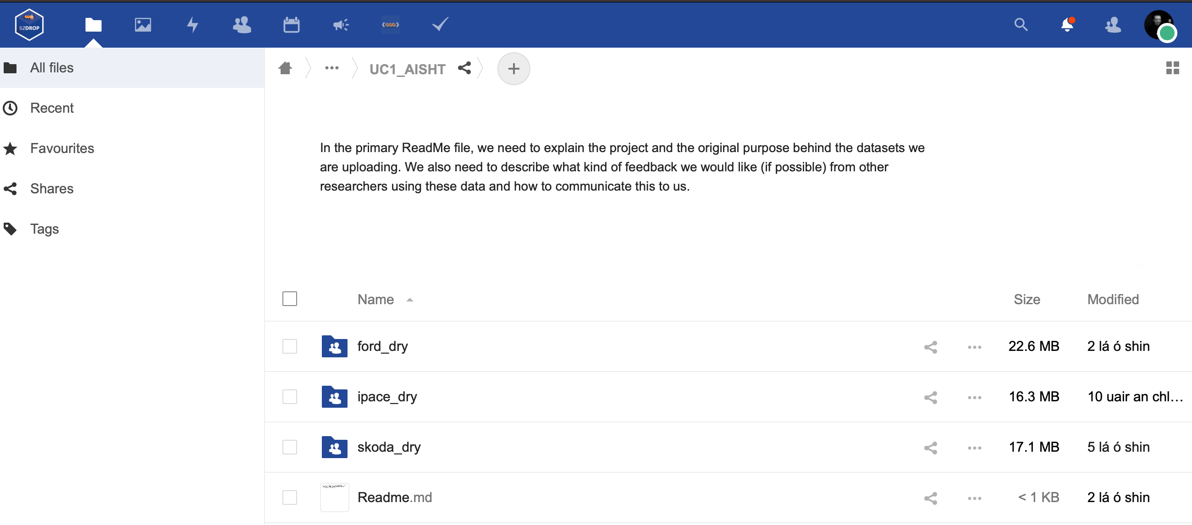
Interacting with eudat services
Data is captured on the FMCI test-track in Shannon. Data processed in Cork (Flaithrí) and Limerick (Patrick)
Signal data (wav); metadata (.csv); Python scripts to structure/associate signal data and metadata in HDF5 format.

Slide 4
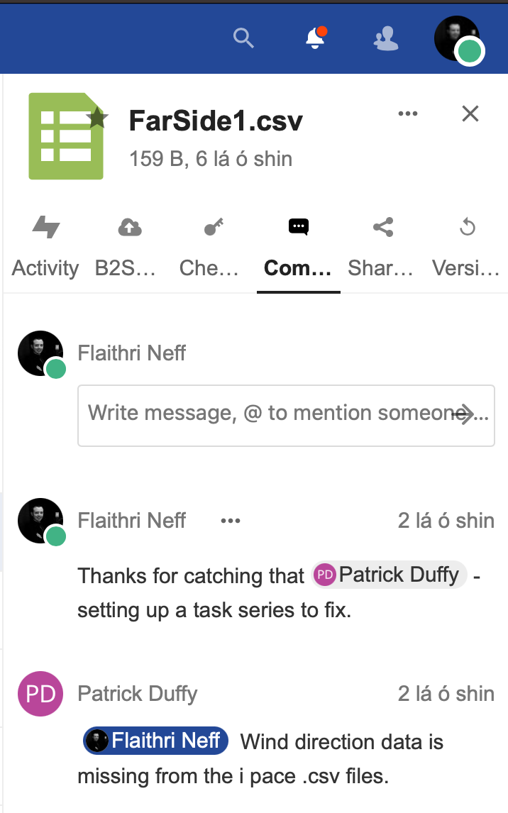
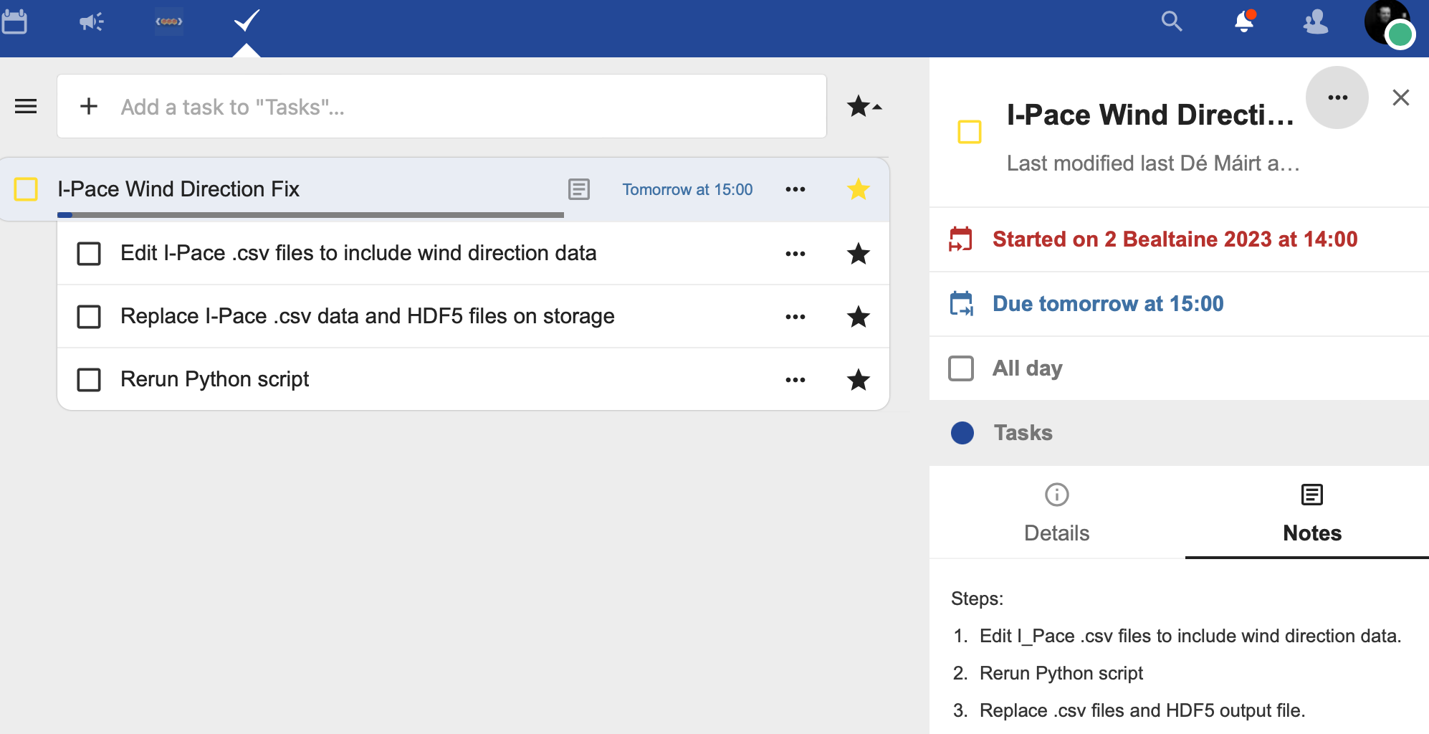
1
2
3

Slide 5
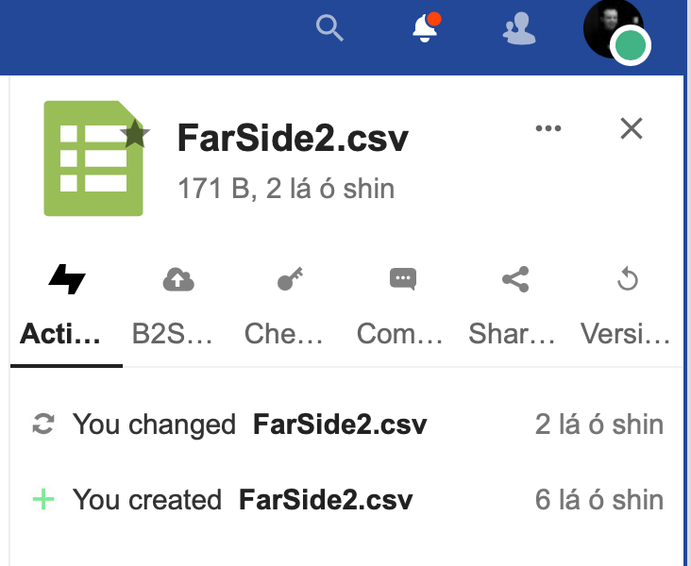
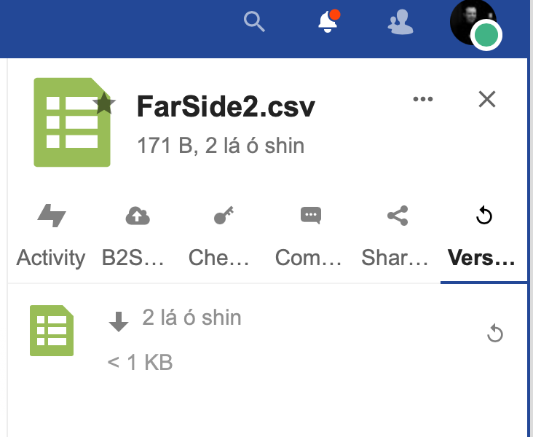
4
5
Clicking this file will download the first version that was replaced 2 days ago.

Slide 6
6

Slide 7
Overall Impressions
Ease of use: both browser side and desktop client have a pleasing and easy-to-use UI.
Excellent traceability: all steps and actions are transparent and trackable.
Version control: removes the worry about accidental overwrites. Embeds active-data sharing from initial project beginnings to open-data reuse by other research teams.
Trust: peace-of-mind when it comes to the organisations involved in the design, implementation, and operation of EUDAT/IRLDAT services.
Connectedness: very easy to pull in collaborations from outside my organisation. Although not impossible, our usual platform makes this very cumbersome.

