Slide 1
IRLDAT Overview and launch of the Stakeholder Advisory Forum
IRLDAT Team
May 4th 2023

Slide 2
Agenda
Introduction to NORF NAP2022 and IRLDAT project (Roberto Sabatino – HEAnet)
Expectations of the SAF
Overview of EUDAT services, user requirement analysis (Debora Testi – EUDAT)
User perspectives:
Acoustic sensoring (Flaithri Neff – TUS)
GeoData (Chris Burbridge – UCD/iCRAG )
Progress to date on national infrastructure design (Fred Clarke – UCD)
Next Steps (Roberto Sabatino – HEAnet)

Slide 3
Housekeeping
Please mute your mics during talks
Use “chat” to ask questions or “raise your MSTeam hand”
Q/A at end of each agenda item

Slide 4
National Action Plan to transition towards Open Research
Ireland’s National Action Plan for Open Research: a roadmap for the implementation of open research across Ireland
Structured across 3 themes:
Establishing a culture of open research;
achieving 100% open access to research publications;
enabling FAIR research data and other outputs
2 years from 1 Nov 2022, 1.75M funding from HEA
See https://norf.ie/funding/
NAP2023 calls launched recently
See https://norf.ie/national-action-plan/

Slide 5
6 Actions
National Open Access monitoring
Open Access repository assessment and alignment
Open Access transition programme
Open Research training programme
National data stewardship network
Shared data storage service pilot for active research data
A competitive call May-October 2022
Notification of award on 14th October
Start 1st Nov 2022
See https://norf.ie/funding/

Slide 6
Action N.6 IRLDAT

Slide 7
Aims and Objectives
Understanding researcher data storage and sharing requirements
Build a platform to be tested and used by researchers for the duration of the pilot.
Design a management, operational and governance model appropriate for the service.
Leverage findings to develop a formal proposal to set up a national production-based environment covering service design, architecture, resourcing, funding and sustainability proposals

Slide 8
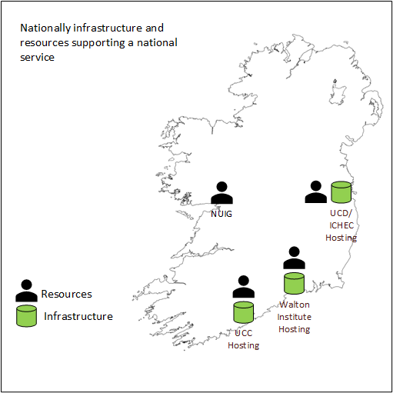
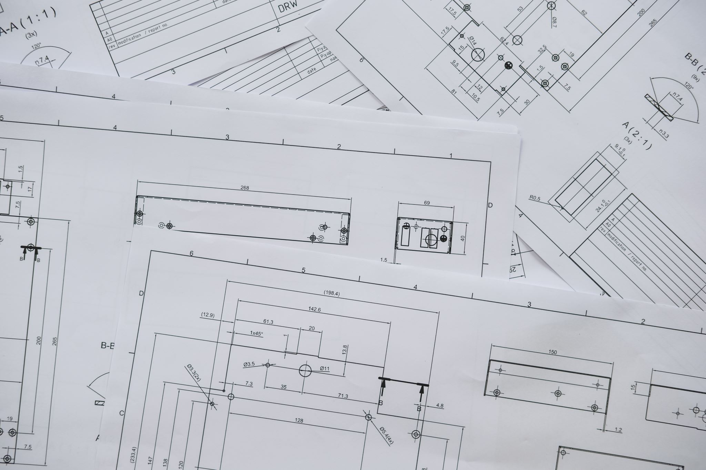
Phase 1
To 30 June 2023
Phase 2
July 2023 – October 2024
Phase 3
Production Service Definition
To October 2024
11 Use cases, in a User Advisory Forum
SAF: Stakeholder Advisory Forum

Slide 9
11 use cases
Phase-1: Acoustic Sensoring, Humanities, GeoData, Material Science
Phase-II: Microscopy/ X-Ray, Life Sciences (ELIXIR), Sports Science, North-South Social Science , Medical
Analysis: IRLDAT_use_cases_analysis_v2.docx
The UAF (User Advisory Forum) established to inform and feedback the project team on the user experience with the services

Slide 10
Project Structure
WP1 Project management (HEAnet)
WP2 User engagement and onboarding for phase-1 (EUDAT)
WP3 National infrastructure design and implementation (UCD)
WP4 User engagement and onboarding for phase-2 (ICHEC)
WP5 Dissemination and SAF (HEAnet)
WP6 Production quality, sustainable, service definition of national scale (ICHEC)
183K budget, matched/exceeded by partner contributions in kind

Slide 11
SAF Composition
Stakeholders in Research Data Management, maps to RESIN membership
RDM/library
Research management
Research IT
Research centre leadership
Research Infrastructure leadership
RPO IT leadership

Slide 12
What do we expect of the SAF?
Attend events, feedback
Take part in consultations
Review documents
Surveys ?
Expect small but focussed effort from members
Subscribe to Email list: LISTSERV 16.5 - Subscribe or Unsubscribe to the IRLDAT-SAF List (heanet.ie)
Web page: https://resin.heanet.ie/index.php/irldat-saf-stakeholder-advisory-forum/

Slide 13
Onto Debora, Flaithri, Chris, Fred

Slide 14
Next Steps, SAF Timetable
~September 2023: In person event to show progress and user demos
~December 2023: Online event with progress update and 1st iteration of service definition
~March 2024: In person event, user demos, progress update, 2nd iteration of service definition
~June 2024, online event, final iteration of service definition.
Subscribe to IRLDAT-SAF@listserv.heanet.ie ML

Slide 15
Thank You !

