Slide 1
EOSC-Ireland on Procurement and EOSC nodes
Roberto Sabatino
12th September 2023

Slide 2
Outline
The EOSC architectural vision
EOSC, in practice, today
The EOSC core procurement
EOSC nodes ?

Slide 3
(one of) My definition of EOSC
A web of FAIR Data, complemented by infrastructure, tools and services that enables researchers within and across disciplines and within and across institutes & countries to collaborate in the context of Open Science.
Based on a federated system of systems (nodes?)

Slide 4
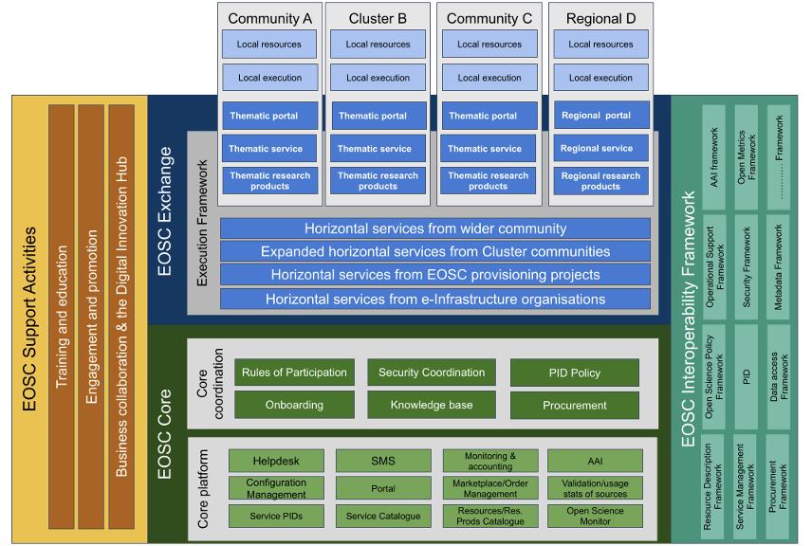
Architecture
EOSC is not a single monolithic organisation or resource provider but a federation of many independent organisations and resource providers.

Slide 5
EOSC in practice today
Several Horizon 2020 and Horizon Europe projects funded to develop the EOSC architecture, and develop examples of its components.
Eosc-portal.eu, run by EOSC-Future project, is the entry point to a catalogue of services and data that comply to FAIR
EOSC-Future ends 30 Sep 2023, replaced by a service procured by EC
Extension until service is in place early 2024

Slide 6
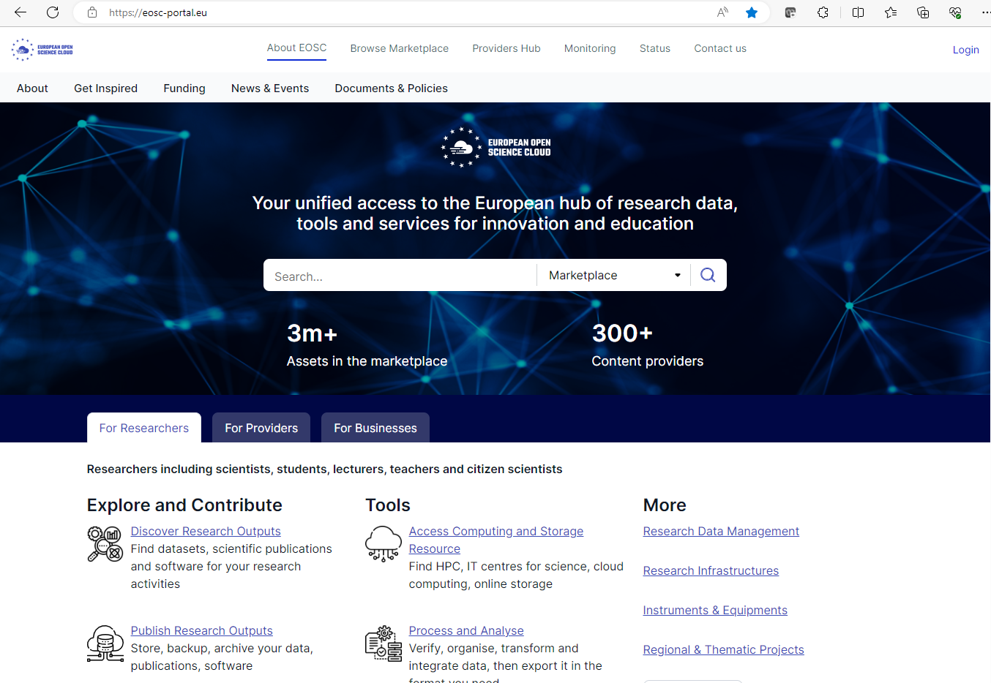

Slide 7
The EOSC EC procurement
On-going procurement by DG CNECT to procure the EOSC EC-node (35M€)
Lot 1: Managed EOSC core services
Lot 2: Managed Container Platform and Virtual machine Service for EOSC Exchange
Lot 3: Managed Collaborative data Platform, Interactive Data Analytics Platform and Virtualization Services for EOSC Exchange
3 years of operation starting by Q1 2024
The EOSC Node is a particular implementation of the EOSC Platform concept. The EOSC procurement action is to build and deploy a fully operational EOSC Node at the European level. This EOSC Node may act as the master node for the federation and may serve as a deployment blueprint and operations guideline for future, national, regional and/or institutional (even thematic) implementations of the EOSC nodes, not covered in this procurement

Slide 8
The EOSC platform and nodes
Extract from the EOSC EC procurement document

Slide 9
What’s a node ? 4 Questions
What is the definition of a node?
What must a node contain and what is optional?
What defines the boundaries of one node from another?
Are EOSC core and Exchange services common to the whole EOSC platform or does their implementation and access vary across nodes?
How do the different layers of policies for EOSC participation map on to nodes?
What policies apply at the EOSC platform level and what policies may vary by node?
Who decides?
Who is responsible for such policies, how are they enforced and monitored?
Who decides if a node can be admitted or excluded to the federation and on what basis?

Slide 10
What next ?
Stay tuned for updates on EOSC node definition
Have our own conversation on what a node is and how do we go about it
Updates at EOSC national event 3 Nov
Probably a focused workshop early 2024
What’s the relation with National Data Infrastructure (NDI) ?
Hear from our CESNET colleague on activities in CZ in this space

Slide 11
Thank you

