Slide 1
EOSC priorities 2025-2027 and EOSC federation
Sara Garavelli, CSC - IT Center for Science & EOSC Association Board of Directors
sara.garavelli@csc.fi
03 | 11 |2023 – EOSC Ireland NTE

Slide 2
EOSC vision in a nutshell
EOSC is the European web of FAIR data and related services for research
Research data that is easy to find, access, interoperate and reuse (FAIR)
Trusted and sustainable research outputs are available within and across scientific disciplines
What
Unlock the full potential of research data to accelerate discoveries and innovation
Why
Ensure that Open Science practices and skills are rewarded and taught, becoming the ‘new normal’
Enable the definition of standards, and the development of tools and services, to allow researchers to find, access, reuse and combine results
Establish a sustainable and federated infrastructure enabling open sharing of scientific results
Strategic Research and Innovation agenda (SRIA)
How
eosc.eu/sria-mar

Slide 3
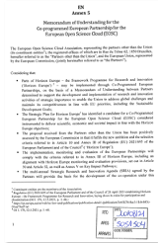
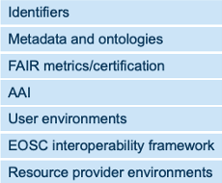
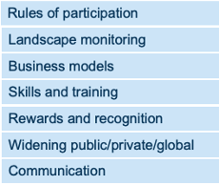
How EOSC is implemented
Co-Programmed
European Partnership
Strategic Research & Innovation Agenda
(SRIA)
3 General objectives
In kind contributions
EOSC Association members
Countries represented in the EOSC Steering Board
9 Specific objectives
14 Action Areas
H2020 & HE projects
H2020 projects: 350M€
HE 2021: 6 topics / 59M€
HE 2022: 4 topics + Pu Pr / 65 M€
HE 2023: 6 topics + 2 GIB / 70M€
HE 2024: 5 topics / 61 M€

Slide 5
MAR 2025-2027
The process to establish the MAR
Autumn of 2022: Task Forces were asked for inputs
The Board reviewed and selected from these to propose topics to the EC in December 2022
The Board worked up a preliminary text according to the MAR structure
Further iterations were made with Task Forces
A finalised draft version for consultation was agreed on by the EC early March and put out for consultation to members and observers until April 2022
Draft version agreed on by the board on 4 August 2023
Draft delivered to the EC on 1 September 2023
Discussion with community on 20 September 2023
Finalising draft in October 2023
Integration in SRIA >>> SRIA 1.2 in October 2023
Adoption of MAR by EOSC-A at GA#7 on 21 November 2023
Adoption of SRIA 1.2 by Partnership Board in December 2023
MAR – Multi Annual Roadmap
About the MAR
The Multi-Annual Roadmap is a part of the Strategic Research and Innovation Agenda (Chapter 8)
The MAR sets priorities for activities in a given period of work
The MAR informs the Work Programme which is defined by the European Commission
The MAR under development is for 2025-2027
EC request for a separate document
“Input and advice by the EOSC Association for the definition by the EC of call topics to be included in the Horizon Europe Work Programme 20xx”

Slide 6
European level priorities for 2025-2027
Align on core curricula for data stewardship, Open Science and FAIR for both support staff and researchers (2025)
Support the development and sustainability of networks for data stewards, research software engineers, semantic artefact curators and Open Science communities, leveraging on existing national networks and coordinating these at European level to promote the added value of EOSC (2025)
Collect, connect and scale up ongoing good practices and case studies for the research and career assessment of open science practices in collaboration with the Coalition for Advancing Research Assessment (CoARA) (2025)
Support and complement the CoARA movement with developing tools and processes for the research and career assessment of open science practices.
Pilot indicators/metrics at the European level for the research and career assessment of open science practices and disseminate them Europe-wide.
Support and embed appraisal and preservation procedures for long-term data preservation and monitor their value and costs. Practices should be transparent, aligned were possible and interoperable (i.e. through machine actionable rights management).
A dedicated provision for supporting the EOSC Partnership in its concertation actions. A cascading grant mechanism should support widening activities with under-represented countries and national competence centres, amongst other things.

Slide 7
National level priorities for 2025-2027
Support the implementation of aligned European curricula for data stewardship and encourage the inclusion of these as a core element in research programmes. The establishment of proper career paths for research support professionals is also needed.
Establish the cost of data management, data stewardship, maintenance and preservation of research outputs (including software and semantic artefacts) as eligible within national funding schemes.
Leverage existing national Competence Centres and strengthen their participation in coordination networks.
Use cases from the public sector, citizen science and industry should be encouraged in the next period in parallel to the research sector, whilst ensuring that services developed remain under the control of academics. Also use cases running at national or regional level are interesting. Emphasis should be to support uptake (2025).

Slide 8
Institutional level priorities for 2025-2027
Offer codified and certificated core Open Science, FAIR and CARE training to researchers and research support units at all levels and recognise the skills as part for their professional development through different certified means.
Support professional development programmes to ensure research support staff have the required data stewardship skills.
Engage in competence centres and networks for data stewards, research software engineers, semantic artifact curators and Open Science communities to share models and harmonise best practises.
Adjust, follow up, and evaluate research review mechanisms to ensure FAIR research outputs and Open Science are appropriately recognised and rewarded.
Define and implement training and procedures to select data, software, and other research outputs that retain the value necessary to be preserved

Slide 9
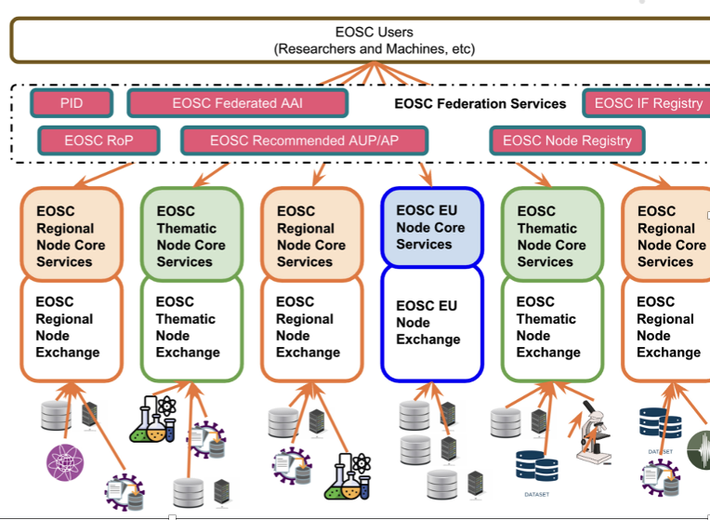
EOSC federation
EOSC intends to become a federation of distributed systems, combined into a system of systems, consisting of multiple "nodes" that are interconnected and can collaborate to share and manage information and resources (FAIR data & services) across thematic and geographical boundaries.
Courtesy of EGI

Slide 10
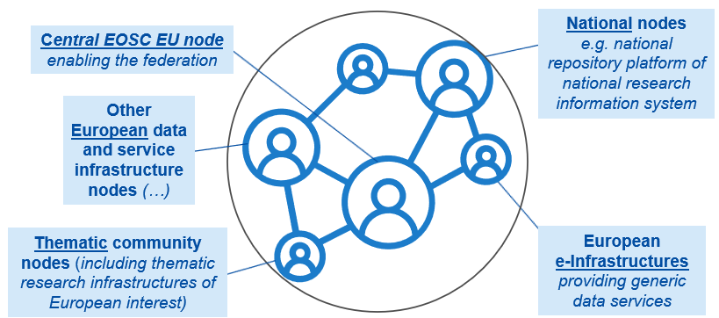
EC public procurement Managed Services for the European Open Science Cloud platform
Status update
4 May 2022: Prior Information Notice
4 May to 5 August 2022: Open Market Consultation (3 months)
20 December 2022: Tender Publication
2 May 2023: Submission of Initial Tender Response for Dialogue
May to July 2023: Dialogue Stage (9 weeks)
28 July 2023: Final invitation to tender
7 September 2023: Final submission
Ongoing: Evaluation (to be followed by contract signatures by the end of this year)
Procurement Lot Structure
Managed Collaborative Data Platform, Interactive Data Analytics Platform and Visualization Services for the EOSC Exchange (Application Services)
Lot 3
Lot 2
Managed Container Platform and Virtual Machine Services for the EOSC Exchange (Infrastructure Services)
Lot 1
Managed Services for the Development, Integration, Deployment and Operations of the Federated EOSC Core
The EOSC EU node should provide from next year onwards core functionalities enabling the EOSC federation
Slide courtesy of EC

Slide 11
The concept of “node”
Main inputs captured via community consultations
The EU node is the federating node and should operate ONLY the functions necessary for the federation (this avoids the issues of budget allocation by countries/disciplines) (EOSC-A GA)
EOSC architecture needs to be defined (EOSC-A GA)
The EOSC federation comprises multiple Nodes that work together (MOs)
There should be basic policies at the EOSC federation level that apply to all Nodes (MOs)
There may be Node specific policies that vary from one Node to another (MOs)
The organisation that is responsible for a Node ensures that all applicable policies are enforced and monitored (MOs)
A Node may itself be a collection or federation of Nodes (MOs)
Many RIs are already operating distributed, multi-national federated structures and can contribute valuable experience (RIs)
EOSC should not put the entry requirements to federation too high (RIs)
RIs would find it valuable if the EOSC federation can contribute to the sustainability aspects (RIs)
The Rules of Participation for EOSC need to be compatible with those of the Ris (RIs)
The EU Node should be considered as a reference implementation rather than a master Node RIs)
RIs would find it valuable if the EU Node provides additional storage and processing capacity (RIs)
Take-away 1: Multiple nodes x country
Take-away 3: No EU master node but reference node
Take-away 2: A node might itself be a collection of nodes

Slide 12
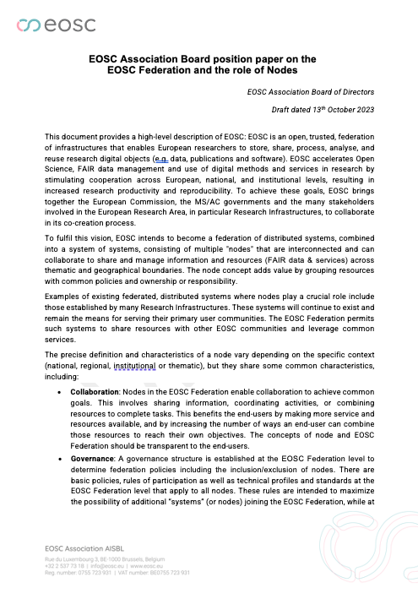
EOSC-A / Draft Position Paper of the Board on the EOSC Federation and the role of Nodes
EOSC node main characteristics
Collaboration: Nodes in the EOSC Federation enable collaboration to achieve common goals.
Governance: A governance structure is established to determine federation policies incl. the inclusion/exclusion of nodes. Each node has an identified legal representative that takes responsibility for ownership and accountability.
Autonomy: There may be node specific policies that vary from one node to another.
Interconnectivity: Nodes offer interfaces that respect the EOSC Interoperability Framework.
Resources: All nodes contain resources (FAIR data and/or services) that should add value to the EOSC Federation (as well as its users). The services may be of a technical nature (i.e. allow to perform actions on data) but may also include training services or expertise such as centres of competence.
Scalability: The federation can be scaled by adding new nodes.
Heterogeneity: Nodes belonging to different categories may vary in the collection of resources to which they provide access and the infrastructure on which they are built.
The EOSC Federation model is enabled by the EOSC Interoperability Framework, which defines the interfaces to interconnect EOSC Nodes and their resources
Notes:
Collaboration: Nodes in the EOSC Federation enable collaboration to achieve common goals. This involves sharing information, coordinating activities, or combining resources to complete tasks.
Governance: A governance structure is established at the EOSC Federation level to determine federation policies including the inclusion/exclusion of nodes. There are basic policies, rules of participation as well as technical profiles and standards at the EOSC Federation level that apply to all nodes. Each node has an identified legal representative that takes responsibility for ownership and accountability.
Autonomy: The legal entity responsible for a node has a degree of autonomy so it may operate independently to perform specific tasks or functions. There may be node specific policies that vary from one node to another.
Interconnectivity: Nodes offer interfaces that respect the EOSC Interoperability Framework. Information about a node and its resources should be visible to the whole federation.
Resources: All nodes contain resources (FAIR data and/or services) that should add value to the EOSC Federation (as well as its users). The services may be of a technical nature (i.e. allow to perform actions on data) but may also include training services or expertise such as centres of competence.
Scalability: The federation can be scaled by adding new nodes.
Heterogeneity: Nodes in the EOSC Federation belonging to different categories may vary in the collection of resources to which they provide access and the infrastructure on which they are built.

Slide 13
Next steps
Defining the EOSC federation
EOSC A will continue to lead on shaping the definition of the EOSC Federation and the role of Nodes
The EOSC-A Board of Directors will present its position paper to the EOSC Partnership in December 2023
In 2024 the ambition is to evolve and extend the paper into a formalised handbook of operations* that provides guidelines for administration of and engagement with the EOSC nodes.
A key dependency to this evolution, and indeed that of the nodes concept itself, is the definition of access policies at both the node and Federation levels
*Elixir’s Handbook of Operations provides a good reference model: https://elixir-europe.org/aboutus/governance/handbook-operations

Slide 14
Conclusions
EOSC is a federated initiative that aims to promote the production and reuse of research data
EOSC has entered a critical convergence phase. In 2024
the EU node will become operational
the EOSC Federation will be defined and started
the sustainability plan for EOSC beyond 2027 will be decided
And in parallel … several other challenges:
demonstrate EOSC added value to the research process; showcase demonstrators; increase uptake by researchers;
EOSC as a public good: researchers primary users; open progressively to public/private sectors
Deploy EOSC as a European data space, and connect other data space
EOSC enabling citizen science
EOSC support to EU Missions
…
expansión para desarrollar el impacto de Open Science
13

Slide 15
Many Thanks… and stay tuned

