Slide 1
WELCOME to the 2nd EOSC National Tri-Partite Event
Programme:
Welcome by Paddy Howard, DFHERIS
EOSC context and summary of NORF NAP2022 and NAP2023 projects (Roberto Sabatino - HEAnet)
summary of EOSC MAR and SRIA. Intro to EOSC node concept (Sara Garavelli -EOSC-A)
Perspective from an Irish-based data infrastructure (Chris Burbidge - iCRAG )
Perspective from other CZ NDI (Ludek Matyska - EOSC-CZ)
Panel discussion

Slide 2
A short meeting today, with clear aims:
Understand how Ireland’s National Action Plan for Open research maps to the EOSC SRIA and MAR
The evolution of EOSC from 2024 foresees building the EOSC federation, starting with the EOSC EU node.
What do we need to do in Ireland, at national level, to contribute to the EOSC federation?

Slide 3
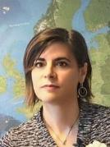
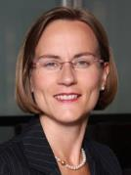
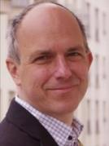
EOSC Partnership
EOSC is a collaborative effort involving a wide range of stakeholders across the scientific community. Its development is driven by the EOSC Co-Programmed Partnership governance.
MoU
Partnership
Board
EOSC ASSOCIATION
European Commission
DG-RTD
DG-CNECT
Anna Panagopoulou
Tripartite Collaboration
President
Karel Luyben
Secretary General
Ute Gunsenheimer
MS/AC collective representation
Member States and Associated Countries
BOARD
General Assembly
(including organisations performing research, funding research, providing services, organisations mandated by MS/AC and other organisations)
EOSC STEERING BOARD
Exchange of information
Volker Beckmann

Slide 4
EOSC-Ireland forum
Co-ordination between EOSC and Ireland stakeholders,
resulting from NTE 2022
EOSC-Association task force updates:
Financial sustainability
Long term data preservation
FAIR metrics and data quality
Contribution to EOSC
Feedback to planning the MAR
Task force deliverable reviewers
Review of EOSC-SB policy documents
Monitoring
Community Inputs
Technical overview of CZ NDI
More to come

Slide 5
National Action Plan to transition towards Open Research
Ireland’s National Action Plan for Open Research: a roadmap for the implementation of open research across Ireland
2022-2030
Structured across 3 themes:
Establishing a culture of open research;
achieving 100% open access to research publications;
enabling FAIR research data and other outputs
See https://norf.ie/national-action-plan/

Slide 6
2022
National Open Access monitoring
2023
Open Access repository assessment and alignment
Open Access transition programme
Open Research training programme
National data stewardship network
Shared data storage service pilot
Incentivising Open Research practices in Ireland
Public Engagement and Open Research
National Research Data Management Framework
Institutional Open Access policies and rights retention
Also: 9 Open research stimulus projects; commissioned work on a national PID roadmap

Slide 7
And next?
We can expect more funded actions to 2030, across the 3 themes:
Establishing a culture of open research;
achieving 100% open access to research publications;
enabling FAIR research data and other outputs
Drawing from https://norf.ie/national-action-plan/
Not yet defined what they will be
Opportunity today to cross-check with EOSC what areas we should prioritise, noting
Strengthen connections to international infrastructures supporting
open research and research data, including the EOSC

Slide 8
Staying tuned and involved EOSC-Ireland forum
Web page:
To join the forum, email
researchengagement@heanet.ie
Please ensure it’s sent from your institute email

Slide 9
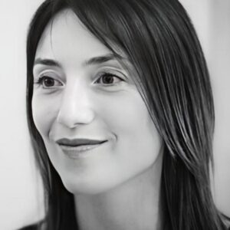
Sara Garavelli works as Strategic European Engagement and Coordination Development Manager at CSC – IT Center for Science in Finland and is the coordinator of the EOSC Finnish Forum, the EOSC national structure supported by the Finnish Ministry of Education and Culture in charge of organising the EOSC activities and engagement at country level.
Sara has more than ten years of experience in the areas of stakeholder engagement, outreach and international collaboration in the research infrastructures landscape. Sara has a degree in Telecommunications engineering and a Masters degree in logistics and organisation for industry and commerce.

Slide 10
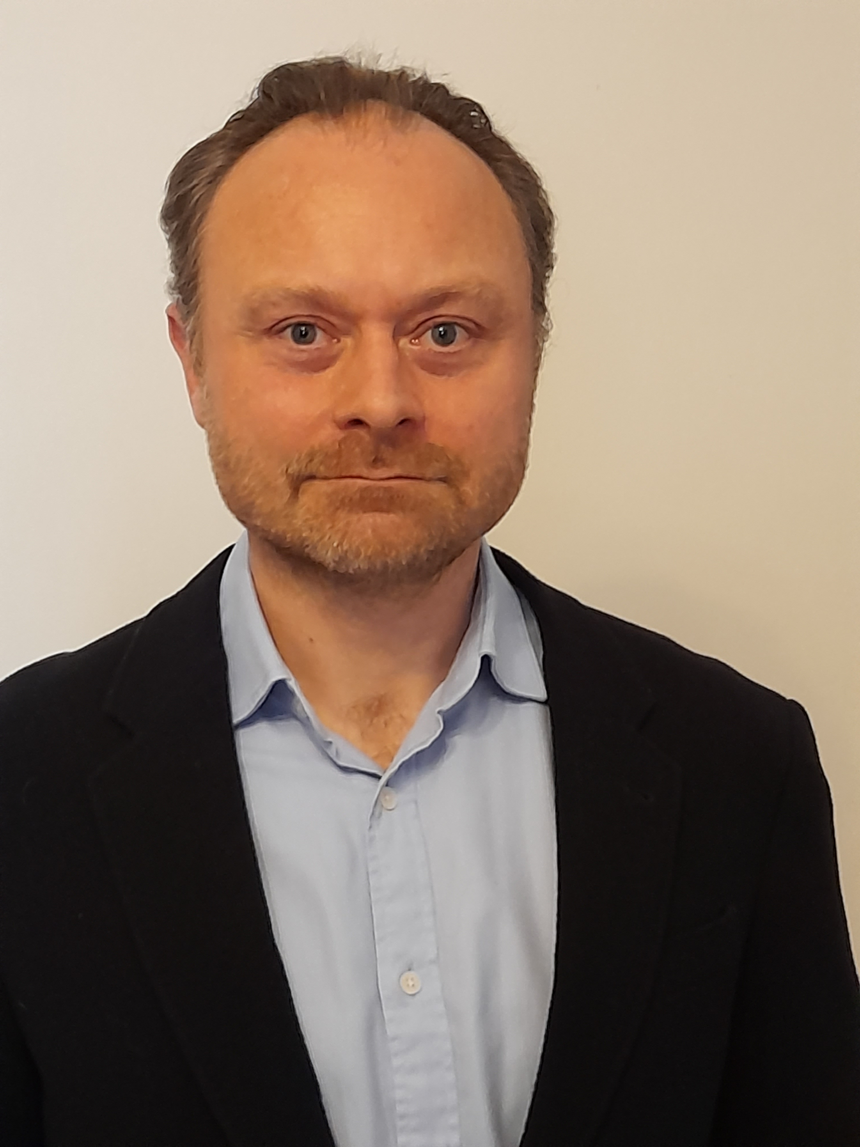
Christopher Burbidge
Background in multidisciplinary academic research, metrological and regulatory environments in the scientific areas of environmental radiation physics and chemistry
Currently developing solutions in iCRAG for improved data analytics and machine learning, data management and processing approaches and capacity for the research centre: methods, policies, infrastructure and resourcing. Pilot user lead for iCRAG and co-chair of the user advisory forum. IRLDAT. NORF 2022 Open Research Fund, Target Action 6.

Slide 11
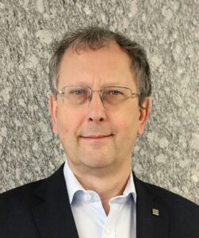
Luděk Matyska is a full professor at Masaryk University (MU) and a senior researcher at CESNET. Since 2022 he has been a director of Institute of Computer Science at Masaryk University, currently serving as a director of the national Centre CERIT-SC, part of ICS MU and one of the three members of the national large research e-infrastructure e-INFRA. Ludek Matyska serves on the Board of directors of e/INFRA CZ, since 2021 he is also chair of the board of the Czech National Infrastructure for Biological Data Elixir CZ, and representative at the Elixir Board.
His primary research interests revolve around the realm of security in large-scale distributed systems, e-infrastructure architecture (network, computing, and data), as well as cloud and grid systems.

Slide 12
Our Panelists
Peter Healy – DFHERIS
Daniel Bangert – NORF
Venkatesh Kannan – ICHEC Technical Director
Kathrin Winkler – European Commission DG Research and Innovation
Sara Garavelli – EOSC Association board member
Christopher Burbidge – iCRAG data infrastructure
Luděk Matyska - Full professor at Masaryk University

