Slide 1
Sensitive Data Management Services for Education and Research
Dec 2023, Jaakko Leinonen, development manager, CSC – IT Center for Science, Finland

Slide 3
CSC – IT Center for Science, Ltd
CSC – IT Center for Science is a company entrusted with special state assignments, owned by the state of Finland and Finnish higher education institutions.
We provide high-quality ICT services to our customers.
CSC is a non-profit state enterprise;
we measure our success by the value we create to our owners.
Our primary customers are the Ministry of Education and culture, and organizations in the field, higher education institutions, research institutes and public administration.
CSC has one of the world’s most eco-efficient data center environments located in Kajaani, Finland.
Notes:
Finnish state owns 70% of CSC and Finnish higher education institutions own 30%. Companies entrusted with special state assignments are companies owned either partly or completely by the state, and in which the state has special interests regarding regulation or official duties; the company on its behalf has an assignment defined by the state. As part of national research system CSC develops, integrates and provides high-quality information technology services and ensures that Finland remains at the forefront of development.
As a non-profit state enterprise with special tasks, the foundation for our existence is to create value for our customers. We catalyze our customers’ success by helping them to compute, preserve, transfer, analyze, and utilize information. Our owners determine the purpose of the enterprise and a majority of our services are aimed at meeting our owners' needs.
Our primary customers are the Ministry of Education and Culture and organizations in the field, higher education institutions (universities and universities of applied sciences), research institutes and public administration. Our owners are able to purchase our services without bidding and we provide services to our owners for no profit. As a non-profit enterprise we do not seek financial profit, and our success is measured in terms of how much value it generates for our owners and customers.
We provide internationally high-quality ICT services for our customers, such as:
Computing and data management services for researchers
Digital learning and education services for education organizations
Common platforms, identity management services and network for public administration and culture.
CSC´s datacenter has operated in Kajaani since 2012. Our data center ecosystem includes Finland’s national computing resources Puhti and Mahti supercomputers and Allas, which is a data management system. In addition, EuroHPC’s, that is, EU’s supercomputing joint undertaking’s LUMI, which is one of the world’s fastest and ecofriendliest supercomputers, is also located in our Kajaani data center. The data center’s carbon footprint is minimized: for instance Kajaani’s geographical location provides excellent conditions for cooling down servers with outdoor air. LUMI’s waste heat is also reused in Kajaani district heating.

Slide 4
CSC’s history
Higher education institutions’ systems were integrated and harmonized in Raketti project
CSC began representing Finland in ELIXIR network
First supercomputer Cray X-MP came to CSC
CSC datacenter was founded in Kajaani
Digivisio 2030 project office was established
Funet network was designed and developed
CSC began to host higher education institutions’ library materials
International collaboration (especially EU) accelerated
CSC’s story begins
1971
1980-
1990-
2000-
2010-
2020-
CSC connected Finland to the Internet in 1988
Scientist’s User Interface was created
Linux was uploaded to a FTP server hosted by CSC
Services for open science and research were born
LUMI supercomputer was inaugurated in Kajaani
Haka identity federation was established
ePouta
First secure processing environment
Sensitive Data Services platform
Notes:
Choose a few highlights from this slide that you believe are interesting to your audience. Below you can find more information about the events presented in the timeline.
1971 – CSC’s operations begin with hosting Univac mainframe computer in Finnish state Computer Centre
1980’s:
Designing Funet (Finnish University and Research Network) began in the beginning of the decade and building started in 1985. Funet includes about 80 research organizations and approximately 370 000 users. More information, if necessary: https://www.csc.fi/en/funet-all-services
1988 CSC connected Finland to the Internet
1989 the first supercomputer Cray X-MP came to Finland. CSC’s strong expertise in supercomputing originates from Cray X-MP
1990’s:
7.9.1991 Linus Torvalds uploaded Linux kernel to Nic.Funet.fi, from where it broadened.
CSC’s role in generalizing open source is significant, and the Linux story is a good example of it.
2000’s:
Raketti project, which was a project for higher education institution aimed to integrate and harmonize higher education institutions and their systems. Raketti project has lead to the use of many common services, such as Oili which is used by students for registering as attending or absent on semesters.
In the beginning of 2000’s, CSC began hosting higher education institutions library materials. This emphasized CSC’s central role on researchers’ path as well, as common host made it possible for researchers to access other institutions’ materials. The hosting lasted almost for 20 years before the higher education institutions took the responsibility for their materials again.
CSC was ensuring the integration of higher education institutions through common identity management. With Haka Identity federation users can login to many different services with one key. Today Haka is used in over 300 services
2007 International (EU) collaboration accelerated when PRACE
2012 PRACE is the starting point for internationally sharing computing resources – to collaborate and trade internationally and investing in other countries (LUMI being one example)
2010’s:
Open science and research services were born in the beginning of 2010’s. Nowadays we talk about Fairdata, which refers to data being findable, accesible, interoperable and reusable.
2012 CSC decided to locate data center and supercomputers in Kajaani. The data center has increased Kajaani’s attractiveness as a city.
Digital preservation services, DPS, were taken into use in the beginning of 2010’s. CSC has had a remarkable role in determining national standards for digital preservation as well as in ensuring the preservation of cultural heritage materials.
In 2015, a state agreement was made regarding ELIXIR network, in which CSC represents the Finnish node. ELIXIR is a European research infrastructure that collects life science resources across Europe, such as databases, software tools, training materials, cloud storage, and supercomputing. More information, if necessary http://www.elixir-europe.org/about-us
2020’s:
European research infrastructure LUMI, built by ten countries and EU, centered around one of the fastest and greenest supercomputer was inaugurated in Kajaani in the Summer of 2022. Finnish and European research organizations can benefit from LUMI’s capacity.

Slide 5
CSC today
OUR PURPOSE
Together we build world-class research, learning, and innovation environments
We catalyse our customers’ success
OUR CAPITAL
THE VALUE WE CREATE
Competent and customer-oriented staff
World-class infrastructure for data management and computing
Comprehensive international collaboration network
Broad network of suppliers
Non-profit, transparent and healthy finances
For our owners and customers
A smooth daily life
Trustworthiness and security
Sharing expertise
Synergy benefits with common platforms
To the society
The digital transformation is advancing
Better cyber security
Enhancing interoperability
Advancing green transition
Notes:
Our capital
Our strength is in extensive collaboration, and sharing knowledge and competence
CSC has widespread networks both nationally and internationally
Collaboration networks are important part of our operations and help us build world-class environments for research, learning and innovation.
For instance, the project office for Digivisio2030, which is a project of 38 Finnish higher education institutions, is located at CSC.
We enable research and education
CSC provides a national digital working environment for research, education and culture heritage
For instance FUNET network – Finnish university and research network – guarantees higher education institutions and public research organizations high bandwidth and trustworthy networks connecting them to each other, international research networks and to the commercial Internet.
We are collaborating in joint European ecosystems, such as LUMI and DL2021 that provide plenty of computing resources to national and international researchers.
Our Purpose
Our vision is: Together we build world-class environments for research, learning and innovation. We are going towards this goal together with our owners, customers and partners.
We provide solutions for creating a future with
Customer orientation and dialogue
Expertise
Openness and transparency
Trustworthiness and security
Increasing interoperability
Responsibility
Technology foresighting
The value we create
FUNET network had 390 000 users in 2021
5802 data managtement and computing services users
Several interoperability solutions, such as digital preservation services and Fairdata (information is findable, accessible, interoperable and reusable) services
Digital preservation services, DPS, secure cultural heritage and research materials.
We for instance make sharing online learning materials via the Library of Open Educational Resources
Haka works as a pathway to 300 services, and there were 65,7 million logins in 2021
Services produced by international networks where CSC is included, such as ELIXIR, EUDAT and EOSC.
We are advancing digital transformation by, for instance, developing new technologies and ways of working with artificial intelligence and quantum computing
We are advancing green transition with, for instance, energy efficient datacenter and carbon neutral server rooms, and the waste heat produced in the server rooms is collected and reused for district heating in Kajaani
*The content for this slide is from CSC’s value creating model that can be found from our corporate social responsibility page: https://www.csc.fi/en/corporate-social-responsibility. We encourage you to use the page in your own search for information, and you can also suggest the audience to find more information there. In this slide’s notes we have chosen some highlights that describe CSC well and helps in giving more in-depth information for diverse audiences. Fit the highlights you make in your presentation to your audience and think what they could think as interesting.

Slide 6
Glossary
LUMI (531,5 Pflops), Mahti (9,5 Pflops), Puhti (1,8 Pflops)
Supercomputers designed for massively parallel jobs that require large floating point performance and a capable interconnect.
cPouta, ePouta, Rahti
Cloud computing services allowing users to access, use and manage virtualized infrastructure using a self-service model. Based on the open source cloud software called OpenStack (cPouta, ePouta) and OpenShift (Rahti).
Allas
A general-purpose data storage service for storing and sharing data. Based on CEPH object storage technology.

Slide 7
ePouta — a virtual private cloud service
ePouta IaaS cloud service allows you to deploy virtual machines and storage resources directly to your organisation’s internal network, not to the internet.
ePouta provides:
high performance computing with superior flexibility and user experience via Infrastructure-as-a-Service;
full control over the resources you deploy (virtual machines, storage, and networks); and
a variety of resources: virtual machines, block devices, virtual networks, high performance computing and GPUs, and so on.
Notes:
TL IV — NATO RESTRICTED — EU RESTRICTED

Slide 8
ePouta architecture
The ePouta service combines virtual computational resources with the users’ own resources using a Virtual Private Network solution.
As the virtual machines are directly connected to the user’s network, any external network access by the virtual machines is in the hands of the user.

Slide 9
Benefits and disadvantages of using ePouta
Pros | Cons
Allows easy scaling of compute and storage resources for organisations. | Requires a dedicated OPN/MPLS network connection.
Combines virtual computational resources seamlessly with the organisations’ own resources. | A lot of IT skills are needed to set up and maintain the resources.
Full control of the allocated resources. | Everything needed for work must be build up from scratch.
Local IT support. | Local IT support.

Slide 10
Sensitive Data (SD) services
SD services have simple to use web-interfaces which provide a secure workspace and facilitate sensitive data management. They are comprised of:
SD Connect — store and share
SD Desktop — compute
SD Submit and Federated EGA — publish under controlled access
SD Apply — apply for reuse.
The services are available on-demand and accessible from the internet. They are designed to support collaborative work.
The services are built on existing infrastructure, ePouta and Allas.

Slide 11
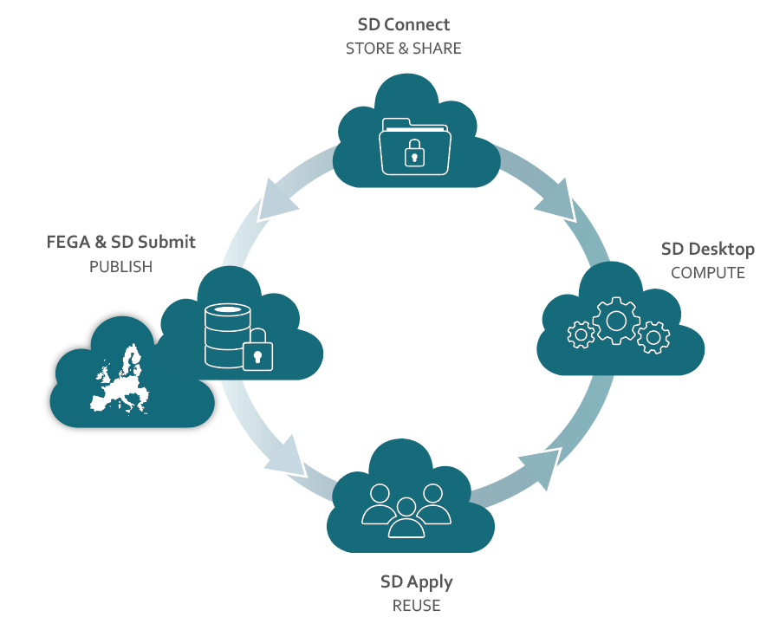
SD services support full research life cycle
During active research phase SD Connect is used for data collection, storage, and sharing, and SD Desktop for analysis.
At the end of the research datasets can be published for publication purposes, or for reuse.
Other researchers may apply for access to published datasets.

Slide 12
Comparison of ePouta and SD Services
ePouta | SD Services
Used for sensitive data analysis and storage. | Used for sensitive data analysis, storage, sharing, publication, and reuse under controller access.
Needs to be built as part of your organization's infrastructure with the help of your IT unit. | Available via MyCSC self-support portal on demand.
Accessible only from the internal network of your organization. | Accessible from the public internet.
Requires extensive IT admin skills. | No technical skills required.
Software and computing capacity are fully customisable. | Software maintained by CSC, supports containerised software.

Slide 13
General design principles for Sensitive Data Services
Promote collaboration within the project, prevent information leakage out of it.​
All project members should have equal access to data.​
Use project manager privileges sparingly.​
Trust the users but make sure they are accountable for their actions.​
All data transfers need to be logged.​
Trust the user to do the right thing – it should also be the most obvious thing.​
Best UI is where user action is not needed.​
Do not reinvent a wheel.

Slide 14
Application Architecture for SD Services
Services
Customer support & service management
SD Connect
SD Desktop
SD Submit
SD Apply
Managed platform
Remote access gateway
Encryption and decryption engine
Secrets management
Authentication proxy
Container platform
Infrastructure services
ePouta
Allas
HPC
IdM
Networks

Slide 15
Lessons learned
Development is expensive!
Whatever features you implement, there’s always a need for something new.
Whatever feature you think you don’t need, you’ll need it anyway.
Operation is also expensive!
Whatever resources you have, there are not enough of them, and utilising existing infrastructure is the key for scaling.
Standards and open source are your best friends!
Whatever you end up building will need to interact and communicate with the outside world — research is international.
Also helps preventing vendor lock-ins.

Slide 16
For information on SD Services:
https://research.csc.fi/sensitive-data

