Slide 1
A Secure Data Infrastructure that Supports Data Visiting
Martin Weise, Andreas Rauber
Research Unit Data Science - Insights for Society
^{TU Wien}
^{Vienna, Austria}
{martin.weise , andreas.rauber}@tuwien.ac.at
^{http://ds-ifs.tuwien.ac.at}
This project is supported by the European Union’s H2020 programme by the EOSC-Secretariat project under the Co-Creation programme (grant agreement number 831644) and by EOSC-Life (grant agreement number 824087) in cooperation with the Austrian COVID-19 Future Operations Platform.

Slide 2
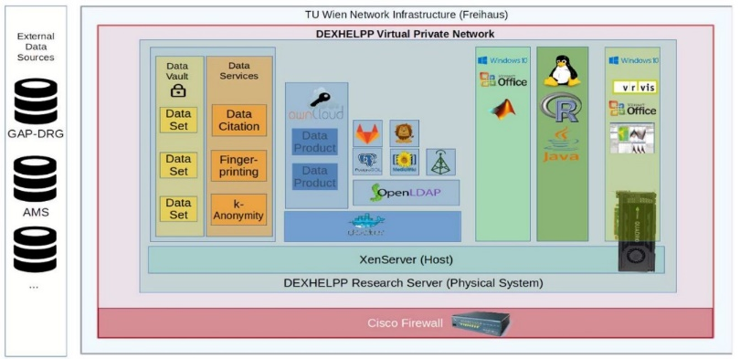
Secure Research Environments
The birth of OSSDIP
Request to set-up ad-hoc SRE during COVID Pandemic
Primarily for commercially sensitive data
Set-up and operational within 2 weeks
Based on experience from operating the DEXHELPP infrastructure for medical data (http://www.dexhelpp.at) at TU Wien for more than 10 years
Limited tasks, ad-hoc
Still complex trust and legal issues
Wanted to enable others to operate such an infrastructure
Wanted to make sure we follow best practices
Understand the risk-security-flexibility trade-off
Understand the processes, roles, components, configurations
DEXHELPP Infrastructure

Slide 3
Secure Research Environments
Secure Research Environments (SRE)
Many SREs exist
Large variance in size (data, compute, users, ...)
Quite similar set-up, principles
Very similar services, processes, slightly varying by domain
Little to no (public) documentation about set-up, operations
Little guidance on what to do, what to avoid and why, risks, ...
Hard to explore details: configurations, processes, ...
--> needed a blue-print / reference set-up to explore and demonstrate

Slide 4
Secure Research Environments
Goals: find out how to...
... enable institutions / SMEs to (quickly) set-up a basic TRE environment, self-hosted or trusting us / a third party?
... design the processes for data ingest, project approval, ...?
... organize roles to ensure we can provide evidence that nobody would be able to unduely access data unnoticed?
decide the balance between security and flexibility?
... decide which controls to integrate on-demand, and their impact on the research (pseudonymization, anonymization, fingerprinting, differential privacy, data shielding, homomorphic encryption*, ...)
... set up support for federated learning?
... test attacks (steganographic QR codes, ML models storing data)
... sanitize DNN models to avoid data egress?

Slide 5
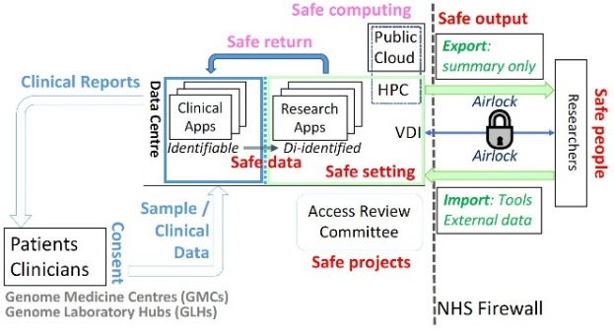
OSSDIP
OSSDIP: Open Source Secure Data Infrastructure and Processes
"Reference implementation" of a TRE
Incorporating experience from DEXHELPP
Following the 5-Saves Model
Based entirely on open source software
Possibility of a fully virtualized set-up on a single machine (not for operations, obviously!)
Allowing to explore processes, technical configurations, trade-off between control and flexibility for analysts, ...
Key risk: not a brute-force attack or stealing, but sloppy researchers

Slide 6
OSSDIP
OSSDIP: Open Source Secure Data Infrastructure and Processes
Allow analysts to work directly with micro-data
Data owners provide access to specific subsets of data
Analysts visiting authorized subsets of data in SRE
Preventing any unauthorized data export by analysts
Extensive monitoring / logging
Data server completely air-gapped
Supporting research (transparency, citeability, FAIRness*)
Allowing to explore processes, technical configurations, controls, trade-off between control and flexibility for analysts, ...

Slide 7
Data node
Air-Gap
Temporal tables (versioning / reproducibility)
Query store (citeability)
(Recommendations of the RDA WGDC)
to be "replaced" by DBRepo
Data Node
default config:
Remaining infrastructure
is air-gapped from data
Data Monitoring Node
"The only system which is truly secure is one which is switched off and unplugged locked in a titanium lined safe, buried in a concrete bunker, and is surrounded by nerve gas and very highly paid armed guards. Even then, I wouldn't stake my life on it." (Gene Spafford, Director, Computer Operations, Audit, and Security Technology (COAST) Project, Purdue University)

Slide 8
Proposed Solution
OSSDIP: Open Source Secure Data Infrastructure and Processes
Individual analysis request
Research question and specific subset of data requested
Approval by Data Owner
Legal agreements (processing, monitoring, ...)
Extensive monitoring (logging, video stream)
Data extract on dedicated Analyst-VM with requested (and approved) software
Optional anonymization, data fingerprinting, ...
Access only via Remote Desktop-VM (media break transmitting only pixels)
Encryption via VPN, network segmentation
Result export only via dedicated process

Slide 9
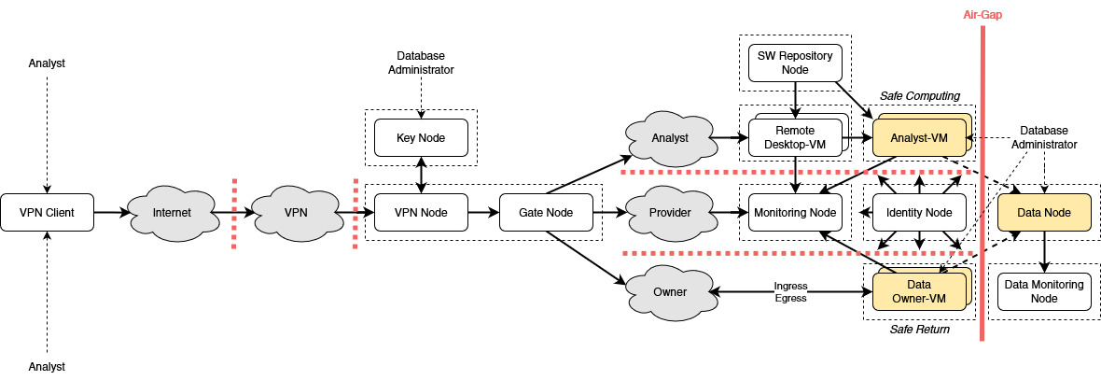
Technical Architecture
if SRE Operator ≠ Data Owner
Weise, M., Kovacevic, F., Popper, N., & Rauber, A. (2022). OSSDIP: Open Source Secure Data Infrastructure and Processes Supporting Data Visiting. Data Science Journal, 21(1), 4. DOI: 10.5334/dsj-2022-004

Slide 10
Security Controls
Control | Goal
Roles and controlled access | Physical security
Data segmentation | Stream isolation per role
Network segmentation | Network security
Automation | Secure configuration
Monitoring | Detection

Slide 11
Security Controls Implementation
Roles and controlled access
Dedicated server room
Locked racks (designated, certified operator has access)
Four-eye principle (room access via keycard of another operator)
Bare-minimum privileges per role on need-to-know basis
Limitation on number of roles
Two-factor authentication (Google Authenticator)
Data segmentation
Strongly restricted, isolated virtual machines (libvirt)
Query store for subset citation, e.g. via DOI (DBRepo)
One-way communication (safe data, safe return)
(under evaluation:) run Data Node based on DBRepo (database repository environment) https://www.ifs.tuwien.ac.at/infrastructures/dbrepo
Optional:
Data fingerprinting*
Anonymization*

Slide 12
Security Controls Implementation
Network segmentation
Subnets for nodes that hold restricted data (iptables)
Firewall network segmentation (firewalld)
Dedicated VPN node (OpenVPN Access)
Identity management (FreeIPA)
No direct SSH access to Analyst-VM
Media-break between Remote Desktop-VM and Analyst-VM (TigerVNC)
Automation
Playbooks for infrastructure configuration (Ansible)
Encryption key roll-over
Creation and (safe*) destruction of temporary VMs

Slide 13
Security Controls Implementation
Monitoring
Contractual agreements for extensive monitoring
Append-only logging node (filesystem, rsyslog)
Shell logging
Remote desktop video stream monitoring (vncproxy)
Dedicated Data Monitoring Node for the Data Node (libvirt)
Inspect possibility by the Data Owner via live-stream or video recordings*

Slide 14
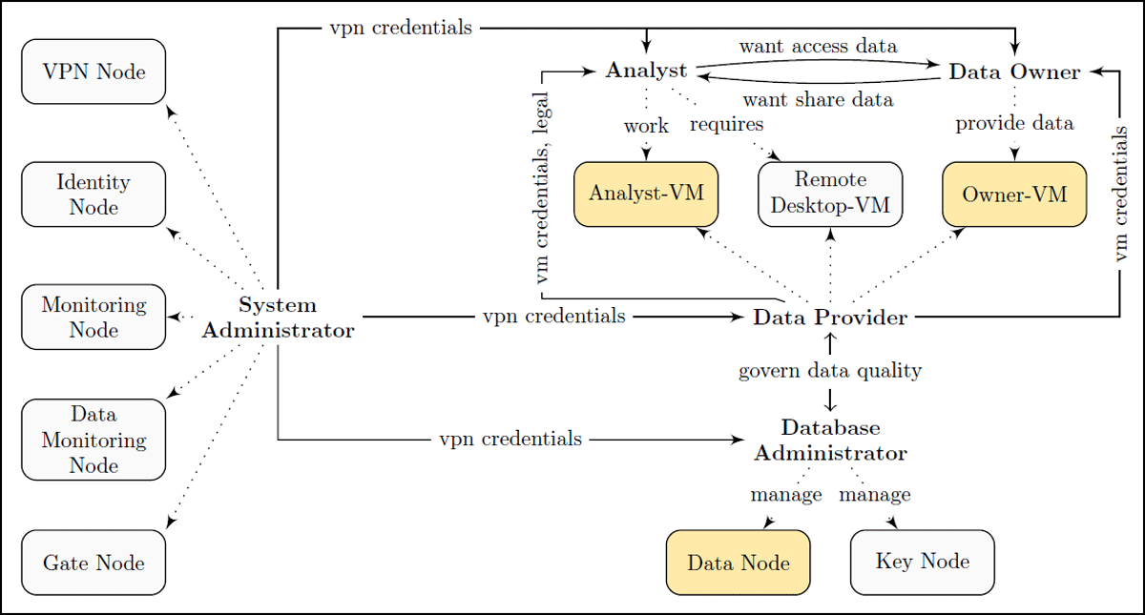
Social Architecture
Repository Node
Weise, M., Kovacevic, F., Popper, N., & Rauber, A. (2022). OSSDIP: Open Source Secure Data Infrastructure and Processes Supporting Data Visiting. Data Science Journal, 21(1), 4. DOI: 10.5334/dsj-2022-004

Slide 15
Sandbox deployment for testing
Everything can be virtualized for test / evaluation set-ups

Slide 16
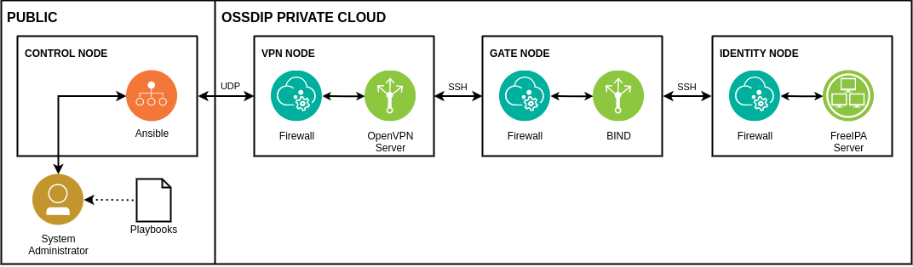
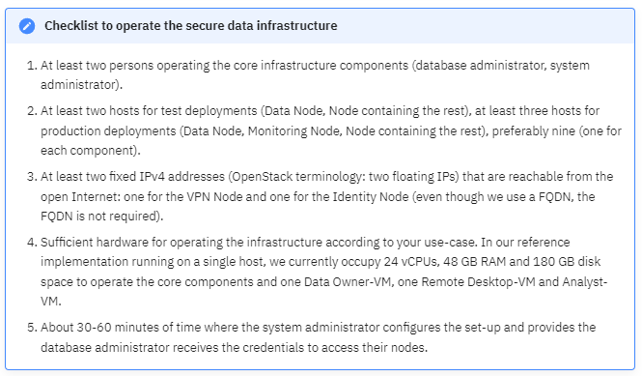
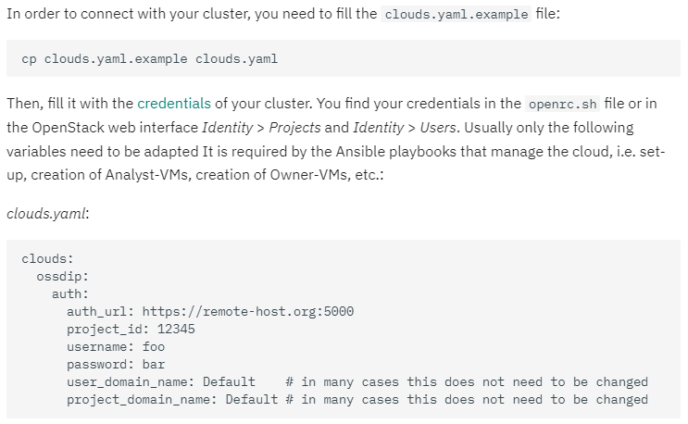
Installation
Checklist before installation
Guided set-up
No domain name needed
Getting Started. [Online] URL: https://www.ifs.tuwien.ac.at/infrastructures/ossdip/getting-started/, accessed 2023-12-06

Slide 17
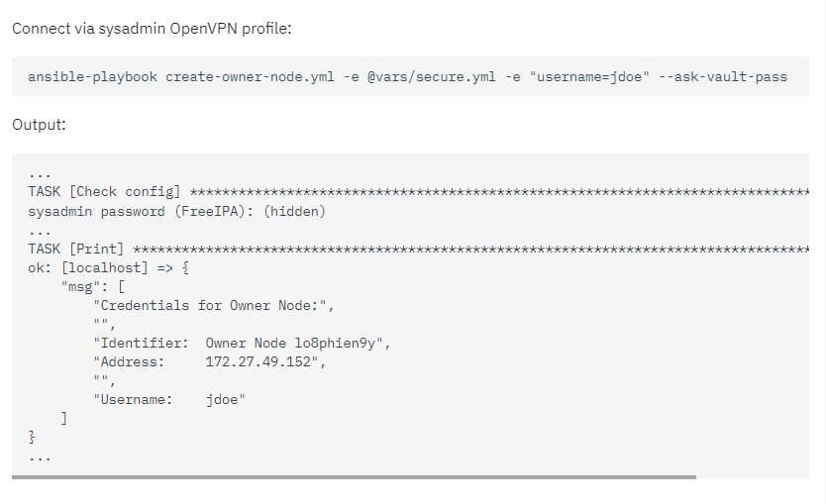
Data Ingest
Sysadmin creates temporary VM for Data Owner
Data Owner deposits confidential data
DBAdmin moves the confidential data to the Data Node
Temporary VM is securely destroyed
Operation. [Online] URL: https://www.ifs.tuwien.ac.at/infrastructures/ossdip/operation/, accessed 2023-12-06

Slide 18
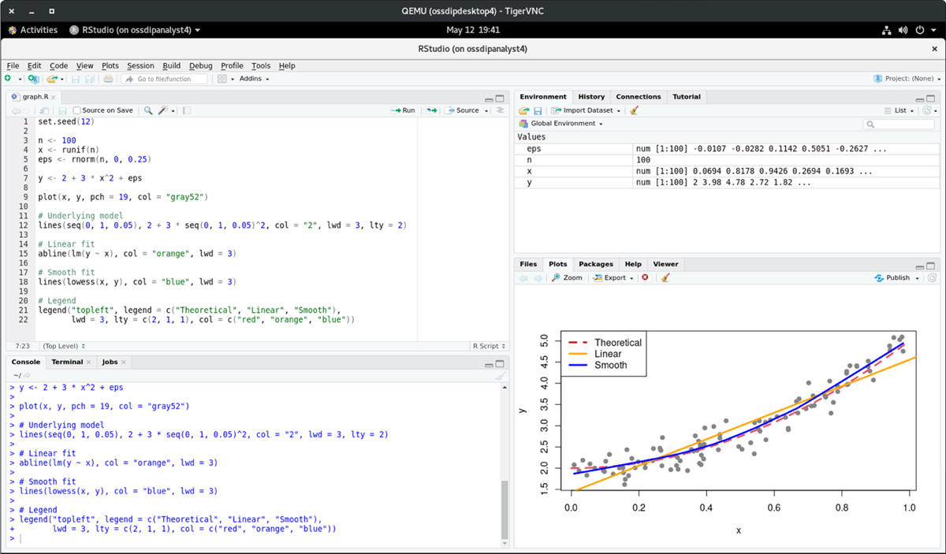
Data Access

Slide 19
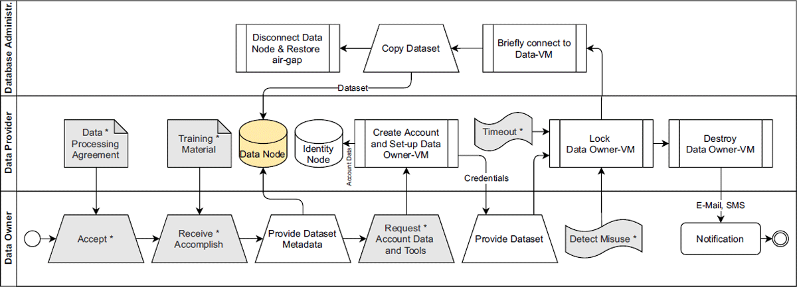
Secure Data Processes
Ingesting data into the infrastructure
(grey boxes: when Data Owner ≠ Data Provider / SRE Operator)
Weise, M., Kovacevic, F., Popper, N., & Rauber, A. (2022). OSSDIP: Open Source Secure Data Infrastructure and Processes Supporting Data Visiting. Data Science Journal, 21(1), 4. DOI: 10.5334/dsj-2022-004

Slide 20
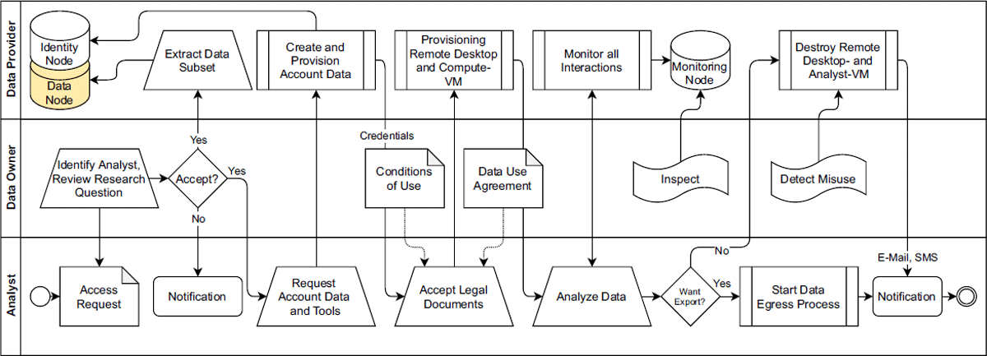
Secure Data Processes
Accessing data remotely
*
Weise, M., Kovacevic, F., Popper, N., & Rauber, A. (2022). OSSDIP: Open Source Secure Data Infrastructure and Processes Supporting Data Visiting. Data Science Journal, 21(1), 4. DOI: 10.5334/dsj-2022-004

Slide 21
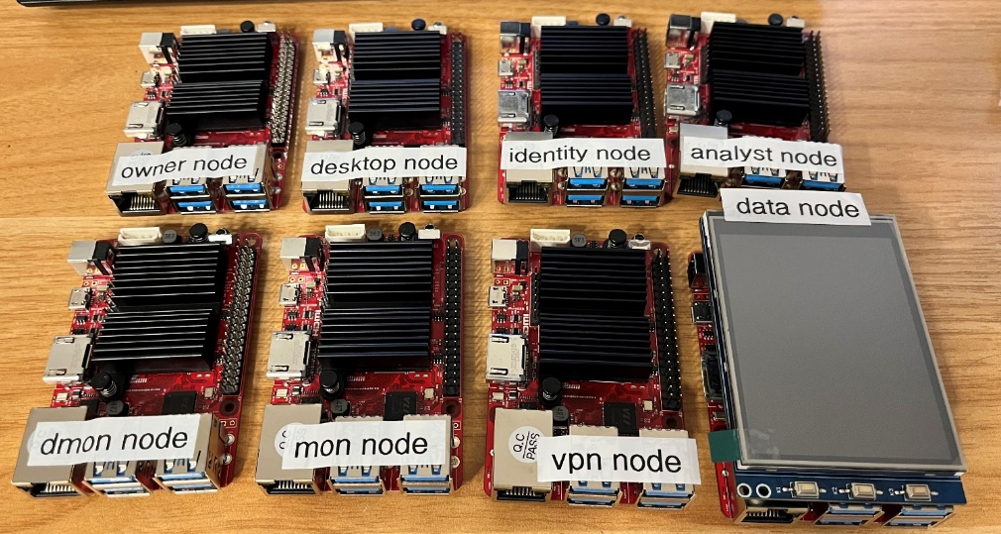
Future Work
Technical Blueprint
Devise a community-agreed technical blueprint with building blocks and adaptable infrastructure components
Best practice processes for anyone to set-up a SRE
Reference Implementation
Deployment on a Raspberry Pi cluster, showcasing the air gap and data management for training purposes

Slide 22
Technical requirements
Test instance quota
26vCPU
48GB RAM
180GB storage space
Network range 172.27.48.0/22 must be free

Slide 23
OSSDIP = Open Source
OS: Rocky Linux
Platform: OpenStack, libvirt
Networking: OpenVPN Access, iptables, firewalld
Identity: FreeIPA
Tools: Ansible, bash
Databases: MariaDB, PostgreSQL (for Keycloak)
Logging: rsyslog, vncproxy
Desktop: GNOME, TigerVNC
Analysis/Reporting: RStudio, KNIME, Python3 (pandas), Java, Perl, MariaDB, LibreOffice suite, LaTeX, Gimp, ...

Slide 24
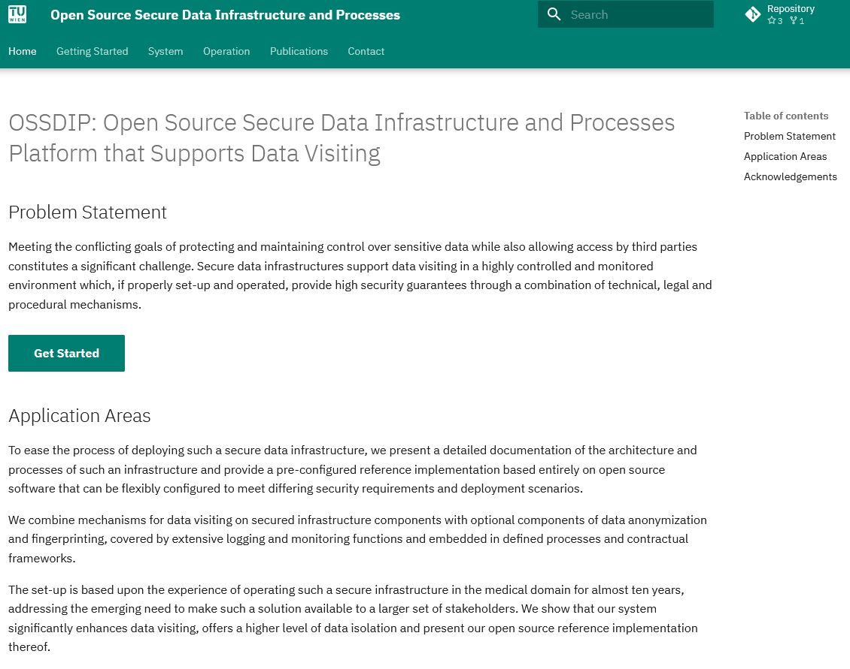
Links
Project website: https://www.ifs.tuwien.ac.at/infrastructures/ossdip

Slide 25
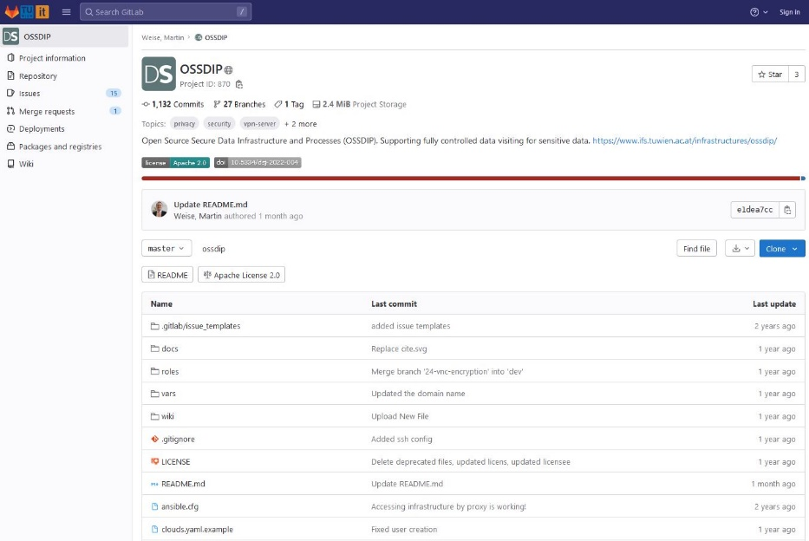
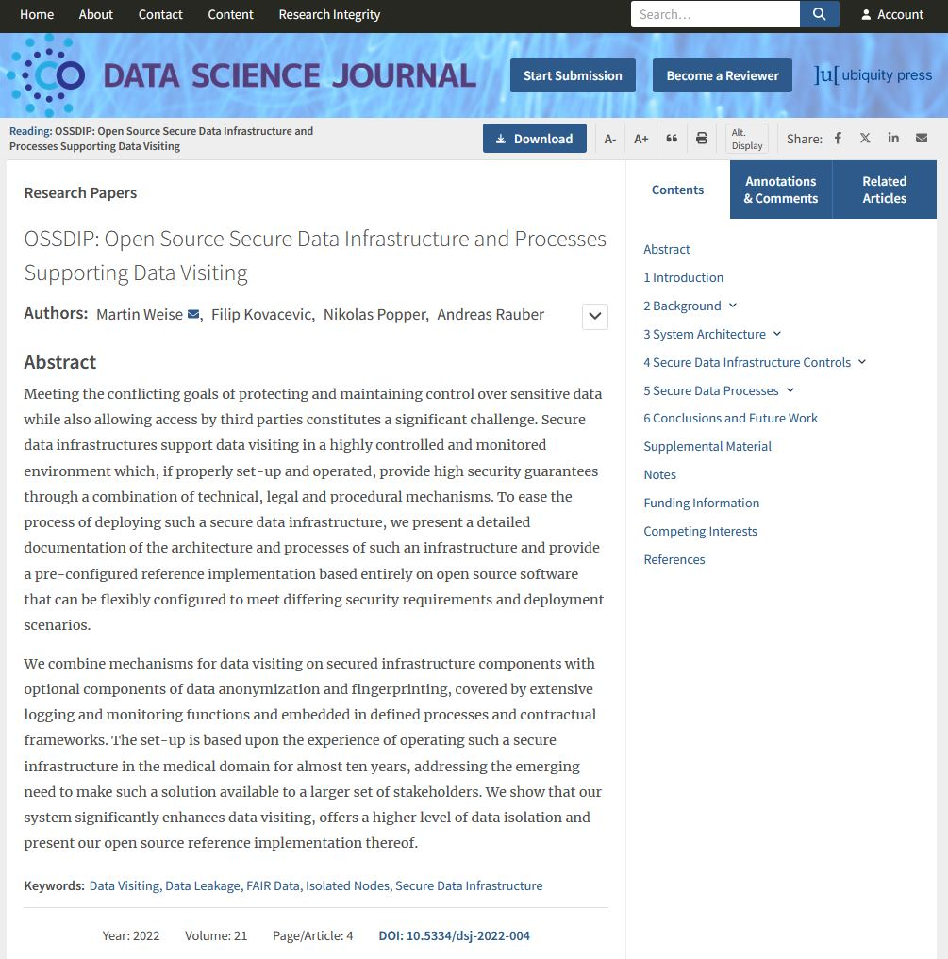
Links
Source code: https://gitlab.tuwien.ac.at/martin.weise/ossdip
Paper:
https://doi.org/10.5334/dsj-2022-004

Slide 26
RDA WG
Trusted / Secure Research Environments for Sensitive / Confidential Data: FAIRness for "Closed" Data and Processes
Two BOF sessions in Gothenberg and Salzburg
Preparing to submit Case Statement
Planned WG activities:
P1: Blueprint (Martin Weise)
P2. Interoperability between TREs (Rob Baxter, Lucas van der Meer)
P3: Risk Management (Ville Tenhunen)
P4: FAIR for Sensitive/Confidential Data (???)
Draft Charter: https://docs.google.com/document/d/1877OtQyZ46QCHVZ8_1QqRgZJPXyImZdW1qYVyKItMSQ
If interested: sign up and join!

Slide 27
Andreas Rauber, Martin Weise
Technische Universität Wien, Austria {andreas.rauber, martin.weise}@tuwien.ac.at
https://www.ifs.tuwien.ac.at/infrastructures/ossdip/ — website
https://gitlab.tuwien.ac.at/martin.weise/ossdip — source code
https://doi.org/10.5334/dsj-2022-004 — paper
https://docs.google.com/document/d/1877OtQyZ46QCHVZ8_1QqRgZJPXyImZdW1qYVyKItMSQ - RDA WG Draft Charter
This project is supported by the European Union’s H2020 programme by the EOSC-Secretariat project under the Co-Creation programme (grant agreement number 831644) and by EOSC-Life (grant agreement number 824087) in cooperation with the Austrian COVID-19 Future Operations Platform.
27

