Slide 1
Oracle and HEAnet
Workshop on services for handling sensitive data
Ronan Kelly
Strategic Cloud Account Manager
Keith Eccles
Account Cloud Engineer
Quentin Jansen
Autonomous Domain Specialist
V1.46, 04-DEC-2023

Slide 2


Discovering new pharmaceuticals
Processing insurance claims after disasters
Simulating crash performance for new cars
Keeping hotel customers safe during stays
Exchanging currencies for foreign trade
Ensuring the electric grid is reliable
Improving diagnosis and resolution of illness
Protecting critical communications networks
Reworking restaurant operations to adapt to change
Increasing the speed and lowering the costs of construction
Adapting to supply chain volatility to keep up with demand
Detecting money laundering and reducing business risk
Supporting citizens through crisis
Making purchases available at curbside
44+ years of helping customers manage
the world’s most important data
Notes:
If you think about all of the really important things that must happen to keep economies running:
[PICK 3-5 TO MENTION BASED ON YOUR AUDIENCE]
Discovering new pharmaceuticals
Processing insurance claims after disasters
Simulating crash performance for new cars
Keeping hotel customers safe during stays
Exchanging currencies for foreign trade
Ensuring the electric grid is reliable
Improve diagnosis and resolution of illness
Making purchases available at curbside
Supporting citizens through crisis
Many of these things—things for which you must always trust that they perform reliably and stay secure—are running on Oracle technologies, in many cases for decades. We’ve been helping our customers solve hard problems like these for more than 44 years.

Slide 3
OCI

Slide 4










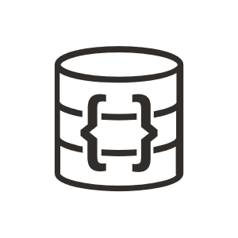

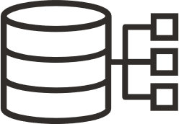

OCI has all the services you need to build, run, and scale
Infrastructure, platform, and SaaS in one cloud
Oracle Applications
Industry | ERP | EPM | SCM | HCM | ACX
Custom Applications
Polyglot | Traditional | Cloud Native
ISV Applications
Hundreds to choose from
100+
platform services
to support your workloads
Developer
Services
Containers and
Functions
Integration
Analytics and BI
Machine Learning
and AI
Data Lake
10,000
OCI developers
Compute
Storage
Networking
Oracle
Databases
Open Source
Databases
Operating Systems,
Native VMware
3,000
field cloud engineers
Security | Observability | Compliance | Messaging | Governance
OCI’s Distributed Cloud
Public Cloud | Hybrid Cloud: Cloud@Customer | Dedicated Cloud | Multicloud: Azure, AWS

Slide 5
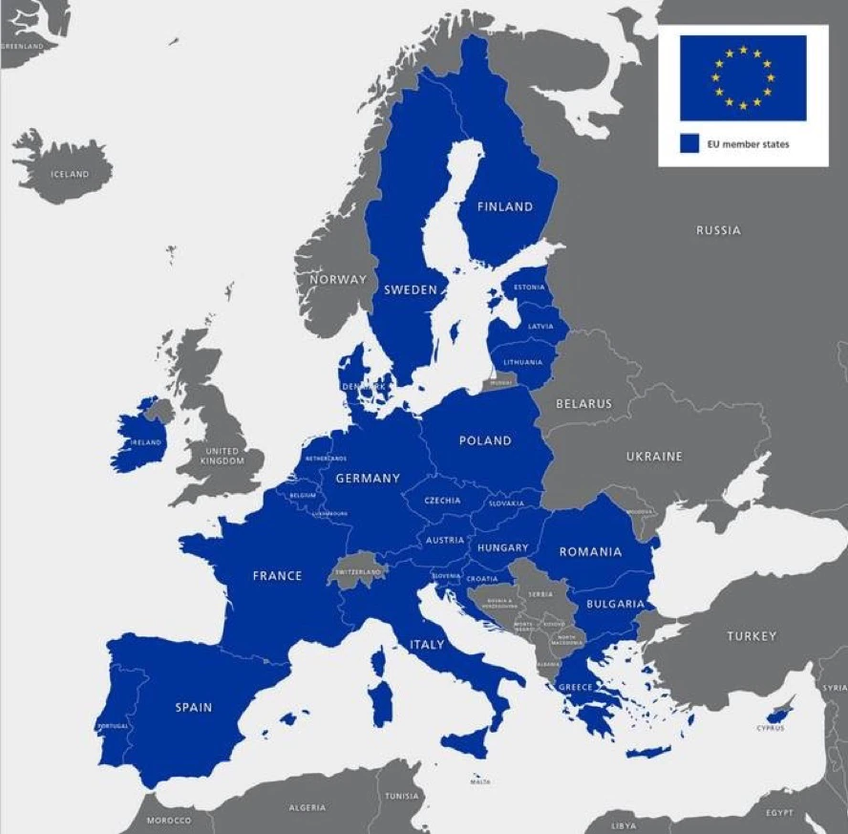


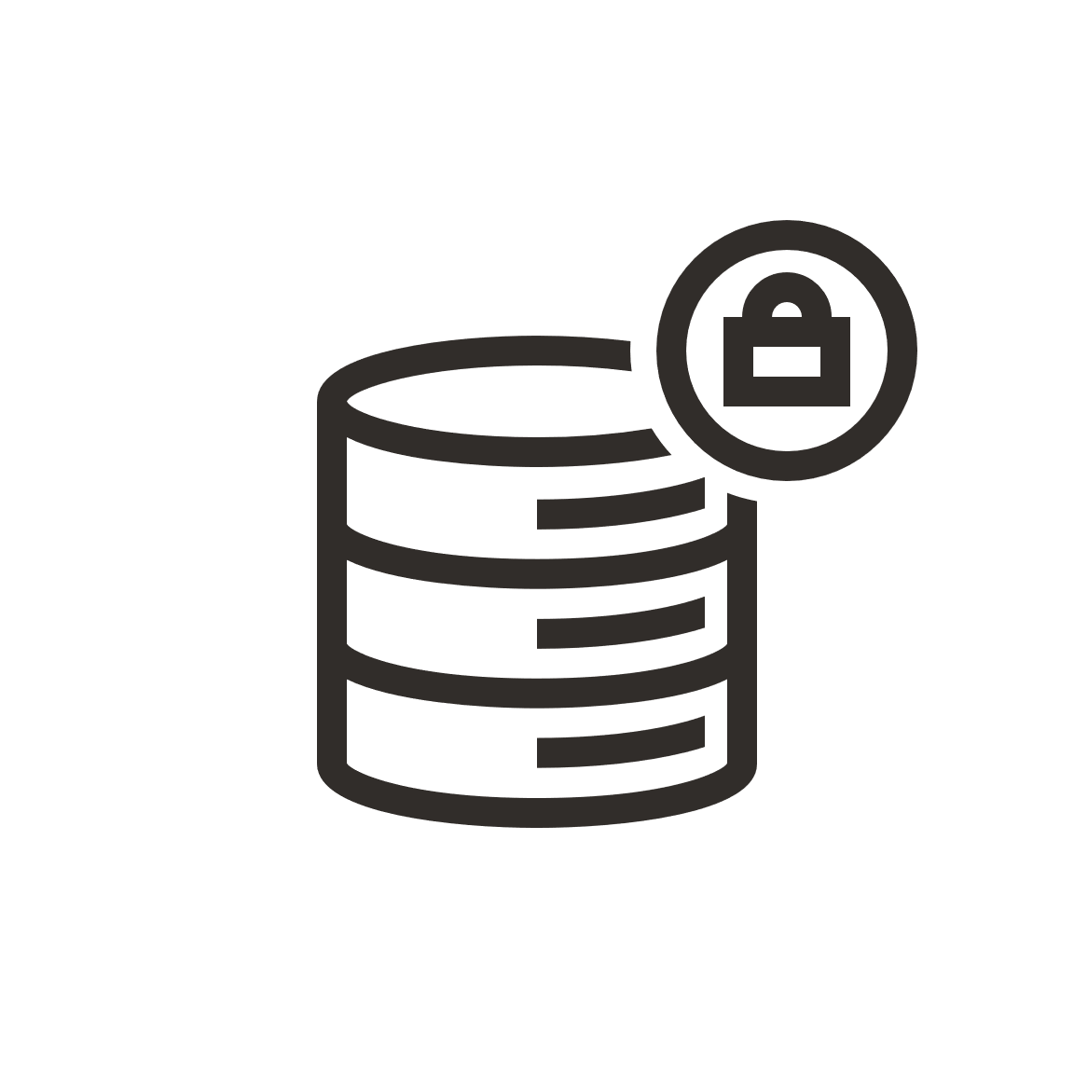








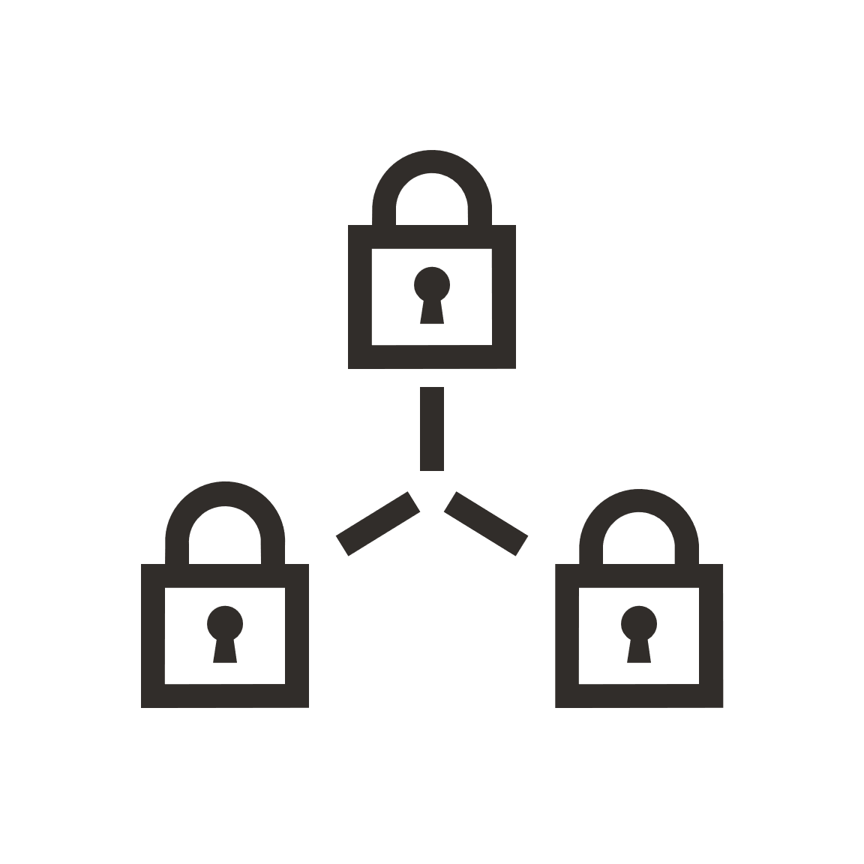
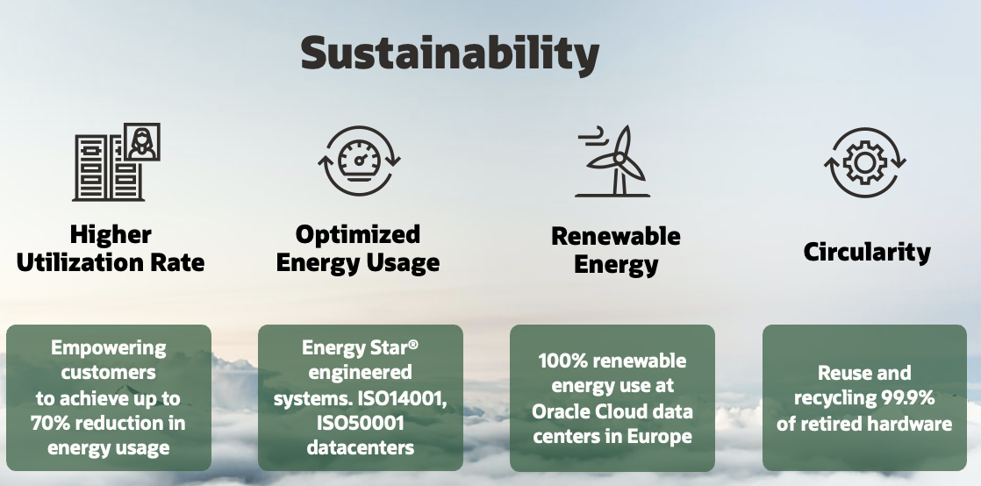

EU sovereignty capabilities
Regulations are guiding sovereignty requirements
Access restrictions
Tenancies may be limited to a specific company, geography, or organization.
EU Sovereign
Frankfurt
Madrid
UK
London
Newport
EU
Amsterdam
Frankfurt
Madrid
Marseille
Milan
Paris
Stockholm
Choice of location
Customers control the location where their data is hosted—helping to address data residency requirements.
UK Government
UK Gov South UK Gov West
Regulatory requirements
Oracle has established special legal entities along with contractual and operational business practices to meet sovereignty needs.
Operations and support
Oracle can restrict operations and support based on additional security clearance, citizenship, or residency requirements.
Serbia
Jovanovac
Dedicated network connectivity
Air-gapped regions provide complete isolation from the internet, allowing customers to meet their security requirements.
Switzerland
Zurich
5
Encryption
Customers can bring a key from their own key management infrastructure to Oracle and use it with any integrated OCI services or from within their own applications.
Copyright © 2023, Oracle and/or its affiliates

Slide 6












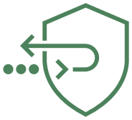


















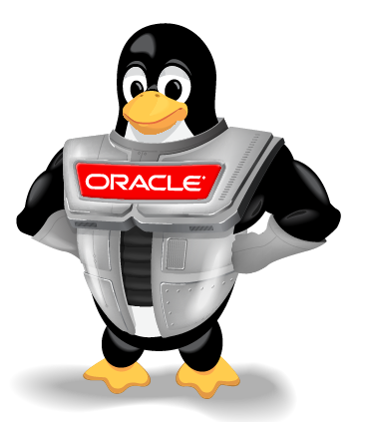


Oracle offers a full stack of cybersecurity capabilities
Prevent
Monitor
Mitigate
Protect
Encrypt
Access
Block attacks and
malicious traffic
Log, analyze, and
audit activity
Isolate communications with secure and reliable networks
Hardware-enabled security built into the architecture
Encrypt and protect all data
Ensure authentication, authorization, and accounting
Cloud Guard
Security posture management
Virtual Cloud Network
Secure, isolated network
Bare Metal Servers
Servers with full customer control
Confidential computing
Encrypt VMs in motion
Security Zones
Security policy compliance
Security Lists
Virtual network firewall rules
Hardware
Root of Trust
Protect from firmware attacks
Threat Intelligence
Multi-source, actionable guidance
Network Firewall
Advanced firewall service
Data Safe
Monitor data usage in database
Access Governance
Proactive guidance for user actions
Signed Firmware
Prevent rootkit installation
Distributed Denial of Service protection
Automatic DDoS protection
Threat Detector
Monitor for known threats
Bastion
Time-limited SSH access
Vault
Hardware security module protection
OCI Identity and Access Management
Control access to cloud resources
Hardened Disk Images
OS with expert security settings
Web Application Firewall
Internet-facing endpoint protection
Logging
Single pane for service logs
Dynamic Routing Gateway
Virtual router
Key Management
Encryption key administration
Policies
User access rules
Off-box
Control Plane
Isolated admin of compute hardware
Fusion Apps Detector
Monitor ERP and HCM apps
Fast Connect
Dedicated, high-speed connection
Secrets Management
Credential and similar administration
Federation
Identity provider inter-operation
Off-box Network Virtualization
Encapsulated, separated traffic
Vulnerability Scanning
Patch and port monitoring
Virtual Private Network
Secure connectivity over any network
Certificates
Validation certificate administration
Oracle Linux &
Oracle Enterprise Linux
Performant, secure, enterprise Linux
Auditing
OCI API logging
NAT Gateway
Protected access to the internet
INTERNET & EDGE
MONITORING & PREVENTION
NETWORK
COMPUTE
STORAGE & DATABASE
IDENTITY & OPERATOR ACCESS

Slide 7



















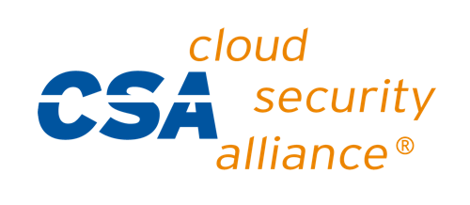

OCI compliance programs in EMEA
Expansive list of independent assessments across industries and regions
GDPR
EU
ENS
Spain
HDS
France
DESC
UAE
ESMA
EU
NCSC
UK
BSI C5
Germany
PASF
UK
EU CoC
EU
NHS DSPT
UK
CST
Saudi Arabia
EBA
EU
POPIA
South Africa
TISAX
Germany
ADISS
UAE
G-Cloud 13
UK
FINMA
Switzerland
SAMA
Saudi Arabia
Global
SOC 1 : SOC 2 : SOC 3
9001 : 27001 : 27017 :
27018 : 27701 : 20000-1
Level 2
Level 1
GxP

Slide 8
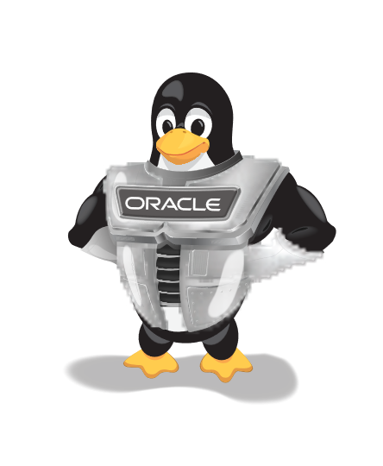
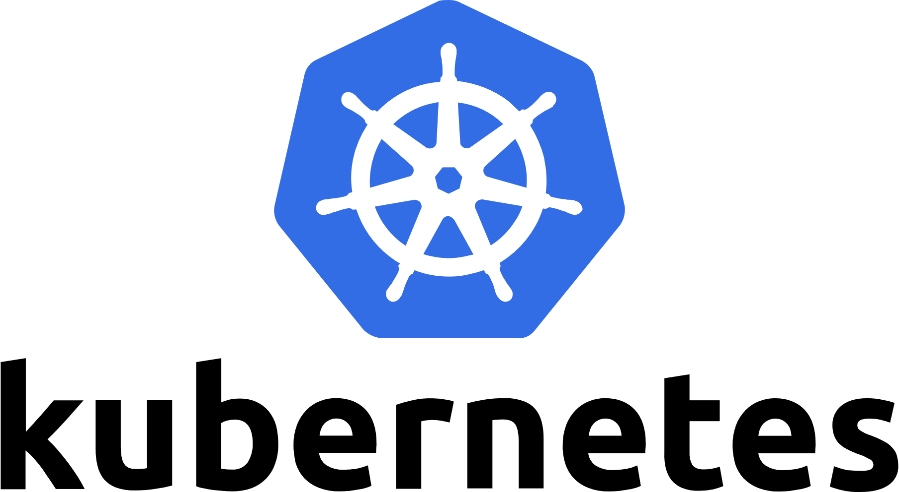
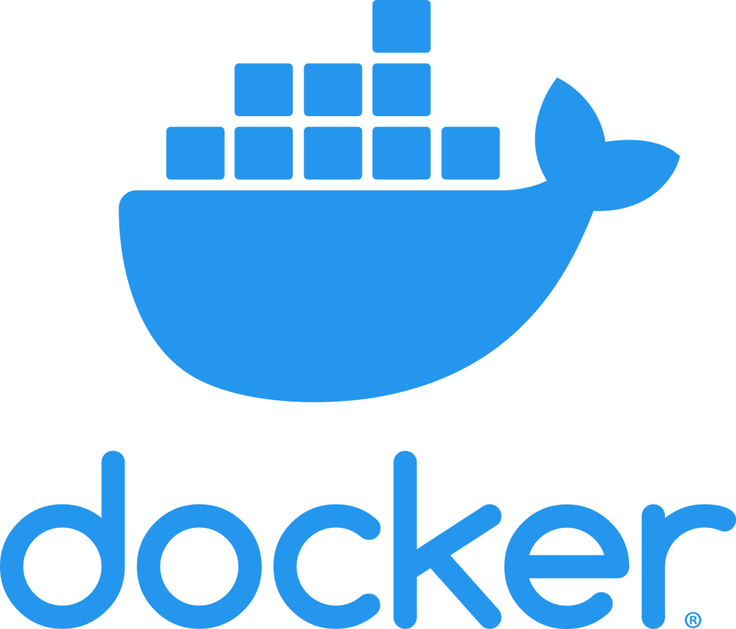





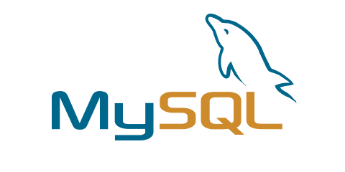

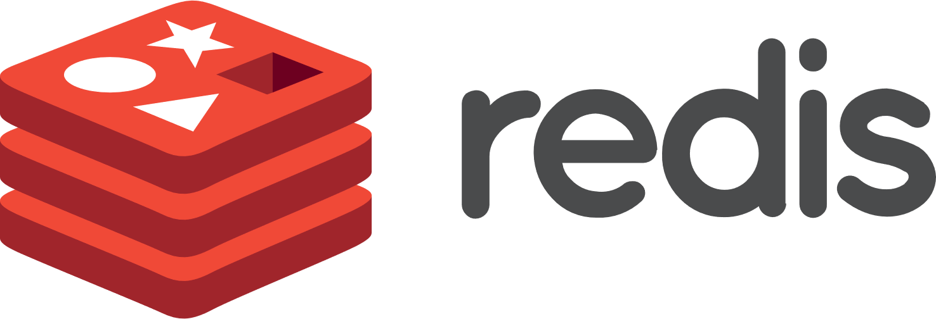


















Oracle Cloud Infrastructure is supporting your open-source code
Managed open-source services in OCI
Run the technologies
you already use
Native integrations with the
dev tools you’re used to
Red Hat
Oracle Linux
Ubuntu
CentOS Debian
SUSE
DEV-OPS | AUTOMATION
DEV-SEC-OPS | AUTOMATION
CONTAINER MANAGEMENT | PACKAGE MANAGEMENT
MANAGED CONTAINERS | CONTAINERS | INFRASTRUCTURE AS CODE | AUTONOMOUS LINUX
DATABASE | BIG DATA | ANALYTICS ENGINE | CACHING DATABASE
DATA COLLECTION | EVENT DELIVERY | STREAMING | DATABASE
LINUX OS | WINDOWS SERVER OS | VIRTUAL ENVIRONMENT
PROGRAMMING LANGUAGE | PROGRAMMING LANGUAGE | DATABASE
APPLICATION FRAMEWORK | NOSQL DATABASE | APPLICATION FRAMEWORK
SERVERLESS PLATFORM | SEARCH AND ANALYTICS | INTERFACE DEFINITION
BLOCKCHAIN | MACHINE LEARNING FRAMEWORK
INFRASTRUCTURE AS CODE | TEAM COLLABORATION | RISK MANAGEMENT

Slide 9





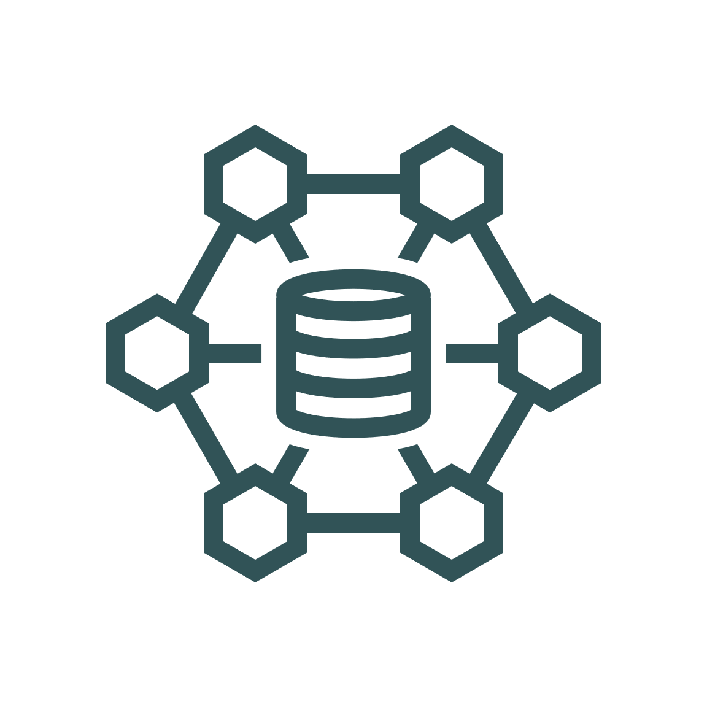



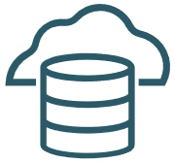


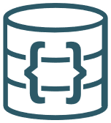


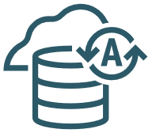
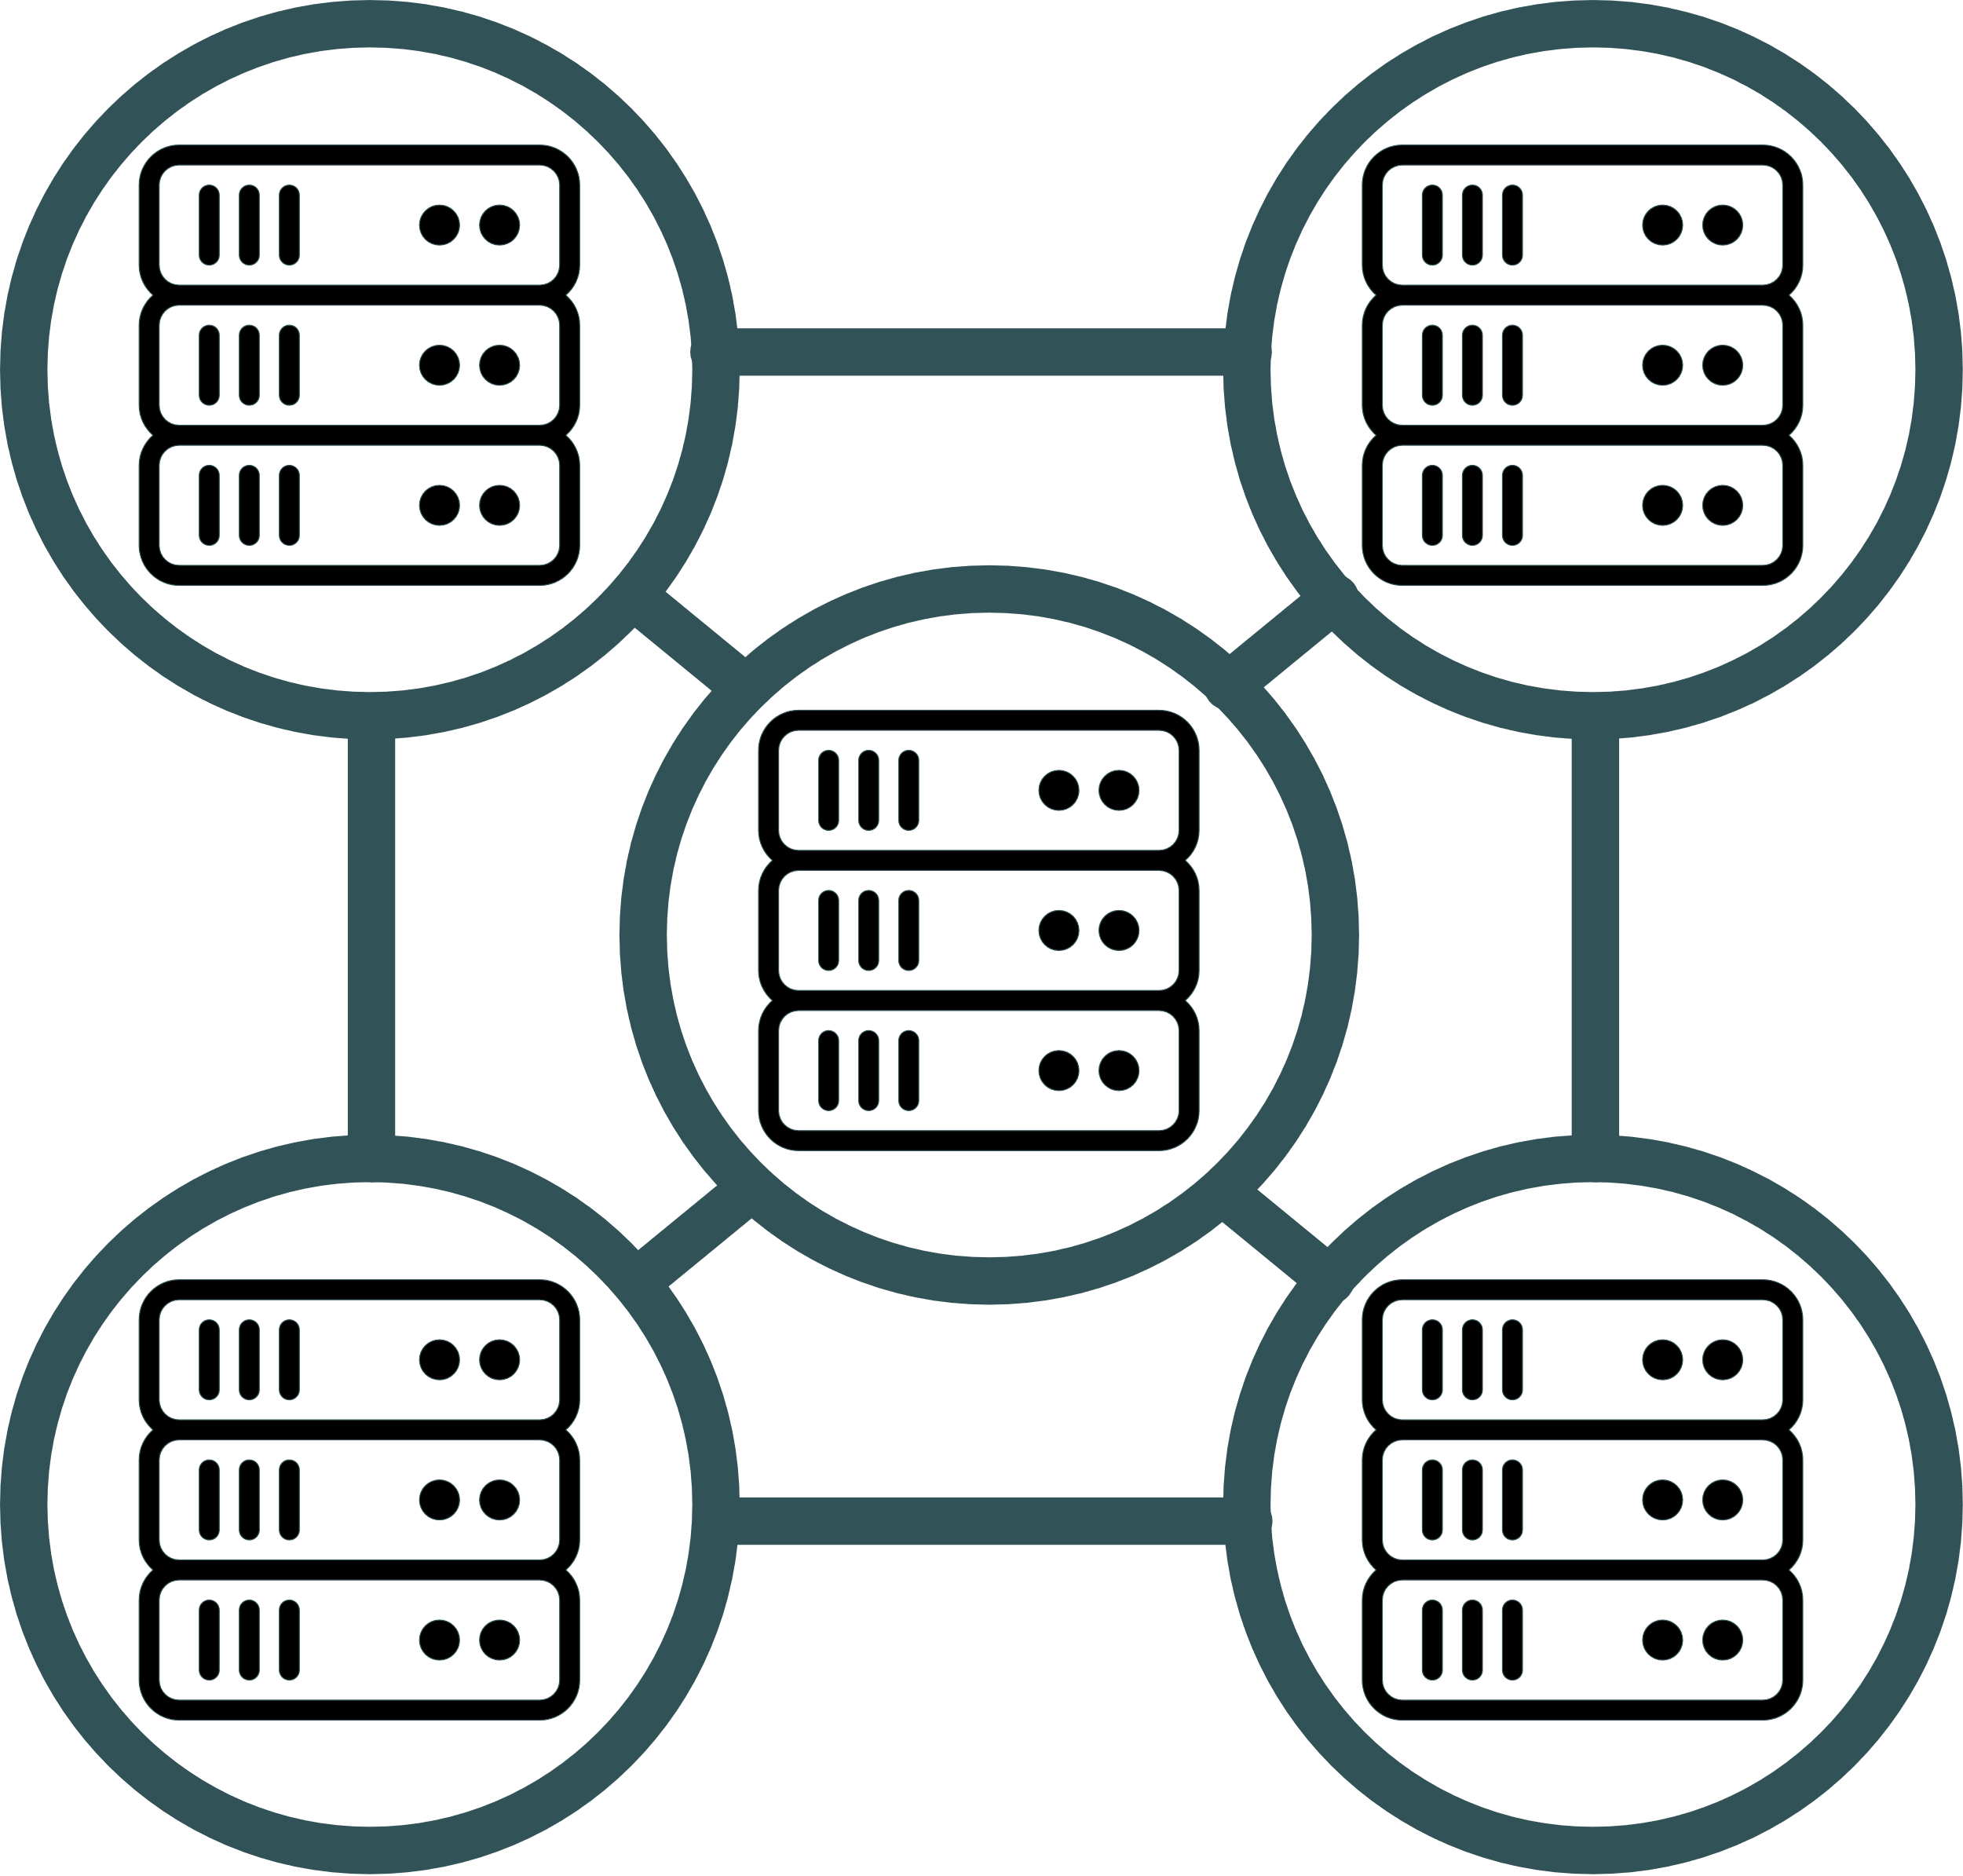
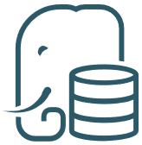










Oracle Data Platform: A complete suite of services
Oracle Data Platform
Integration
AI/ML
Analytics
Data Sources
Business
Outcomes
Speech
Vision
Language
OCI Data Science
OCI Digital
Assistant
Generative AI
Classification *
Data Management
Enterprise Data
& Applications
OCI Data
Integration
Applications data
Oracle or
Any Business Applications
Growth and
Resilience
Autonomous Transaction Processing
Oracle Database Cloud Service
Exadata Cloud Service
MySQL
HeatWave
No SQL Database
ERP
CRM
OIC
(Application
Integration)
Oracle
Analytics Cloud
Enterprise SaaS Applications
Data Warehousing/Analytics
Other Open-Source databases
Better Forecasts and Predictions
Any
SaaS
Autonomous Data Warehouse
MySQL
HeatWave
OpenSearch
PostgreSQL
Redis
GoldenGate
(RT Data Replication)
GoldenGate
Stream
Analytics
Operational Efficiency
IoT
Social
Media
Big Data and Data Lake
OCI
Query Service*
Any
Applications
Data Flow
Big Data
Data Lake
Lower
Costs
Digital Assets
OCI
Streaming
Data Access, Security, and Governance
Data Catalog
Identity and Access
Management

Slide 10
Autonomous Database

Slide 11
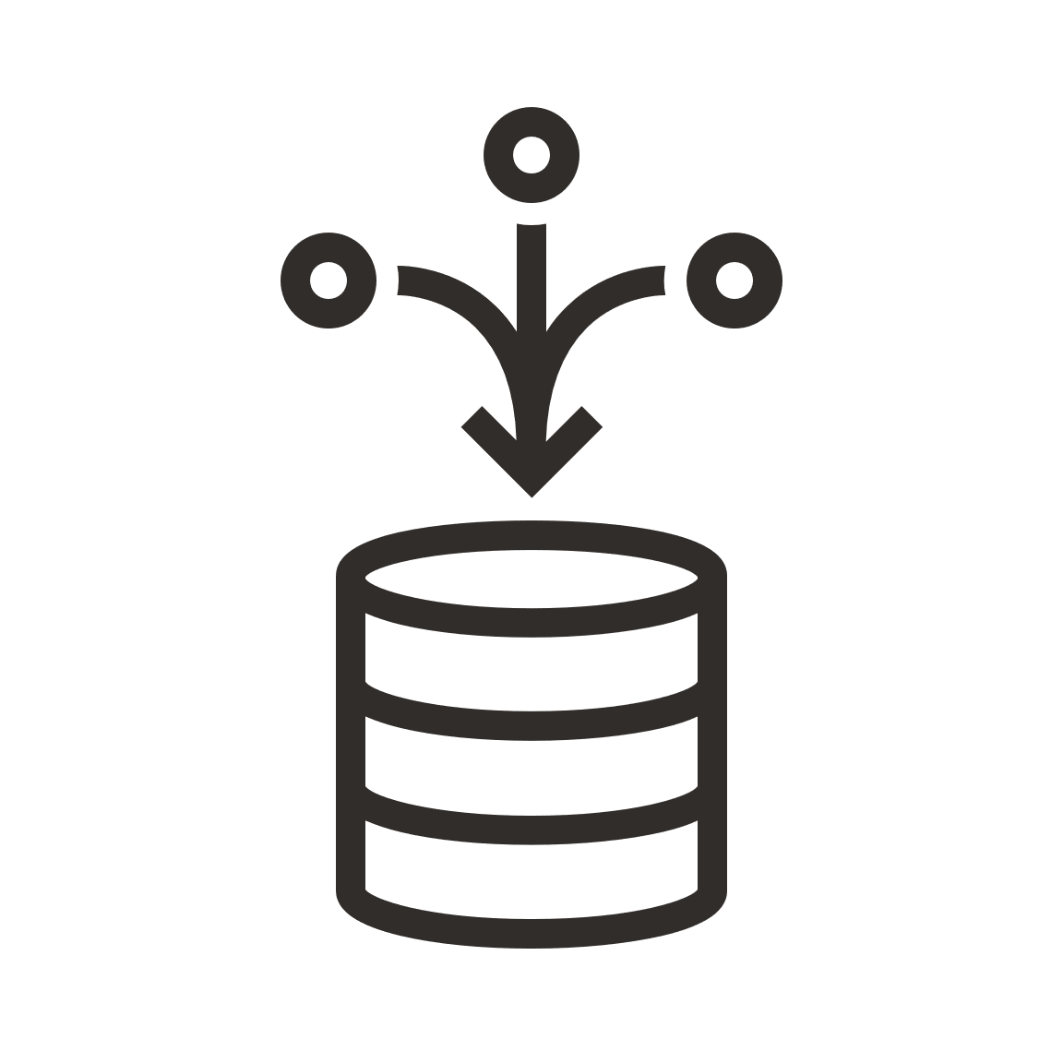
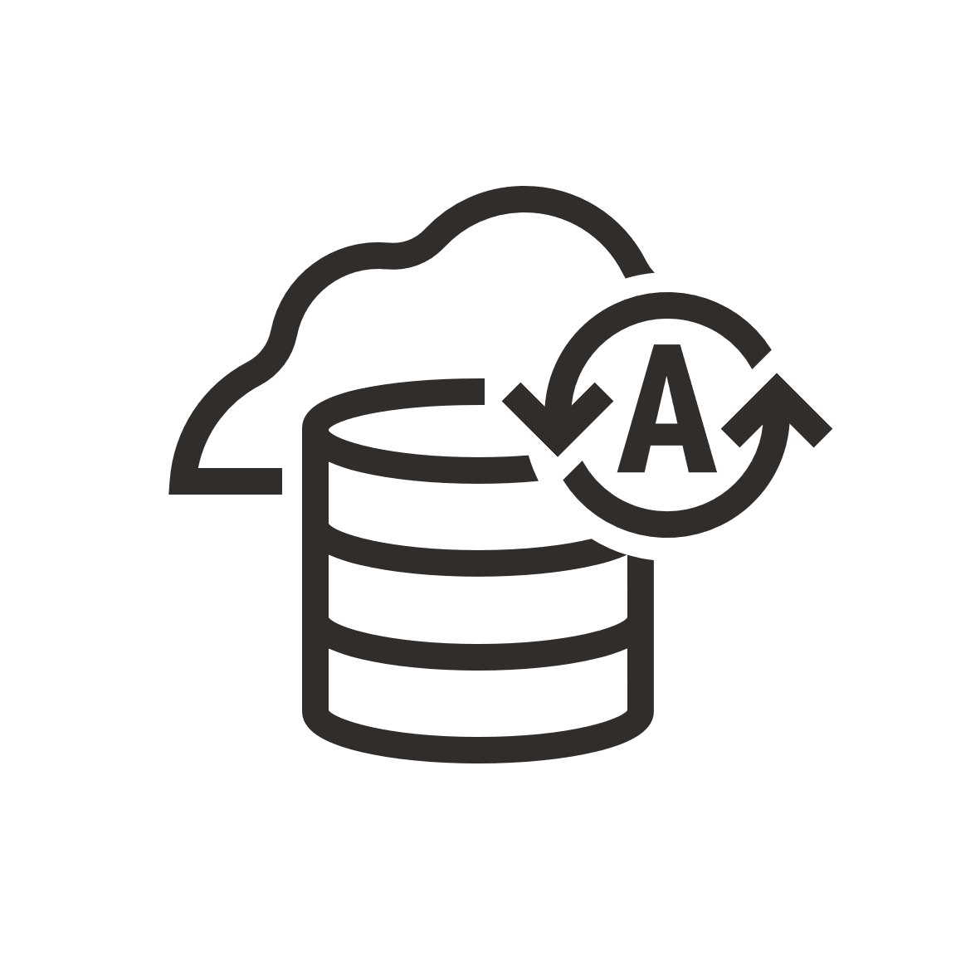
Big Picture - Oracle Data Management with Autonomous
Easiest and Most Productive for Developing and Running Apps and Analytics
Converged Database
Complete support for all modern data types, workloads, development styles
Completely scalable, available,
and secure
Simply Complete
Autonomous Database
Simplest cloud database for developers and analysts
Simplest cloud database for running any app at any scale or criticality
Completely Simple

Slide 12
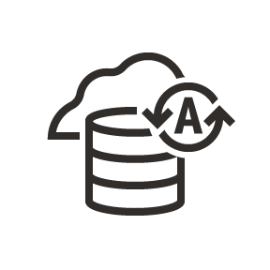


What is Autonomous Database?
Eliminates all Database and Infrastructure Complexity
Oracle
Autonomous
Database
Complete Infrastructure Automation
Complete Database Automation
Automated
Data Center
Operations

Slide 13
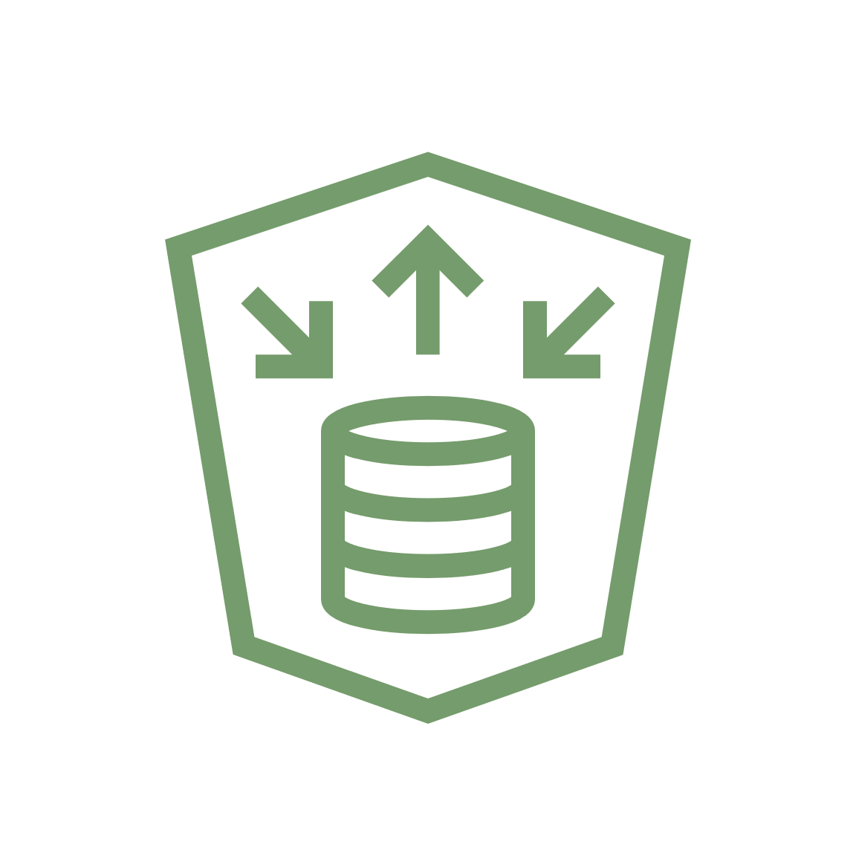

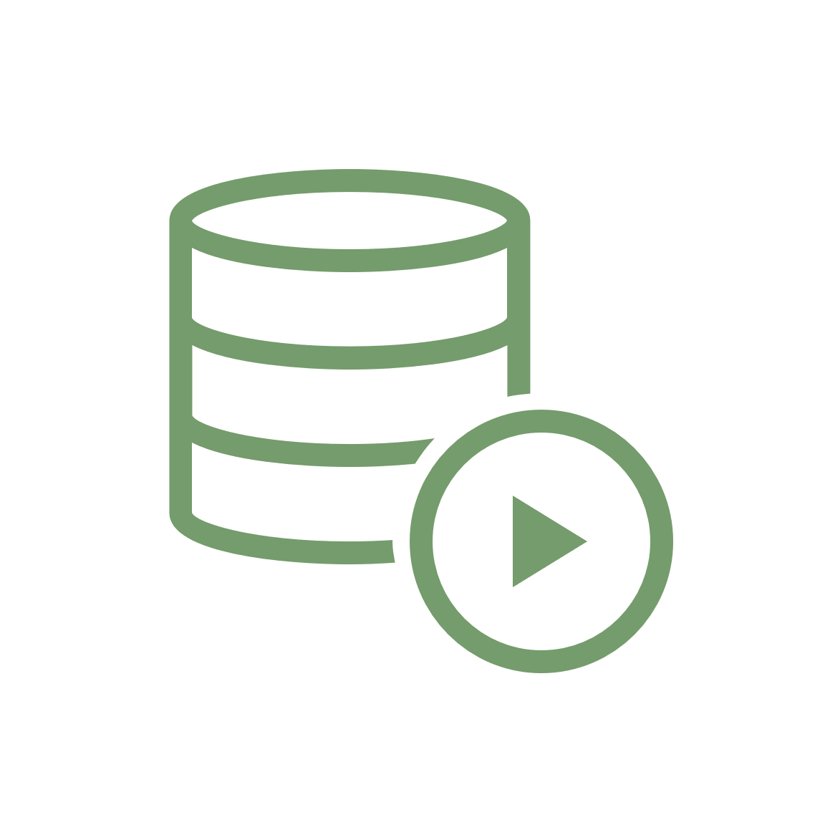
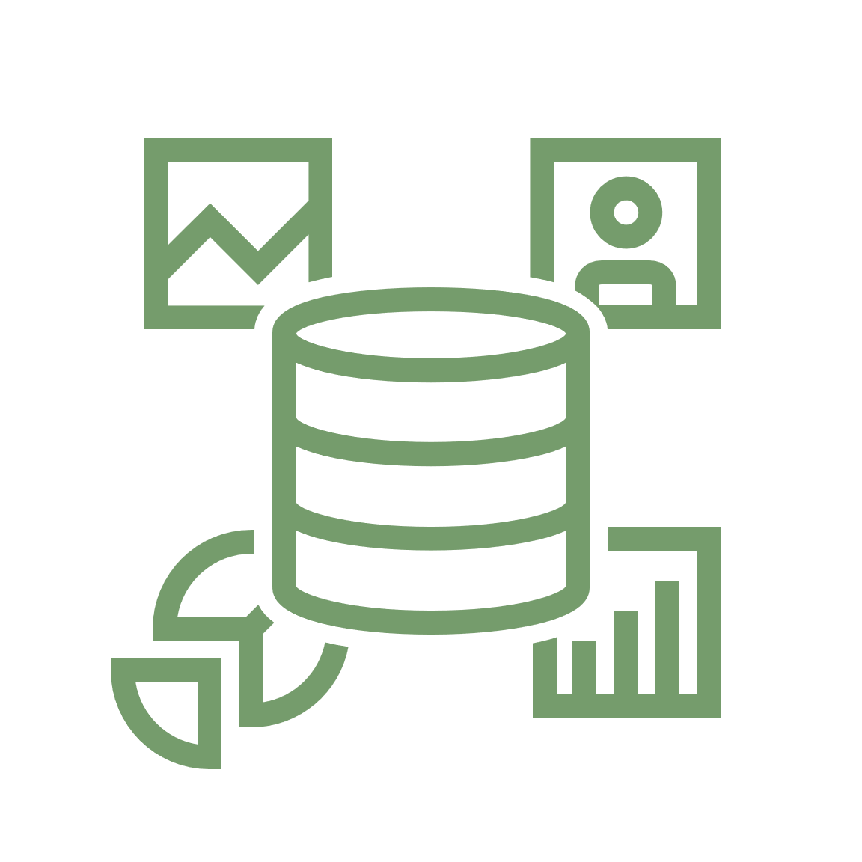
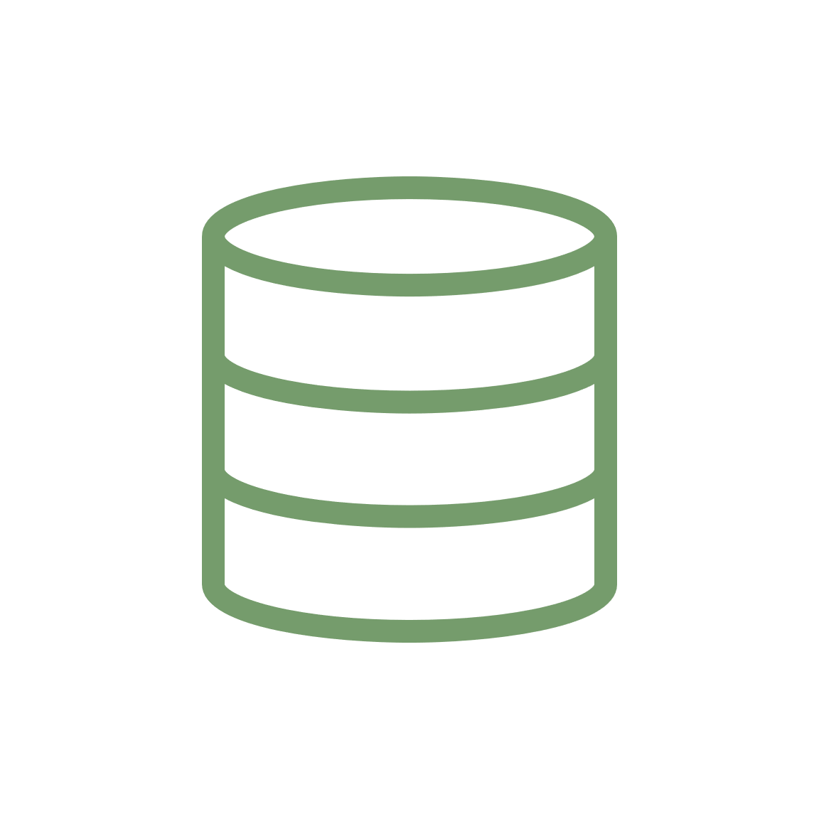
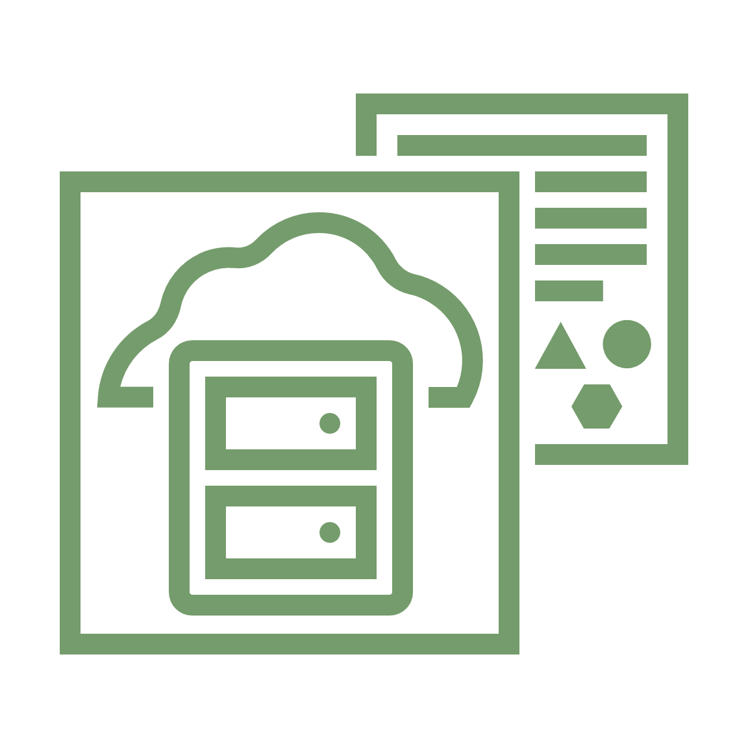
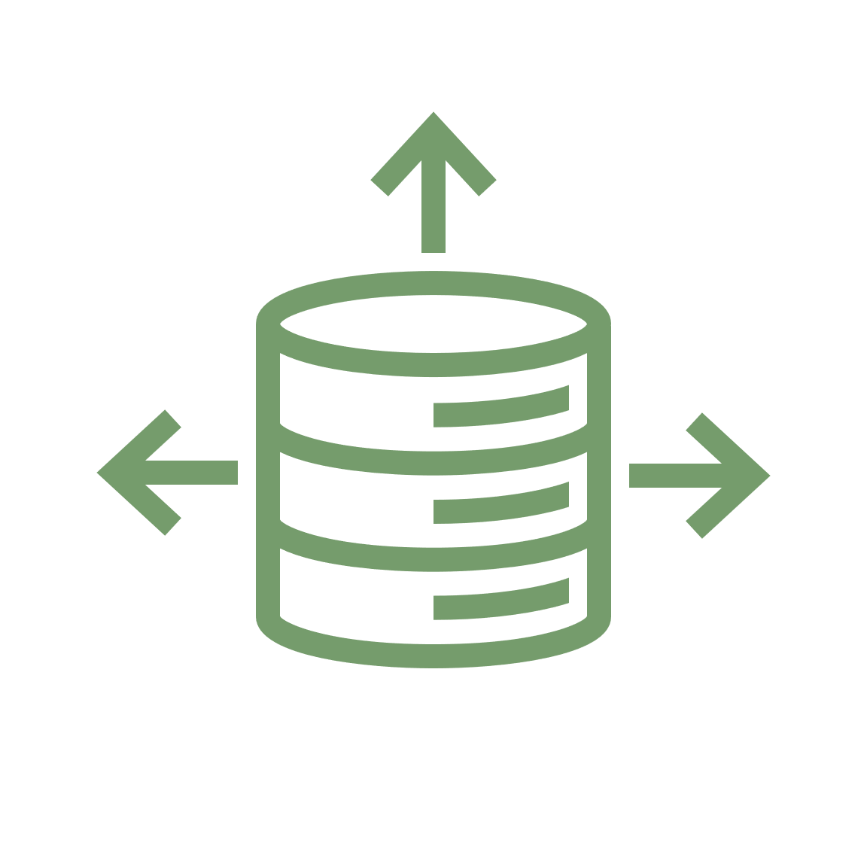






Deploy new data platforms 84% faster* with 85% less staff time*
Data Warehouse
Built for decision support and data warehouse workloads. Fast queries over large volumes of data.
APEX
Built for Oracle APEX application development. Cre-ation and deploy-ment of low-code applications with database included.
{JSON}
REST
Services
Data
Modeling
Low-code
APEX
SQL
Worksheet
Notebooks
JSON
Worksheet
Transaction Processing
Built for transact-tional workloads. High concurrency for short-running queries and transactions
Data
Safe
Database
Vault
Data
Catalog
Data
Sharing
JSON
Built for JSON-centric application development. Developer-friendly document APIs and native JSON storage.
Data
Integration
Semantic
Modeling
Data
Analysis
ML
Modeling
Graph
Modeling
Spatial
13
Copyright © 2023, Oracle and/or its affiliates
* IDC whitepaper: Real-World Business Value of Oracle Autonomous Data Warehouse
https://www.oracle.com/a/ocom/docs/database/value-oracle-autonomous-data-warehouse-wp.pdf

Slide 14
Completely Simple Operational Model
Autonomous delivers essential features for corporate governance and development agility
Designed for simplistic Pay-Per-Use Consumption Model
Auto-Scaling, Overprovisioning, pay only for active OCPUs
Self-service with team isolation, quotas, built-in best practices
Designed for mission-critical high availability
Native and transparent Real Application Clusters
Always online, including planned maintenance
Autonomous Data Guard for disaster recovery
Designed for automated and enforce security best practices
End-to-end encryption, role-based data isolation, data redaction
Data Safe auditing, monitoring, user and config risk assessment
Autonomous
Database
Copyright © 2023, Oracle and/or its affiliates

Slide 15
Autonomous Database – True Pay per Use
Traditional
Pay for Max Potential CPU Usage
Autonomous DB
Pay for Usage
12
12
Pay for 12 CPUs
even when not used
Pay for 4 CPU typical usage
plus occasional spikes
8
8
CPU Usage
CPU Usage
4
4
0
0
Pay for CPUs and software for
peak load + additional headroom
Automatically scale CPUs up to 3X
when needed. Instant scaling with zero downtime

Slide 16











Completely Simple Mission-Critical Security
ADB delivers the simplest and best security for all workloads, use cases, and apps
Mission-Critical Data Security Made Simple
Transparent
Encryption
Data
Redaction
Administrator
Risk Controls
Label Security
and VPD
Blockchain
Tables
Data Risk Management as a Service – Data Safe
0 | 8 | 4 | 5 | 3 | 2
Autonomous
Database
* | * | * | * | 3 | 2
Centralized Auditing
Config Risk Assessment
User Risk Assessment
Sensitive Data
Discovery
Data Masking
Database Security Patches Applied Automatically
Unique seamless and identical security across all data types and workloads

Slide 17





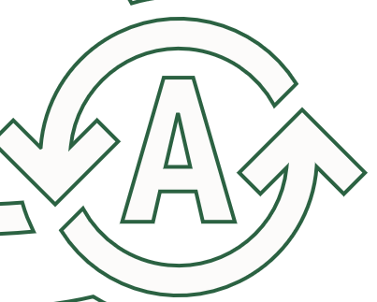




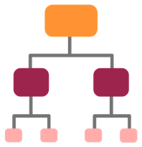
Completely Simple Cloud Native Development
ADB simplifies the complete dev lifecycle – Modeling, Coding, ETL, Optimizing, Analyzing
Point-and-Click Cloud-Native Development
Data Modeler
SQL Dev
APEX
Liquibase
Native
Data Modeling
Native
SQL I.D.E.
Native
Low-Code
Native
ETL
Native
CI/CD
Automates Difficult Data Engineering
Automates Difficult Database Engineering
Autonomous
Database
Auto
ML
Auto
Insights
Auto
Scaling
Auto
Indexing
Auto
Partitioning
Unique cloud-native support for developing apps that use any data or workload, with any dev style

Slide 18
Data Lake

Slide 19
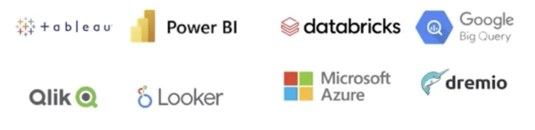






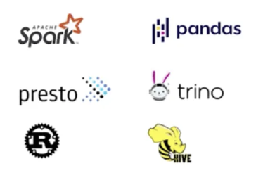


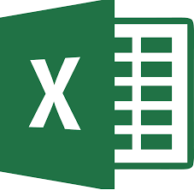





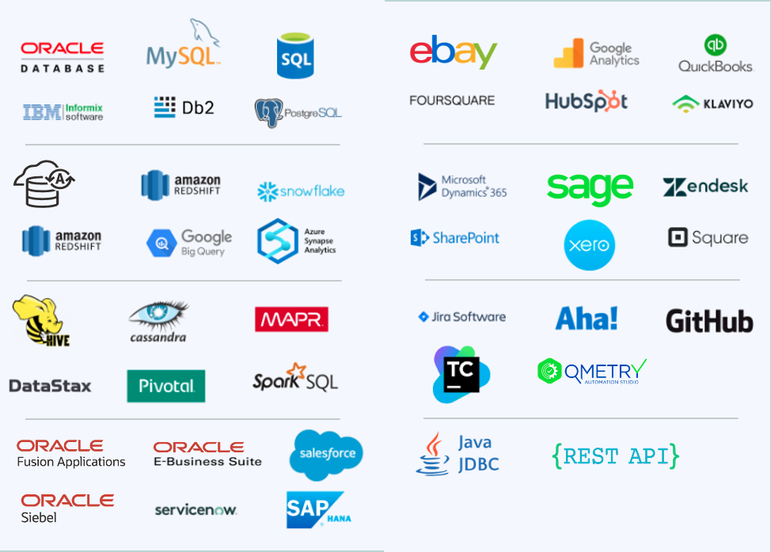


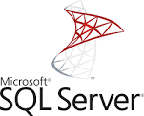
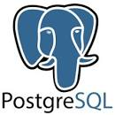

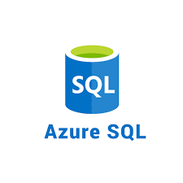
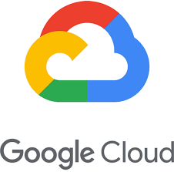

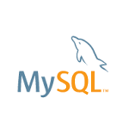


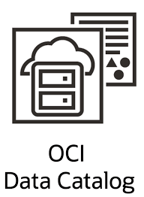


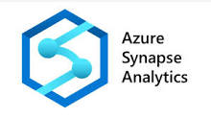
Autonomous Database and the Multi-Cloud Data Ecosystem
Data
Sharing
Data Lake
File Formats
Share with other databases, data analytics tools, open-source platforms
Access any data lake file format
Data integration
sources
100+ Built-in
Data Source
Connectors
Secure object store access
Data
Virtualization
Data
Catalogs
Direct connections to non-Oracle databases
OCI
Data
Catalog
Amazon Glue

Slide 20
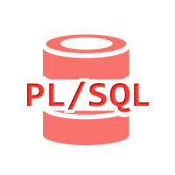

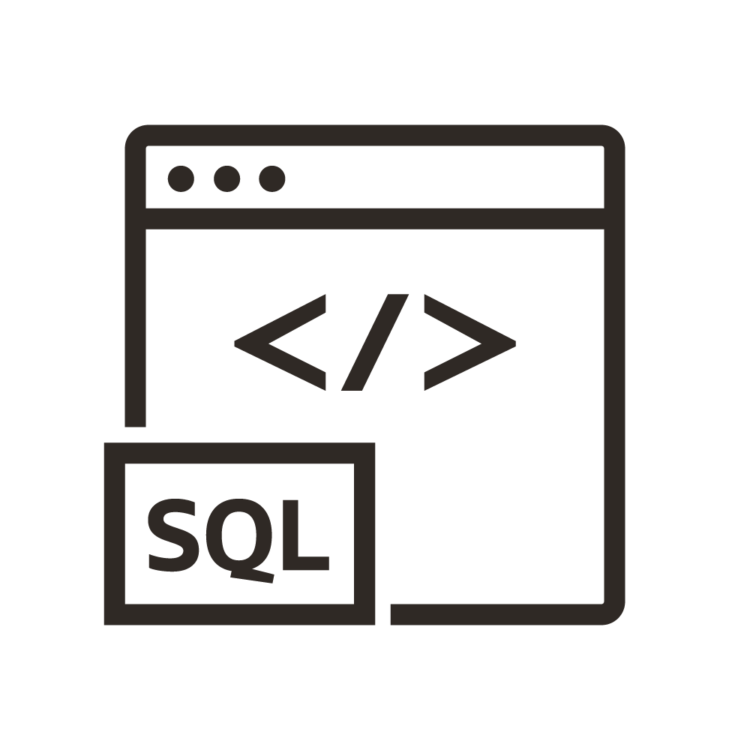



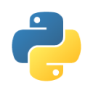



Any language, any tool
Multiple Languages and APIs
Oracle Autonomous Data Warehouse is Polyglot
Data Lake
Data Lake
Data Lake
Data Lake

Slide 21







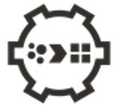


Data Lake architectures with Autonomous Data Warehouse
Customers can choose the best architecture for their requirements
Cloud Data Lake in OCI
Open and interoperable
Data processing via engine of choice
Autonomous Data Warehouse as a Data Lake
Optimized and unified
All data processing via ADW
OCI Data
Catalog
Autonomous
Database
Data Lake
Data
Transforms
/ Cleansing
Data
Analytics
Data
Science
/ ML
Graph Analytics
Spatial
Analysis
MySQL
Heatwave
OCI Data
Integration
OCI
Data Flow
Managed
Open Source
Autonomous Data Warehouse
21
More details here

Slide 22
Any language, any tool – with secure access
Oracle Autonomous Data Warehouse is Polyglot – with unified, secure data access control
Types of data:
  Structured
  Semi-structured
  Unstructured
Data Format:
  File based format
    CSV
    Parquet
    ORC
    Avro
    JSON
  Table based format
    Iceberg
    Delta Share
Platforms:
  Oracle Cloud Infrastructure (OCI)
  Amazon Web Services (AWS)
  Azure
  Google Cloud Platform
  On-premise
Languages (APIs):
  SQL
  Python
  R
  REST
  MongoDB API
  Spark Connector
One Security model

Slide 23
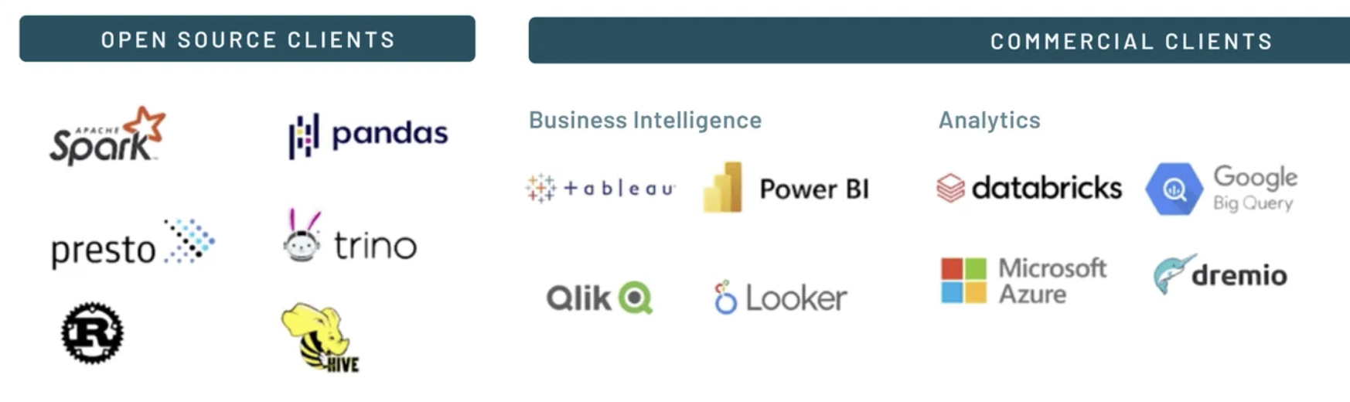




Data Sharing with Autonomous
Share Oracle Data with non-Oracle Clients
Real-time data exchange across Oracle instances
Collaborative Multi-Cloud and Multi-Workload Environments
Oracle
Cloud Links
Delta Sharing
Delta Sharing
23
Copyright © 2023, Oracle and/or its affiliates | Confidential Under NDA

Slide 24
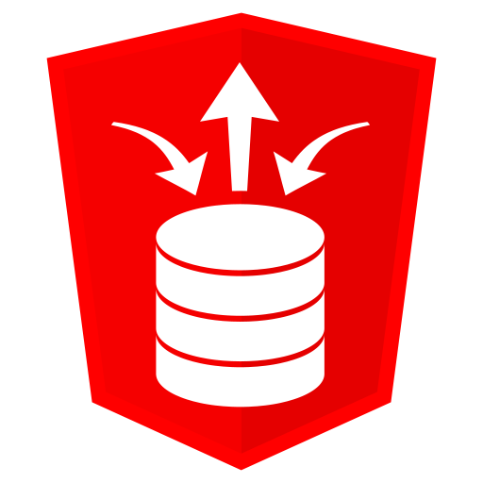


Unleashing Data: Access, Process, Share with ADW
Data Lake
Access data in any format from any source
Process data efficiently with Autonomous Database
Develop data products and share them flexibly

Slide 25
Customers

Slide 26
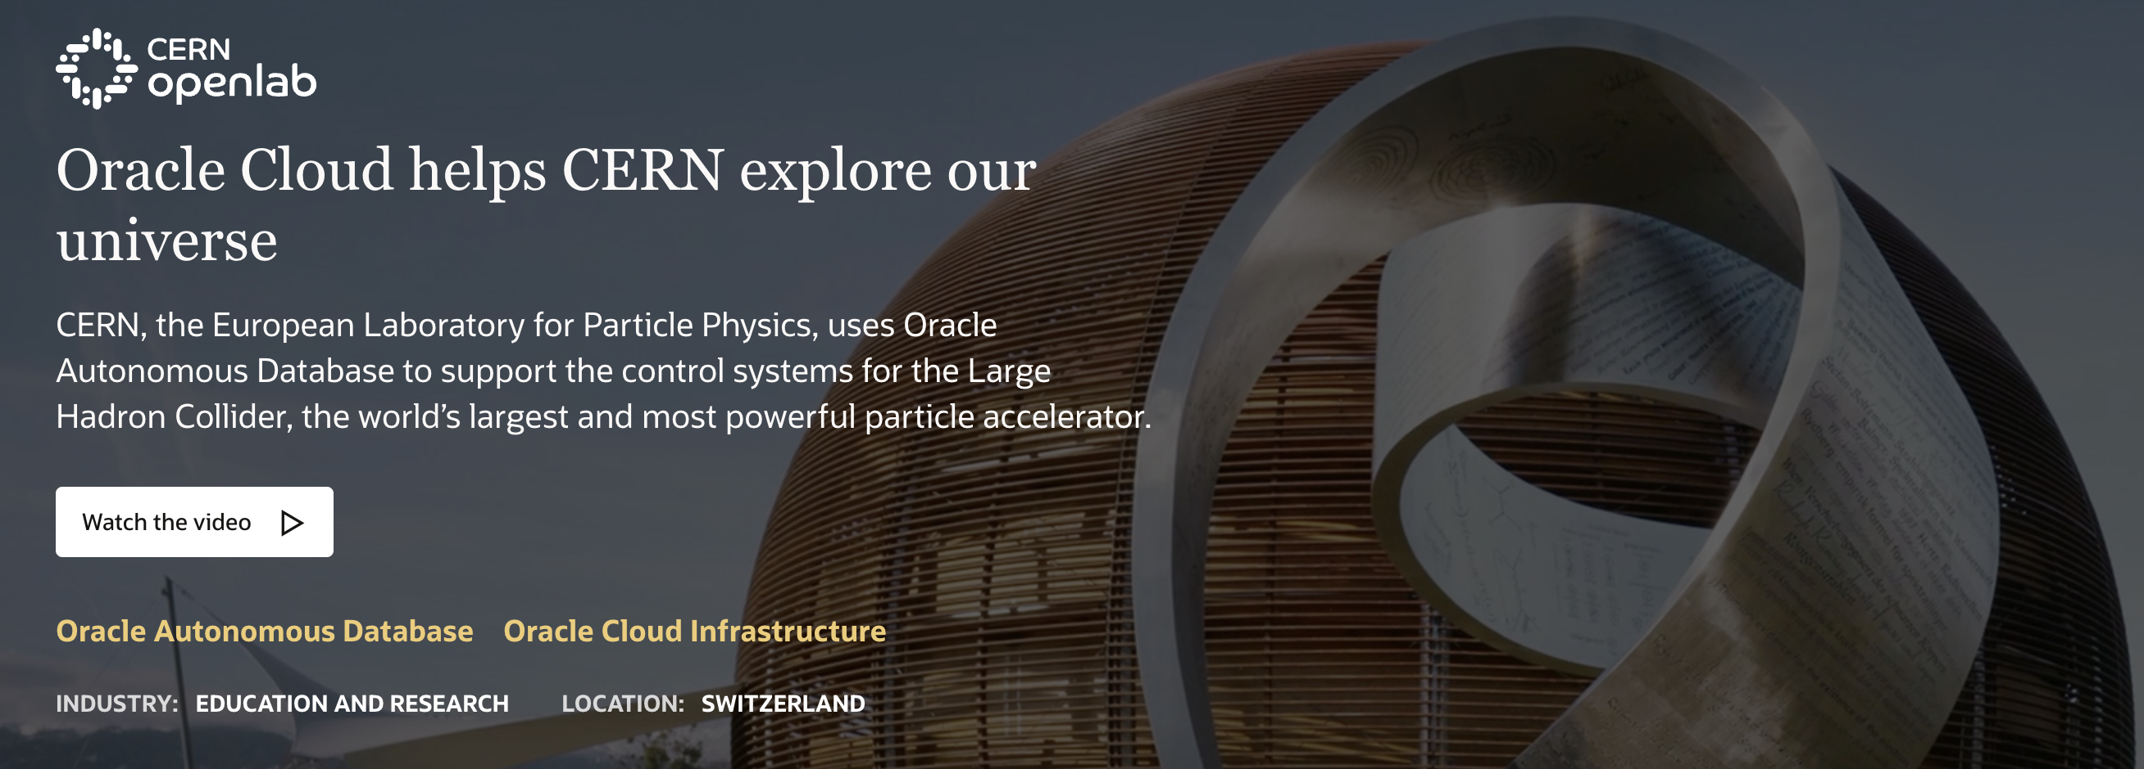

Slide 27
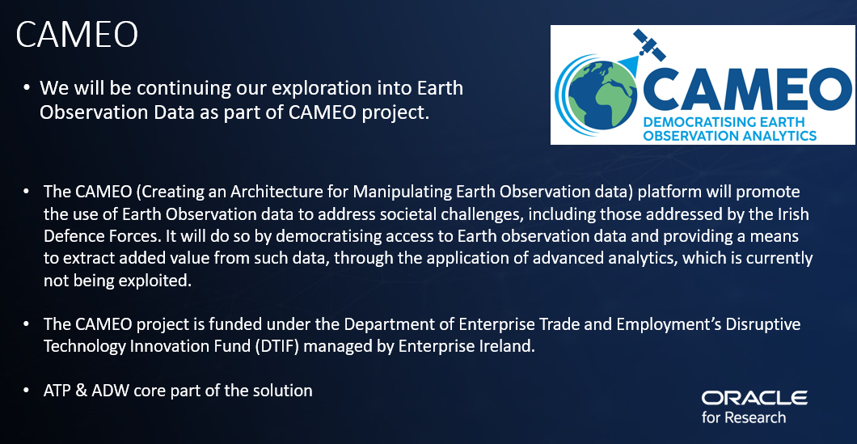

Slide 28

Higher Education & Oracle Cloud Infrastructure
Running Oracle Peoplesoft on OCI
Student record system demands highly secure platform given sensitive data requirements
“Queen’s selected OCI as the only cloud solution that could significantly lower the university’s IT costs while also meeting performance and security requirements”
Ann Mc Partlan – Students System Manager

Slide 29
Conclusion

Slide 30
Benefits of Autonomous Database
Lower total cost of ownership through more automation and operational delegation to Oracle
Fully Managed
Faster Support / DevOps
Simple Self-Service
Pay-Per-Use
Add-On Developer Solutions
Fully Secure
Zero Downtime
Operational Delegation
Fully Managed Database Operations: backup, update, upgrade, OS maintenance, incident management, health monitoring
Faster support, less customer involvement via DevOps incident response and monitoring of health metrics and logs
Built-in Application Continuity for zero downtime via application aware, workload specific and prioritized connection services
Improved Automation
Zero upfront cost for simple database self-service setups, with auto workload configuration and capacity management
Auto-scaling with pay-per-use billing, not on allocation
Managed developer add-on’s: APEX, ORDS, DB Actions
MAA disaster recovery setup with FSFO automated failover
Same Unit Cost
More Value
Lowest TCO
(~30% Reduced Cost)
Notes:
N

Slide 31








Get started today!
Sign-up for a free Oracle Cloud Account bit.ly/adb-free-trial | Review the getting started guide bit.ly/get-started-adb | Visit our library of free workshops bit.ly/adb-workshops | Watch our demo videos bit.ly/adb-demos
Sign up for “what’s new” announcements bit.ly/adb-announcements | Join us on LinkedIn bit.ly/linkedin-adb | Follow us on Twitter twitter.com/AutonomousDW | Got a question? We are on stackoverflow bit.ly/adb-stackoverflow

