Slide 1

Title slide
Services for handling sensitive data @ SURF
Ahmad Hesam
Notes:
Presentation summary
Personal introduction + What is SURF?
Current ways to work with sensitive data at SURF (OSSC, SANE)
Operational aspects
Legal aspects
Future directions

Slide 2


What is SURF?
SURF is a cooperative association of Dutch educational and research institutions.
We work together to acquire or develop the best possible digital services, and to encourage knowledge sharing through continuous innovation.

Slide 3





SURF members
MBO
56
WO
14
OTHER MEMBERS
Together with our members, we ensure that the education and research community has access to the best and latest IT facilities for top-level research and talent development.
Find the full list of SURF members here
RESEARCH
6
8
UMC
8
HBO
36
Notes:
MBO: Secondary vocational education
De leden van SURF zijn in de ledenraad verdeeld over 6 afdelingen: wo, hbo, mbo, umc, research en overige leden. Voor het opstellen van de plannen trekken research en overige leden samen op als de afdeling research+. Hoewel we spreken over sectoren en sectorprioriteiten, vormen zij formeel geen sector.

Slide 4
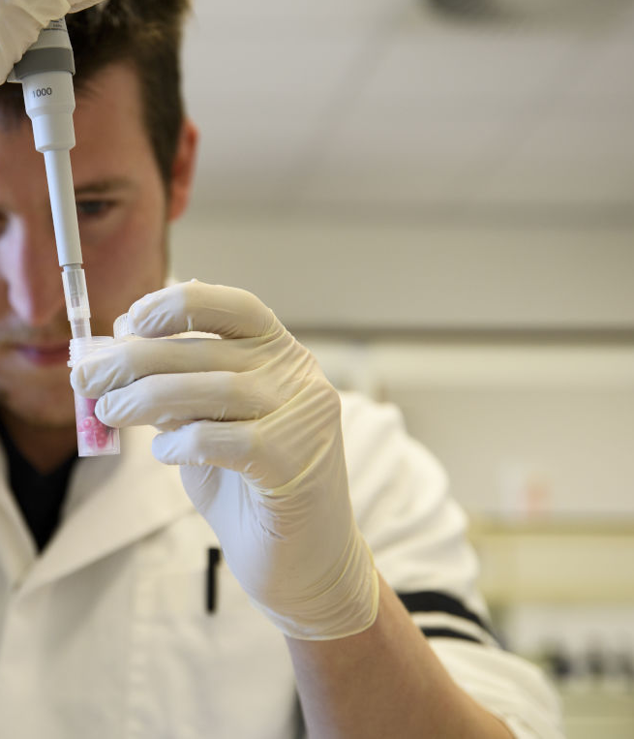
Sharing sensitive data
Problem
No infrastructure for researchers to analyse sensitive data in a way the data providers remain in control
Barriers
Privacy
Copyright
Competition

Slide 5

Current services for handling sensitive data
    ODISSEI Secure Supercomputer (OSSC)
A scale out solution for Statistics Netherlands (CBS)
Layer 3 IPSec VPN tunnel to extend the ‘virtual walls’ of CBS
Virtual cluster on top of the Dutch National Supercomputer (Snellius)
Microdata Services team of CBS as data provider
ODISSEI research community as users
Secure ANalysis Environment (SANE) on SURF Research Cloud
A cloud-based solution to analyse sensitive data
Two variants of secure analysis environments (Thinker, Blind)
Initial target: research in social sciences and humanities
Soft launch in Q1 2024

Slide 6
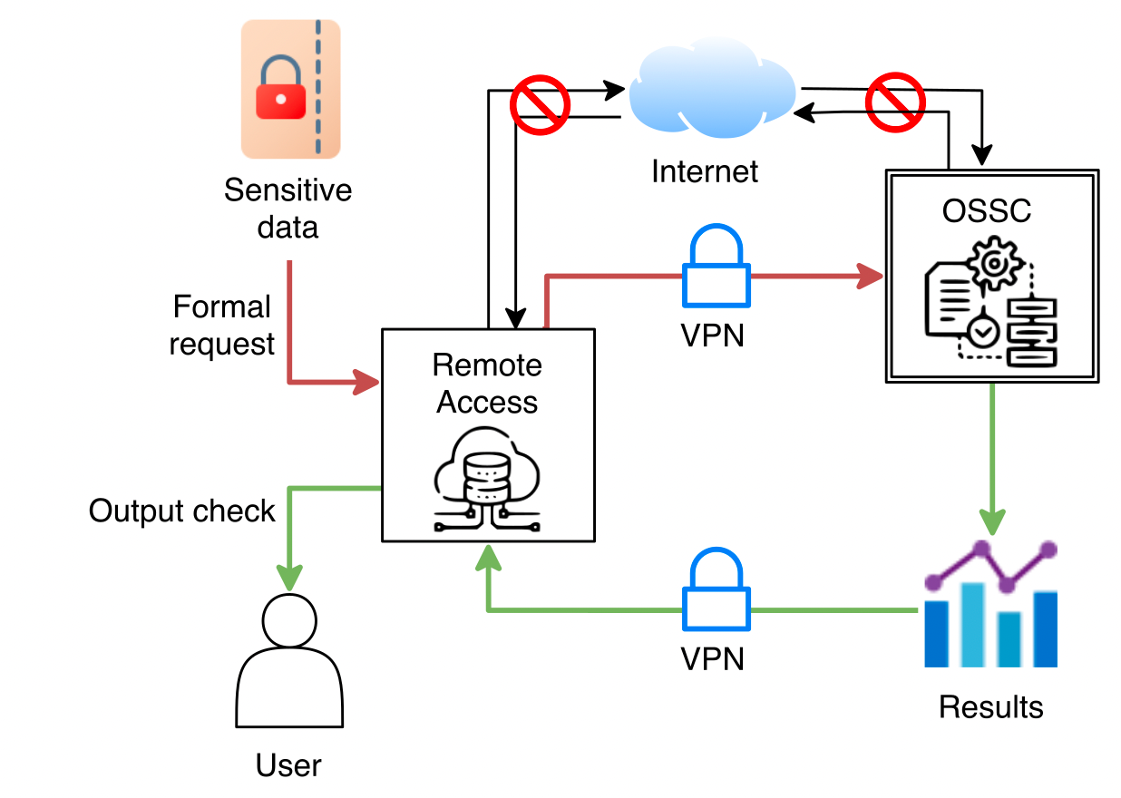
ODISSEI Secure Supercomputer (OSSC)

Slide 7
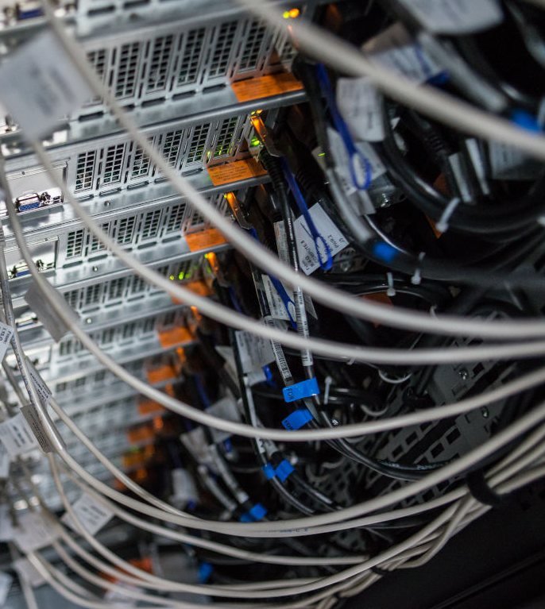
SANE – secure analysis environment
SANE is a virtual, fully shielded computing environment containing pre-approved analysis software and access to the sensitive data. It allows the data provider to maintain complete control while still allowing the researcher to study the data in a convenient manner.
Tinker SANE: allows the researcher to see, manipulate and play with the data.
Blind SANE: the researcher submits an algorithm without being able to see the data and the data provider approves the algorithm and output.

Slide 8
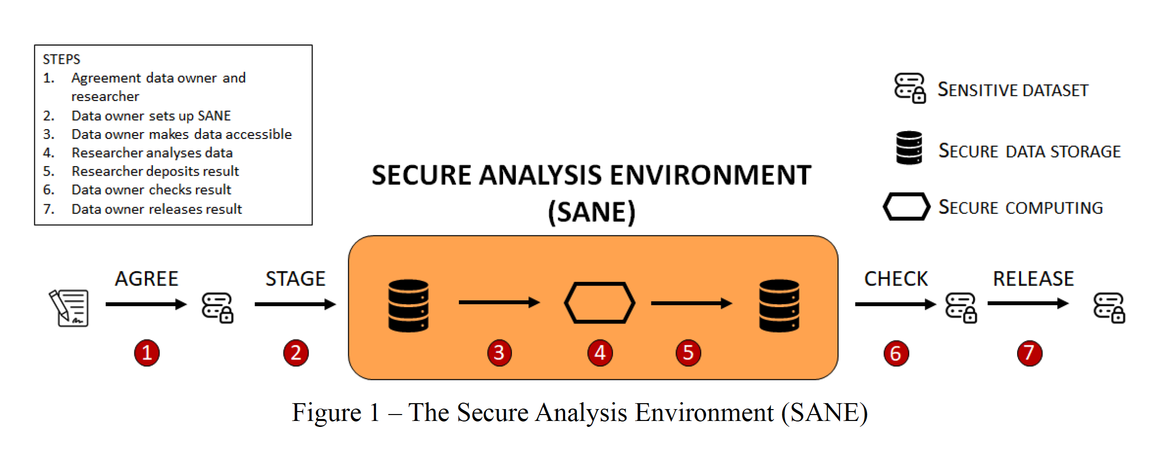
Workflow

Slide 9
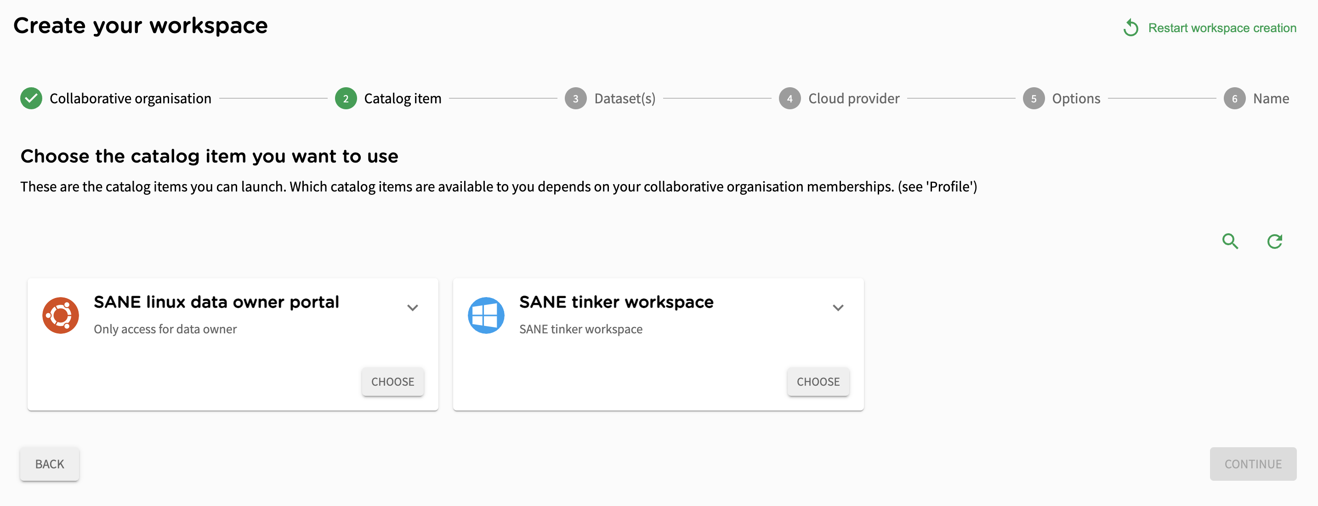
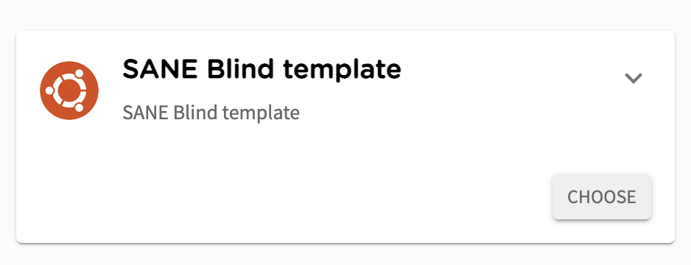
SANE on the SURF Research Cloud portal

Slide 10
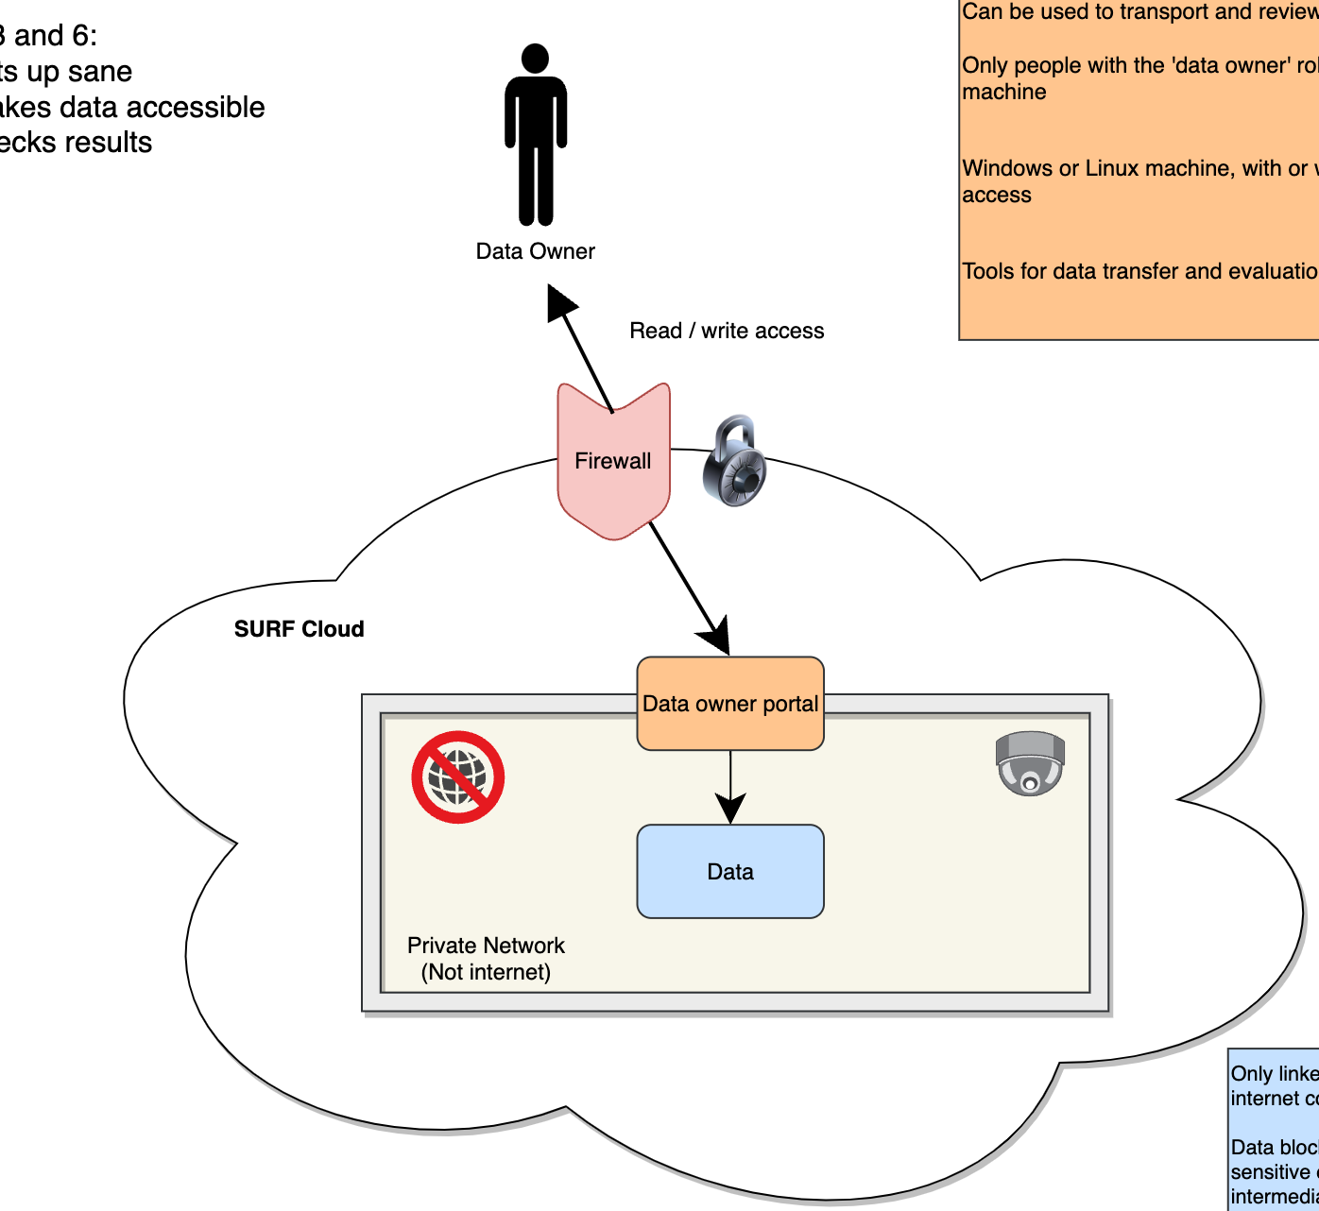
The data owner
Controls
  Hardening of the environment
  Software and libraries
  Output before release
Invites
Researcher through their Federated Identity (FIAM) using SURF Research Access Management (SRAM)

Slide 11
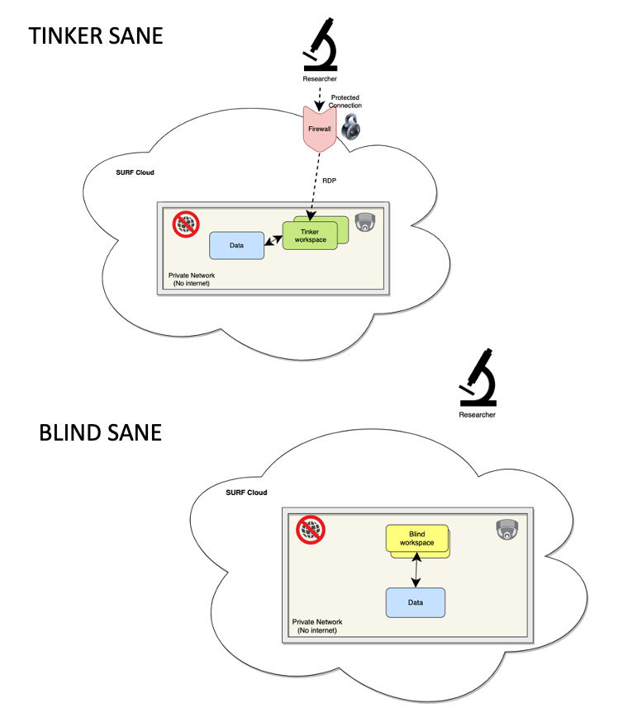
The researcher
Requests access to dataset + tooling from data owner
Is invited through SURF Research Access Management (SRAM)
Chooses size and flavour of compute environment
Uses personal compute budget from national grant

Slide 12
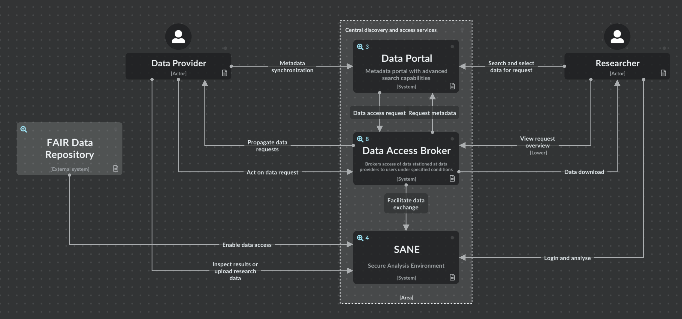
Near-future directions

Slide 13
Thank you!
For more information or questions, please visit:
https://www.surf.nl/en
or send me an email:
ahmad.hesam@surf.nl
Driving innovation together

