Slide 1
EPIC Cloud a GDPR-compliant cloud platform for handling sensitive data at INFN
Jacopo Gasparetto

Slide 2
The context

Slide 3
INFN – Italian National Institute for Research in Nuclear Physics
INFN has a long and prestigious tradition that started in 1951 with Enrico Fermi and his school:
“I Ragazzi di Via Panisperna”

Slide 4
INFN – Italian National Institute for Research in Nulear Physics
The challenge: understand the Universe at the first moments after the Big Bang

Slide 5


Slide 6

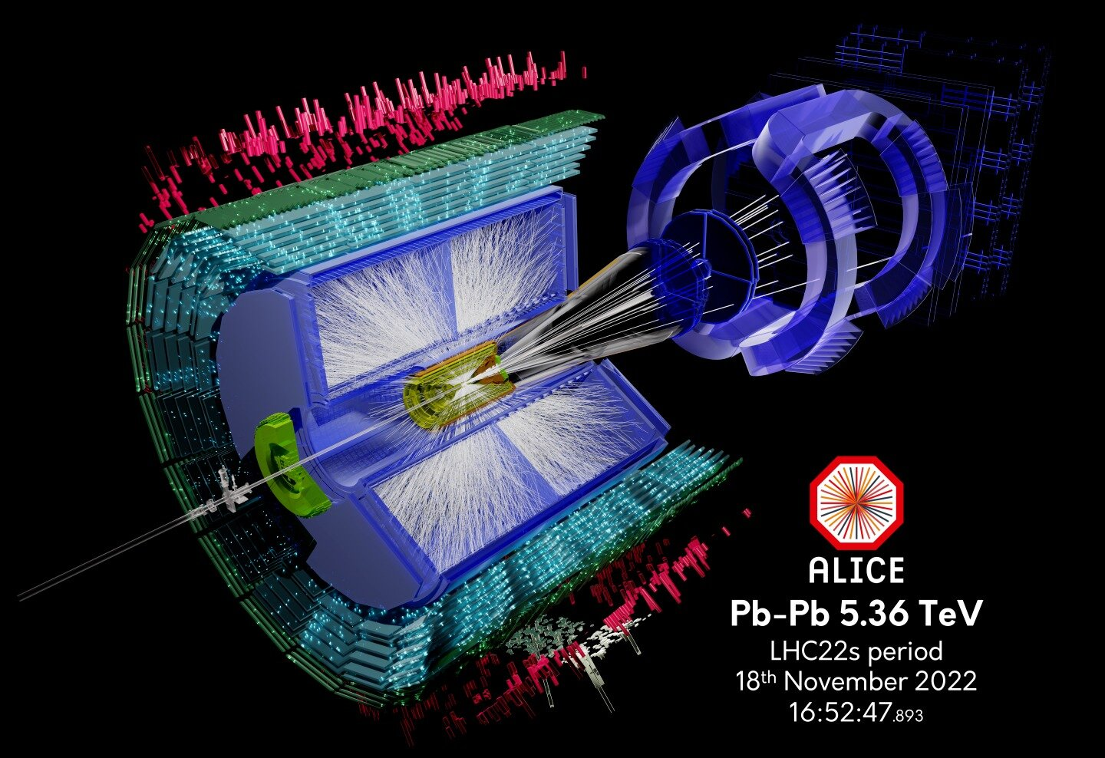
Computing at INFN
Photo of a Bubble Chamber
ALICE experiment at CERN’s LHC

Slide 7
The 5 research lines and the
National Scientific Committees

Slide 8
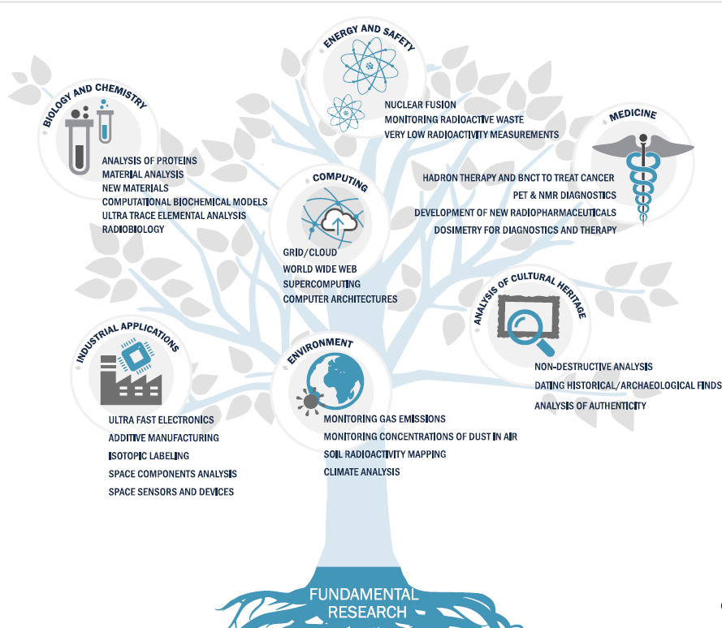
From physics to…

Slide 9
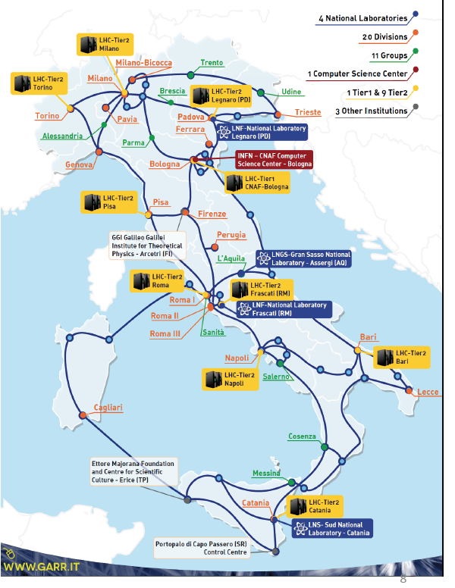
INFN computing and big data management infrastructure
A long tradition in state-of-the-art distributed IT technologies and solutions, from the first small clusters to Grid and Cloud-based computing.
INFN is not interested in computing per-se, but as an essential way to support its research and mission.
INFN operates Grid and Cloud services based on its own:
  1 large national center, at CNAF (Bologna) – with an area certified ISO/IEC 27001, 27017, 27018
  9 medium size centers
All the INFN centers are connected through 10-100 Gbit/s dedicated links via the GARR network.
Collectively, our distributed infrastructure currently offers about 140,000 CPU cores, 120PB of enterprise-level disk space, 100PB of tape storage

Slide 10
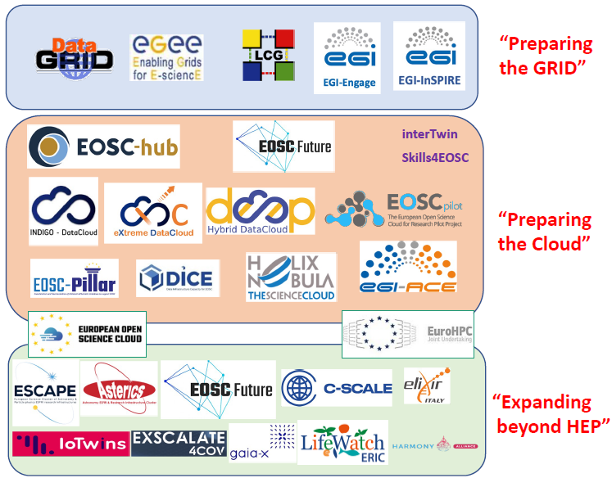

Computing related projects at INFN
Scientific Computing within INFN originally driven by the needs of its own theoretical and experimental communities.
Being at the forefront of computing in research seeded many projects with a much broader scope.
The key overall driver was always to let our users effectively exploit all available resources and technologies.
In 2000-2005 ten main international centers selected to host the Worldwide LHC Computing Grid (WLCG)
Then came the GRID, the Cloud, …
All centers still operational. Their size has increased ~100x since then, with an interconnectivity (thanks to the GARR-X network) up to several 100s Gbps.
Notes:
The development of Scientific Computing at INFN started with the need of satisfying ent

Slide 11

INFN Cloud - https://www.cloud.infn.it
The starting point for a National Data Lake for research and beyond, building on (existing | renewed | new) e-Infrastructures.
The base of the evolution of the INFN Distributed Computing vision.
Built on a middleware layer running on top of federated clouds, decoupling physical and logical views via a service composition mechanism.
In perspective, it will be the Italian Node of the for HL-LHC.
More than 2y of production service.

Slide 12
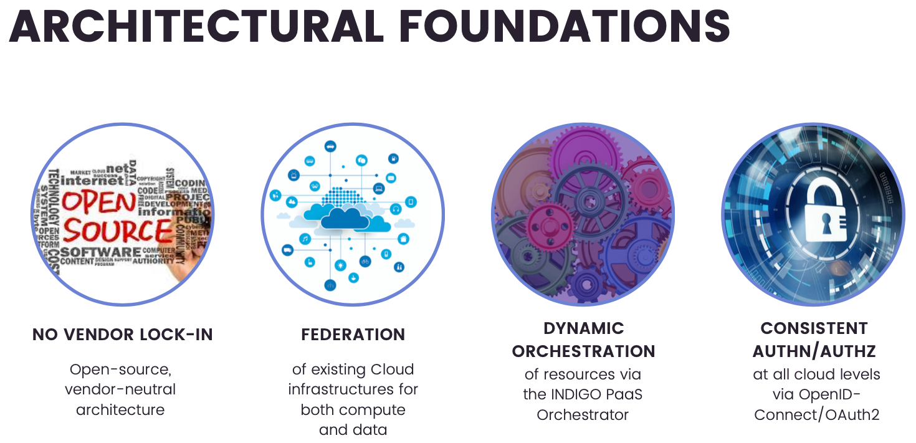

Slide 13
INFN Cloud - Internal organization
Working Groups
WG 1
Operations
WG 2
User & Project Support
WG 3
Resources, usage & Sustainability
WG 4
Security & Policies
WG 5
Middleware & New Services
WG 6
R&D, Testbeds & Use Cases
WG 7
Integrated Management Systems & Legal Compliance

Slide 14
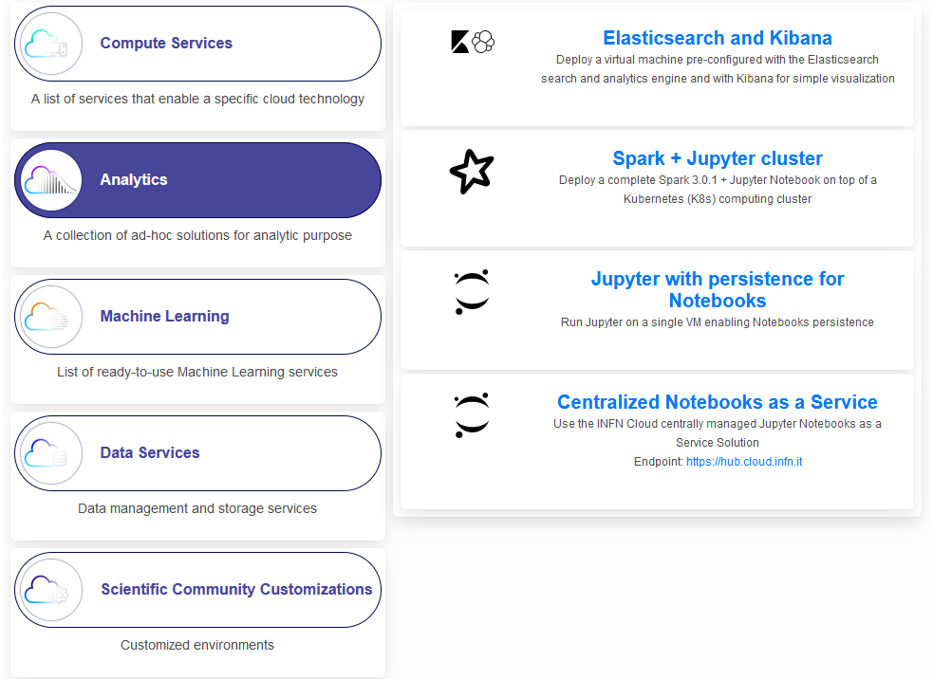
INFN Cloud - What it is
A production-quality set of resources and solutions providing
A core backbone, with ancillary and special-purpose services.
A multi-site, federated Cloud infrastructure.
  INFN Cloud can transparently federate both INFN sites and public or private Clouds
  A customizable portfolio of services accessible via web interfaces, terminal or API.
A fully distributed organization for the support and management of both infrastructure and services.
A set of rules that define access resources and policies, according to INFN, national and European laws.
Notes:
Portfolio si servizi PaaS

Slide 15
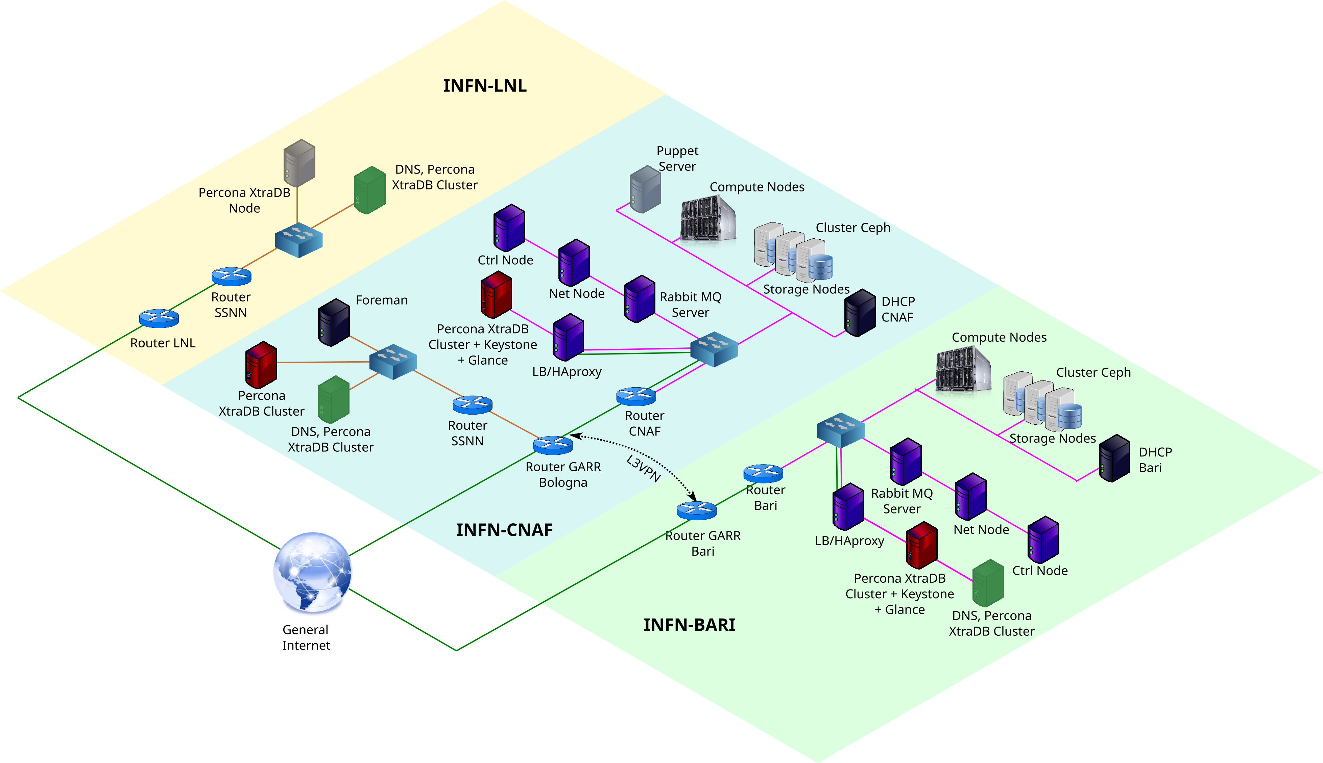
The INFN Cloud Backbone
Multi-site cloud infrastructure running both INFN Cloud Core Services and some user-level resources.
The Backbone topology simplifies the implementation of geographic HA or failover for its Core Services.
Managed by the INFN Cloud Team with extensive use of infrastructure automation tools.
Federated clouds connect directly to the backbone.

Slide 16
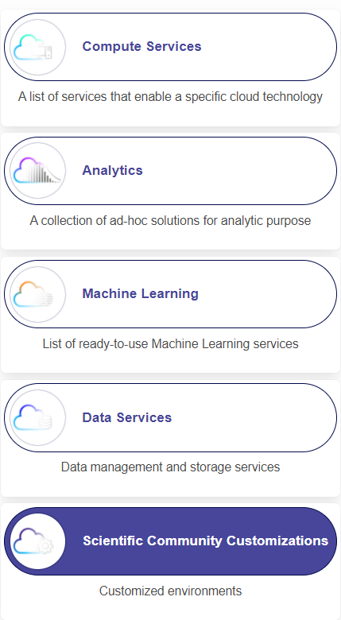
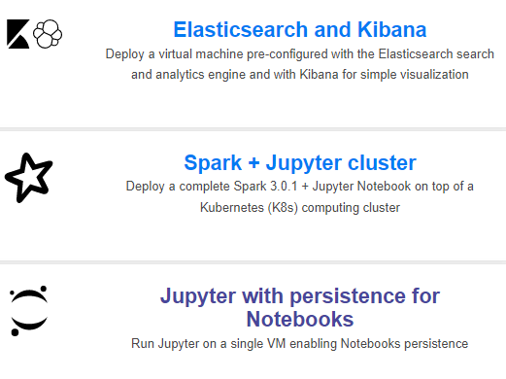
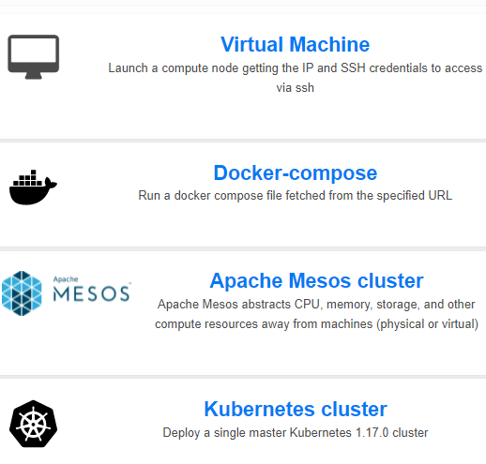
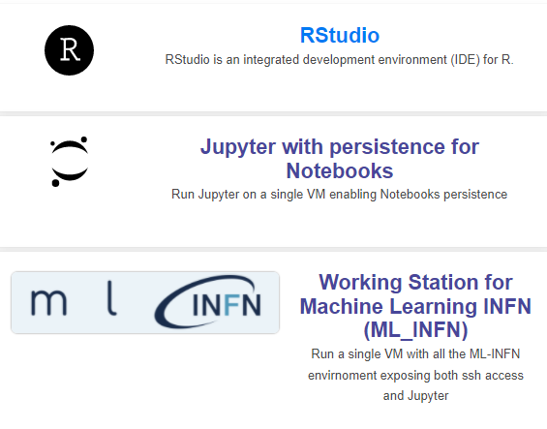
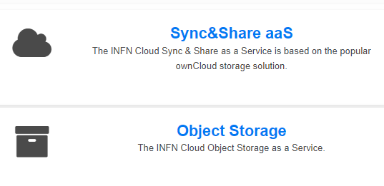
Excerpt from the INFN Cloud portfolio

Slide 17
EPIC Cloud
The INFN Cloud region dedicated to sensitive data management

Slide 18
Motivation
The GDPR states that Clinical and medical data (for instance, genomic) is personal data; i.e., it fits in the Art.9 special categories of personal data.
  Genomic data is mostly impossible to be anonymized → GDPR shall always be applied
  ISO/IEC 27001 is the main certification mechanism compliant with GDPR requirements (Art. 43, 58, 63)
To comply with the requirements of health research projects INFN is involved in, we created a portion of the INFN Cloud infrastructure, applied specific organizational and technical security measures, and certified it ISO/IEC 27001, 27017, 27018.
  This is the EPIC Cloud: a reference Cloud implementation for the treatment of sensitive data at INFN.
From the Data Controller side, the fact that EPIC Cloud is ISO-certified is a way to demonstrate that processing is performed in accordance with the GDPR.

Slide 19
EPIC
Enhanced PrIvacy and Compliance Cloud
Enhanced PrIvacy and Compliance Cloud is an ISO certified cloud platform
A region of INFN Cloud with a certified Information Security Management System
EPIC Cloud offers an IaaS Community Cloud for the communities of
Biomedical and genomic researchers Industrial researchers
Site locations: Bologna (active now), Bari and Catania sites will be added in June 2024 enabling for high availability and disaster recovery
Resource available today: about 700 TB of storage, 1440 cores, 10 TB RAM, 6 GPU A100
On going expansion with 3M euro of NRRP resources and 4M euro of funds from other projects
Notes:
storage: 500TB-N HDD 200TB-N
CPU: 1440 core
RAM 10TB
6 A100

Slide 20
Technology
It is based on the same technologies of INFN Cloud (OpenStack, CEPH, IAM), with various enhancements introduced to meet higher security and privacy standards.
For example:
The IAM provides 2FA, integration with web services, SSH and VPN (OpenVPN)
Network segregation between OpenStack tenants is guarantee by ACLs
At-rest and in-transit encryption
Standard shared responsibility model:
  User manages data, applications, runtime, middleware and OS
  EPIC manages networking, storage, servers, virtualization
Advanced logging and auditing services
  centralized syslog server managed applying the segregation of duties principle

Slide 21
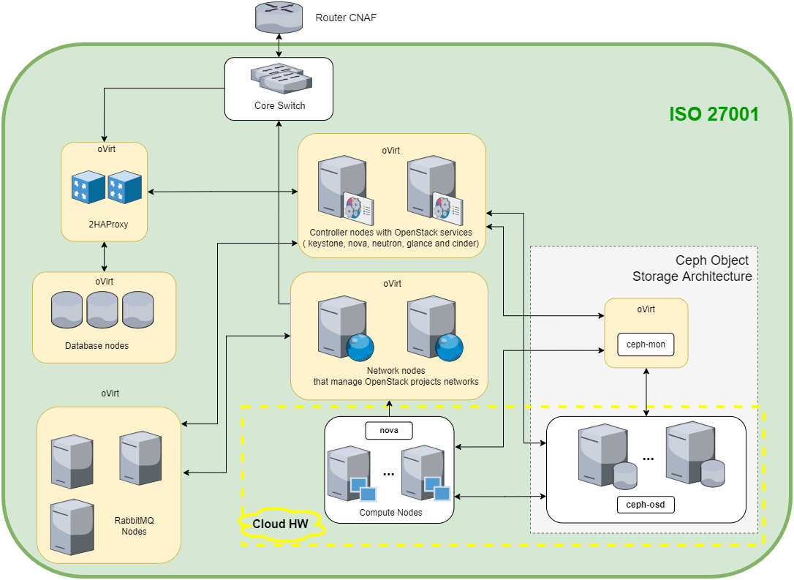
The EPIC Cloud infrastructure
All services in HA (Availability is one aspect of security)
It currently hosts 5 Projects
~ 1440 ~10TB RAM, ~700TB Disk
Tenant/domain segregation
Physical security (defined perimeters, controlled access to racks, TVCC)
Network isolation from Tier-1 resources, Next-Generation Firewall (NGFW) in place
OpenStack Infrastructure

Slide 22
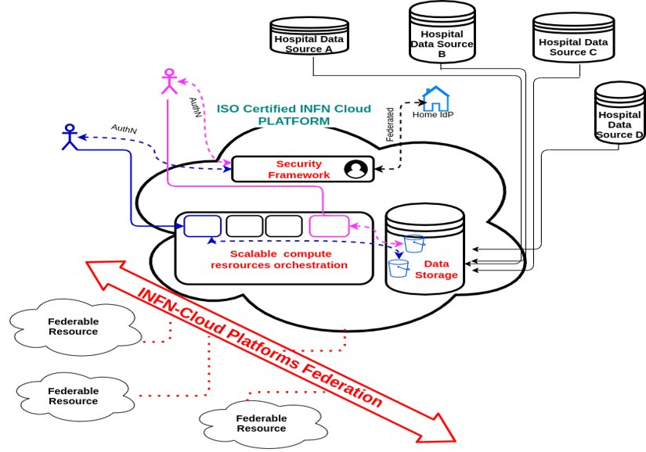
EPIC Cloud enables the federated data lake for health-related projects
In general, we receive heterogeneous requirements form life-science communities: some need central repository, others need to store data locally
Possible scenarios:
  Central harvesting of data collected remotely ​
  Edge-level anonymization and central ingestion and analysis of data ​
  Edge-level Feature Extraction and central ingestion and analysis of features​
  Federated learning (training at local sites and algorithm publishing) ​
https://www.physicamedica.com/article/S1120-1797(21)00320-3/fulltext
Notes:
Vision

Slide 23
Operational and support requirement to offer sensitive data management services within INFN EPIC Cloud

Slide 24
ISO/IEC 27001 27017 27018 certification
This is a certification of the correct implementation of an Information Security Management System (ISMS)
Information Security Management is about preserving the Confidentiality, Integrity and Availability (CIA) of information and associated facilities (systems, services, infrastructure or physical locations)
It ensures business continuity by preventing and reducing the impact of security incidents
Other properties can also be involved, such as authenticity, accountability, non-repudiation, reliability and FAIRness
The objectives of the ISMS are NOT fixed, they depend on the context and are defined by the organization

Slide 25
ISO/IEC 27001 27017 27018 certification
Certification of EPIC Cloud, adding the ISO 27017 and ISO 27018 standards
Certification of multiple sites and all service models: IaaS SaaS PaaS
First certification of a bare metal platform
Migration to a cloud platform
Renewal of certification
2016
2017
2019
2020
2021
2022
2023
2024
In 2017 we started with a bare-metal that was ISO-27001 certified infrastructure
In 2019 we moved to a Cloud-based infrastructure, and EPIC Cloud was born
In 2021 we added the cloud certifications ISO-27017 and ISO-27018
Notes:
Information Security is not achievable with technical measures only, but it is necessary also management measures that nowadays is something required by all national and european frameworks
The ISO 27001 proposes a list of internationally accepted best practices to manage an ISMS exploiting consolidated project management methodologies and processes
The key mechanism of the Management System is the Risk Assessment and Risk Evaluation
We have to aim to a continuous improvement iterating the ISMS processes every year
Requirements must be seen as an input of the system, meaning that they are not fixed a-priori, as they can change with time
Service Availability is a key aspect of ISMS, whose guidelines can be very helpful even though there are not strong requirements about data confidentiality
The certification is needed to demonstrate to stakeholder the ISMS standard adoption by INFN

Slide 26
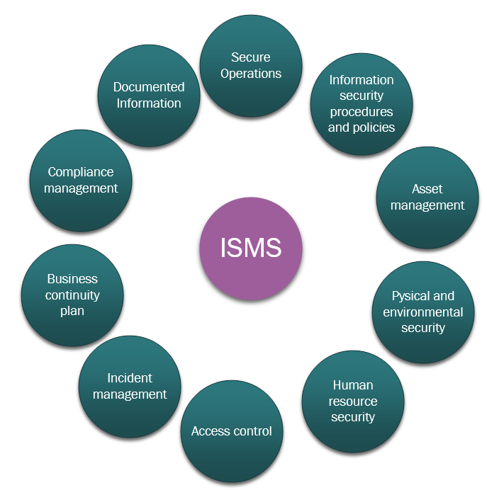
ISMS: what’s all about
Information Security Management System
It is an organizational framework linking all the elements relevant to the information security, to assure that policies, processes and security objectives are implemented, communicated and assessed.
It needs to continually improve -> Deming Cycle
It is centered to the risk assessment process -> all decisions are based on the output of this process
Goal: achieving the optimal CIA balance, i.e., ensuring Confidentiality of information, while still ensuring the information remains accessible to authorized persons and is not altered

Slide 27
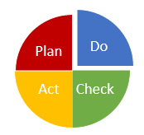
Deming Cycle and Risk Assessment
Plan
(context, leadership, planning & support)
Do
(risk assessment & operations)
Check
(performance evaluation)
Establish the organization
Define the scope
Analyze the context and define the security requirements and objectives
Define the Security Policy
Determine roles and responsabilities
Define the risk assessment approach
Risk Assessment
Monitoring KPI
Control Implementation (Operations)
Control Selection
Internal Audit
External Audit
Effectiveness
Act
(continual improvement)

Slide 28
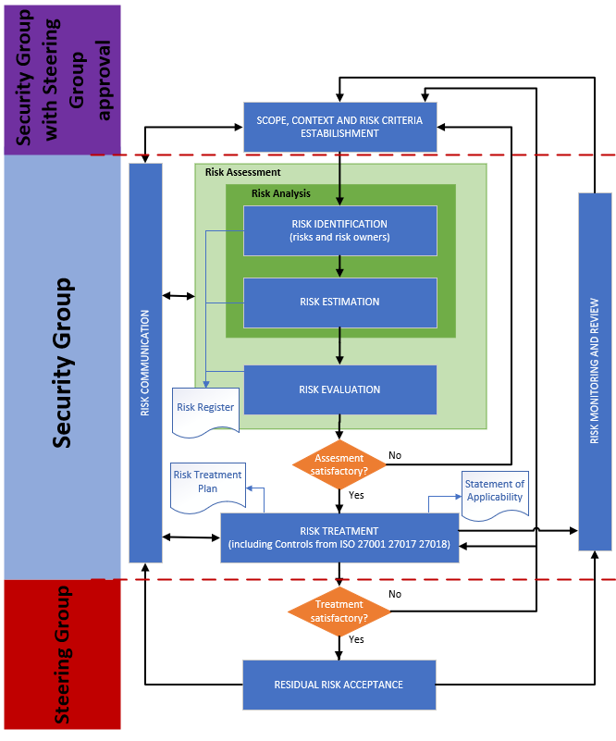
Risk Management
Process in EPIC
Iterative process aimed at supporting the decision-making process
In EPIC is performed once a month and whenever a relevant change in the system occurs
  ISO 27001 clause 8.2 requires to perform it “at planned intervals or when significant changes are proposed or occur, taking account of the criteria established in 6.1.2 a). ”
Established criteria to define Risk Owners

Slide 29
Security Incident Management
Security incidents impacting CIA are managed following a documented security management process
In case of high risk, the incident is escalated to INFN CSIRT (Computer Security Incident Response Team) https://csirt.infn.it
The CSIRT team performs:
  Incident identification
  Incident categorization
  Incident prioritization
  Incident response
  Incident closure
A root cause analysis is also performed to prevent that the same incident occurs again

Slide 30
Required Document Information
8.1 Evidence Operational Planning and Control
A.5.1.1 Information Security Policy
9.2 Evidence of Audit Programme and Results
4.3 Scope
A.13.2.1 Information Transfer Policy and Procedures
A.10.1.2 Key Management Policy
9.3 Evidence of Results of Management Reviews
5.3 Organization Chart
6.1.3 Risk Treatment Process
A.11 Physical and Environmental Security Policy
A.12.2.1 Controls Against Malware Policy
A.6.2.1 Mobile Device Policy
6.2 Security Objectives
A.8.1.3 Acceptable Use of Asset Policy
8.3 Information Security Risk Treatment
ISO/IEC 27001
A.12.3.1 Backup Policy and Procedures
A.10.1.1 Cryptographic Control Policy
A.14.2.1 Secure Development Policy
A.11.2.9 Clean Desk Clean Screen Policy
A.15.1.1 Information Security Policy for Supplier Relationships
A.6.2.2 Teleworking Policy
A.12.6.2 Restrictions on Software Installation
A.14.1 Information Security Requirements Analysis and Specification
A.8.2.1 Information Classification Policy
7.2 Evidence of competence
A.16.1.4 Assessment of & Decision on Information Security Events
A.9.1.1 Access Control Policy
A.8 Asset Management Policy
A.17.2 Redundancies Policy
10.1 Actions Resulting from Nonconformities and Corrective Actions
6.1.2 Risk Assessment Process
8.2 Risk Assessment Results
A.9.3 Password Policy
9.1 Evidence of Monitoring and Measurement Results

Slide 31
Use case examples

Slide 32
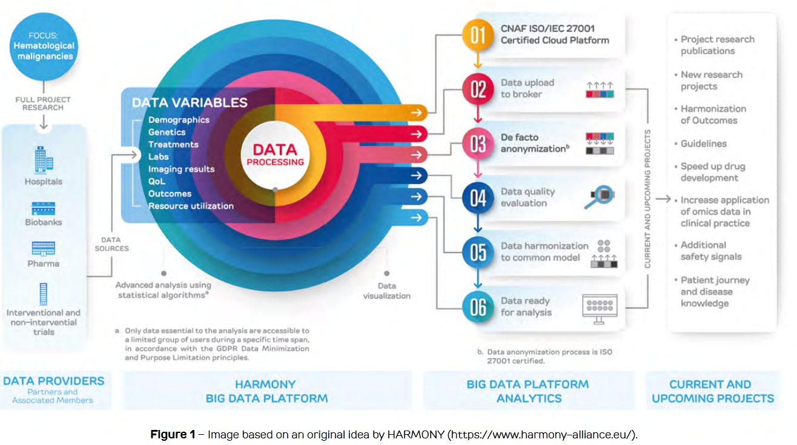
HARMONY / HARMONY PLUS
Healthcare Alliance for Resourceful Medicines Offensive against Neoplasms in Hematology
Two IMI-2 European Projects. HARMONY PLUS, build up on the success of HARMONY, involves 39 partners and 8 Associated Partners from 10 countries.
Use of big data analytics to accelerate blood cancer research
Budget of 42.3M€ for HARMONY and 11.8M€ for HARMONY PLUS
Over 100.000 patient datasets
Harmonization of datasets
Open and Standard interfaces
https://www.harmony-alliance.eu/

Slide 33

HARMONY / HARMONY PLUS
Healthcare Alliance for Resourceful Medicines Offensive against Neoplasms in Hematology
De facto anonymized data
  GDPR does not apply, but the de-facto anonymization procedure assumes that the technology providers are ISO 27001 certified
AgID measures (Standard and some of the Advanced)
IaaS Service Model
  HARMONY is the Data Controller
  We are responsible for the infrastructure
https://www.harmony-alliance.eu/

Slide 34

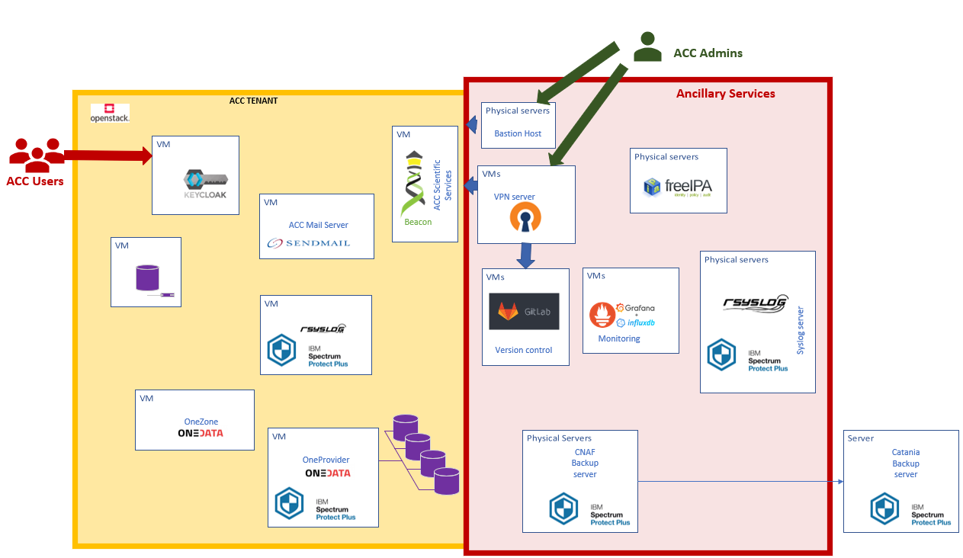
Alleanza Contro il Cancro - ACC
The National Oncology Network founded in 2002 by the Ministry of Health, joined by 51 IRCCS, ISS, AIFA, INFN and Politecnico di Milano and several patients' associations to perform translational research in the field of cancer research.
Genomic pseudonymized data
GDPR applies
AgID measures apply
Italian Data Protection Authority rules apply
https://www.alleanzacontroilcancro.it/en/

Slide 35
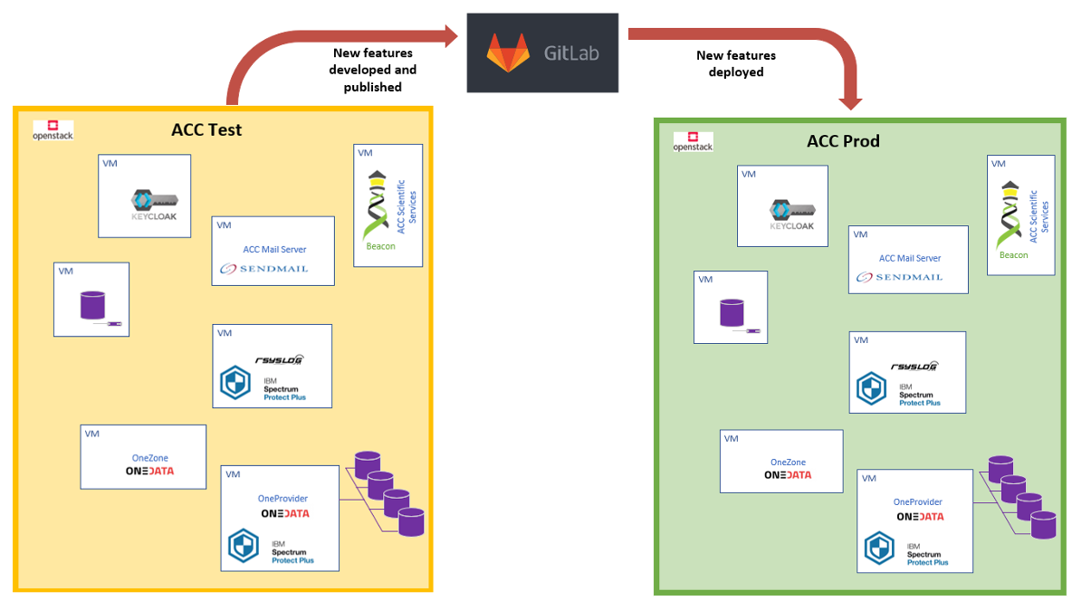
ACC - Services
Alleanza Contro il Cancro
Two separate OpenStack projects:
ACC-Test: services have been configured and tested and every change in configurations has been validated
ACC: where services have been configured and tested and every change in configurations has been validated
Each VM is hardened according to ISO 27001 OpenSCAP profile
https://www.alleanzacontroilcancro.it/en/

Slide 36
PLANET
Pollution Lake ANalysis for Effective Therapy
An INFN funded research initiative aiming to implement an observational study to assess a possible statistical association between environmental pollution and Covid-19 infection, symptoms and course
Data:
  Pseudonymized clinical data (Covid-19 and Electronic Health Records from several hospitals)
  Atmospheric data, population density, urban vs rural environment, mobility, socio-economic
  conditions
Regulated by GDPR, Italian Data Protection Authority and ISS-INFN Convention
Originally deployed on Cloud@CNAF
Our aim is to make this use case the first EPIC SaaS certified service (ambition/need to expand the scope of the ISO certificate to include SaaS services)
Notes:
Is an INFN/CSN5-funded research initiative aiming to implement an observational study to assess a possible statistical association between environmental pollution and Covid-19 infection, symptoms and course.
PLANET builds on a "data-centric" based approach that considers clinical components, environmental and pollution conditions, complementing primary data and many eventual confounding factors such as population density, commuter density, socio-economic metrics and more.

Slide 37
Health Big Data (HBD)
Health Big Data is a 10-years project funded by the Italian Ministry of Health aiming at the creation of a federated and integrated big data platform for the health research at national level
  4 research networks: ACC, RIN, Cardio, IDEA
  Research objectives: preventing diseases, personalizing treatments, improving the quality of life of patients
  Budget: 55M€
Notes:
Is an INFN/CSN5-funded research initiative aiming to implement an observational study to assess a possible statistical association between environmental pollution and Covid-19 infection, symptoms and course.
PLANET builds on a "data-centric" based approach that considers clinical components, environmental and pollution conditions, complementing primary data and many eventual confounding factors such as population density, commuter density, socio-economic metrics and more.

Slide 38
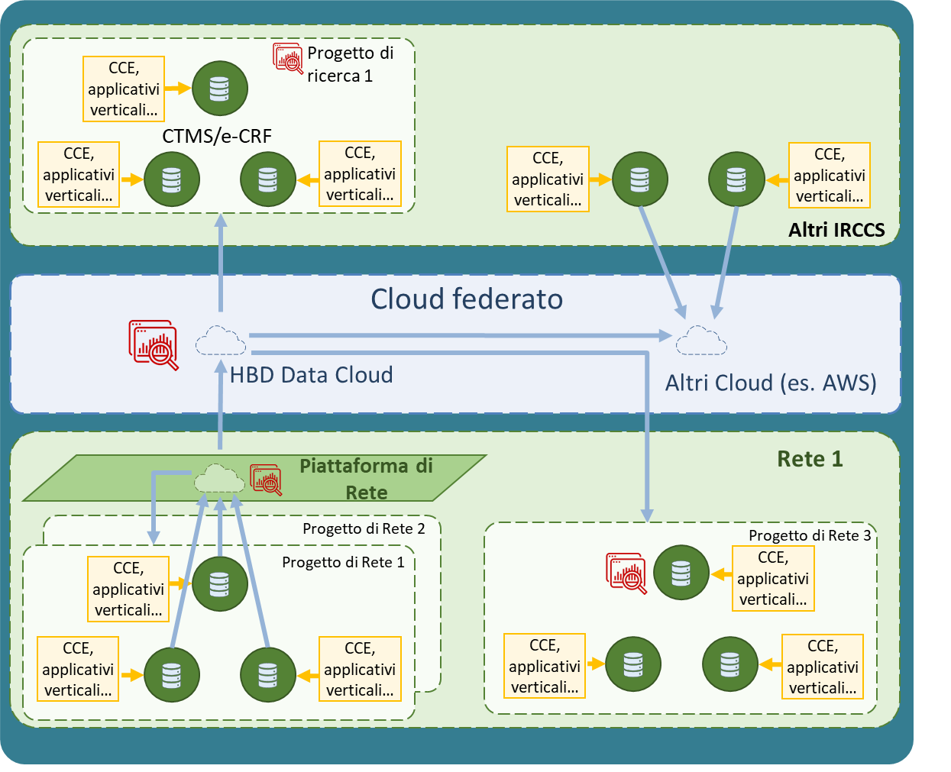
Health Big Data (HBD)
INFN is in the managing board of HBD. Its tasks include the definition of an integrated national platform and contributions to several Work Packages.
The HBD architecture will provide solutions for several scenarios:
  Central harvesting of data collected remotely
  Edge anonymization, followed by central ingestion and analysis of data
  Edge feature extraction, followed by central ingestion and analysis of features
  Federated learning based on edge-based training, followed by publishing of the trained methods and by inference performed either centrally or at other edge locations
Notes:
Is an INFN/CSN5-funded research initiative aiming to implement an observational study to assess a possible statistical association between environmental pollution and Covid-19 infection, symptoms and course.
PLANET builds on a "data-centric" based approach that considers clinical components, environmental and pollution conditions, complementing primary data and many eventual confounding factors such as population density, commuter density, socio-economic metrics and more.

Slide 39
INFN-IRCCS Sant’Orsola Collaboration
Joint research agreement with the following objectives
secure applications for genomic data
GPU -based solutions for genomic analysis methods
federated and integrated cloud platforms for homics data
adaptation of genomic pipelines to cloud and data lake architectures based on microservices
Integration of homics data and other clinical data like Electronic Medical Records (EMR)
Baseline Platform
Apps managed by Sant’Orsola
(Data Controller)
Phase 1
(no personal data)
IaaS managed by INFN
(Data Processor)
New features jointly developed
by Sant’Orsola and INFN on Integration
and then deployed to Baseline
Integration Testing Platform
Apps and IaaS managed by both Sant’Orsola and INFN (Joint Controllers)
Baseline Platform
Apps managed by Sant’Orsola
(Data Controller)
Phase 2
(personal data on both
platforms)
IaaS managed by INFN
(Data Processor)
New features jointly developed
by Sant’Orsola and INFN on Integration
and then deployed to Baseline
Integration Testing Platform
Apps and IaaS managed by both Sant’Orsola and INFN (Joint Controllers)
Baseline Platform
Apps and IaaS managed by both Sant’Orsola and INFN (Joint Controllers)
Phase 3
(personal data on both platforms)
Notes:
Data Controller (titolare dei dati): GDPR is the entity who decides the technical/organizational measures to apply.
Data Processor (responsabile esterno del trattamento dei dati): is has the duty to apply and enforce all the measures decided by the Data Controller
We started with a Phase 1, where we only provided the certified IaaS to Sant’Orsola that remains the owner of the software installed and how it is used.
Right now, we are in the Phase 2, where INFN works on the applications hardening and evolutions in a twin testbed called “Integration”. Within this tenant, both we are joint controllers and that means that both INFN and Sant’Orsola jointly decide about which security (technical and organizational) measures to adopt.
The final goal is to reach the end of Phase 3 with a full hardened platform (IaaS + Applications), that theoretically can be seen as a ”certifiable” SaaS.

Slide 40
Conclusions
EPIC Cloud is the INFN reference architecture for fulfilling the request for trusted Cloud solutions in health-related research fields
EPIC is configured as a secure cloud region inside the INFN Cloud infrastructure, and its IaaS is certified it ISO/IEC 27001 27017 27018
We plan to evolve the Information Security Management System to include all the service models, IaaS, PaaS and SaaS, to expand the certification to Bari and Catania sites by June ’24
Thanks to increasingly stronger collaborations with the health research community, we are evolving our service portfolio to include a growing number of applications and services, driven by use-cases needs
NRRP initiatives heavily rely on the availability of these INFN-backed solutions

Slide 41
Many thanks to all contributors
Alessandro Costantini, Andrea Chierici, Arianna Carbone, Cristina Vistoli, Daniele Cesini, Daniele Spiga, Nadina Foggetti, Davide Salomoni, Diego Ciangottini, Diego Michelotto, Cristina Duma, Giacinto Donvito, Giusy Sergi, Enrico Fattibene, Jacopo Gasparetto, Letizia Magenta, Lorenzo Chiarelli, Luca dell’Agnello, Luigi Scarponi, Stefano Dal Pra, Stefano Longo, Stefano Zani, Patrizia Belluomo, Vincenzo Ciaschini, Barbara Martelli

Slide 42
Backups Slides

Slide 43
Which type of service can we offer?
Responsibility model | IaaS (Infrastructure as a Service) | PaaS (Platform as a Service) | SaaS (Software as a Service)
GRC (Security Governance Risk & Compliance)
Data Security
Application Security
Platform Security
Infrastructure Security
Physical Security
In our cloud solutions (based on EPIC Cloud) the delimitation of responsibility is clearly defined in contracts and agreements signed with each customer, project or collaboration
Customer responsibility
Provider responsibility
Different shared responsibility models

