Slide 1


Ergo & Microsoft
Serge Parson
Data Security and Data Governance Manager

Slide 2
Agenda
Introduction
5 phases to ensure data security and data governance
  Phase 1 Planning & Preparation
  Phase 2 Implementation & Deployment
  Phase 3 Monitoring & Continuous Improvement
  Phase 4 Training & Awareness
  Phase 5 Compliance & regulation
What is in the box ?
Conclusion

Slide 3
Introduction
Data is the lifeblood of modern organizations. It drives decision-making, enables innovation, and creates new opportunities. However, managing data effectively can be challenging, especially for organizations with large and complex data estates..

Slide 4
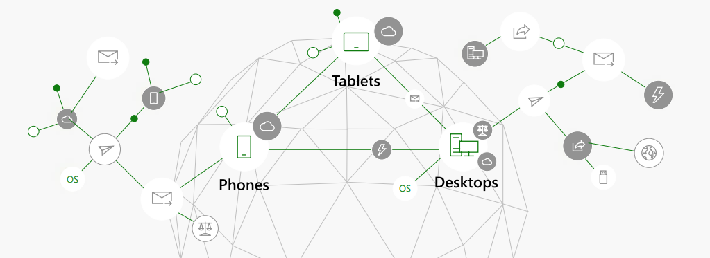
Data usage is evolving and complex breaking the traditional borders of business

Slide 5
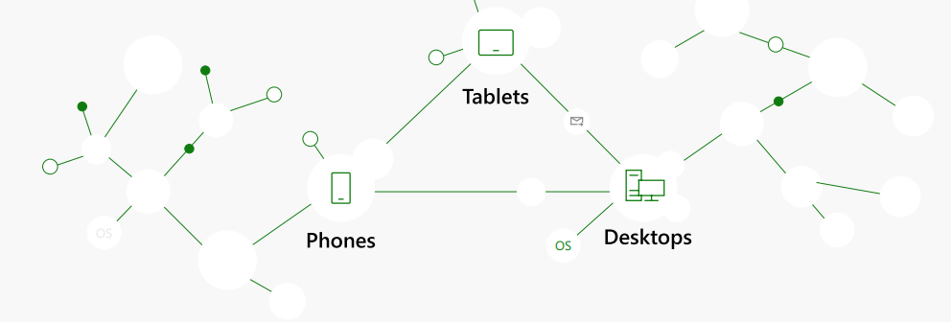
Organizations lack of visibility into their data
Data growth double year over year and 93% of data is considered dark

Slide 6
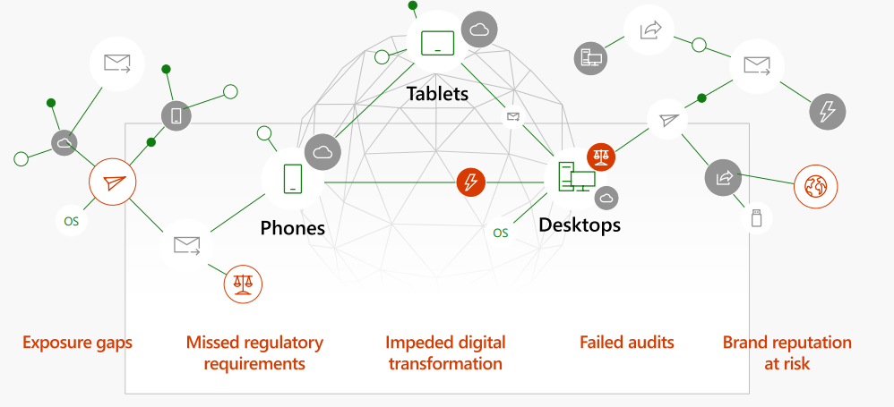
The landscape is fragmented, creating risk

Slide 7
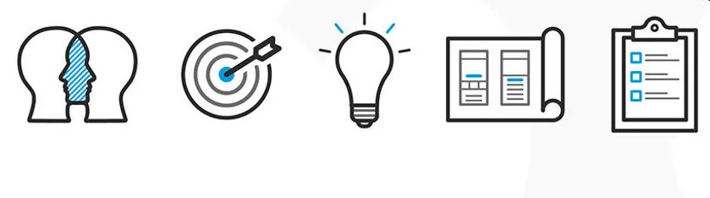
5 phases to ensure data security and data governance

Slide 8


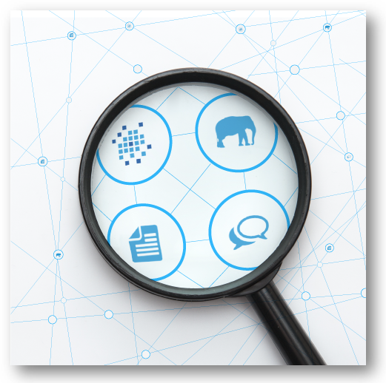
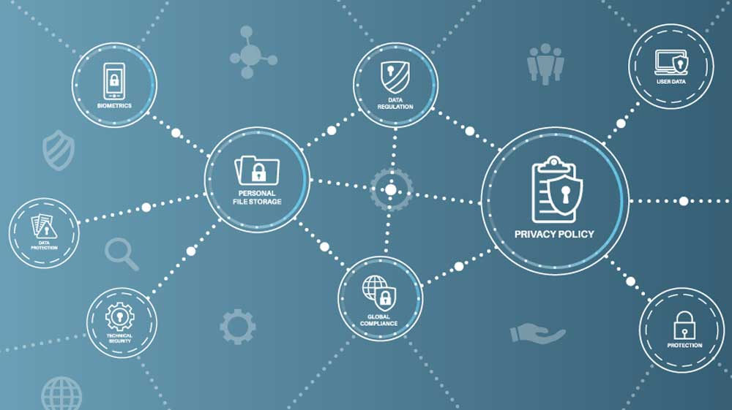
Phase 1: Planning & Preparation
Define Role
Identify Data Assets
Define Data Classification
Notes:
Planning and Preparation:
a. Identify Data Assets: Assess the organization's data landscape, identifying sensitive data types, including PII (Personally Identifiable Information), GDPR (General Data Protection Regulation), and CPI (California Consumer Privacy Act) regulated data.
b. Define Data Classification: Classify data based on its sensitivity, risk, and usage requirements. This helps prioritize data protection measures and resource allocation.
c. Establish Data Governance Policy: Develop a comprehensive data governance policy outlining data ownership, access controls, retention policies, and data usage guidelines.
d. Conduct Risk Assessment: Evaluate the organization's data security posture, identifying potential risks and vulnerabilities. Prioritize mitigation strategies based on risk severity.

Slide 9
Phase 1: Planning & Preparation
DPO
DSO
Data Governance Committee
Data Stewards
Define Role
Notes:
to ensure regulatory compliance, organizations need to have data governance structures in place that define how data is collected, stored, used, and disposed of. These structures should include the following elements:
Roles and responsibilities: The organization should clearly define who is responsible for different aspects of data governance, such as data quality, data security, and data compliance.
Policies and procedures: The organization should have documented policies and procedures in place that govern how data is managed. These policies and procedures should be aligned with the organization's regulatory requirements.
Data governance committee: A data governance committee is a cross-functional group of individuals who are responsible for overseeing the organization's data governance program. The committee should include representatives from different departments, such as IT, legal, and compliance.
Data stewards: Data stewards are individuals who are responsible for the management of specific data sets or data domains. Data stewards are responsible for ensuring that the data in their care is accurate, complete, secure, and compliant with all applicable regulations.
Data privacy officer (DPO): A DPO is responsible for overseeing the organization's data privacy compliance program. The DPO should be independent from other departments, such as IT and marketing.
Data security officer (DSO): A DSO is responsible for overseeing the organization's data security program. The DSO should be responsible for implementing and managing security controls to protect the organization's data from unauthorized access, use, disclosure, or destruction

Slide 10
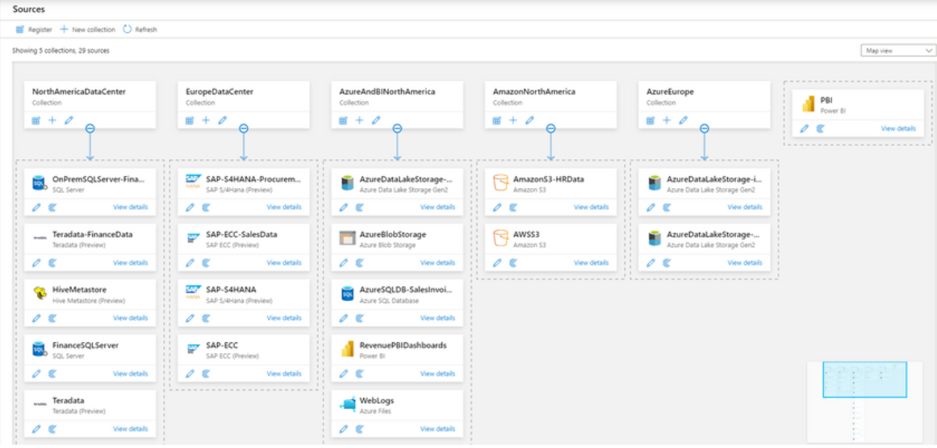
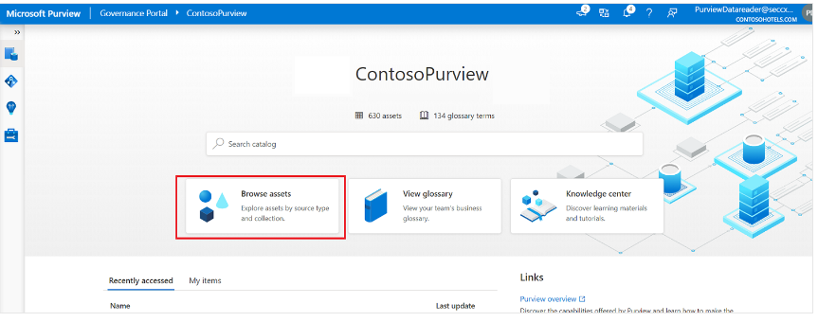
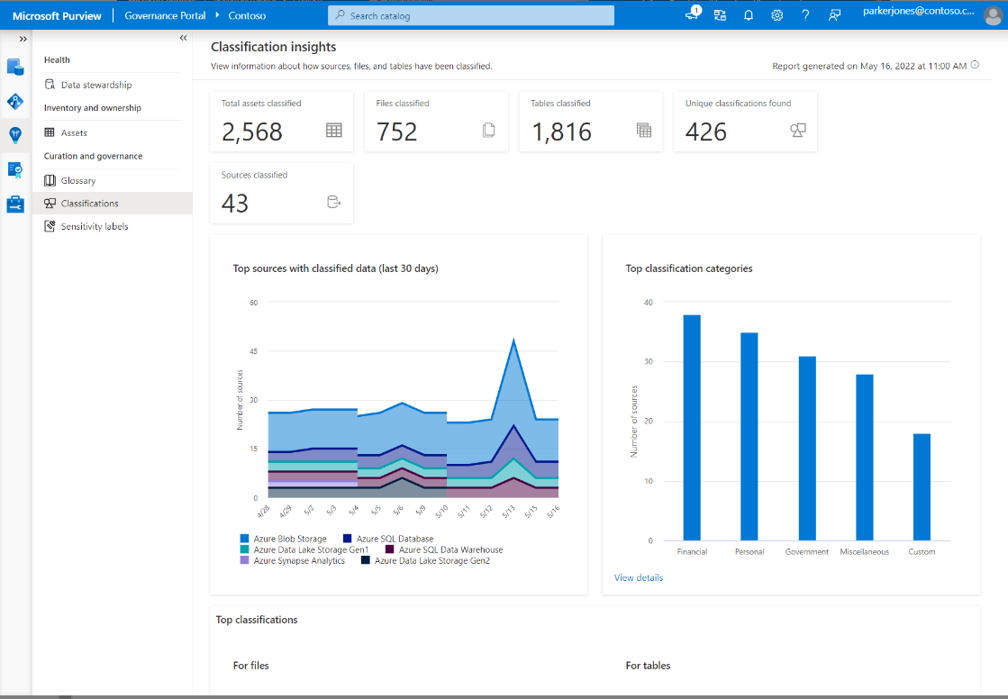
Phase 1: Planning & Preparation
Identify Data Assets
Define Data Classification
Data Map
Data Catalog
Data Estate Insights
Notes:
Planning and Preparation: a. Identify Data Assets: Assess the organization's data landscape, identifying sensitive data types, including PII (Personally Identifiable Information), GDPR (General Data Protection Regulation), and CPI (California Consumer Privacy Act) regulated data.
b. Define Data Classification: Classify data based on its sensitivity, risk, and usage requirements. This helps prioritize data protection measures and resource allocation.
c. Establish Data Governance Policy: Develop a comprehensive data governance policy outlining data ownership, access controls, retention policies, and data usage guidelines.
d. Conduct Risk Assessment: Evaluate the organization's data security posture, identifying potential risks and vulnerabilities. Prioritize mitigation strategies based on risk severity.

Slide 11

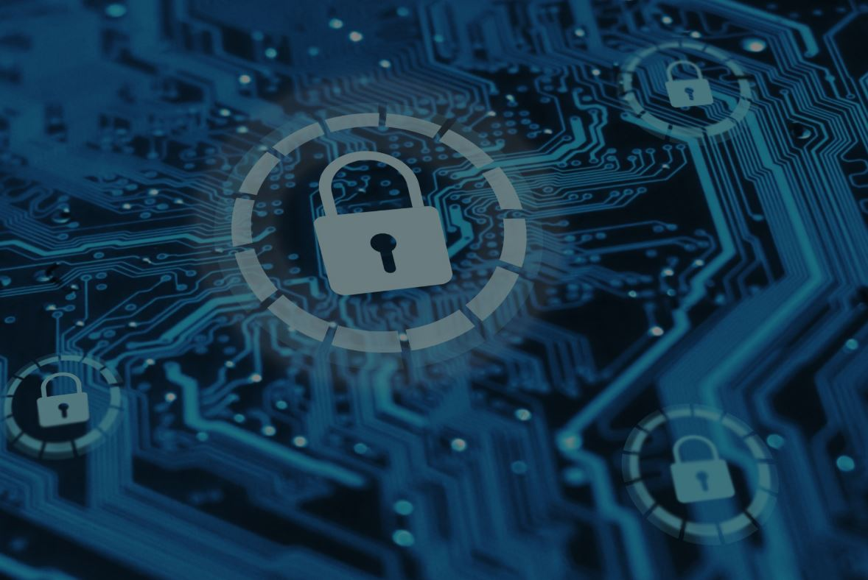
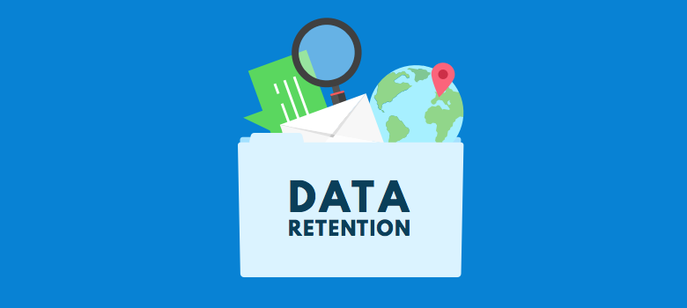
Phase 2: Implementation & Deployment
Implement Security Controls
Implement Data Retention Policies
Notes:
a. Implement Security Controls: Implement technical security controls, such as access controls, encryption, data loss prevention (DLP), and intrusion detection systems (IDS), to protect data from unauthorized access, modification, and destruction.
b. Establish Data Ownership and Access: Define data ownership and access roles, ensuring only authorized personnel can access sensitive data. Implement least privilege access principles, granting users the minimum access required to perform their duties.
c. Implement Data Retention Policies: Design data retention policies specifying how long different types of data should be retained. Implement automated data archiving and deletion mechanisms to comply with regulatory requirements.
d. Data Breach Response Plan: Develop a comprehensive data breach response plan outlining procedures for identifying, investigating, containing, and remediating data breaches. Conduct regular training and awareness sessions to prepare employees for potential breaches.

Slide 12
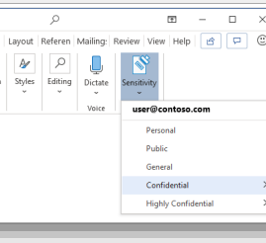

Phase 2: Implementation & Deployment
Implement Security Controls
Purview Information Protection
Discover and Classify data at scale
Safeguard data throughout its life cycle with labelling and encryption
Extend the protection experience across environment to protect data wherever it lives
Notes:
• Discover and classify data at scale using automation and machine-learning
Safeguard data throughout its lifecycle with labeling and encryption built into productivity tools
Extend the protection experience across environments to protect data wherever it lives

Slide 13
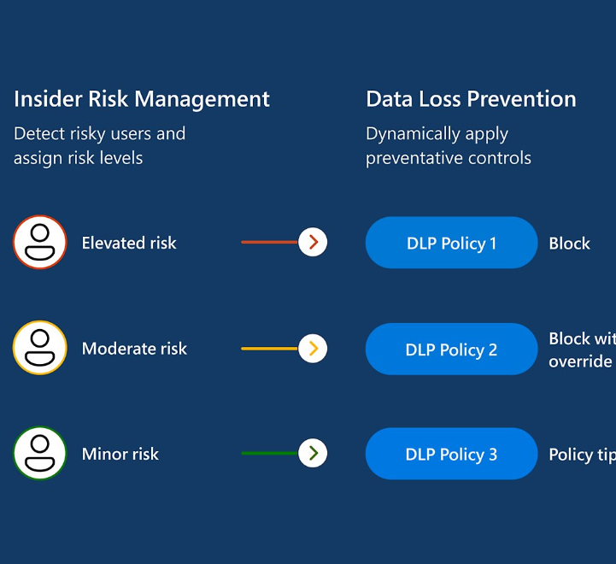

Phase 2: Implementation & Deployment
Implement Security Controls
Purview Data Loss Prevention
Context-aware detections
Dynamic controls
Automated mitigation
Notes:
Context aware detection helps you identify the most critical risks with the ML-driven analysis in Insider Risk management
Dynamic controls eforce effective DLP controls on high risk users while others maintain productivy
Automated mitigation minimize the impact of potential data security incidents and reduce admin overhead

Slide 14
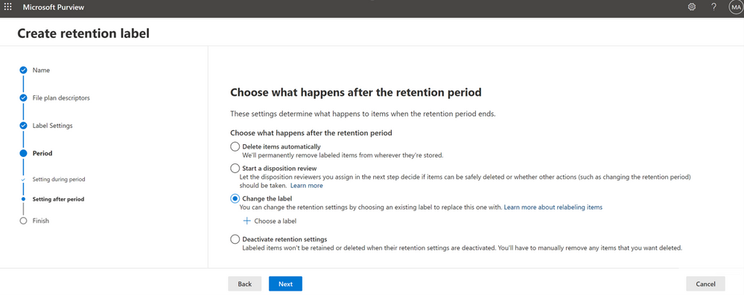
Phase 2: Implementation & Deployment
Implement Data Retention Policies
Purview Data Lifecycle Management
Retain or delete data and manage records where users collaborate to manage risk.
Demonstrate compliance with label analytics insights, defensible disposal, and rich audit trails
Notes:
Retain or delete data and manage records where users collaborate to manage risk and prevent productivity loss
Demonstrate compliance with label analytics insights, defensible disposal, and rich audit trails
Manage non-Microsoft data import with pre-built data connectors*

Slide 15
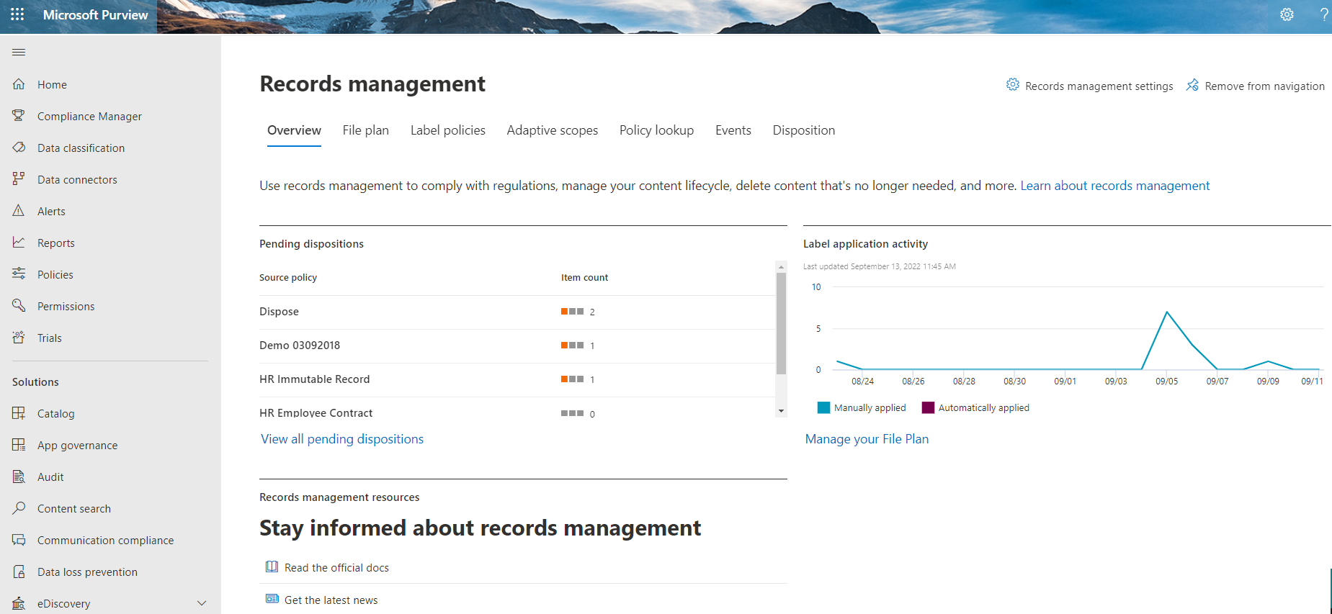

Phase 2: Implementation & Deployment
Implement Data Retention Policies
Purview Records Management
Manage regulatory, legal and business critical records labels and disposition
Manage your retention requirements
Start different retention periods when an event occurs
Set permission for records manager with audit trail
Notes:
Manage regulatory, legal, and business critical records with records labels and regular disposition.
Manage your retention requirements with a file plan.
• Start different retention periods when an event occurs with event-based retention
Set specific permissions for records manager functions and review, validate, and export disposition details.

Slide 16
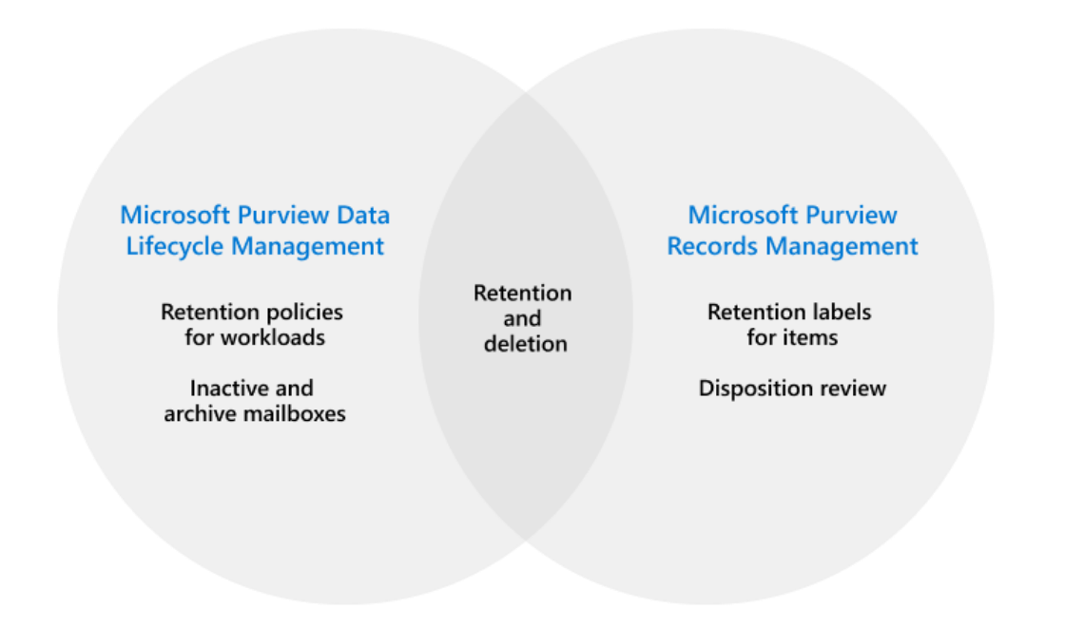
Phase 2: Implementation & Deployment
Implement Data Retention Policies
Why Data Retention & Deletion is important?
Notes:
Keeping data longer than needed or required…
• imposes significant costs and risks for your organization
Removing data sooner than you should… •
may cause undue hardship if it’s required for business reasons •
may make you non-compliant with policies and government regulations
Tools to manage retention and policy-based deletion are needed to balance these needs in a uniform way

Slide 17

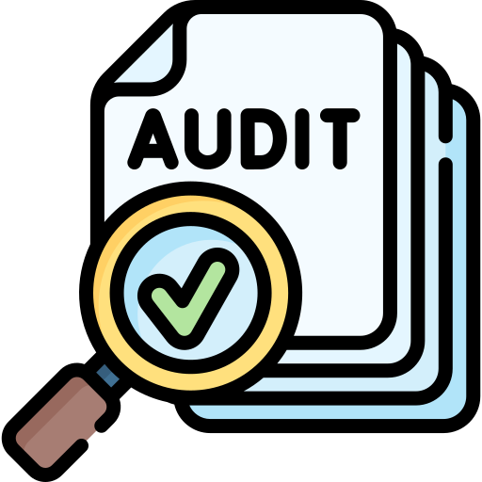
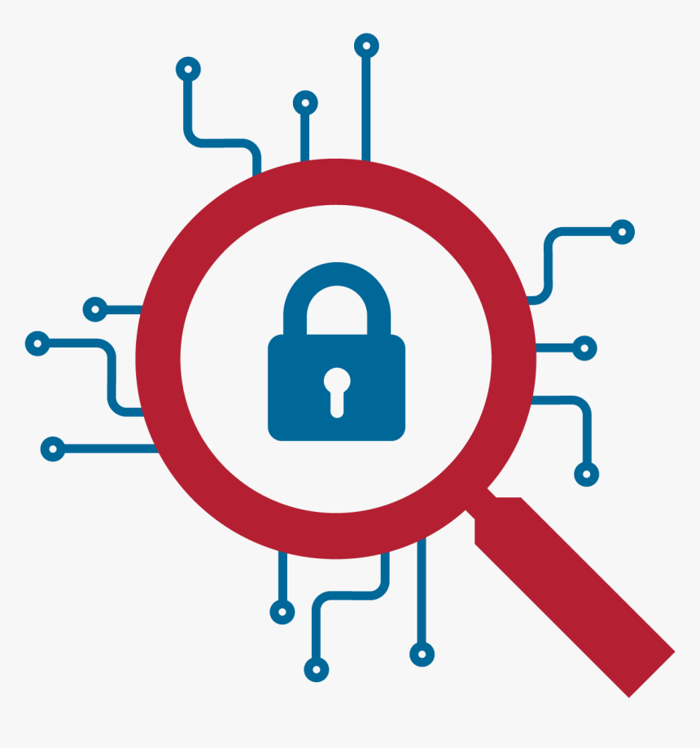
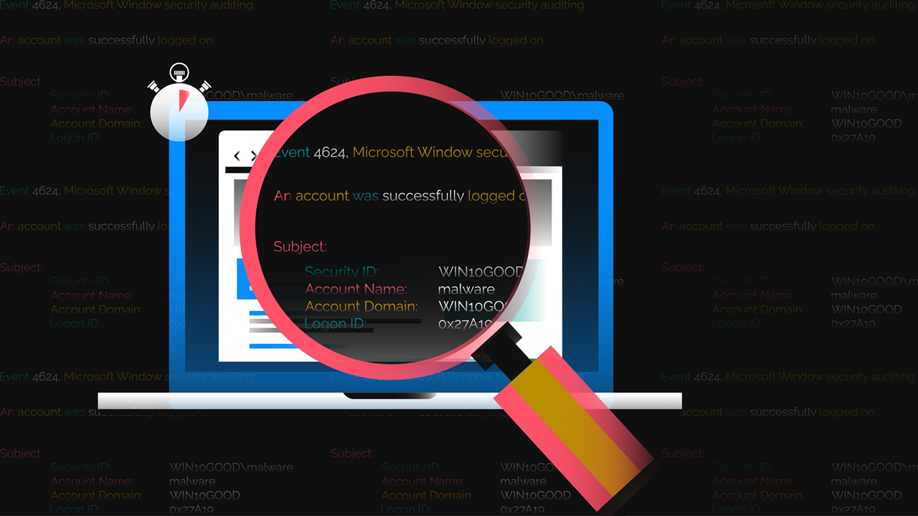
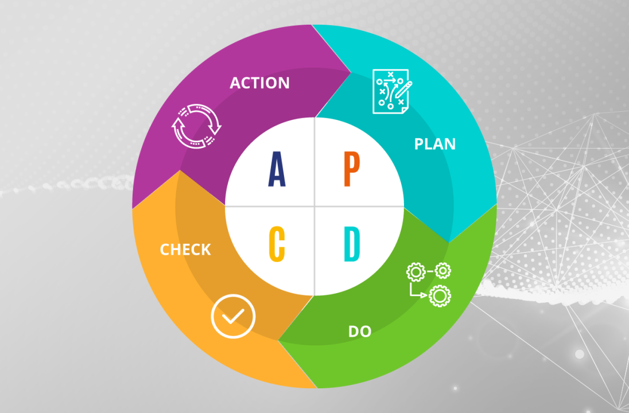
Phase 3: Monitoring & Continuous Improvement
Conduct Regular Audit
Implement Security Monitoring
Analyse Security logs
Continuously Improve Data Security
Notes:
Monitoring and Continuous Improvement: a. Implement Security Monitoring: Establish continuous security monitoring using security information and event management (SIEM) tools to detect and respond to security incidents in real-time.
b. Conduct Regular Audits: Regularly conduct internal and external audits to assess compliance with data security policies, regulatory requirements, and industry standards.
c. Analyze Security Logs: Regularly review security logs for suspicious activity and identify potential threats. Implement threat hunting and incident response procedures to address identified issues.
d. Continuously Improve Data Security: Continuously evaluate and enhance data security measures based on evolving threats, industry best practices, and regulatory changes

Slide 18
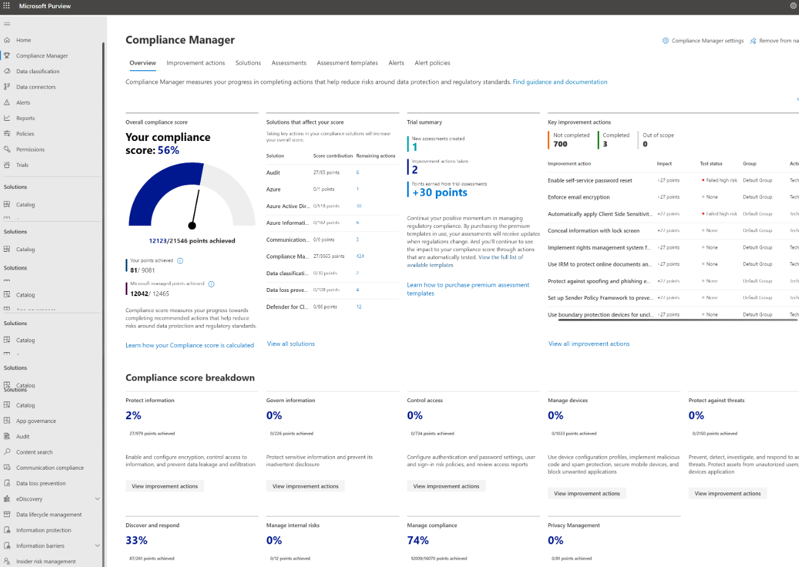

Phase 3: Monitoring & Continuous Improvement
Conduct Regular Audit
Purview Compliance Manager
Manage end-to-end compliance from easy onboarding control
Configure out of the box assessments to meet your requirements across all assets
Simplify compliance
Detailed step-by-step guidance on improvement actions
Notes:
Manage end-to-end compliance from easy onboarding to control implementation
Configure out of the box (pre-built) assessments to meet your requirements across all assets
Simplify compliance with continuous assessments, automated control mapping, and a compliance score
Detailed step-by-step guidance on improvement actions

Slide 19
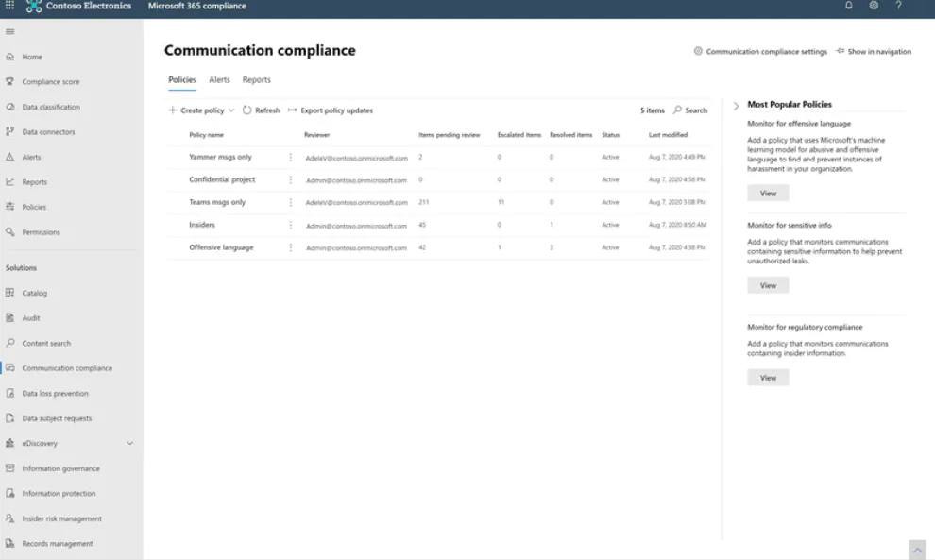
Phase 3: Monitoring & Continuous Improvement
Conduct Regular Audit
Purview Communication Compliance
Intelligent customizable playbooks to detect violations.
Flexible remediation workflow to enhance response
Identify and investigations communication risks
Notes:
Intelligent customizable playbooks detect violations across Teams, Exchange, Engage, and third-party content to detect violations such as confidential information, harassing, threatening language, or adult content
Flexible remediation workflows enable quick action on violations, like remove incriminating messages on Teams
Identify and investigate communications risks while maintaining end-user privacy

Slide 20
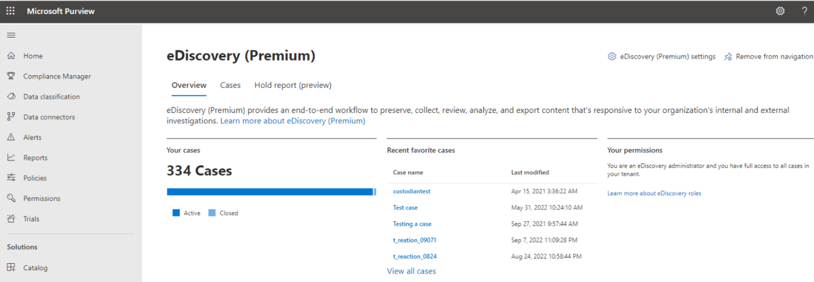
Phase 3: Monitoring & Continuous Improvement
Conduct Regular Audit
Purview eDiscovery
Preserve content by custodian and hold notification
Review and manage static sets of documents withing a case
Duplicate detection, email threading, themes to help identify potential high value content.
Notes:
Preserve content by custodian, send hold notifications, and track acknowledgements
Review and manage static sets of documents within a case, that can be independently searched, analyzed, shared, and acted upon
Identify and investigate communications risks while maintaining end-user privacy

Slide 21
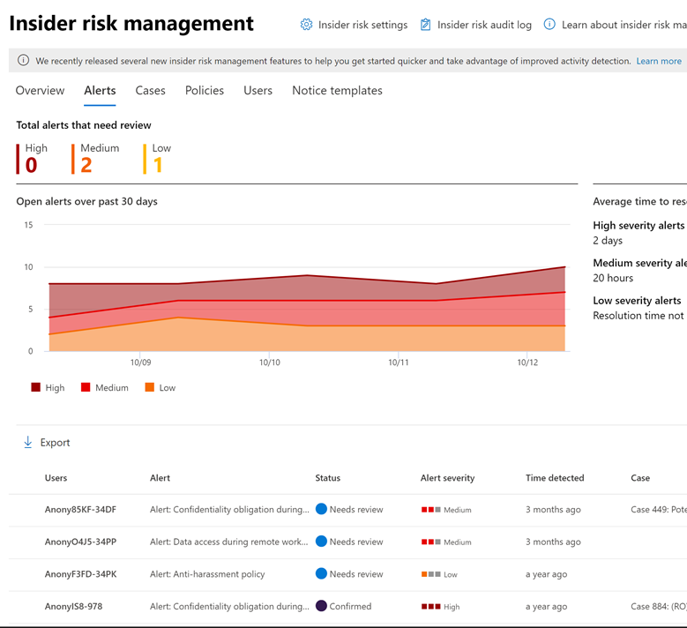
Phase 3: Monitoring & Continuous Improvement
Implement Security Monitoring
Purview Insider Risk Management Monitoring
Protect user trust and build a holistic insider risk program with strong privacy control
Identify hidden risks with hundreds of built-in models and indicators
Expedite mitigation with enriched investigation and adaptive protection enforcing dynamic controls
Notes:
Protect user trust and build a holistic insider risk program with pseudonymization and strong privacy controls
`• Identify hidden risks with hundreds of builtin machine-learning models and indicators, requiring no endpoint agents.
• Expedite mitigation with enriched investigations and adaptive protection that enforce controls dynamically.

Slide 22
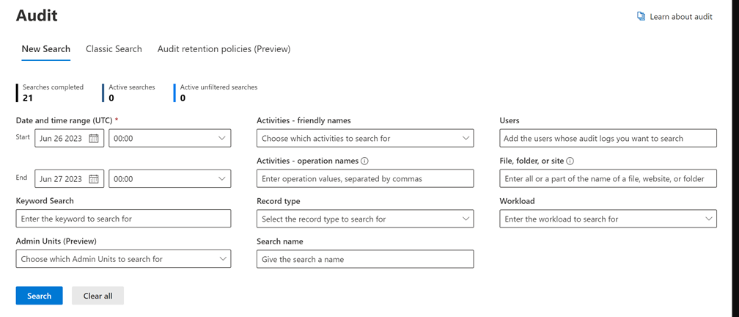
Phase 3: Monitoring & Continuous Improvement
Analyse Security logs
Purview Audit
Find additional event that are important for investigations.
Preserve audit logs for up to year
Standard audit = 90 days retention
High bandwidth access to data to export via PowerShell
Notes:
• Tap into additional events that are important for forensic investigations (e.g. mail items accessed, mail send, user search) and enabled by default
Preserve audit logs for up to a year, with option for 10-year retention add-on (premium)
Standard audit = 90 day retention and no mailitemaccessed activity

Slide 23
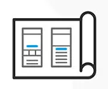
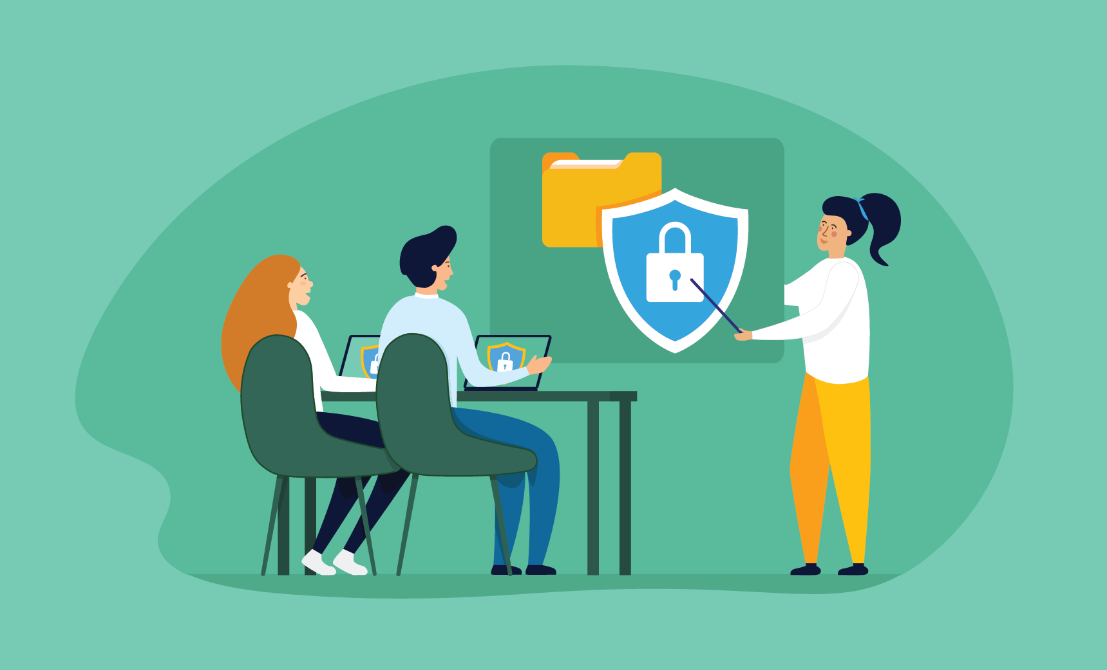

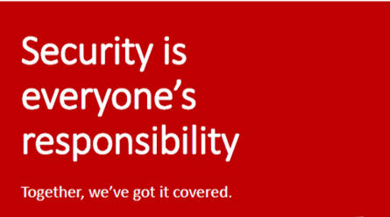
Phase 4: Training & Awareness
Provide Data Security Training
Incorporate Data Security Culture
Promote Data Security Culture
Notes:
a. Provide Data Security Training: Conduct regular data security awareness training for all employees, covering topics such as phishing scams, social engineering attacks, password management, and data handling practices.
b. Incorporate Data Security into Culture: Integrate data security awareness into the organization's culture, emphasizing the importance of data protection and individual accountability.
c. Promote Data Security Culture: Foster a culture of data security, encouraging employees to report suspicious activity and promote responsible data handling practices.

Slide 24
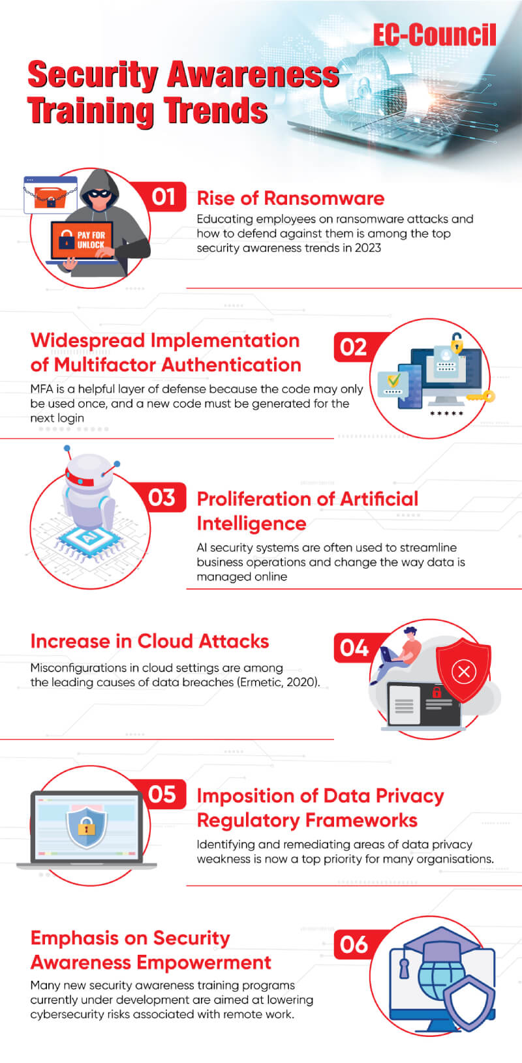
Phase 4: Training & Awareness
Provide Data Security Training
Incorporate Data Security Culture
Phishing Stats
Increase of 47.2 % number of attacks YoY
Life Science had 114 Million attack in 2023
Most Imitate brand in an attack Microsoft
Notes:
Apart from outlining the threats, the aim of security awareness training should also offer guidance on the importance of security awareness, the challenges involved, and how to overcome these challenges. As cybersecurity threats constantly change, security awareness training should be designed to help employees be alert to the latest threats and take appropriate defensive steps.
Organizations must educate employees on the importance of protecting their data and systems, regardless of their job function. Running phishing simulations, conducting vulnerability assessment tests, and creating personalized content for security training and education are vital in improving defense systems. Making updates should prioritize feedback from these processes. When employees know about cyber security risks, organizations are less likely to be hacked and can worry less about massive data breaches. Read the complete whitepaper here.

Slide 25

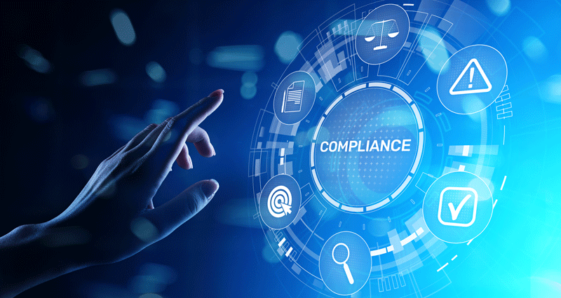
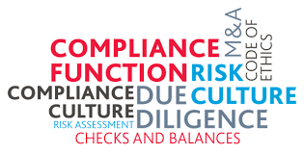
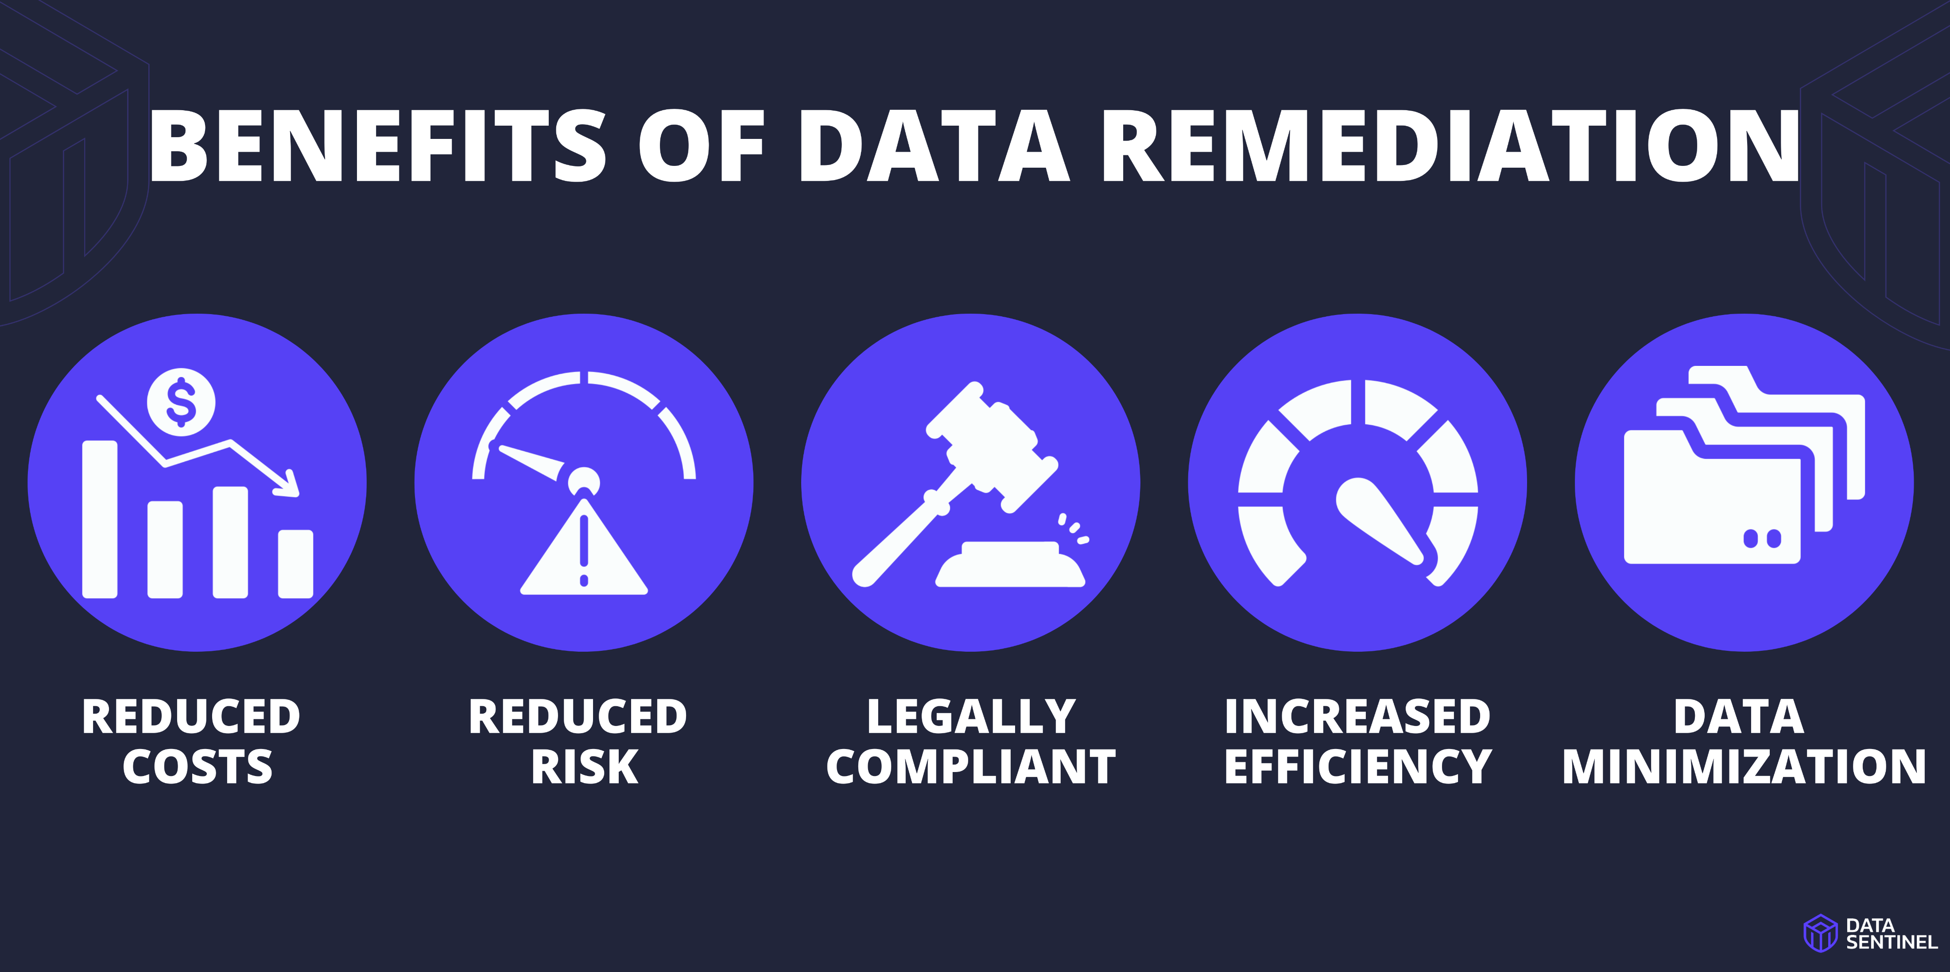
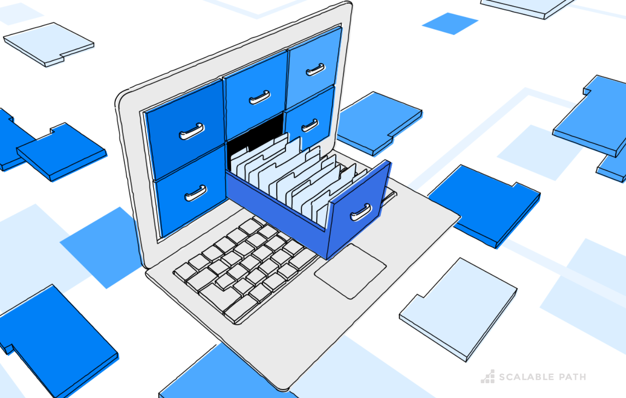
Phase 5: Compliance & Enforcement
Stay updated on Regulations
Conduct Compliance Assessments
Implement Remediation Procedures
Maintain Documentation
Notes:
a. Stay Updated on Regulations: Regularly review and update data security policies in accordance with evolving regulatory requirements, such as GDPR, CCPA, and other relevant data privacy laws.
b. Conduct Compliance Assessments: Regularly conduct compliance assessments to ensure adherence to data privacy regulations and industry standards.
c. Implement Remediation Procedures: Proactively identify and remediate any gaps or non-compliance issues identified during assessments.
d. Maintain Documentation: Document all data security policies, procedures, and compliance requirements to ensure clarity and accountability

Slide 26

What ‘s in the box?

Slide 27
What do you need?

Slide 28
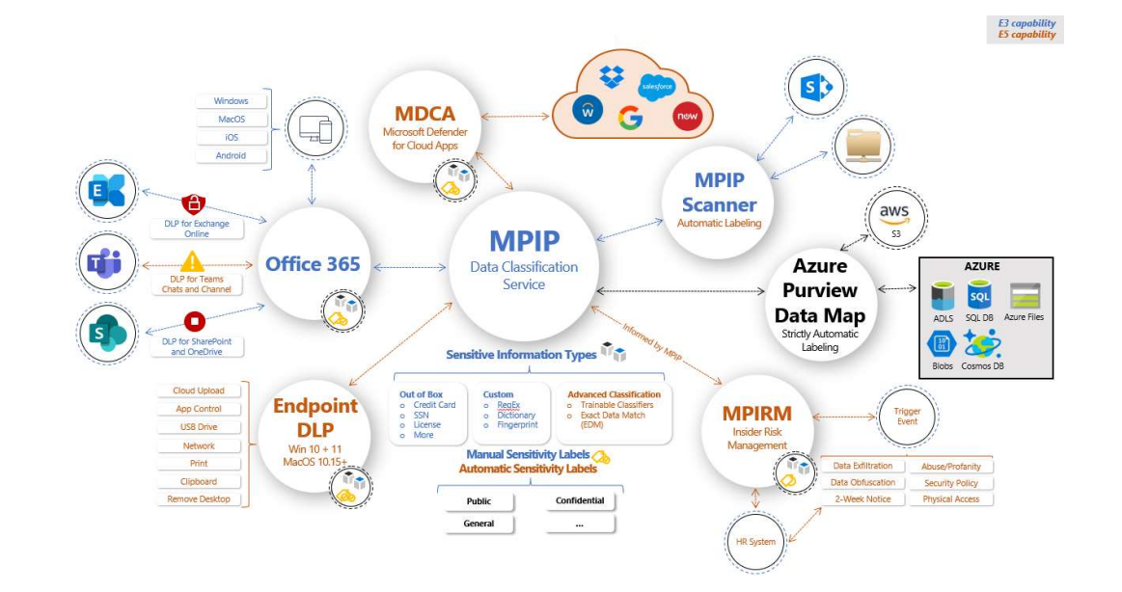
What do you need?

Slide 29
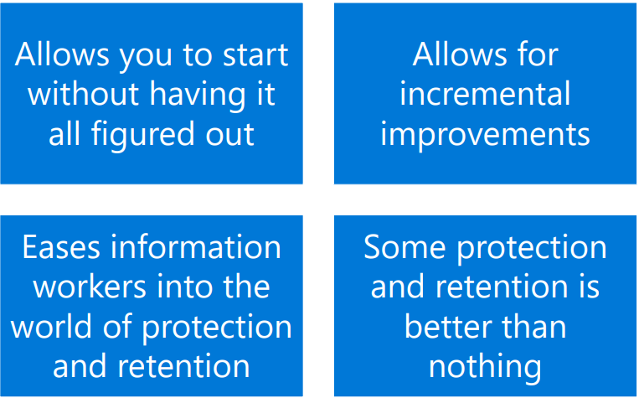
How do you learn to fully use Purview
Utilizing a crawl-walk-run strategy

Slide 30
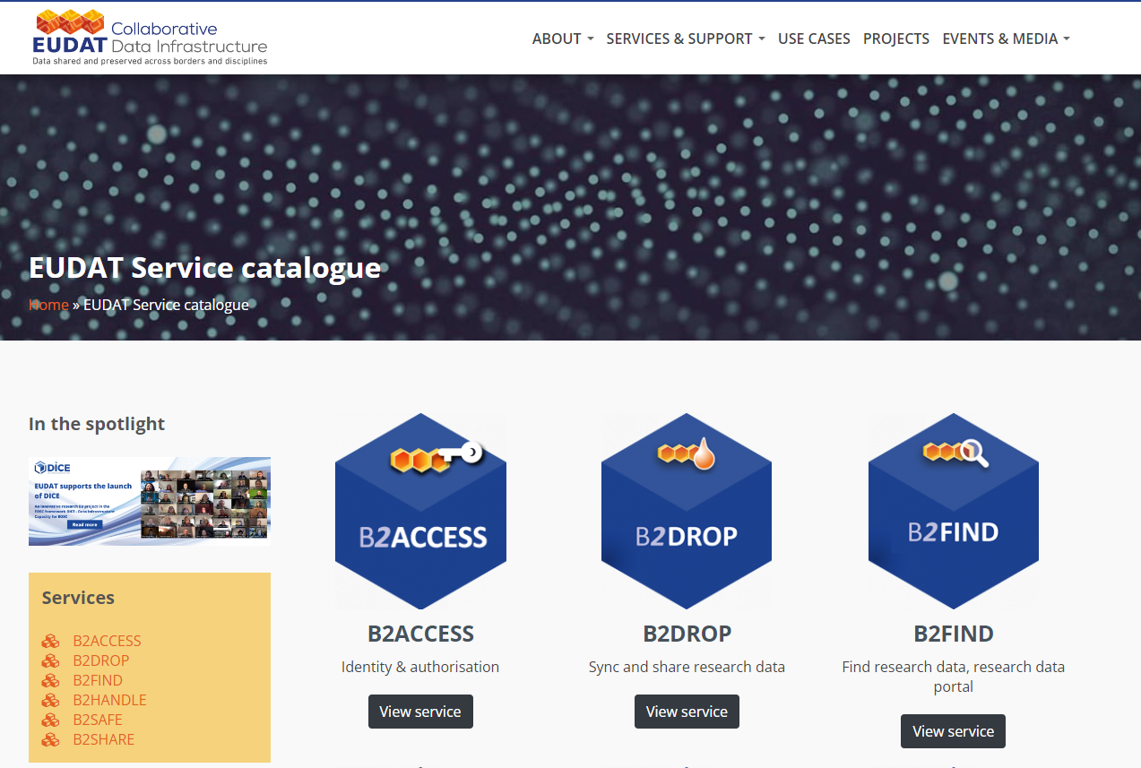
Collaborating without Microsoft
Use Case:
Research Institute:
CompBioMed
Challenge:
Transfer, management and longer-term preservation of sensitive data
Benefits:
Alignment with international standards and approaches for FAIR data management

Slide 31
Conclusion

Slide 32

Thank you
Serge Parson
Data Security & Governance Manager
M: +353 877056350
Email:serge.parson@ergogroup.ie

