Slide 1
IRLDAT SAF
Towards the definition of a national production quality service.
IRLDAT Team
11th December 2023

Slide 2
Agenda and expectations
Introduction
Service provider experience with pilot so far
User experience with provider so far
Start discussion on options and considerations for national production quality service
  Not decided today, but discuss the options to consider, and what needs to be taken into account

Slide 3
National Action Plan to transition towards Open Research
Ireland’s National Action Plan for Open Research: a roadmap for the implementation of open research across Ireland
Structured across 3 themes:
  Establishing a culture of open research;
  achieving 100% open access to research publications;
  enabling FAIR research data and other outputs
2 years from 1 Nov 2022, 1.75M funding from HEA
See https://norf.ie/funding/
  NAP2023 calls launched recently
See https://norf.ie/national-action-plan/

Slide 4
6 Actions
National Open Access monitoring
Open Access repository assessment and alignment
Open Access transition programme
Open Research training programme
National data stewardship network
Shared data storage service pilot for active research data
A competitive call May-October 2022
  Notification of award on 14th October
  Start 1st Nov 2022
See https://norf.ie/funding/

Slide 5





Action N.6 IRLDAT

Slide 6
Aims and Objectives
Understanding researcher data storage and sharing requirements
Build a platform to be tested and used by researchers for the duration of the pilot.
Design a management, operational and governance model appropriate for the service.
Leverage findings to develop a formal proposal to set up a national production-based environment covering service design, architecture, resourcing, funding and sustainability proposals

Slide 7
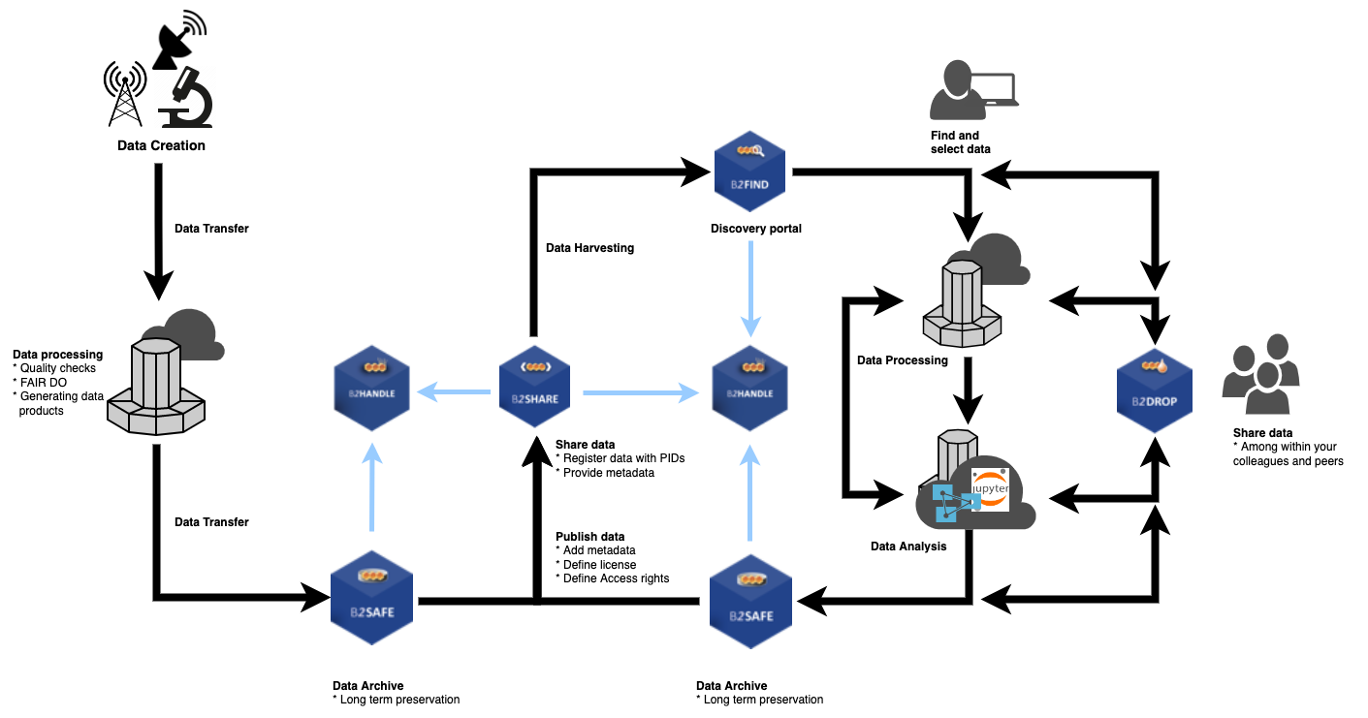
Research Data Life Cycle

Slide 8




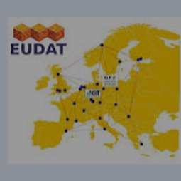
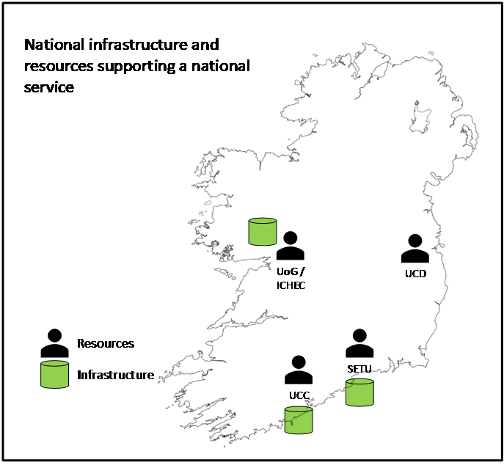




: National Shared Storage Service
NORF Open Research Fund 2022
Partners:
HEAnet: co-ordinator
EUDAT: expertise and technology provider
ICHEC, SETU, UCC, UCD: expertise and infrastructure providers
11 Use cases from:
GeoData
IoT for smart roads
Material sciences
Social Sciences
Humanities
Life Sciences
Wider sector engagement through Stakeholder Advisory Forum
Next meeting 11 December 2023, Dublin
Contact: Roberto.Sabatino@heanet.ie
Develop and run a pilot for a national service for active research data. Leverage findings to develop the specification of a national production-quality and sustainable service.
Phase 1
Verify services on EUDAT European infrastructure with 2 use cases.
Phase 2
Onboard pilot users on
national infrastructure
Phase 3
Develop specification for a national production quality and sustainable service
Design and implement national pilot infrastructure

Slide 9
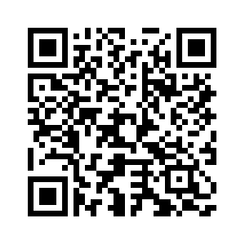
Joining the SAF
Communication with the SAF occurs via a mailing list: IRLDAT-SAF@listserv.heanet.ie.
To subscribe to the mailing list:

Slide 10




ICHEC Infrastructure for IRLDAT Pilot
Region: EU-West-1
AWS S3 Bucket
VM Software Components and Versions
Linux 5.10.0-25-cloud-amd64 #1 SMP Debian 5.10.191-1 (2023-08-16) | Nextcloud version: 26.0.6 - 26.0.6.1
mysql 10.5.19 | Apache/2.4.56 (Debian) (apache2handler)
PHP version: 8.2.10 | VM Backed Up? = Yes
File Versioning = NextCloud Defaults | Large File Parameters and Timeouts Setup per Uploading Big Files guide
B2Drop - Nextcloud Server / MySQL DB
Single r6i.large EC2 Instance Type

Slide 11
Observations from User Onboarding
Observations | Comment
Use Cases still not ready from initial list | Time constraints, resource constraints, though are interested in the platform
B2ACCESS usability | Too easy for admin to accidentally delete themselves or use case users from Upman console if not careful to filter users being managed, as admin I found it slow in browser, be nice to include option of IRLDAT instance in the invitation as a link field, so the user gets that alongside the confirmation of registration message same as link option I get if I invite user as local IRLDAT instance user
Add advanced permission rule for groups, B2ACCESS Group Administrator options | Works and does what we need; feels clunky using the Deny on child folders. Be nice if group administrator(s) could see the view (Create Group, Add Users) via Upman console like a non-B2ACCESS group admin sees on local instance UI
B2ACCESS and MFA | SSO and MFA works fine for users with institute logon integrated with B2ACCESS. Regular username accounts don’t have MFA support (unless you bypass B2ACCESS) and add them locally on the IRLDAT instance or use social identity login (with MFA enabled in B2ACCESS). Planned in B2ACCESS in 2024
Desktop client issues on AWS S3 as primary storage (did not affect non-S3 NextCloud storage) | A bug was introduced by NC Desktop Client developer which took several weeks to resolve and impacted ICRAG in our case – raised question of dependencies, potentially using a forked codebase (and personnel to support)

Slide 12

Model for Future Sustainable Service – Considerations and Options
Technical
  Is Nextcloud-like sync and share service sufficient?
  How to manage inter-institutional sharing? B2ACCESS + EUDAT?
  How to provide technical support?
Governance
  Who decides which projects supported and how much resources?
  Policies on security, criteria for supported projects, etc.
  Oversight of service & how it develops
Funding
  Hardware, operational costs, staff.
  Multi-annual + long term
  Should projects pay for usage?
Centralise
OR
Federate?

