Slide 1
IRLDAT: from pilot to service
IRLDAT SAF
18th April 2024
IRLDAT team

Slide 2
Agenda
Recap on IRLDAT project
Technical Options
Operations
Towards the definition of a production service
Examples of national service from other countries
How might a national service be funded, cost recovery scenarios
Example financial analysis
Open discussion on business models
Your input on expected demand

Slide 3
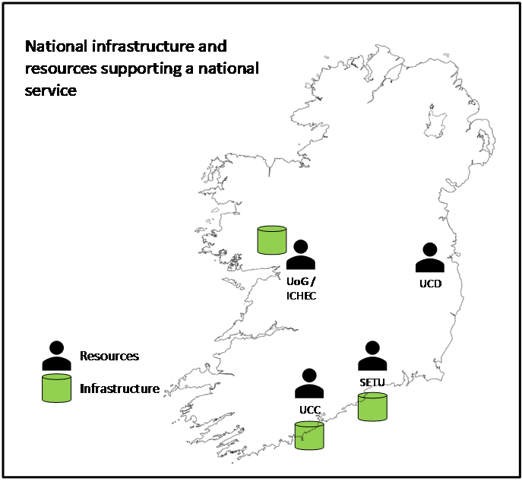
: National Shared Storage Service
For Active Research Data
Partners:
HEAnet: co-ordinator
EUDAT: expertise and technology provider
ICHEC, SETU, UCC, UCD: expertise and infrastructure providers
11 Use cases from:
GeoData
IoT for smart roads
Material sciences
Social Sciences
Humanities
Life Sciences
Wider sector engagement through Stakeholder Advisory Forum
Next meeting April 2024
Contact: Roberto.Sabatino@heanet.ie
Develop and run a pilot. Leverage findings to develop the specification of a national production-quality and sustainable service.
Phase 1
Verify services on EUDAT European infrastructure with 2 use cases.
Phase 2
Onboard pilot users on
national infrastructure
Phase 3
Develop specification for a national production quality and sustainable service
Design and implement national pilot infrastructure

Slide 4
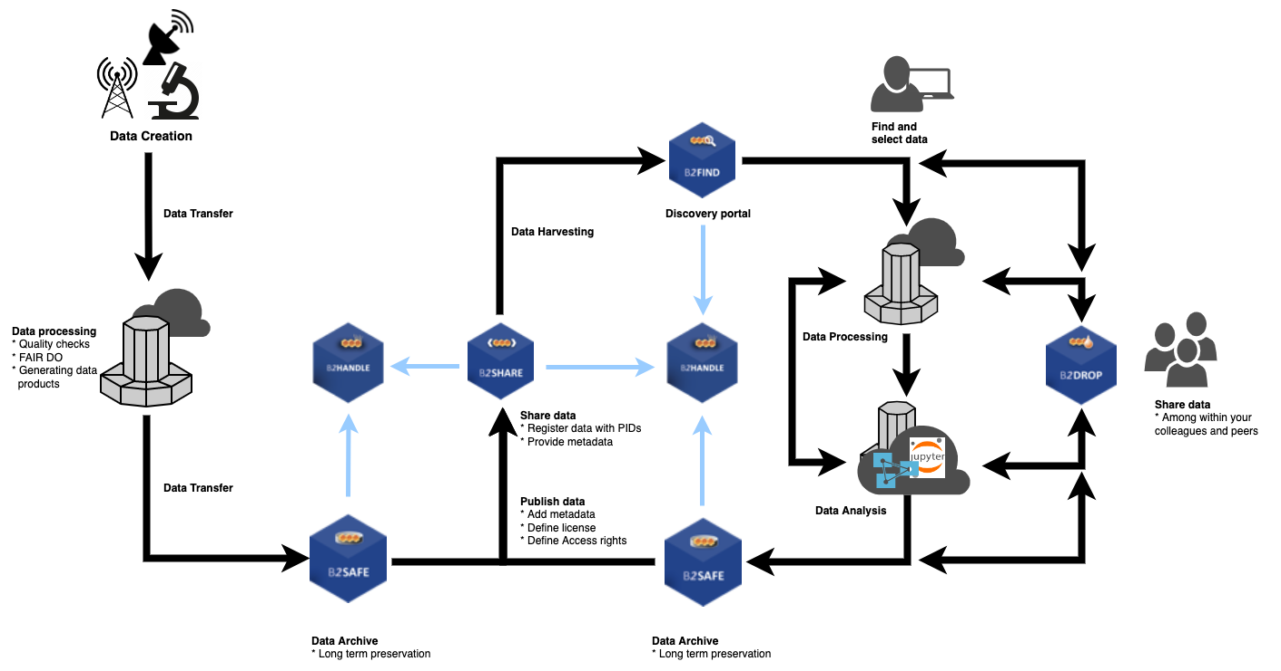
Research Data Life Cycle

Slide 5
Learnings so far from IRLDAT team
Good grasp of what’s involved in deploying and operating nextcloud + B2Drop:
AWS + S3 object storage
Compellent SAN + 2 ESX VMs
Openstack / Ubuntu
Clear on onboarding process
Consensus for 1 national centrally managed instance, unless we buy
Consensus to not have fully funded service, there needs to be a user fee

Slide 6
Local Admin Duties for National Shared Service
User Support Tasks for Local University Administrator
Maintain and monitor ticketing system for user support for their university or institute account on national shared service. Example issue categories and sub-tasks for a local admin regarding user support include:
User Onboarding (telephone and screenshare support with users if possible) Request
User Offboarding Request
Data Syncing Level 1 troubleshooting support (Web, Desktop Client). Level 2 or Level 3 issues depending on support tier model could be escalated to national shared service technical team (Level 2) or service provider technical resources (Level 3)
Handle Training Info Session requests from users
Assist users who may need to open an EUDAT support request for B2ACCESS issue
Ensure user awareness of data storage and retention policy to avoid data loss
Generate report and count of issue types by week/month to ensure a system improvement feedback cycle to infrastructure providers of national shared service

Slide 7
Operations Duties for National Shared Service
User Lifecycle Management
User Invitations for university users onboarding to IRLDAT national shared service
User Group Management in B2ACCESS Authorization and Authentication (AAI) service
User Shared Folder setup for PIs and Group assignment to root shared folder
User Storage Quota Management
User registration, onboarding technical support if any user registration or sign-in issues
Data syncing technical support for users
User account cleanup in B2ACCESS if user leaves IRLDAT national shared service project
System Management
Software Patching Maintenance, Software Release Version Upgrades (NextCloud)
System Data Storage Management – File system, Database, Backups
System Security Management – Firewalls, OS Security Patches, Software Security Patches
Identity Provider (IDP) integration with B2ACCESS for user single-sign-on (Edugain)

Slide 8
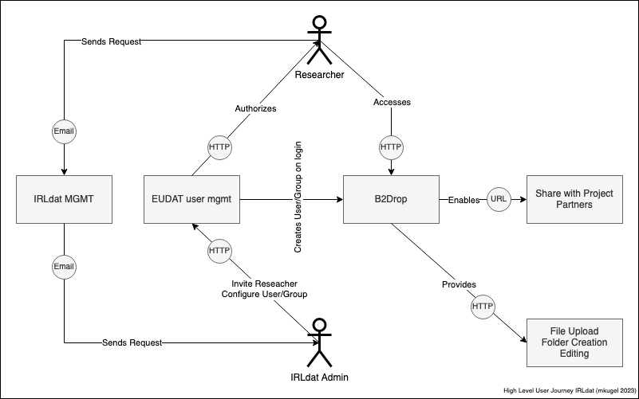
User Onboarding for National Shared Service
Notes:
IRLDAT admin configures root Shared Folder and assigns one or many Groups in IRLDAT national shared service
A PI can use Advanced Permission Rules in B2Drop to provide granular sub-folder/project access control (Read, Write, Create, Delete, Share) to individual users or groups – the IRLDAT admin has no need to do any action regarding Advanced Permission Rule access control. The access control at sub-folder level is managed by the PI or use case owner
User Onboarding Journey for IRLDAT national shared service.
Diagram Author: Michael Kugel

Slide 9
Path towards service definition
Informed by discussions with our Stakeholder Advisory Forum (you!) and sessions with other NRENs
Full service definition done by October 2024
Includes Build vs Buy analysis
Business and operational model
Decisions made by summer and use the time to October to complete the deliverable

Slide 10
To resolve
Scale of service and demand
Business / funding model

Slide 11
Learnings from NRENs
Common theme that once the service is stable, limited resources needed to manage central service.
On top of managing underlying infrastructure
Universities need a local contact
Path towards stable service and scale of service differs
NREN | Capacity | N. Users | Central Staffing | Underlying infrastucture | Funding model
CARnet | 200TB | 600 | <1 FTE | On prem cloud | Fully funded centrally
SWITCH | 600TB | >35K | ~1 FTE | On-prem cloud | Unis pay based on size
SUNET | 450TB | ~2000 (19 unis) | < 2 FTE | Safespring | Fixed unit charge

Slide 12
The business modelling
Assumption: Universities buy units
Currently defined as <10TB, 50 users>
Inputs:
Demand pattern over 5 years based on unit size
Infrastructure and Recurring costs to meet demand pattern (for both “build” and “buy from EUDAT”)
A hypothetical fixed unit charge (currently set at 8k/year)
Outputs:
TCO over 5 years
Unit size cost for full recovery of non-funded costs. Comparison with fixed unit cost
Year-on-year and cumulative cash flow for various cost recovery models

Slide 13
3 Scenarios
Buy from EUDAT: a dedicated instance hosted and managed by EUDAT in Germany.
Build on–prem leveraging existing infrastructure resources, starting small and growing to meet demand.
Build on an IaaS provider, who provide the storage capacity and VMs required for the service

Slide 14
Sizing
A unit is defined as <50 users, 10 TB>
Is this a reasonable definition ?
Per year? Or longer ?
Modelling based on this demand forecast:
Is it a reasonable demand forecast ?
 | Y1 | Y2 | Y3 | Y4 | Y5
Units | 7 | 10 | 15 | 18 | 30
Capacity | 70TB | 100TB | 150TB | 180TB | 300TB
Users | 350 | 500 | 750 | 900 | 1500

Slide 15
All Numbers Are Estimates They are NOT Final Intended to give a reasonable indication of expected costs Still a Work in Progress

Slide 16
TCO comparison

Slide 17
Cost recovery scenarios
 | Scenario | What is centrally funded | What is recovered from user fees
Full cost recovery | Build and buy | Nothing | All costs recovered from user fees
Recurring costs recovery | Build | Infrastructure throughout whole lifecycle | Central Staffing, user licences
Capacity growth | Build | Initial Infrastructure. 80% of staffing | Infrastructure increments to support capacity growth, 20% of staffing
Allocated capacity | Buy | Service and central staffing | Actual allocation on EUDAT
Calculates a Unit Fee to ensure breakeven at 5 years.
How does a Fixed Unit Fee work (P/L) with these models. For example 8k/year.

Slide 18
Full cost recovery – calculated unit cost
Build on-prem - 15.5K
Build on IaaS - 11.6K
Buy - 15K

Slide 19
Recurring Costs (RC) Recovery
Build on-prem – 9.8K
Build on IaaS – 8.6K

Slide 20
Capacity growth recovery
Build on-prem – 4.6K
Build on IaaS - 6.1K

Slide 21
EUDAT – Allocated capacity cost recovery
In this case a unit <50 users, 10TB> costs ~5.2K/year
Spend per year == income per year
With fixed unit cost at 8K…
There is profit per unit

Slide 22
Summary
Scenario | Calculated Unit cost/year | 8K/year Fixed unit price 5 year Profit/Loss
Buy EUDAT, full cost recovery | 15K | -560K
Buy EUDAT, allocated capacity fee to users | 5.2K | +220K
Full cost recovery Build on prem | 15.4K | -590K
Full cost recovery IaaS | 11.6K | -282K
RC recovery Build on prem | 9.8K | -140K
RC recovery IaaS | 8.6K | -40K
Capacity growth recovery +20% RC Build on prem | 4.6K | +270K
Capacity growth recovery + 20% RC IaaS | 6.1K | +158K

Slide 23
Qualitative comparison
Scenario | 5 year TCO | User Unit fee | Financial exposure risk | Implementation Operations risk | Vendor lock-in | Data sovereignty | Flexibility
Buy from EUDAT. Users pay allocated capacity | 2 | 2 | 1 | 1 | 2 | 2 | 4
Build on-prem. Users pay RC | 3 | 5 | 4 | 3 | 1 | 1 | 1
Build on-prem. Users pay capacity growth | 3 | 1 | 3 | 3 | 1 | 1 | 1
Build on IaaS. Users pay RC | 1 | 4 | 2 | 2 | 3 | 2 | 3
Build on IaaS, Users pay capacity growth | 1 | 3 | 2 | 2 | 3 | 2 | 3
Dependent on final numbers
Independent of final numbers

Slide 24
Discussion points:
Build vs Buy : principle rather than costs as shown
Funding model
What is centrally funded and what is paid by users
Charging scheme
Units
Fixed fee, subscription
Expected demand

Slide 25
Thank you
Any questions?

