Slide 1
RDM, Data Protection & Ethics
@TU Dublin
Lindsay Dowling
Open Research Support Unit Lead
lindsay.dowling@tudublin.ie
https://orcid.org/0000-0002-7642-5326

Slide 2
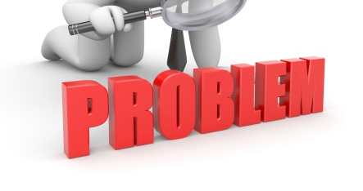
This Photo by Unknown Author is licensed under CC BY-SA

Slide 3
A disaggregated support service…
Compliance
– Ethics & Integrity Office, Data Protection Office
Research Data Management –
Open Research Support Unit, Data Librarian

Slide 4
Compliance Deluge
Time Poverty
Where to go and when
Not seen as ‘core’ work
An ‘NCT’ approach
Researcher Engagement

Slide 5
This Photo by Unknown Author is licensed under CC BY

Slide 6
What We Have in Place
Open Research Support Unit
Data Stewardship Services
Designed to act as a link service between Library, Research Support and other services, e.g., DPO
Close relationship with Pre-Award (data planning)
Joint GDPR & Open Research Training – lecture-based format
Suite of Shared/Agreed Materials
Good Relationships!

Slide 7
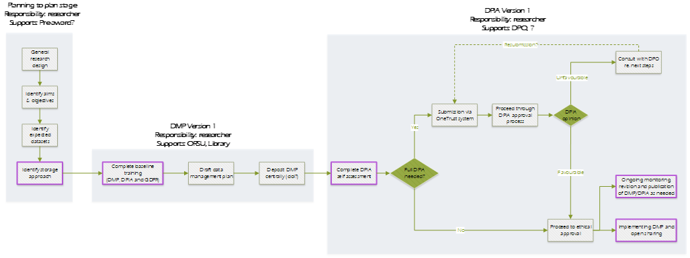
An RDM Workflow

Slide 8
Mandated Training
Must be submitted to and reviewed by ORSU, and a DPIA where necessary must be completed in order to submit an Ethics application.
Data Management Plan
Must be completed in advance of submitting a DMP, and in order to access the DPIA system where necessary.
Policy
An RDM Policy Requirement
AI Assistant (maybe)
ChatGPT - Research Data Compliance Assistant
In Development

Slide 9
Go raibh maith agat
Thank You
Lindsay Dowling
Open Research Support Unit Lead
lindsay.dowling@tudublin.ie
https://orcid.org/0000-0002-7642-5326

