Slide 1
EOSC-Ireland Planning
3 December 2024
Roberto Sabatino – HEAnet
Niall Guerin – ICHEC
Jenny O’Neill – HEAnet

Slide 2
Long term objectives (to end 2025/early 2026)
Define what Ireland must do, in terms of Infrastructure and Services
To enable Open Research
Contribute to EOSC
Start to implement it
Connect to EOSC

Slide 3
Today’s Objectives
Provide you with necessary base information
Enable your feedback on the proposed process and stakeholders
Who should be involved?
What challenges do you foresee?
Agenda:
Overview of the EOSC-EU node
HEAnet’s position paper on Ireland’s contribution to the EOSC Federation
From HEAnet position paper to national stakeholder position paper
Poll #1

Slide 4
EOSC-EU node

Slide 5
Background
At European level: much talk about EOSC since 2015, and lots of preparation work
Specification and design work done by EOSC-Future.
EU funded EOSC related projects – EOSC Beyond.
Not much in terms of tangible, immediate, benefit to researchers as enabler to Open Science.
Until now…

Slide 6
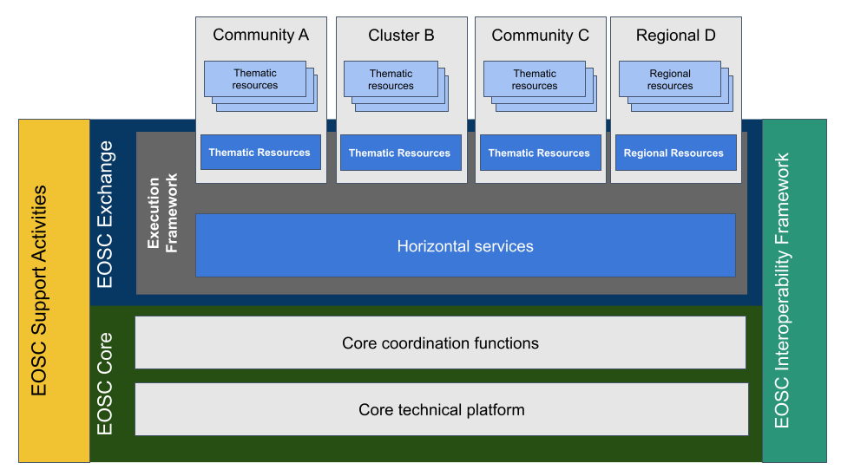
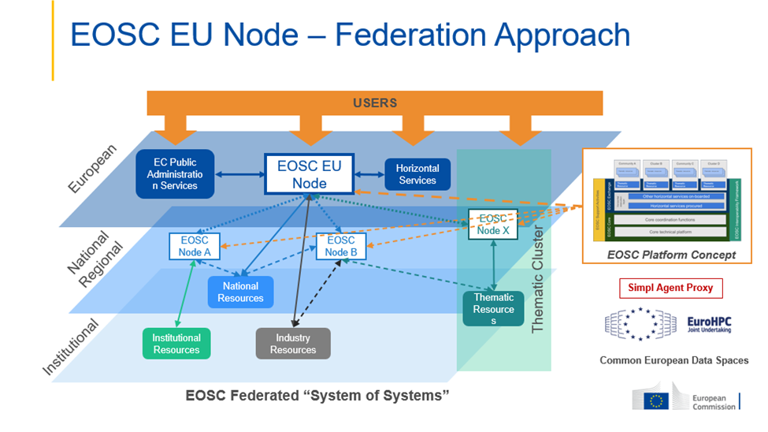
EOSC Conceptual illustrations

Slide 7
EOSC as a reality for researchers
In 2023 EC initiated procurement of the EOSC EU node
As the first of a collection of federated nodes, making up the EOSC Federation
Launched October 2024
Demo
https://open-science-cloud.ec.europa.eu/
Ask from DFHERIS: what do we need to do in Ireland ?

Slide 8
EOSC federation development roadmap
In summer 2024 questionnaire to interested parties:
121 responses. None from Ireland
Filtered down to 29 for 1st wave, expected to connect Q2/2025
Large research organisations
NRENs
ERICs
Clusters
Expected to proceed with <10
2nd wave Q3/2025. Process to be defined in Q2/2025

Slide 9
Goals of the build-up phase of the EOSC Federation​
Testing and building the federating capabilities
EOSC AAI, federation-wide catalogue of resources, sharing metadata of research objects via EOSC knowledge graph,…​
Exploring the organisational arrangements
Policy development - shared across the Federation​
Understand the costs, effort and time required to enrol a node and onboard a resource to the EOSC​
Demo multi-node end-to-end use cases and scientific workflows
The EOSC Federation Handbook​: https://eosc.eu/eosc-federation-handbook/

Slide 10
Poll #2 HEAnet position paper

Slide 11
HEAnet's Vision to Implement the European Open Science Cloud (EOSC) in Ireland
Introduction
Background
Expectations on Ireland
Relevant initiatives in Ireland
Initiatives in other countries
Recommended actions
Conclusion
https://doi.org/10.23728/B2SHARE.A3412BCC801948CDA62D79552CE39B52
Notes:
Europe ploughing ahead, we will be left behind

Slide 12
Why an EOSC-Ireland node?
Why EOSC in Ireland at all?
Advance Open Science participation
Supports the National Action Plan for Open Research 2022-2030
Enhance research competitiveness in accessing future EU funds
Access to a network of resources, data & expertise
Could all resources in Ireland be connected to EOSC-EU node?
Technically, Yes
Strategically, No
Open Science within Ireland needs to work independently of EOSC-EU
Notes:
Europe ploughing ahead, we will be left behind

Slide 13
What might an EOSC-Ireland node look like?
A FAIR-compliant data repository
Thematic, General
Institutional, national
A service, such as storage, compute, notebooks
National, institutional
Enabling services such as
Catalogues, metadata, PIDs
Operational co-ordination & governance
Combinations of the above

Slide 14
Services/Enablers in Ireland
In place | In development, via NORF NAP | Missing
Network, AAI | IRLDAT | Catalogue of resources
HPC services | National PID roadmap | Metadata services
Membership of ERICs | National OA monitor | Monitoring services
PID services | Repository alignment | A “node” running enabling services at national level
 |  | Co-ordination between initiatives (strategy, technical, operations, governance)

Slide 15
Recommended actions (1/2)
Continue to support EOSC as a national ERA priority
Follow closely the developments of the EOSC-Beyond project to inform national developments.
Ensure the recommendations resulting from the national PID strategy and roadmap for Ireland are funded and implemented.
Support the NORF National Action Plan projects, such as, but not limited to, IRLDAT transition from pilot service to national production service.
Ensure alignment and linkage of existing/upcoming national research data and compute infrastructure, particularly, CASPIr, with the EOSCIreland node.

Slide 16
Recommended actions (2/2)
Establish and fund a co-ordination entity tasked with governing and coordinating the implementation and operation of all necessary enabling services for EOSC in Ireland.
Fund the development and operation of the identified service gaps: catalogue, metadata, monitoring.
Establish an “EOSC-Ireland” node, providing all the enabling services to establish a web of FAIR data in Ireland. It will be governed and operated by the co-ordination entity described above.
Identify two additional use cases of data repositories (thematic/disciplinary, multidisciplinary/ generalist, institutional) to be connected to EOSC, either directly to the EOSC EU node or to the proposed EOSC-Ireland node, and support/fund the development required for them to be connected. This will result in having a national blueprint for connecting such services to EOSC including funding requirements.

Slide 17
Proposed Implementation Plan
EOSC EU node RFS.
V1. Node handbook Ready
Implement NORF services from funded actions (IRLDAT, PIDs) **
V1 MVP of tech developments for EOSC-Ireland node. Connect to EOSC
Two data repositories connected to EOSC-Ireland, and EOSC
Submit paper to DFHERIS
Agree roadmap and governance
April 24
Q3 24
Oct 24
Dec 24
Q1 25
Mid 25
Q4 25
Q4 25
Q1 26
May 24
EOSC EU web portal Ready for Service (RFS)*
V1. Policy documents
EOSC EU node starts pilots with candidate nodes, and with EOSC-Beyond project
Establish governance and co-ordination entity
EOSC EU node completes pilots with nodes.
Set RoP, guidelines for EOSC nodes
DFHERIS convenes stakeholders to discuss roadmap and governance
Staff recruited and start developments for EOSC-Ireland node: catalogue, metadata, monitoring
* https://open-science-cloud.ec.europa.eu/
** National Action Plan for Open Research. https://doi.org/10.7486/DRI.ff36jz222
Our north star

Slide 18
Poll #3

Slide 19
From HEAnet position to National position

Slide 20
Proposed Timeline
3 Dec 2024 This event
Allow for a period (to 10 January 2024) for feedback on the engagement plan and HEAnet position paper
A few volunteers to work towards first draft national paper by early-mid February 2025.
Mid-Late February 2025 2x in-person (to facilitate participation as much as possible, it is not 2 different workshops) to address the feedback and work towards a second draft national paper by April 2025.
Feb-April 2025 In parallel to (2), engage 1:1 with stakeholders from the research community (VP/Directors of Research, Research Centre leads, CIOs anyone in an influential position and is engaged with Open Science).
Supported by local “champions”
April-May 2025 After 2nd draft of the paper available, stakeholder in-person/hybrid event.
Develop final version of position paper
Setup of a smaller WG to act on agreed next steps.
May 2025 onwards – WG setup in (4b) act on actions identified

Slide 21
Feedback
Are the timelines realistic ?
Stakeholder engagement plan: Poll #4.1
Implementation plan: Poll #4.2
Who are the stakeholders to engage? Poll #5
What challenges do you see ? Poll #6
Open Discussion

Slide 22
Next Steps
By 10th January 2025
All to provide feedback (freeform)
HEAnet position paper
Process & plan
Email:ResearchEngagement@heanet.ie
Volunteers to develop 1st draft national position paper and refine engagement plan
Send in your interest to volunteer: Email:ResearchEngagement@heanet.ie

Slide 23
Thank You

Slide 24
Slide title
The first wave will consist of around 7-10 organisations. Since the only operational EOSC Node is currently the EOSC EU Node, the first wave will necessarily involve exploratory and testing activities, as it will need to develop the technical and organisational modalities for an operational EOSC Federation. This will be developed through regular engagement and consultation of the broader community.
The build-up phase will count on volunteer work by the participating organisations and the contribution of the EOSC EU Node. By taking part in these activities, the organisations will have the opportunity to test the interconnection with the EOSC EU Node3, including in particular its federating capabilities, as well as to explore in practice the additional value that joining the EOSC Federation can bring to them and have a key role in the development of a first fully operational EOSC Federation.
POINT TO THE HANDBOOK

Slide 25
The Federation
By Q4 2025 the EOSC Federation will …​
consist of several enrolled EOSC Nodes​
have established a first operational governance and organisational structure, including clear description of the roles and responsibilities of its constituent bodies​
have detailed the application process to become an EOSC Node, including assessment of organisational, legal and technical requirements​
have established a first edition of Federation-wide policies, such as Rules of Participation, Access and Acceptable Use policies, cybersecurity, privacy and data protection​
have established a first edition of the EOSC Interoperability Framework​
have demonstrated cross-Node utilisation of some of the federating capabilities such as monitoring, accounting or helpdesk​

Slide 26
For Users
access the resources offered through the EOSC Federation through a single EOSC sign-on​
search and find the resources through a common EOSC catalogue of resources, enhanced with discoverability functionalities​
use an EOSC virtual research environment that integrates horizontal tools and services​
access high-value, FAIR and machine actionable research datasets and other outputs from diverse domains ​
be continuously engaged in testing the development and enhancing the value proposition of the EOSC Federation​

Slide 27
Contributors
By Q4 2025 communities/stakeholders interested to contribute to the EOSC Federation will be provided with …​
detailed practical information about the key aspects and components of the EOSC Federation, such the governance, operations, policies, procedures, technical specifications and standards (included in the EOSC Federation Handbook)​
guidance on the procedures for enrolment of Nodes and onboarding of resources, as well as the estimated costs and effort​
demonstration of multi-node end-to-end use cases that showcase the added-value of joining the EOSC Federation​
continuous opportunities to be consulted in the stages of development of the build-up phase​

