Slide 1
Enabling access to EOSC-EU node with MyAccesId
16 December 2024
Roberto Sabatino – HEAnet
Christos Kanellopoulos– GEANT
Glenn Wearen– HEAnet

Slide 2
Today’s Objectives
Provide you with background information on the EOSC EU node, and what you need to do to enable your institute’s staff and researchers to access it.
Agenda:
Overview of the EOSC-EU node
Overview of MyAccessId
Releasing attributes using the Edugate Registry
But first :
Who has watched the demo of the EOSC-EU node ?
Who has received requests for access from their user base ?

Slide 3
EOSC-EU node

Slide 4
EOSC Background
European Open Science Cloud definitions…
Web of FAIR data
An environment where researchers can share, access and process data, using avaiable resources and generate new knowledge, in turn re-shared
Services and resources that enable Open Science to be “the new normal” for researchers
I define it as:
(Federated) Infrastructure and Services that enable Open Research

Slide 5
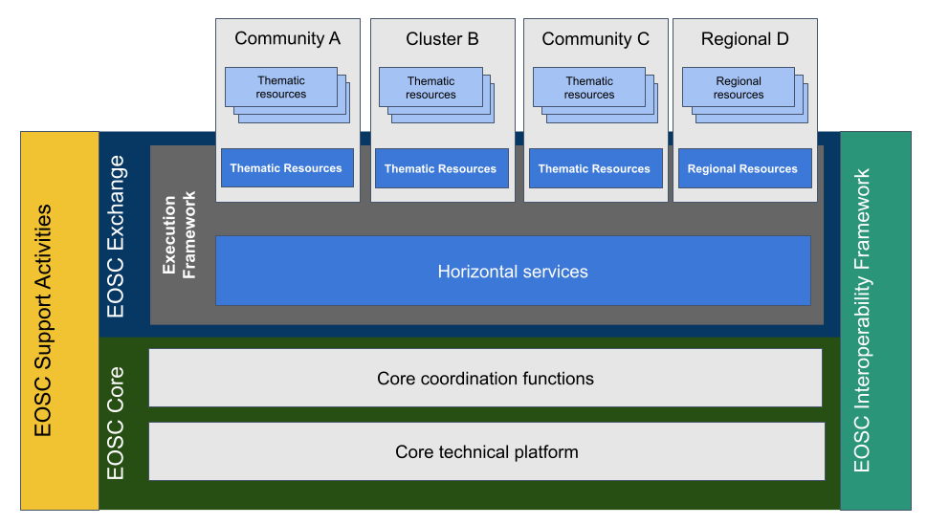
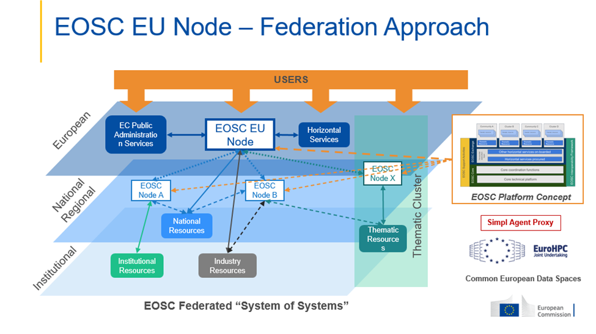
EOSC Conceptual illustrations

Slide 6
EOSC as a reality for researchers
In 2023 EC initiated procurement of the EOSC EU node
As the first of a collection of federated nodes, making up the EOSC Federation
Launched October 2024
Resources funded by EC for 3 years, based on credits used by users
https://open-science-cloud.ec.europa.eu/

Slide 7
Brief demo of EOSC-EU node

Slide 8
MyAccessID
A common Identity Layer for Research Infrastructures
Christos Kanellopoulos
Trust & Identity Coordinator
GEANT

Slide 9
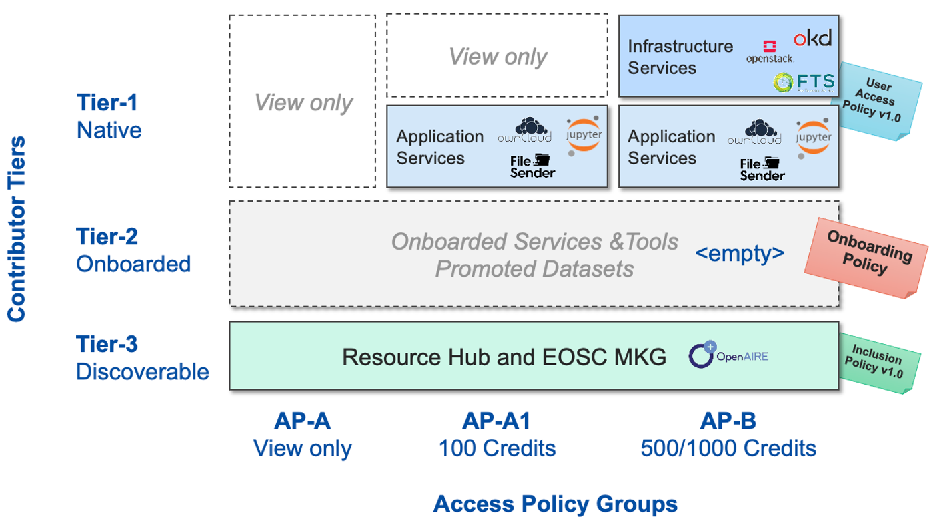

Slide 10
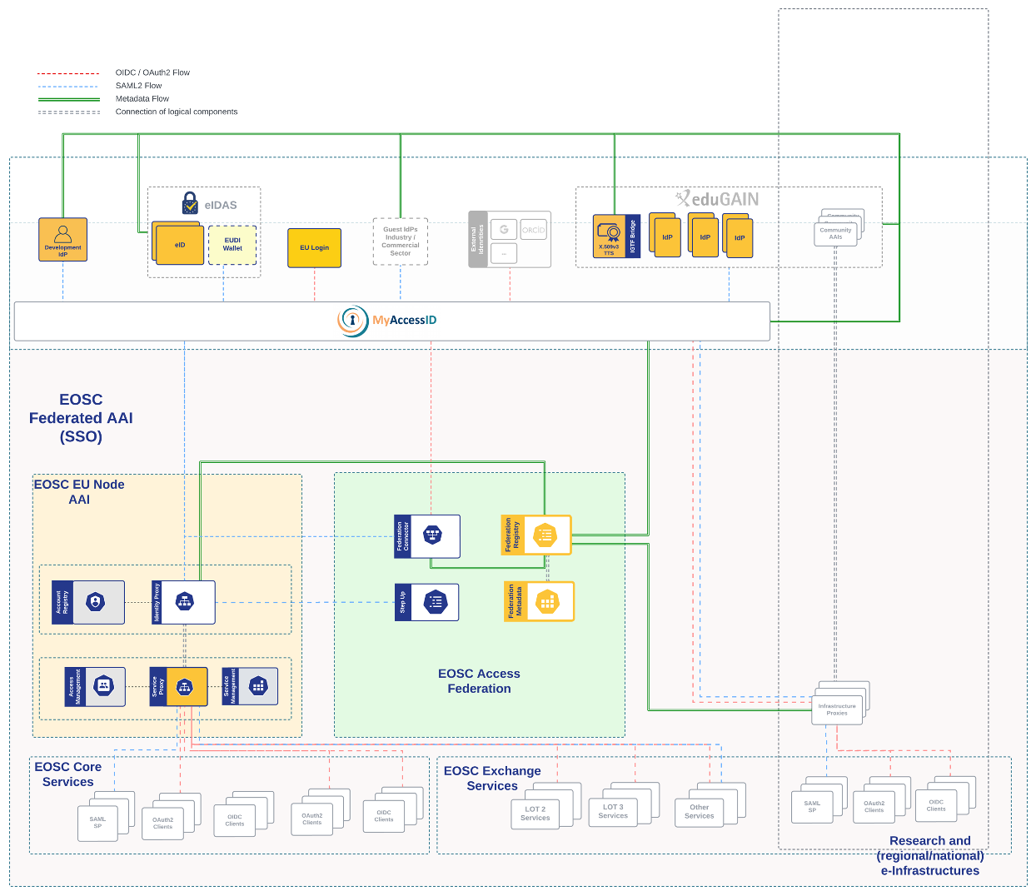

Slide 11
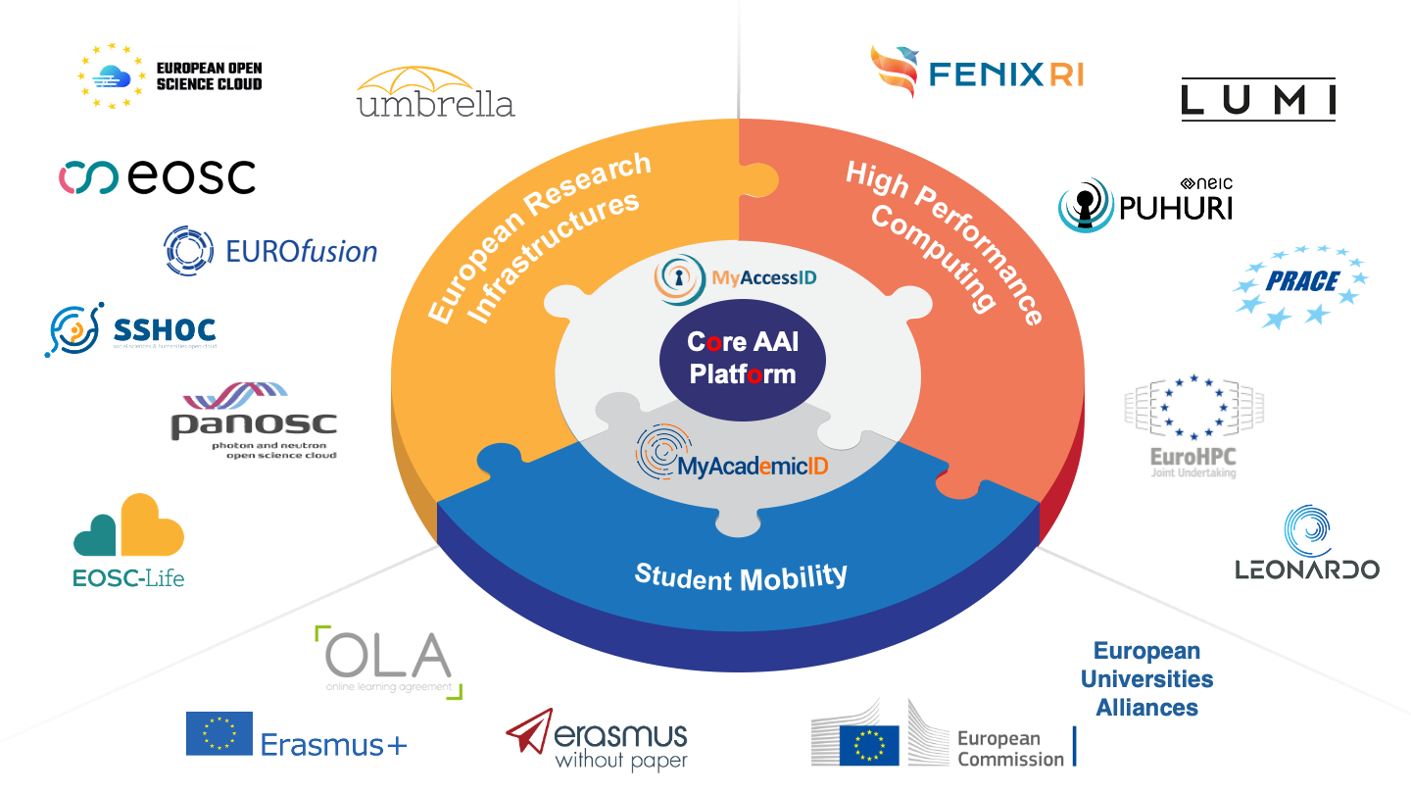
Notes:
This puzzle diagram was designed to show connection between the Core AAI platform and the domains we are supporting through it.
The Core AAI Plattform is an implementation of the Common AAI which we are developing, and on top of this platform, MyAccessID and MyAcademicID are running to support European Research Infrastructures, High Performance Computing communities and Student Mobility.

Slide 12
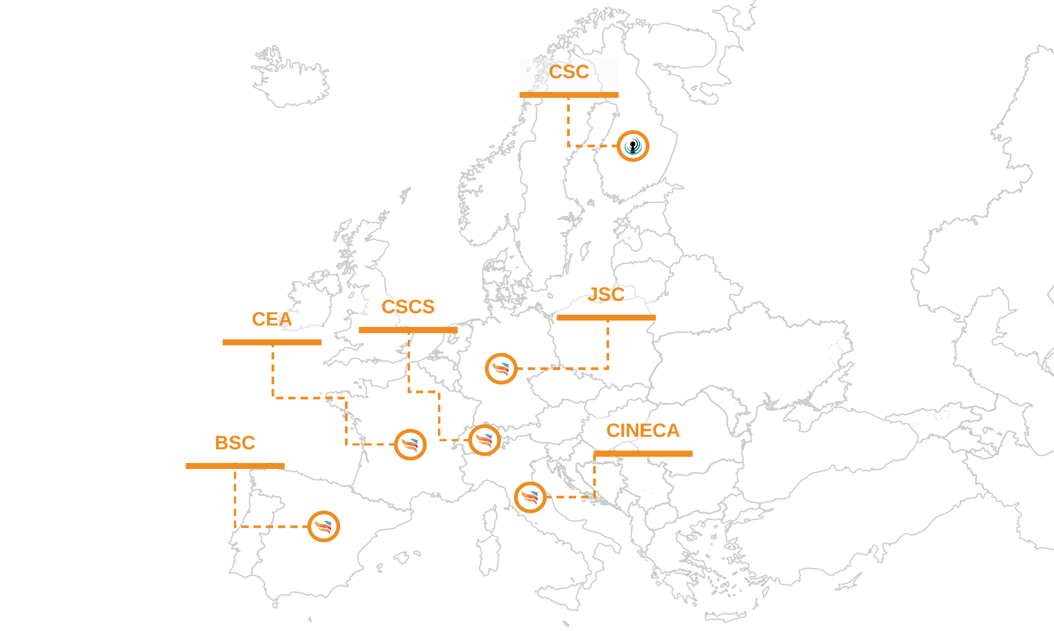
MyAccessID: A common AAI for Research Infrastructures

Slide 13
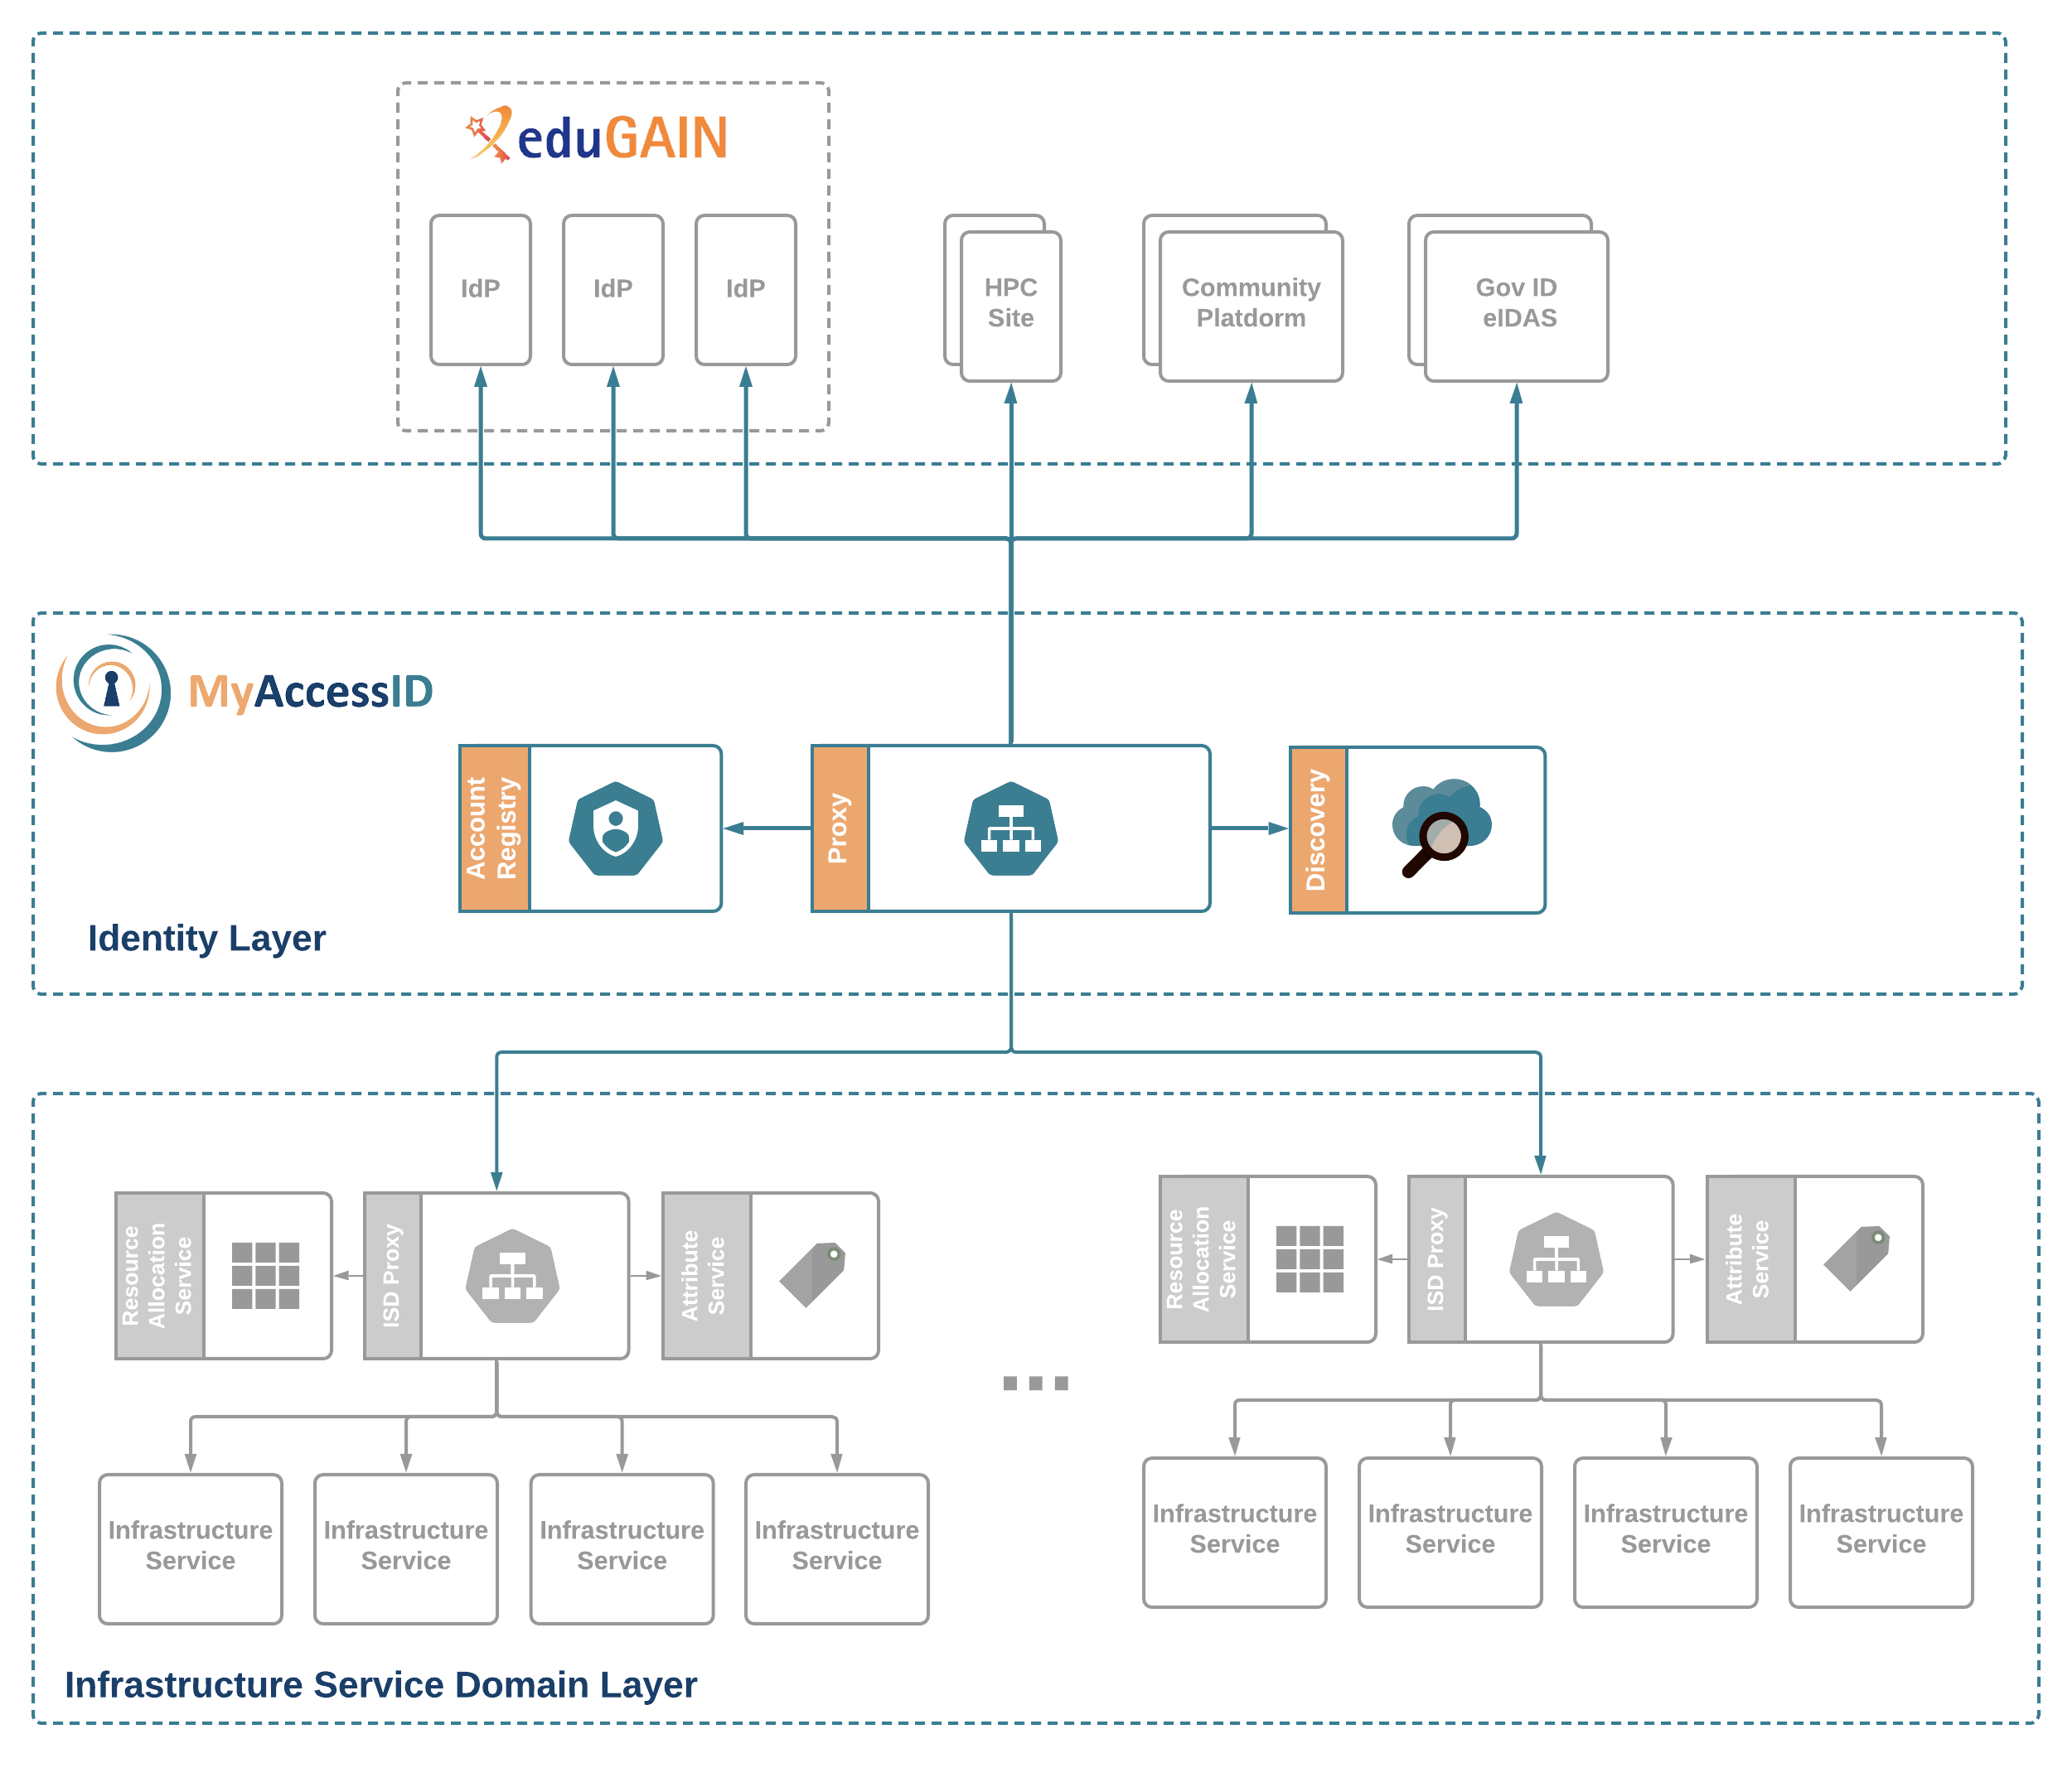
MyAccessID
HPC Data Centers are transforming themselves to Infrastructure Service Providers with diverse Service Portfolios
These infrastructure services become available in different administrative and policy domains (Infrastructure Service Domains)
MyAccessID provides a common Identity Layer enabling uniform accessibility to scientists and engineers at European scale

Slide 14
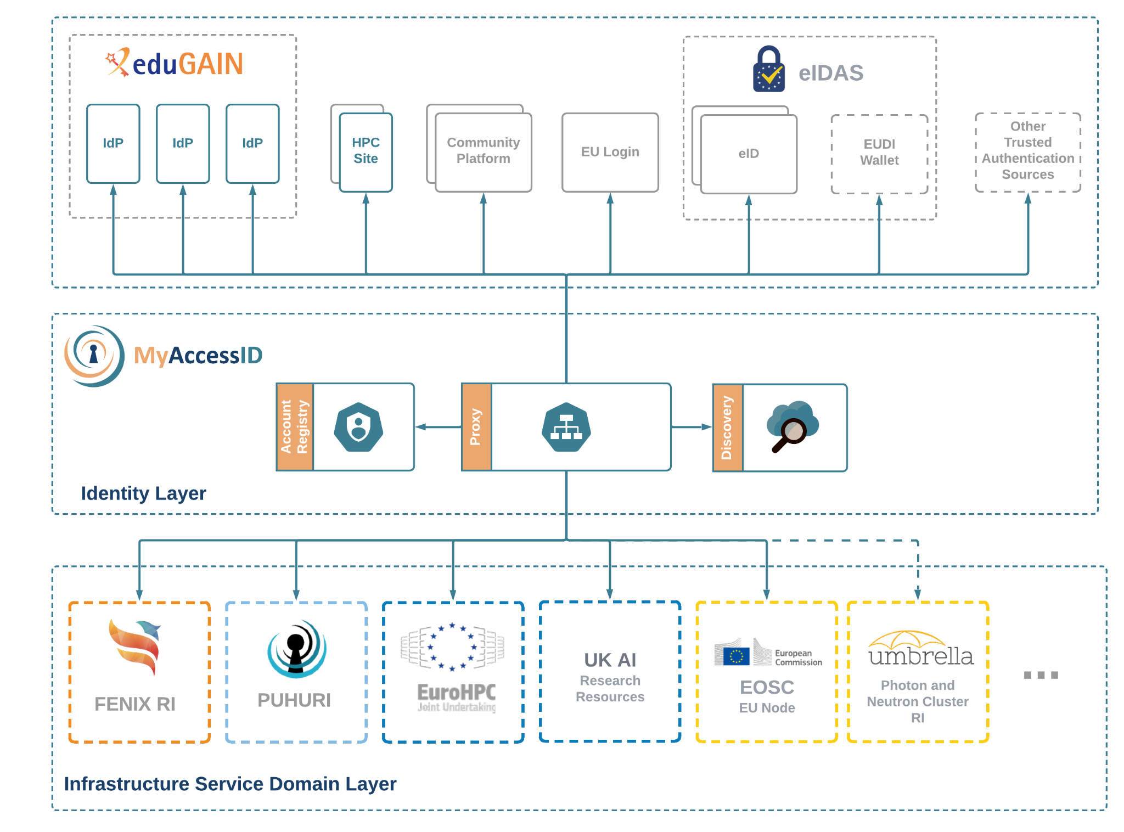
Production Implementations: MyAccessID

Slide 15
MyAccessID: A common AAI for Research Infrastructures
UK
AI
Isambard

Slide 16
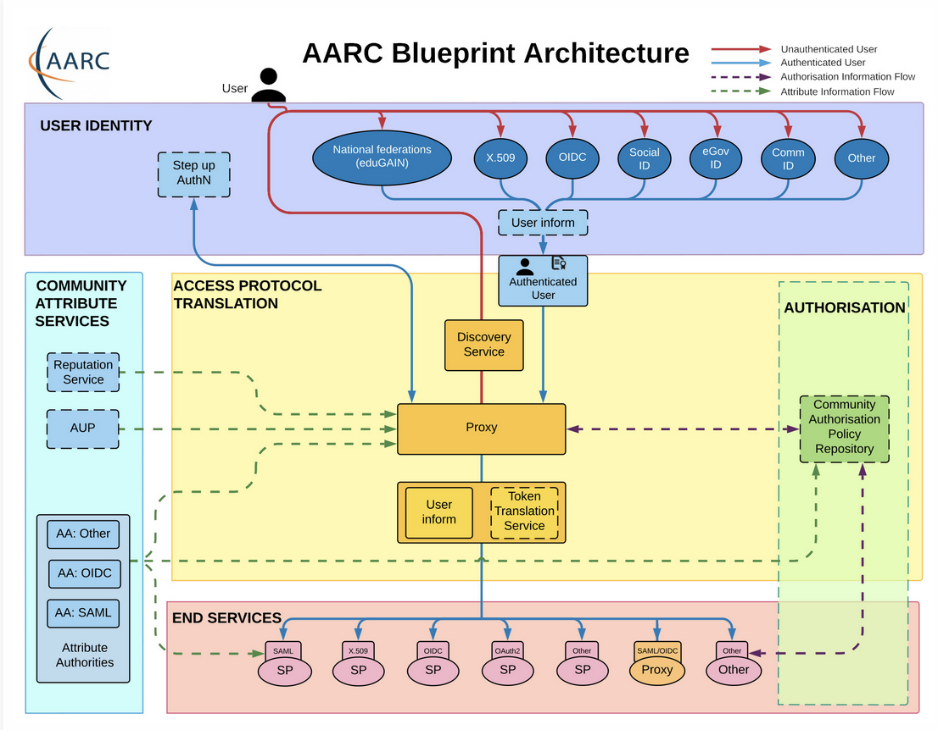
AAI Platform as a Service: Core AAI
Notes:
Right now the MyAccessID AAI is used by FENIX and Puhuri HPC Federations.

Slide 17
Core AAI Platform and AARC Guidelines
01 | AARC-G014 | Security Incident Response Trust Framework for Federated Identity
02 | AARC-G015 | Scalable Negotiator for a Community Trust Framework in Federated Infrastructures
03 | AARC-G021 | Exchange of specific assurance information between Infrastructure
04 | AARC-G025 | Guidelines for expressing affiliation information
05 | AARC-G026 | Guidelines for expressing community user identifiers
06 | AARC-G027 | Specification for expressing resource capabilities
07 | AARC-G031 | Guidelines for evaluating the combined assurance of linked identities
08 | AARC-G045 | AARC Blueprint Architecture 2019
09 | AARC-G049 | A specification for IdP hinting

Slide 18
Core AAI Platform and AARC Guidelines
10 | AARC-G057 | Inferring and constructing origin-affiliation information across infrastructures
11 | AARC-G061 | A specification for IdP hinting
12 | AARC-G062 | Specification for hinting an IdP which discovery service to use
13 | AARC-G069 | Expressing group and role information
14 | AARC-G071 | Guidelines for Secure Operation of Attribute Authorities
15 | AARC-G052 | OAuth 2.0 Proxied Token Introspection

Slide 19
Production Implementations: MyAccessID
Consistent Attributes
Multi-protocol support (SAML, OIDC, OAuth2)
Additional Authentication Sources (eIDs, EU Login, Community Platforms, ORCID, Social Logins, IdPs of Last Resort)
Strong Identity and Authentication assurances (where needed)
Trusted Platform

Slide 20
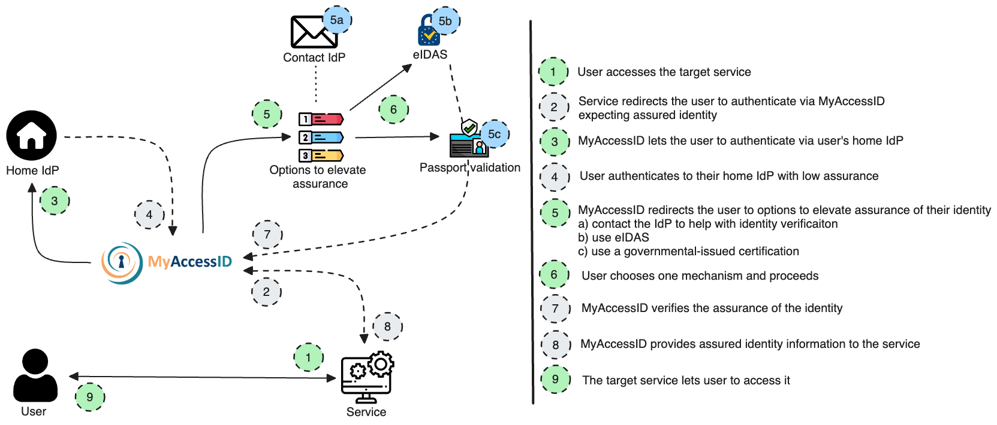
Identity vetting

Slide 21
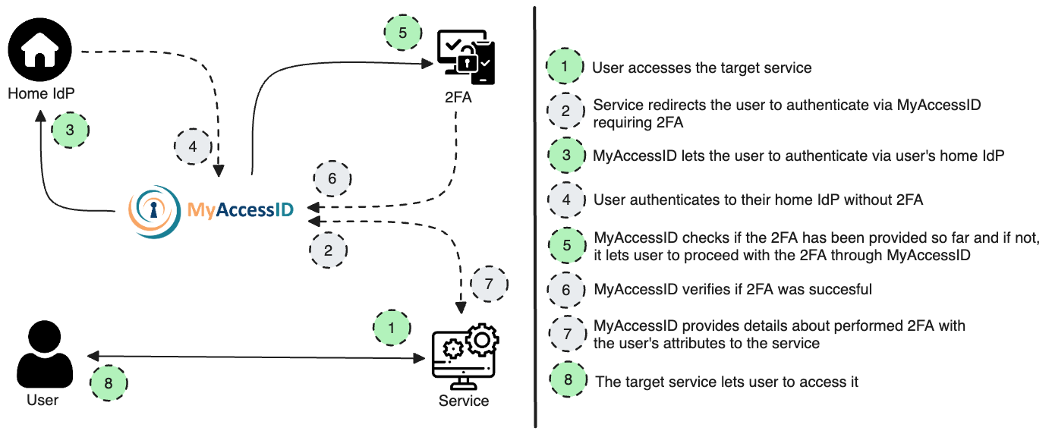
Multi-Factor Authentication

Slide 22
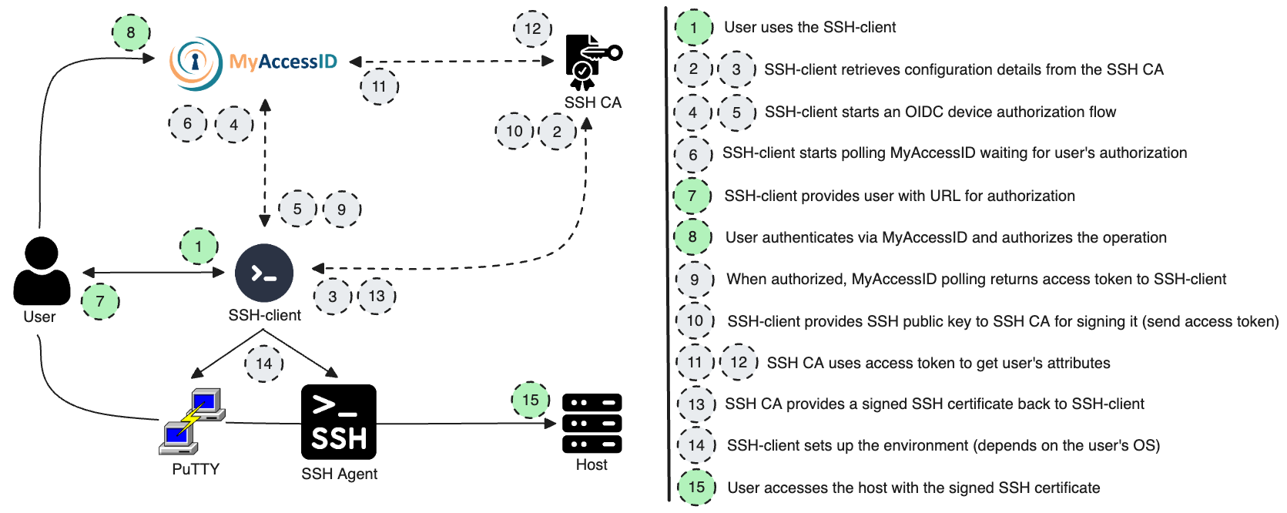
Federated SSH Access

Slide 23
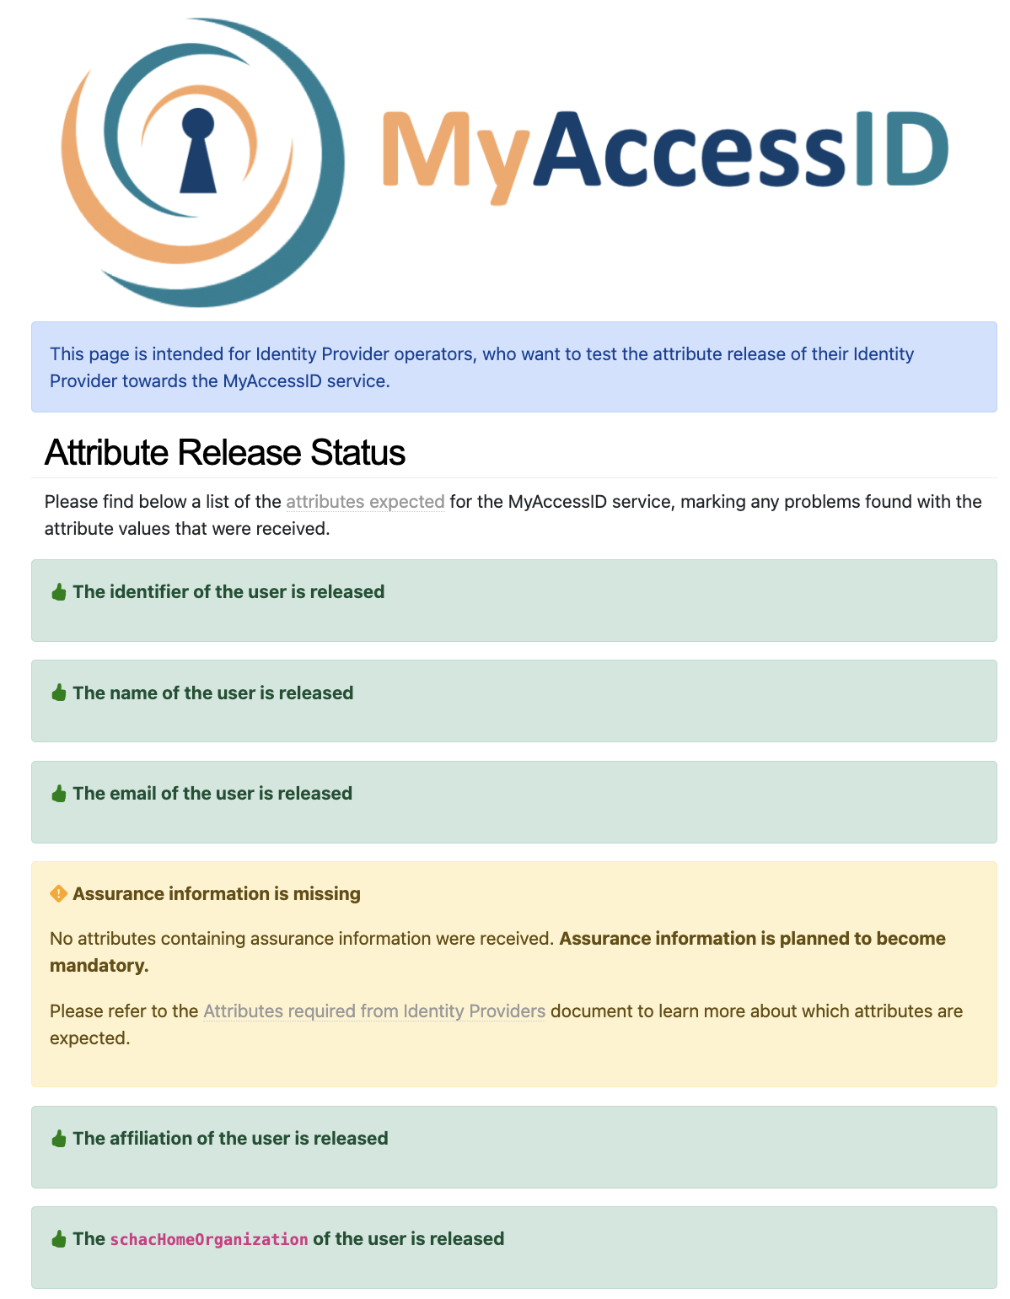
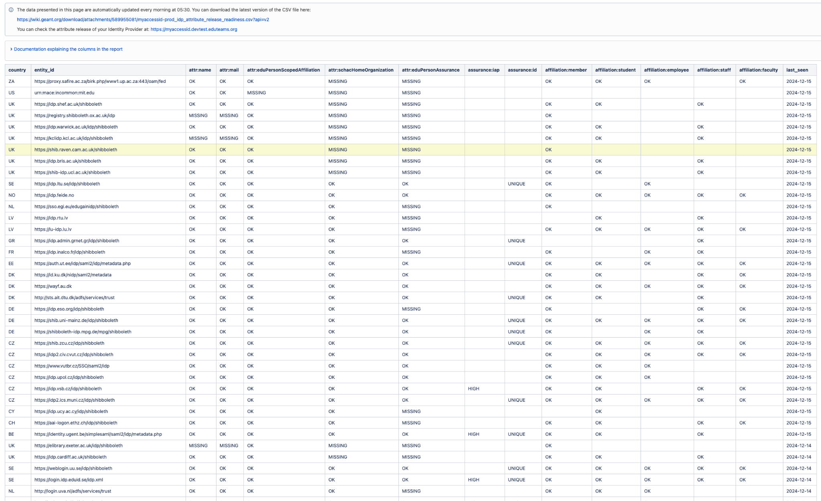
How can I check the attribute release of my IdP?
https://myaccessid.devtest.eduteams.org
https://wiki.geant.org/display/MyAccessID/IdP+Status+Report

Slide 24
Releasing attributes using Edugate registry

Slide 25
Releasing attributes to MyAccessID
If your IdP is not consuming an attribute policy from the Edugate Registry, the followings steps must be replaced with manual configuration .
If you have been nominated as the IdP administrator by your institution, login to the Edugate Registry https://edugate.heanet.ie/rr3/
If your IdP is managed by HEAnet, i.e. you subscribe to HEAnet's Managed Shibboleth IdP service, you can instruct HEAnet to perform these steps on your behalf, or you can follow the steps...

Slide 26
3 Steps
Configure the attribute
1
If all users meet the requirements of MyAcademicID, define static attributes
If only a subset apply, apply the attributes conditionally, e.g. for shibboleth, use either a attribute script or mapped attribute.
Declare your IdP supports the attribute
2
Release the attributes to MyAccessID
3
MyAccessID service only
service providers supporting Codes of Conduct similar to MyAccessID
Edugate service providers
EduGAIN service providers

Slide 27
MyAccessID attributes and Edugate
See definitive requirements at https://wiki.geant.org/display/MyAccessID/Attribute+Requirements
eduPersonAssurance is not an Edugate attribute, but eduPersonTargetedID and eduPersonPrincipalName are supported by all Edugate members. However, there are issues;
eduPersonTargetedID is opaque so comes with the risk that if your IdP can no longer produce the value it produced before, the user will be identified as a new user to MyAccessID and thus users will lose previous profile (and resources). A deprecated hashing algorithm, a loss of salt value (e.g. lost with the replacement of a ransomwared IdP VM), are scenarios where eduPersonTargetedID may be lost. Your users will not know their value so won’t be able to help recover a lost value.
eduPersonPrincipalName can be used if your IdP can meet the non-reassignment requirement of MyAccessID and if your release the correct value of eduPersonAssurance The attribute is frequently based on a persons name, so if your source username changes (e.g. legal name change), so to will eduPersonPrincipalName
eduPersonUniqueID, pairwise-id, and subject-id are not used in Edugate, but…

Slide 28
MyAccessID Attributes and Edugate
While eduPersonUniqueID, subject-id and pairwise-id are not an Edugate schema attributes, it is not unusual for services in other federations to require additional attributes beyond Edugate’s schema (e.g. schacHomeOrganization used in Erasmus+) .
When accounts are created, and a local username is ‘minted’, e.g. uid or sAMAccountName/userPrincipalName, the value could be copied into the source identity system (e.g. Azure AD/Entra ID or AD) into a new attribute (e.g. uidforlife), copying with a simple one-time transformation would avoid the renaming problem, or the transformation can be applied by your Shibboleth IdP.
So it’s a choice of;
subject-id and pairwise-id are emerging as the best option within federations and also for bilateral trusts.
eduPersonUniqueID could be considered a legacy attribute at some point in the future.
eduPersonPrincipalName if you can also fulfil the eduPersonAssurance attribute

Slide 29
MyAccessID Attributes and Edugate
MyAccessID will eventually require eduPersonAssurance attribute, with two specific values.
The first declares that the identity meets the non-reassignment criteria
https://refeds.org/assurance/ID/eppn-unique-no-reassign
The second declares the level of identity proofing that the institution has carried out when creating the account for the user.
https://refeds.org/assurance/IAP/high
This follows the standard : REFEDS Assurance Framework V2 https://refeds.org/assurance
The following is an example showing how to populate the attribute conditionally in Shibboleth.

Slide 30
Conditional application of LoA
<AttributeDefinition id=”eduPersonAssurance" xsi:type="ScriptedAttribute" dependencyOnly="true">
<InputDataConnector ref=”AzPassthroughAttributes" attributeNames=”AzRole"/>
<Script>
<![CDATA[
if(typeof azure AzRole != "undefined" && azure AzRole.getValues().size()>0){
role = AzRole.getValues().get(0).toLowerCase();
if (role == "tenured"){
eduPersonAssurance.addValue("https://refeds.org/assurance/ID/eppn-unique-no-reassign");
eduPersonAssurance.addValue("https://refeds.org/assurance/IAP/high");
} else if (role == "postgrad") {
eduPersonAssurance.addValue(" https://refeds.org/assurance/ID/eppn-unique-no-reassign-1y ");
eduPersonAssurance.addValue("https://refeds.org/assurance/IAP/low")
}
]]>
</Script>
</AttributeDefinition>

Slide 31
Q & A

Slide 32
Thank You

